Slide 1
Verilog Sequential Circuit

Slide 2
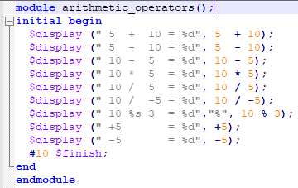
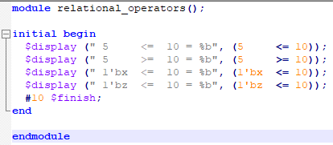
Operators

Slide 3
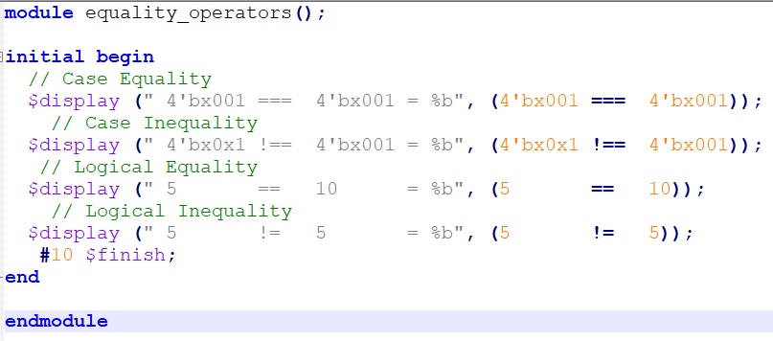
Operators

Slide 4
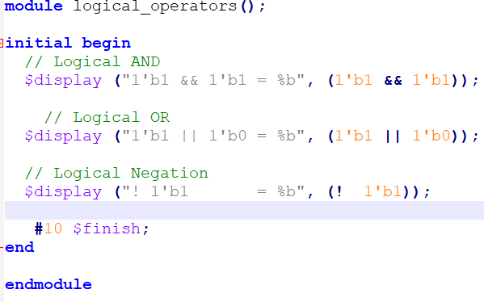
Operators

Slide 5
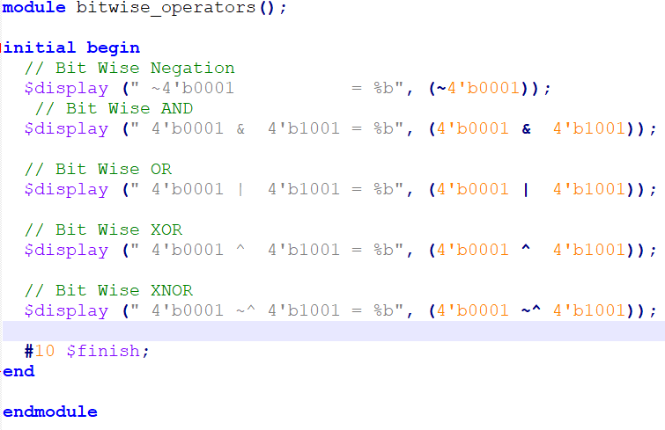
Operators

Slide 6
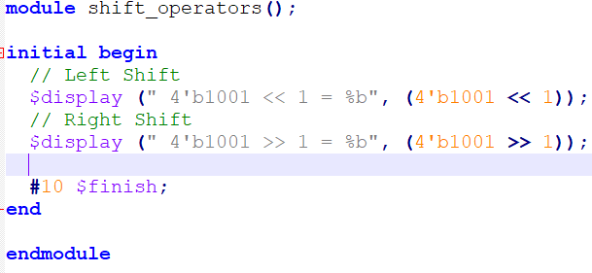
Operators

Slide 7
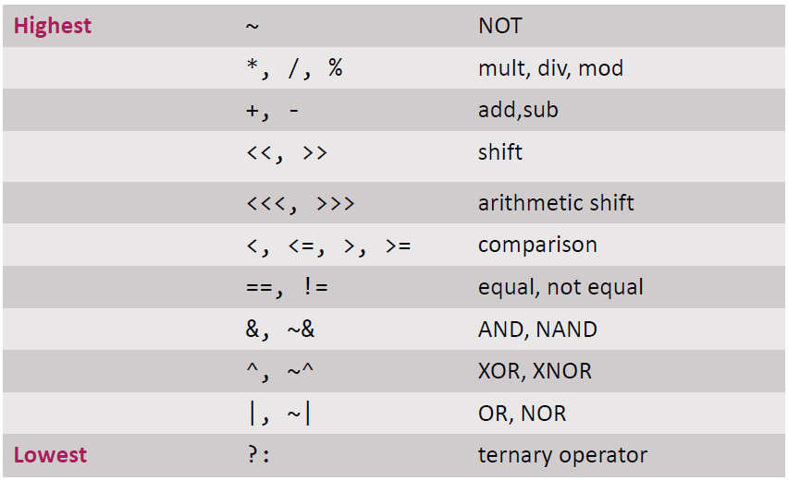
Operators Precedence

Slide 8
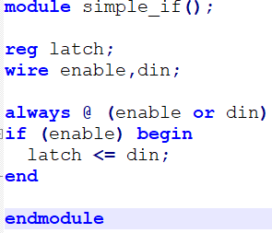
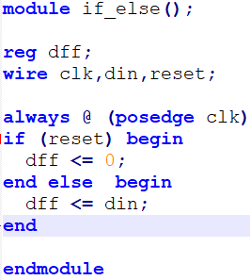
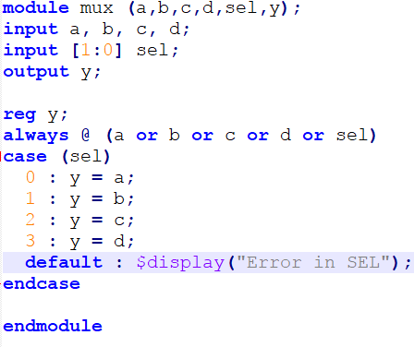
Conditional
Simple if
If else
Switch and Case

Slide 9
Procedural Blocks
Verilog behavioural code is inside procedure blocks
initial : initial blocks execute only once at time zero (start execution at time zero).
always : always blocks loop to execute over and over again; in other words, as the name suggests, it executes always.

Slide 10
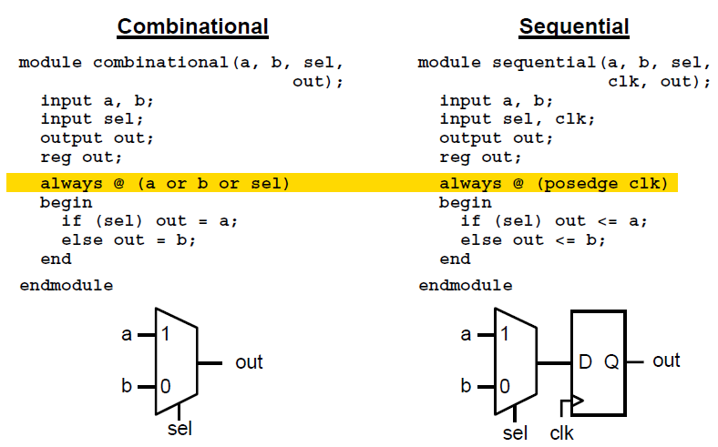
Use of Always In Computational And Sequential Circuit
Edge-triggered circuits are described using a sequential always block

Slide 11
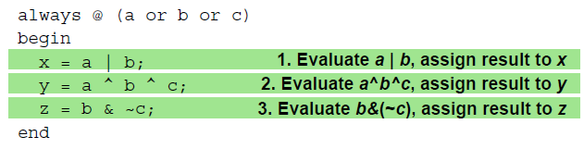
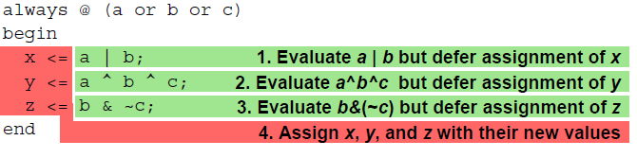
Blocking vs. Non-blocking Assignments
Verilog supports two types of assignments within always blocks, with subtly different behaviors.
Blocking assignment: evaluation and assignment are immediate
Nonblocking assignment: all assignments deferred until all right-hand sides have been evaluated (end of simulation timestep)
Sometimes, as above, both produce the same result. Sometimes, not!

Slide 12
Guideline to use
Use blocking assignments (=) for combinational
always blocks
Use non-blocking assignments (<=) for sequential always blocks
When modeling both sequential and combinational logic within the same always block, use non-blocking assignments
Do NOT mix blocking with non-blocking assignments in the same always block

Slide 13
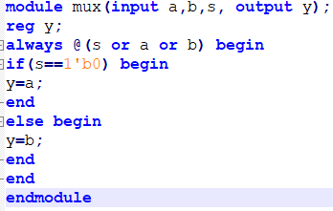
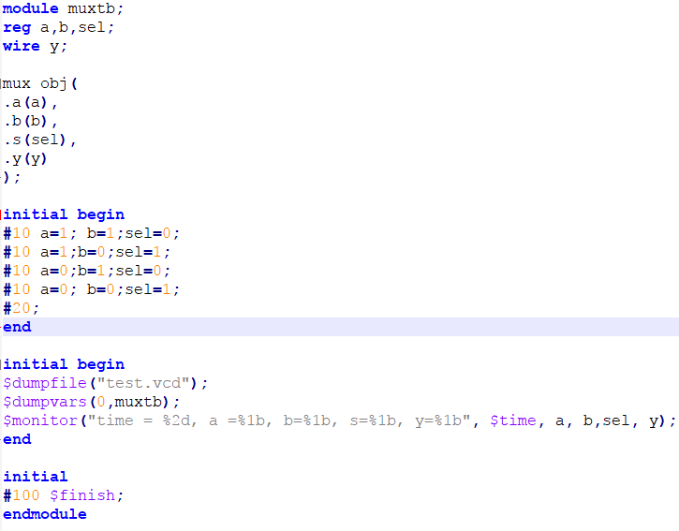
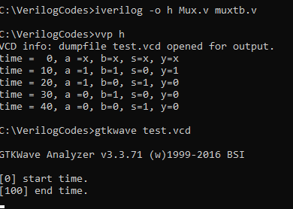
Example Combination Circuit (2x1 mux)

Slide 14
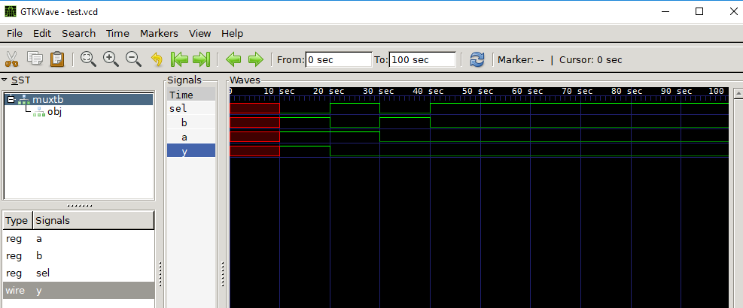
GTKWAVE

Slide 15
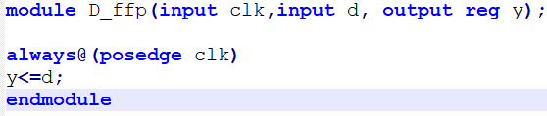
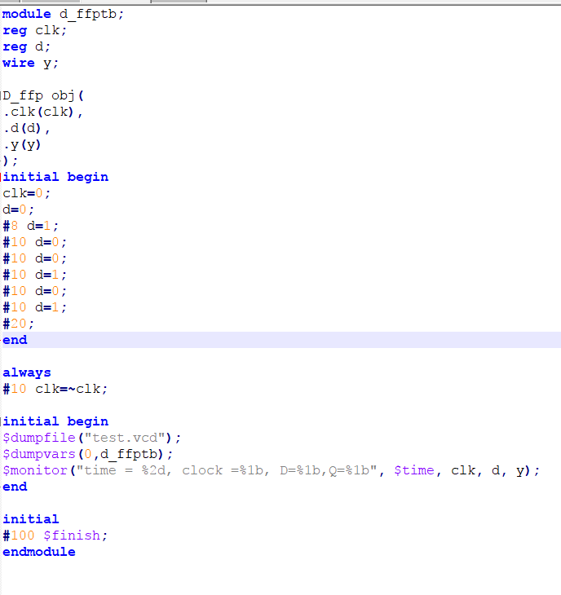
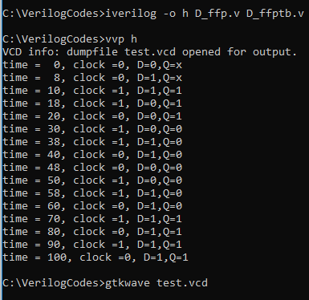
Example D-Flip-Flop (Sequential Circuit)

Slide 16
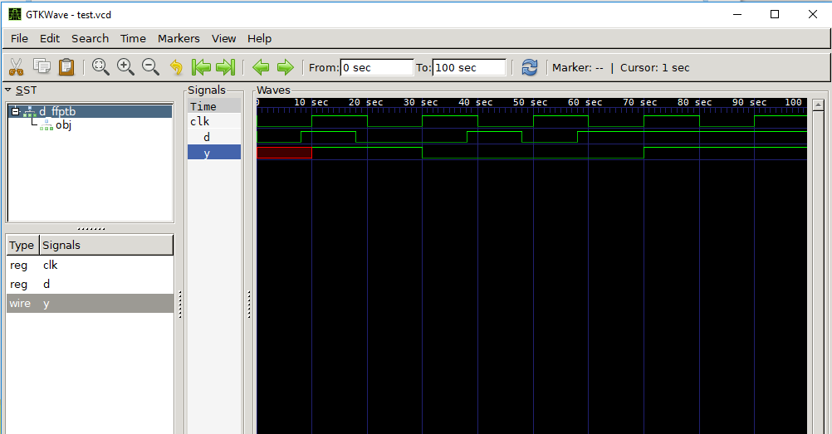

Slide 17
Today Lab Assignments
Using always block create 2 to 4 decoder with enable. (using if else and switch and case)
Using always block create the 8x1 mux (using if else and switch and case)
Using always block create 4 to 2 encoder with enable. (using if else and switch and case)
Using always block create the 1x8 dmux (using if else and switch and case)

Slide 18
Today Assignments
Parity checker 4x2 if more than one input is 1, the result is a don’t-care.
32-bit Adder, 32-bit Subtracter, 16-bit Multiplier (hint arithmetic operator)
Design 2x1 mux using Conditional Operator

