Slide 1



PREDICTION OF CHRONIC KIDNEY DISEASE USING MACHINE LEARNING
Guided By,
Mr.M.A.PRASANNA,B.E,M.TECH., ASSISTANT PROFESSOR ,CSE.
Presented By,
SHARLY PRICILLA A (811722104143)
SRIMATHI K (811722104154)
VINITHA B (811722104184)
11/06/2025

Slide 2


ABSTRACT
Chronic Kidney Disease (CKD) is a progressive condition that affects millions worldwide and often remains undetected until it reaches advanced stages.
• Early diagnosis is critical for effective intervention and management.
• This study presents a machine learning-based approach for the early prediction of CKD using clinical and laboratory patient data.
• Various algorithms, including Decision Trees, Random Forests, Support Vector Machines (SVM), and Logistic Regression, were evaluated for their performance in classifying CKD presence.
Multiple classification algorithms, including Decision Tree, Random Forest, Support Vector
Machine (SVM), and Logistic Regression, were evaluated for their effectiveness in predicting CKD.
11/06/2025

Slide 3
OBJECTIVE
Early Detection – Predict CKD in individuals based on clinical and laboratory parameters to enable timely medical intervention.
Risk Assessment – Identify key risk factors contributing to CKD and determine their impact on disease progression.
Machine Learning Integration – Develop and implement machine learning models that can accurately predict CKD using patient data.
Medical Decision Support – Provide a decision-support system for healthcare professionals to improve diagnosis and treatment plans.
Public Health impact – Help reduce the burden of CKD by enabling preventive measures and reducing complications through early intervention.
11/06/2025

Slide 4
LITERATURE SURVEY
S.No. | Paper Title | Year | Remark
1 | Machine Learning for Early CKD Detection | Smitha et al. (2020) | Machine Learning Algorithms Fe & Model
2 | CKD Prediction Using Support Vector Machines (SVM) | Rajesh & Kumar (2019) | Machine Learning Algorithm
3 | Deep Learning for CKD Diagnosis | Chen et al. (2021) | Deep Learning Algorithm Automated Diagnosis
11/06/2025

Slide 5
LITERATURE SURVEY
S.No. | Paper Title | Year | Remark
4 | CKD Prediction Using Ensemble Learning | Patel & Singh (2022) | Data Preprocessing Machine Learning Models
5 | PredictingCKD Progression Using Random Forest | Kumar & Rao (2021) | Random Forest, Feature Selection.
6 | Comparative Study of ML Models for CKD Detection | Das & Banerjee (2020) | DecisionTrees,Naive Bayes, Accuracy Comparison
11/06/2025

Slide 6
LITERATURE SURVEY
S.No. | Paper Title | Year | Remark
7 | Neural Networks in Early CKD Risk Prediction | Liu et al. (2021) | Artificial Neural Networks, Pattern Recognition
8 | CKD Diagnosis Using Logistic Regression with Feature Ranking | Joshi & Prasad (2019) | Logistic Regression, Feature Ranking, Model Evaluation
9 | Chronic Kidney Disease Prediction Using XGBoost Classifier | Mehta et al. (2022) | XGBoost, Hyperparameter Tuning
11/06/2025

Slide 7
EXISTING SYSTEM
Dataset Collection: Gather patient clinical data related to CKD.
Data Preprocessing: Handle missing values using predictive mean matching and normalize data.
Data Clustering: Apply K-Means clustering to group similar patient records.
Dataset Splitting: Divide data into training and testing sets.
Feature Selection: Use XGBoost to select the most important features.
Model Training: Train multiple ML models (NN, RF, SVM, RT, BTM).
Model Evaluation: Analyze performance and select the best model.
Result Analysis: Use selected model for final CKD prediction.
11/06/2025

Slide 8
PROPOSED SYSTEM
System Architecture :
a. Data Collection : Patient data is collected from publicly available datasets such as the UCI CKD dataset or hospital records, including attributes like age, blood pressure, specific gravity, albumin, serum creatinine, hemoglobin, diabetes mellitus, and others.
b. Model Evaluation : Models are evaluated using metrics including accuracy, precision, recall, F1-score, and ROC-AUC. Cross-validation is performed to ensure generalizability.
C. Feature selection :
Techniques such as correlation analysis, Recursive Feature Elimination (RFE), or mutual information are used to select the most relevant features for prediction.
11/06/2025

Slide 9
SYSTEM ARCHITECTURE
DATASET COLLECTION
DATA PRE-PROCESSING
DATA CLUSTERING
TESTING
DATASET SPLITING
ACREATE DIFFERENT DATASET
AFEATURE SELECTION
TRAINING
APPLIED MACHINE LEARNING ALGORITHEMS
RESULTING MODEL
11/06/2025

Slide 10
MODULE 1 : DATA PREPROCESSING MODULE
Handles Missing Data – Fills or removes missing values.
Scales & Normalizes Features – Ensures consistent numerical ranges.
Encodes Categorical Data – Converts "yes/no" to 1/0 for model compatibility.
Selects Important Features – Removes irrelevant data to improve accuracy.
Splits Data – Divides into training (80%) and testing (20%) sets
11/06/2025

Slide 11
MODULE 2 : MACHINE LEARNING AND TRAINING MODULE
Loads Processed Data – Uses cleaned and preprocessed data for training.
Trains Multiple Models – Implements Logistic Regression and SVM for prediction.
Optimizes Performance – Uses techniques like hyperparameter tuning.
Validates Models – Evaluates using accuracy, precision, and recall.
Saves Trained Models – Stores models as .pkl files for deployment.
11/06/2025

Slide 12
MODULE 3 : PREDICTION & DEPLOYMENT MODULE
Loads Trained Models – Loads Logistic Regression and SVM models from .pkl files.
Receives User Input – Accepts patient data from the web form.
Predicts CKD Risk – Uses the selected model to classify CKD as "Detected" or "Not Detected.“
Displays Results – Shows predictions on result.html with recommendations.
Deploys as Web App – Uses Flask to serve predictions via a user-friendly interface.
11/06/2025

Slide 13
MODULE 4 : USER (UI) MODULE
Input Form (index.html) – Collects patient details like age, blood pressure, and lab test values
Model Selection – Allows users to choose between Logistic Regression and SVM models.
Prediction Submission – Sends user data to the backend for processing.
Result Display (result.html) – Shows whether CKD is detected or not, with recommendations.
User-Friendly Design – Uses CSS for styling, background images, and color-coded results.
11/06/2025

Slide 14
MODULE 5 : MODEL EVALUATION &VALIDATION MODULE
Calculates Metrics – Uses Accuracy, Precision, Recall, F1-score, AUC-ROC
Cross-Validates – Applies k-fold cross-validation for better generalization
Compares Models – Tests Logistic Regression, SVM, etc., to pick the best
Tunes Parameters – Optimizes using GridSearchCV for higher accuracy.
Validates on Test Data – Ensures real-world reliability before deployme
11/06/2025

Slide 15
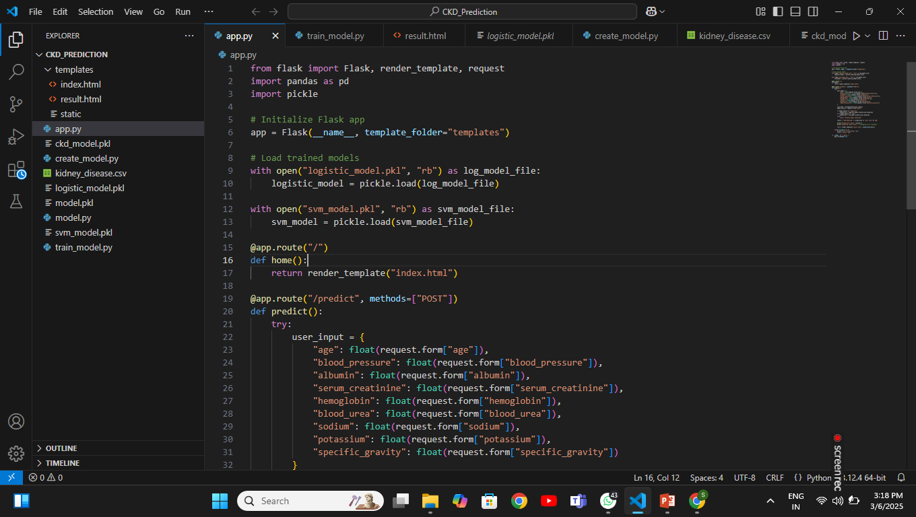
EXECUTION
11/06/2025

Slide 16
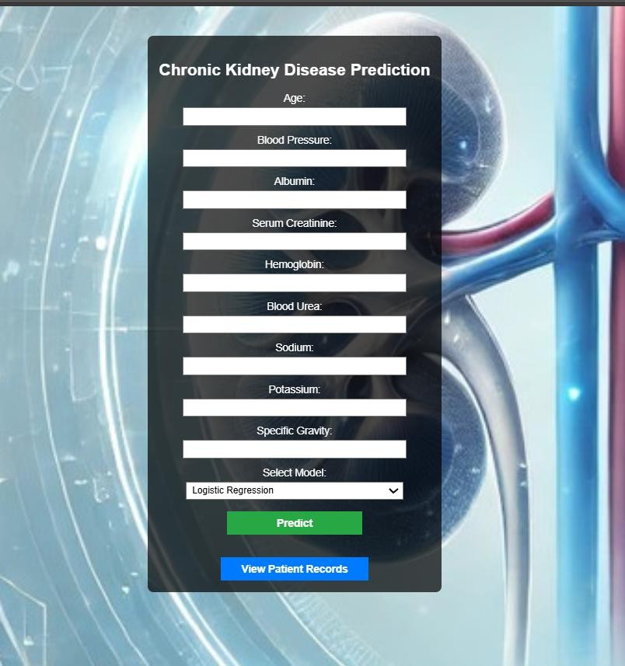
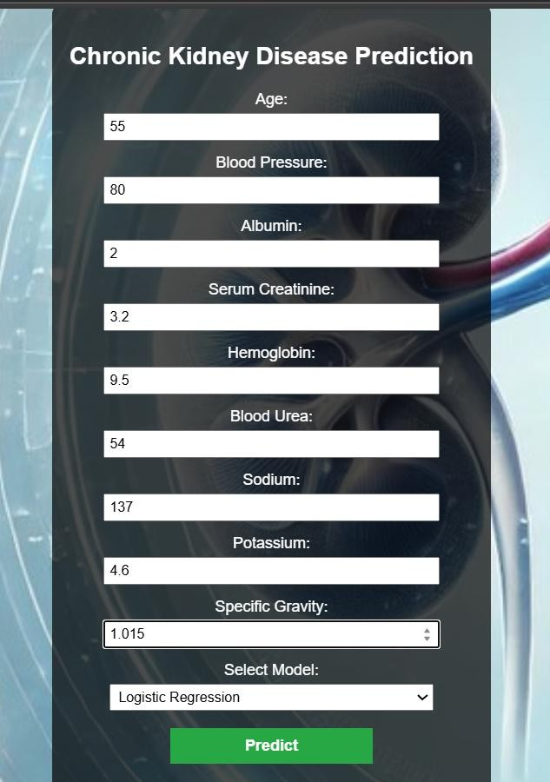
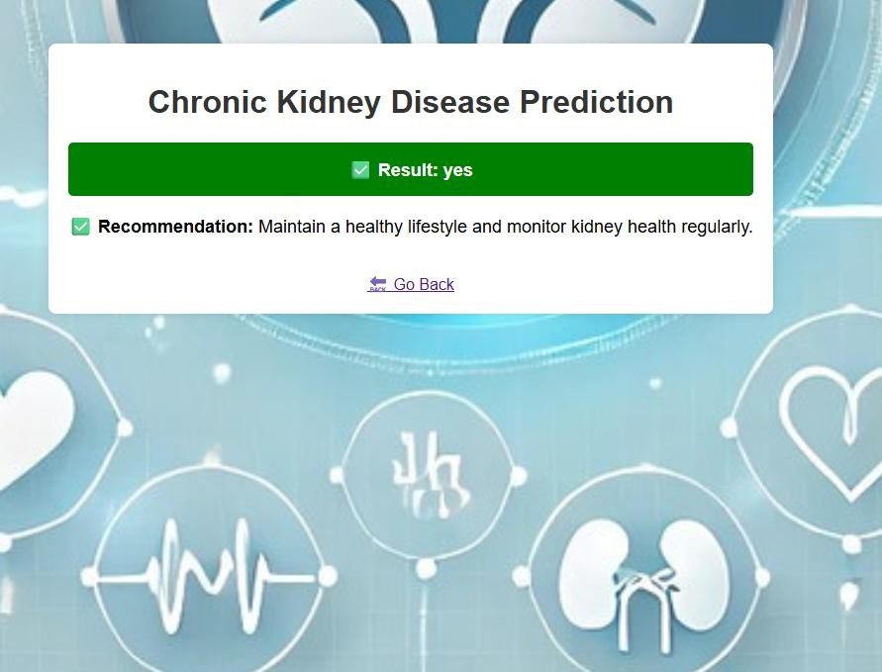
OUTPUT
11/06/2025

Slide 17
CONCLUSION & FUTURE ENHANCEMENT
Early Detection & Intervention – Machine learning enables accurate prediction of CKD, allowing for timely medical intervention and better patient outcomes.
Efficient & Scalable – Automated models streamline diagnosis, reducing the workload on healthcare professionals and making CKD screening more accessible.
Continuous Improvement – Regular updates with new data enhance model accuracy, ensuring long-term reliability in predicting CKD.
AI & Machine Learning: Advanced AI models for more accurate CKD predictions, enabling early diagnosis and personalized treatments.
Wearable Technologies: Continuous monitoring will track key healthmetrics, providing real-time predictions of CKD risk, helping with early interventions.
11/06/2025

Slide 18
REFERENCES
S. S. A. Naqvi and H. A. Khan, “Chronic Kidney Disease Prediction Using Machine Learning Algorithms,” ResearchGate, vol. 6, no. 2, pp. 45–52, 2020.
P. T. Nguyen and L. V. Pham, “A Review on Predicting Chronic Kidney Disease Using Machine Learning,” MDPI Applied Sciences, vol. 10, no. 16, pp. 5674–5685, 2020.
A. Sharma and A. Patel, “Application of Data Mining Techniques for Early Detection of Chronic Kidney Disease,” IEEE Xplore, pp. 183–187, 2019.
S. Raschka and V. Mirjalili, Python Machine Learning, 3rd ed., Packt Publishing, 2019.
B. Reinders, Building Machine Learning Projects with Flask, Packt Publishing, 2021.
11/06/2025

Slide 19

DD/MM/YYYY

