Slide 1
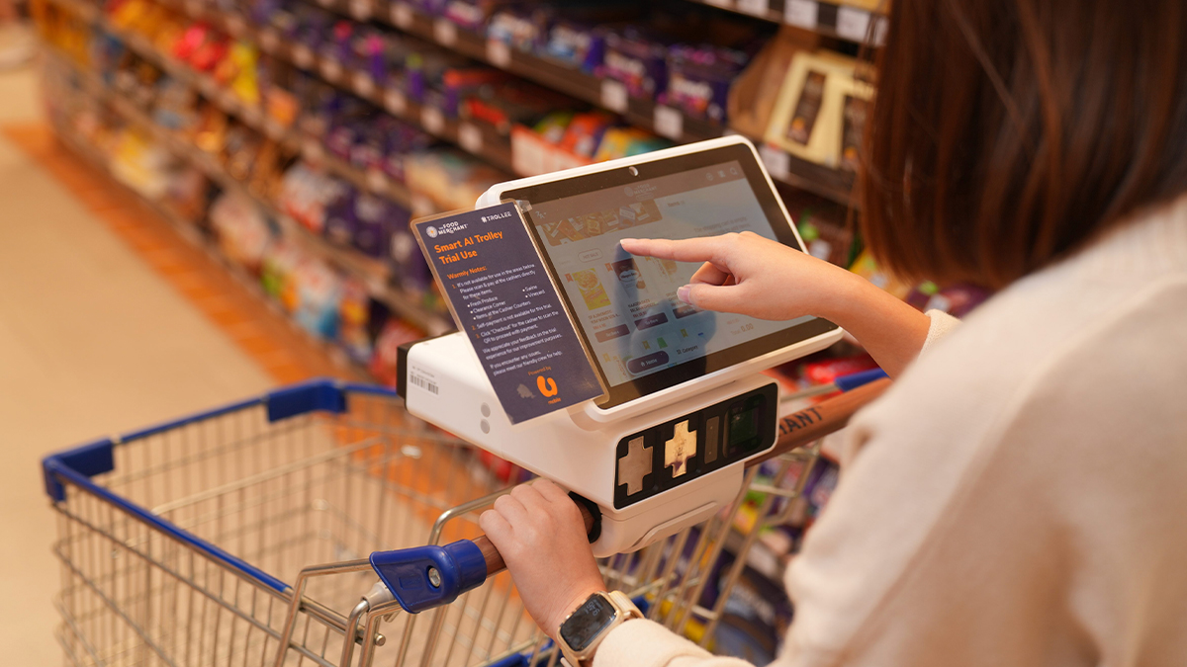
SMART SHOPPING TROLLEY SYSTEM
Presented by: Sahil & Vinitha Abhinashree College: National Skill Training Institute
Course : AIPA – Artificial Intelligence Programming Assistant
Smart Shopping Trolley System

Slide 2

You've been
there.
~30
minutes lost
in billing queues
every visit
Basket full. Ready to go home.
And then… the billing queue.
What if you never had to stand in that queue again?
Smart Shopping Trolley System

Slide 3
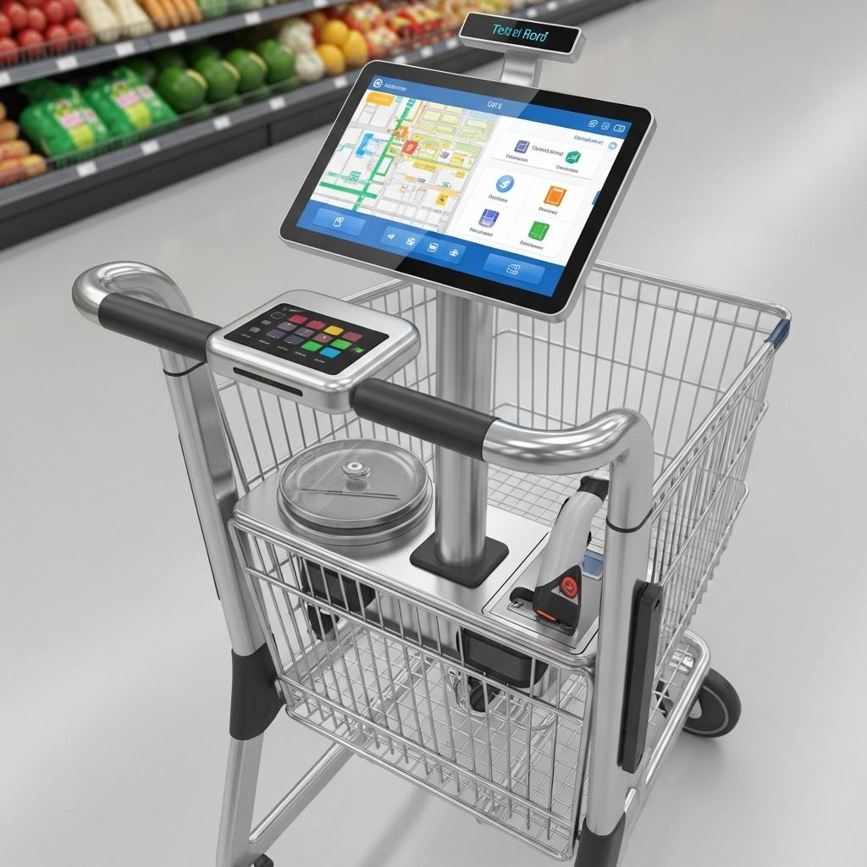



INTRODUCTION
Meet the Smart Shopping Trolley
A smart trolley that lets customers scan products as they shop and automatically generates the bill — so they can pay and walk out without ever joining a queue.
Scan while you shop
Pay from the trolley
Exit — no queue
"Scan. Pay. Go."
Smart Shopping Trolley System

Slide 4




THE PROBLEM
The Real Cost of Waiting
You Shop
You Wait
You Leave Frustrated
You pick products, compare prices, fill your basket with care.
Then you stand in queue. And wait. And wait. Sometimes 20–40 minutes.
What should have been a pleasant trip ends in exhaustion and delay.
Smart Shopping Trolley System

Slide 5

THE SOLUTION
Here's the Fix
" Scan products as you place them in the trolley. Pay before you leave the aisle. Walk out. "
1
2
3
4
5
Collect
Trolley
Scan
Products
Bill
Updates Live
Pay via
UPI / Card
Exit with
Receipt
Smart Shopping Trolley System

Slide 6
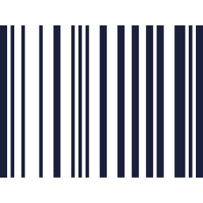




FEATURES
What's Inside the System
Auto Product Scanning
Real-Time Bill Display
Digital Payment
Barcode & RFID scanning the moment you place items in the cart
Running total visible on the trolley LCD screen at all times
UPI, QR code, credit/debit card, and mobile wallets supported
Instant Digital Receipt
Cloud Sync
Exit Verification
QR-based receipt generated on checkout — no paper needed
Product database and billing backed by cloud for accuracy
Smart exit gate confirms payment before the customer leaves
Smart Shopping Trolley System

Slide 7








BENEFITS
Why Everyone Wins
For Shoppers
For Mall Operators
No more standing in long queues
Reduced staffing costs at counters
Real-time bill — no surprise totals
Real-time inventory & sales data
Pay in seconds via UPI or card
AI insights for product placement
Faster, stress-free shopping trips
Higher customer satisfaction scores
Works even during peak hours
Digital receipts — eco-friendly
Smart Shopping Trolley System

Slide 8
CONCLUSION
The Smart Shopping Trolley System eliminates queues, automates billing, and makes every shopping trip faster and more enjoyable — for customers and mall operators alike. Companies like Amazon, Instacart, and Flipkart have already proven this works globally. The technology is ready. The demand is real.
↓80%
Queue Wait Time
↑35%
Customer Satisfaction
↓60%
Scan. Pay. Walk out. — The new normal for shopping.
Billing Staff Needed
Smart Shopping Trolley System

Slide 9

Thank You
Sahil & Vinitha Abhinashree
College: National Skill Training Institute
Course: AIPA –Artificial Intelligence Programming Assisstant
Any Questions?
Smart Shopping Trolley System

