Slide 1

21AIE113 – Elements of Computing – II
Breakout
Phase - I
MisFits
Garikipati Karthik AIE22020
Chakravaram Hari Priya AIE22008
Vinitha Chowdary A AIE22066
Subject Handled
Name: Mr. Niranjan D K
Designation: Faculty Associate
ASC, Bangalore.
Date: 22/June/2023

Slide 2
Contents
Introduction
Motivation
Objective
Problem Statement
Design Plan
Project Plan
References

Slide 3
Introduction
The breakout game is a classic arcade game that challenges players to break bricks using a paddle and a ball.
The aim of this project is to design and implement a breakout game within the Nand2Tetris platform, which involves building the necessary hardware components and writing assembly code to create an interactive gaming experience.

Slide 4
Motivation
The primary source of motivation for undertaking this project is our teacher, Mr. Niranjan who played a crucial role in inspiring and encouraging us to embark on this endeavor. Through his mentorship, he instilled in us the confidence and determination to take on this project, even in the face of challenges. Their wisdom and guidance provided a steady guiding light throughout the project, motivating us to push the boundaries of what we thought was possible and strive for excellence.

Slide 5
Objective
The objective of this project is to create a breakout game using Nand2Tetris.
This Breakout game developed using Nand2Tetris game faces a unique challenge in creating an engaging and educational experience that effectively combines the principles of computer architecture and programming concepts into an enjoyable gameplay format. The project seeks to address the difficulty of translating complex theoretical concepts, such as logic gates, computer chips, and assembly language, into a user-friendly and interactive game.

Slide 6
Problem Statement
The problem lies in striking the right balance between educational content and entertainment value, ensuring that players can grasp fundamental concepts while immersing themselves in an engaging gaming experience. Additionally, the challenge involves designing intuitive gameplay mechanics that seamlessly integrate the step-by-step construction of a virtual computer system, keeping players motivated, and providing meaningful learning opportunities throughout their journey.

Slide 7
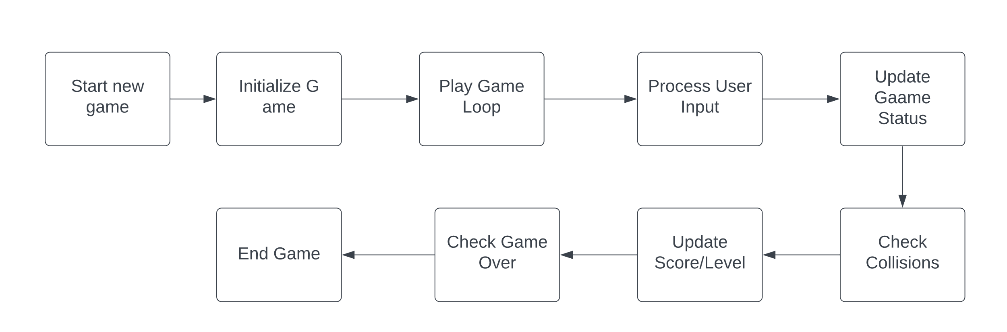
Design Plan

Slide 8
Project Plan
We created individual classes for each major component such as ball, block, Schlaeger, Levels and a utility class used for math functions and random class for movement of the ball and called all these classes containing methods pertaining to the game. All the codes are written in Jack language and then using Jack Compiler they are converted into VM and finally the output is displayed in the screen of the VM Emulator

Slide 9
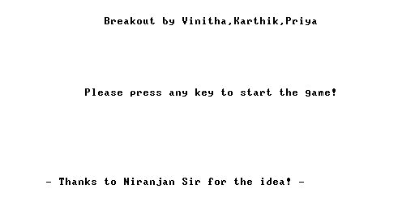
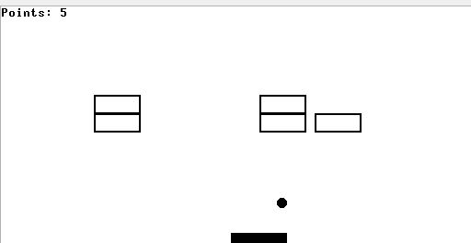
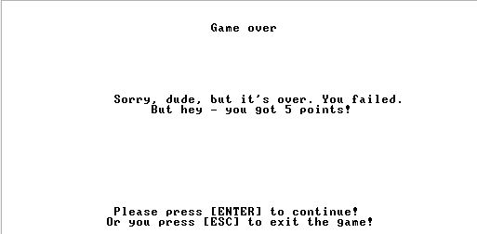
Expected Outcome

Slide 10
Reference
Nisan, Noam, and Shimon Schocken. The elements of computing systems: building a modern computer from first principles. MIT Press, 2005.
M. Morris Mano Computer System Architecture, Prentice Hall, Third Edition.
Hennessy, John L., and David A. Patterson. Computer architecture: a quantitative approach. Elsevier, 5th Edition, 2011.

