Slide 1

SVM-powered Art Movement Identification
Rohan Gamidi – BL.EN.U4AIE22019
Vinitha Chowdary - BL.EN.U4AIE22066 Sneha Saragadam - BL.EN.U4AIE22057
Department of Computer Science & Engineering,
Amrita School of Engineering, Bengaluru

Slide 2
Agenda
Introduction
Related work (Literature Survey)
Methodology
Implementation
Results and Discussion
Conclusion and Future Enhancements
References

Slide 3
Introduction
Problem Statement
The project addresses the challenge of automating art style classification using machine learning techniques. Specifically, it aims to develop a system capable of accurately identifying the artistic style of given images, allowing for efficient categorization and potential recommendations based on predicted styles. The challenge involves implementing a robust pipeline, including preprocessing, feature scaling, and model training, to create an effective tool for art analysis and exploration.
Motivation
Motivation: This project leverages machine learning to classify art styles using a Support Vector Machine (SVM) model trained on an extensive dataset. The system processes input images, applies feature scaling, and employs an optimized SVM to accurately predict art styles. The user-friendly interface allows image classification and recommends similar artworks based on predicted styles, showcasing the potential of AI in art analysis and curation.

Slide 4
Introduction
1. Project Overview:
Embarking on the realm of art-style classification, this project utilizes Support Vector Machines (SVM) to classify artworks into distinct movements like Japanese Art, Expressionism, and Primitivism. The dataset is enriched with grayscale images, resized to 150x150 pixels, and subjected to data augmentation for robust pattern discernment.
2. Key Components:
The dataset undergoes preprocessing steps, including splitting into training and testing sets, shuffling, standardization using StandardScaler, and saving the scaler model. Hyperparameter tuning via grid search optimizes the SVM model's performance, and the final model is saved for deployment.

Slide 5
Introduction
3. Functionality and Features:
The SVM model, trained with the best parameters, demonstrates its ability to classify art styles accurately. Test set predictions undergo similar preprocessing, and model accuracy is assessed using metrics such as accuracy score and classification report.
4. Significance and Impact:
Beyond showcasing machine learning in art classification, this project lays the foundation for exploring and understanding intricate features defining diverse art movements. The comprehensive pipeline from data loading to model evaluation highlights the potential impact on art analysis and appreciation.

Slide 6
Literature Survey
This project bridges critical gaps and makes use of identified in prior research:
The paper by Chaganti et al. explores a hybrid approach using Support Vector Machines (SVM) and Convolutional Neural Networks (CNN) for image classification, achieving 93% accuracy with minimal hardware resources
Dhruv and Naskar's work provides a detailed review of CNN architectures, classic models, and their applications in image classification, achieving a notable 94% accuracy across three distinct classes.
Chandra, Mayank Arya, and S.K.'s paper delves into fundamental aspects of SVM, comparing it with k-NN, decision trees, and neural networks, highlighting SVM's potency in image segmentation.
Anthony et al.'s 2007 paper compares one-to-one (1vs1) and one-to-all (1vsM) SVM methods, providing insights into their computational intricacies and their impact on image classification.

Slide 7
Literature Survey
J. Wu's 2012 paper introduces the High-Order Intersection (HIK) SVM and Intersection Coordinate Descent (ICD) algorithm, emphasizing efficiency and scalability for large-scale image classification.
Fukuda et al.'s 2002 paper focuses on SVMs for unsupervised classification of polarimetric synthetic aperture radar (SAR) images, highlighting SVM's adeptness in handling high-dimensional data.
Pasolli et al.'s 2014 paper introduces an active learning strategy for image classification using SVMs and spatial information, addressing challenges in supervised learning.
Abdullah and M. S. Hasan's 2017 paper explores the application of pre-trained CNNs for image classification, emphasizing their role in enhancing accuracy and efficiency.

Slide 8
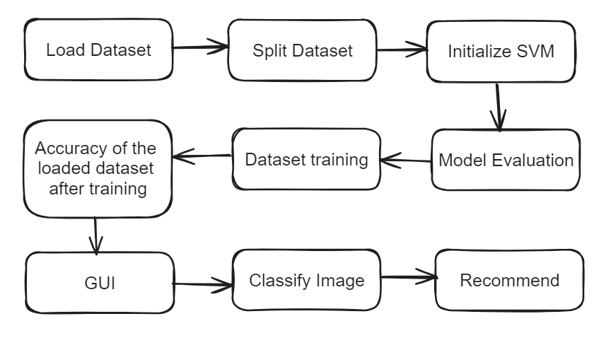
Methodology (Design Plan)

Slide 9
Implementati0n
A. Loading the Datasets:
Specify image categories for identification.
Traverse category folders, resize and flatten images.
Compile flattened data and labels into a DataFrame.
B. Split the Dataset:
Partition dataset into training and testing sets (80/20).
Train on 80% to uncover image patterns.
Evaluate on 20% for unbiased model accuracy.

Slide 10
C. Initialize SVM:
Fine-tune SVM parameters with GridSearchCV.
Train SVM on categorized images for robust classification.
D. Model Evaluation:
Challenge SVM with unseen test images.
Assess accuracy and scrutinize confusion matrices.
Identify areas for model improvement.
E. Dataset Training:
Evaluate SVM on unseen test images.
Measure accuracy and analyze confusion matrices.
Ensure SVM readiness for real-world applications.

Slide 11
F. Accuracy of the Loaded Dataset After Training:
Test model on unseen images for accuracy.
Analyse confusion matrices for category-specific insights.
G. Graphical User Interface (GUI):
Tkinter-based GUI for user interaction.
Buttons for image classification and recommendation.
Dynamic display of predicted style and recommended images.

Slide 12
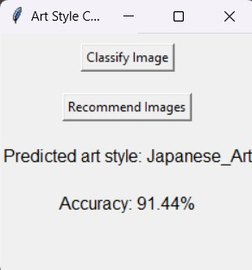
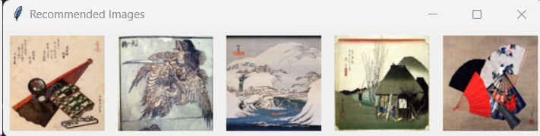
Results
Root Window:
Recommended Images:

Slide 13
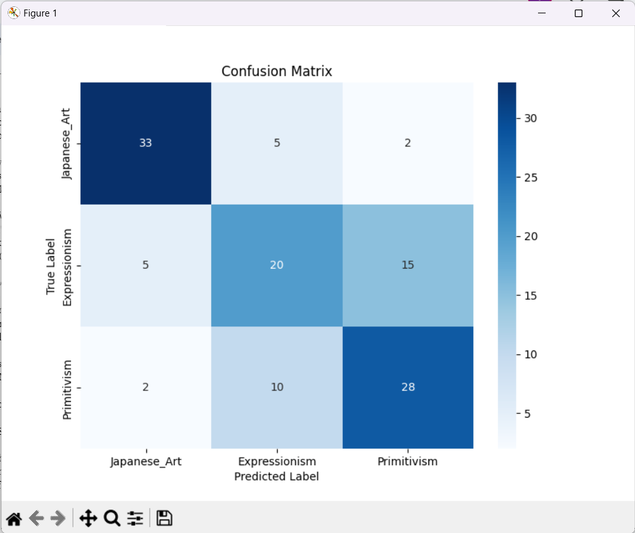
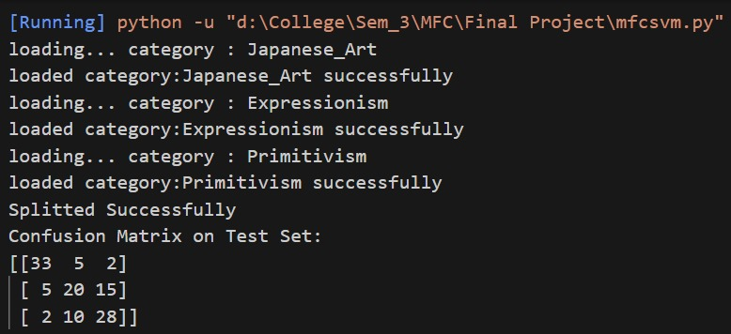
Results:
Confusion Matrix:
Program Output:

Slide 14
Conclusion and Future Enhancements
The Art Style Classifier employs SVM for accurate image classification, coupled with a Tkinter GUI for user-friendly interaction. It dynamically predicts art styles, offers recommendations, and incorporates Pickle for model persistence. Future enhancements may include deep learning integration and real-time classification. This educational tool enriches art exploration, combining simplicity and functionality for art enthusiasts.
1. Explore advanced models like CNNs for nuanced pattern recognition in images.
2. Implement transfer learning with models like VGG, ResNet, or Inception for enhanced accuracy.
3. Utilize efficient feature extraction techniques like PCA to reduce data dimensionality.

Slide 15
Conclusion and Future Enhancements
4. Leverage parallel processing on GPUs for accelerated training using machine learning frameworks.
5. Explore distributed training across machines for handling large datasets and complex models.
6. Expand the project to encompass more art styles by curating a diverse and annotated dataset.
7. Integrate user authentication for personalized recommendations based on individual preferences.
8. Develop a mobile application for wider accessibility, optimizing for mobile platforms.
9. Establish a feedback system for users to contribute to continuous model improvement.

Slide 16
References
[1] Chaganti, Sai Yeshwanth, et al. "Image Classification using SVM and CNN." 2020 International conference on computer science, engineering and applications (ICCSEA). IEEE, 2020.
[2] Chandra, Mayank Arya, and S. S. Bedi. "Survey on SVM and their application in image classification." International Journal of Information Technology 13 (2021): 1-11.
[3] Anthony, Gidudu, Hulley Gregg, and Marwala Tshilidzi. "Image classification using SVMs: one-against-one vs one-against-all." arXiv preprint arXiv:0711.2914 (2007).
[4] J. Wu, "Efficient HIK SVM Learning for Image Classification," in IEEE Transactions on Image Processing, vol. 21, no. 10, pp. 4442-4453, Oct. 2012, doi: 10.1109/TIP.2012.2207392.
[5] S. Fukuda, R. Katagiri and H. Hirosawa, "Unsupervised approach for polarimetric SAR image classification using support vector machines," IEEE International Geoscience and Remote Sensing Symposium, Toronto, ON, Canada, 2002, pp. 2599-2601 vol.5, doi: 10.1109/IGARSS.2002.1026713.
[6] E. Pasolli, F. Melgani, D. Tuia, F. Pacifici and W. J. Emery, "SVM Active Learning Approach for Image Classification Using Spatial Information," in IEEE Transactions on Geoscience and Remote Sensing, vol. 52, no. 4, pp. 2217-2233, April 2014, doi: 10.1109/TGRS.2013.2258676.

Slide 17
References
[7] Abdullah and M. S. Hasan, "An application of pre-trained CNN for image classification," 2017 20th International Conference of Computer and Information Technology (ICCIT), Dhaka, Bangladesh, 2017, pp. 1-6, doi: 10.1109/ICCITECHN.2017.8281779.
[8] Z. Chen, N. Pears, M. Freeman and J. Austin, "Road vehicle classification using Support Vector Machines," 2009 IEEE International Conference on Intelligent Computing and Intelligent Systems, Shanghai, China, 2009, pp. 214-218, doi: 10.1109/ICICISYS.2009.5357707.
[9] Xiaowu Sun, Lizhen Liu, Hanshi Wang, Wei Song and Jingli Lu, "Image classification via support vector machine," 2015 4th International Conference on Computer Science and Network Technology (ICCSNT), Harbin, China, 2015, pp. 485-489, doi: 10.1109/ICCSNT.2015.7490795.
[10] S. Koda, A. Zeggada, F. Melgani and R. Nishii, "Spatial and Structured SVM for Multilabel Image Classification," in IEEE Transactions on Geoscience and Remote Sensing, vol. 56, no. 10, pp. 5948-5960, Oct. 2018, doi: 10.1109/TGRS.2018.2828862

Slide 18

Thank you !!!!!

