Slide 1



IoT sensor data stream compression using hybrid dynamic Huffman and Run Length Encoding(RLZ) techniques
BL.EN.U4AIE22020 - Karthik G BL.EN.U4AIE22059 - Tejaswi Muppala BL.EN.U4AIE22066 - Vinitha Chowdary

Slide 2
AGENDA
Abstract
Introduction
Literature Survey
Methodology
Implementation
Results and Observations
Future Scope
Conclusion
​
​

Slide 3
INTRODUCTION
Overview of Data Compression:
Reduces data size for storage and transmission efficiency.
Essential for managing large datasets and bandwidth constraints.
Facilitates faster data processing and retrieval.
Importance and Applications in Real-World Scenarios
Crucial in telecommunications, media streaming, and web browsing.
Enhances data security through encrypted compression techniques.
Reduces costs for data management and operational efficiency.
6

Slide 4
INTRODUCTION
Project Objective
Analyze various data compression algorithms' effectiveness and efficiency.
Compare performance metrics across multiple compression methods.
Identify optimal compression strategies for specific applications.
6

Slide 5
LITERATURE SURVEY
[1] Pandimurugan et al. Hybrid image hiding combines Huffman coding with RLE or DWT, enhancing data transmission and storage efficiency.
[2]Yamagiwa et al. Introduced Adaptive Stream-based Entropy coding, optimized for hardware implementation and continuous data streams.
[3] Kalaivani et al. Developed a hybrid compression algorithm for ECG data, significantly reducing storage and power consumption.
[4] Qureshi et al. Proposed Multi-Homing Key Exchange Authorization Protocol to enhance security and reliability in subaqueous IoT networks.
6

Slide 6
LITERATURE SURVEY
[5] Azar et al. Examined lossy compression efficiency for IoT, balancing compression ratio and reconstruction accuracy for device longevity.
[6] Correa et al. Investigated lossy data compression techniques for IoT, aiming to optimize between compression efficiency and data accuracy.
[7] Hwang et al. Introduced Bit Depth Compression for time-series sensors, dynamically adjusting pack size to optimize compression efficiency."
[8] Bose et al. Compared various lossy compression algorithms for sensor data, analyzing signal properties to understand compression dynamics."
6

Slide 7
METHODOLOGY
Hardware Setup:
Utilizes Arduino Uno connected through serial port.
Arduino serves as data acquisition and transmission unit.
Reliable for real-time data handling in embedded systems.
Data Acquisition Process:
Data read serially from Arduino when available.
Decoding and handling of data done in Python.
Continuous monitoring and data fetching every 5 seconds.
6

Slide 8
Hybrid Huffman + RLE (Run-Length Encoding):
Combination of Techniques: Integrates Run-Length Encoding (RLE) with Huffman coding to optimize compression.
Initial Compression: RLE reduces data size by compressing sequences of repeated characters or data elements.
Complexity: Maintains a reasonable computational complexity, making it suitable for real-time applications.
6

Slide 9
Further Encoding: Huffman coding is applied to the RLE output, further compressing the data by encoding frequent characters with shorter codes.
Efficiency: Especially effective for data with large numbers of repeated elements, enhancing both compression ratio and speed.
Time Complexity:
Best Case: O(n), where n is the size of the input data.
Worst Case: O(n + k log k), where n is the size of the input data and k is the number of unique symbols in the data.
Average Case: O(n + k log k).
6

Slide 10
Dynamic Huffman Coding:
Adaptive Encoding: Continuously updates its Huffman tree as new data is received, adjusting to changes in data frequency.
Efficiency in Changing Environments: Particularly effective for data streams where character frequencies are not known beforehand or can change over time.
Real-time Compression: Suitable for real-time applications because it can adapt to incoming data on the fly without needing to revisit past data.
6

Slide 11
No Initial Frequency Count: Unlike static Huffman coding, it doesn't require a preliminary pass over the data to build frequency tables, making it faster for large datasets.
Complex Implementation: More complex than static Huffman due to the necessity of updating the tree dynamically, which can increase computational overhead.
Time Complexity:
Best Case: O(n log n), where n is the size of the input data.
Worst Case: O(n^2), particularly when the Huffman tree needs frequent updates.
Average Case: O(n log n), but can vary depending on the data characteristics.
6

Slide 12
Static Huffman Coding:
Fixed Frequency Table: Utilizes a predefined frequency table based on typical or expected data distributions to build the Huffman tree.
Efficiency with Known Data: Most effective when character frequencies in the data are consistent and well-known ahead of time.
Single-Pass Encoding: Since the frequency table is predetermined, the data can be encoded in a single pass, enhancing speed.
6

Slide 13
Simplicity of Implementation: Less complex compared to dynamic Huffman coding as it does not require updates to the tree during encoding.
Limitation: Not as flexible or efficient as dynamic Huffman coding when dealing with data whose frequency distribution is not known or varies.
Time Complexity:
Best Case: O(n log n), where n is the size of the input data.
Worst Case: O(n log n).
Average Case: O(n log n).
6

Slide 14
IMPLEMENTATION
Programming Environment:
Programming Language: Implemented in Python for its versatility and support for numerical operations.
Libraries Used: numpy, matplotlib, psutil, heapq, lzma
Development Tools: Code developed and tested using a local Python environment, ensuring real-time data handling and visualization.
6

Slide 15
IMPLEMENTATION
Modifications and Optimizations Performed:
Code Optimization: Refactored initial code to improve efficiency, reducing runtime and memory usage by optimizing data structures and loops.
Algorithm Tuning: Adjusted parameters and optimized the implementation of Huffman and LZW algorithms to better suit the nature of incoming data.
Enhanced Data Handling: Improved the data reading function to handle irregular data inputs and ensure robust data processing under varying conditions.
6

Slide 16
Run-Length Encoding (RLE):
Basic Concept: RLE compresses data by reducing sequences of repeating elements into a single data value and count.
Efficiency for Specific Data: Highly efficient for data with large blocks of repeating elements, such as graphic images in certain formats or simple text files.
Implementation Simplicity: One of the simplest forms of data compression in terms of implementation.
6

Slide 17
Compression Speed: Due to its straightforward nature, it operates very quickly, making it suitable for real-time applications.
Limitations: Not effective for data with high variability or few repeated elements, as it can actually increase file size in such cases.
Time Complexity:
Best Case: O(n), where n is the size of the input data.
Worst Case: O(n).
Average Case: O(n).
6

Slide 18
LZW (Lempel-Ziv-Welch):
Dictionary-Based: LZW works by building a dictionary of input sequences during the encoding process, incrementally adding new entries as it encounters new sequences.
Self-Learning: As the algorithm processes data, it automatically adds new sequences to its dictionary, making it more efficient as it progresses through the data.
Wide Applications: Commonly used in file compression formats like GIF and TIFF, as well as in the UNIX compress utility.
6

Slide 19
Efficiency: Typically more efficient than simpler methods like Run-Length Encoding (RLE), especially for files with a wide variety of data patterns.
Handling of Common Substrings: LZW is especially proficient at compressing data with frequent and recurrent substrings due to its dynamic dictionary construction, which continuously adds longer sequences as it encounters them. This ability makes it uniquely effective for datasets with complex but repetitive patterns.
Time Complexity:
Best Case: O(n), where n is the size of the input data.
Worst Case: O(n^2), particularly for data with minimal repetition.
Average Case: O(n).
6

Slide 20
ZLIB(using Deflate algorithm):
Combination of Techniques: Deflate combines the LZ77 algorithm with Huffman coding, optimizing both dictionary-based replacements and bit-level encoding.
Configurable Compression: ZLIB allows users to choose between different compression levels, balancing speed and compression efficiency to suit various needs.
Wide Usage: ZLIB is extensively used in software applications for its robustness and effectiveness, including within PNG image format and HTTP compression (gzip).
6

Slide 21
Stream Compression: Suitable for use in streaming data applications due to its ability to compress a continuous data stream.
Error Checking: Provides built-in error detection using the Adler-32 checksum method to ensure data integrity after compression and decompression.
Time Complexity:
Best Case: O(n log n), where n is the size of the input data.
Worst Case: O(n log n).
Average Case: O(n log n).
6

Slide 22
LZMA(Lempel-Ziv-Markov chain Algorithm):
Known for its high compression ratio and fast decompression, suitable for compressing large datasets.
​
Dictionary-Based Compression: Uses a sliding window to find repeated sequences.
Range Coding: Efficient entropy coding method used for compression.
Markov Chain Model: Predicts probabilities of literals and matches for efficient encoding.
Applications: Widely used in the 7z format and other utilities for file compression
​
6

Slide 23
LZMA(Lempel-Ziv-Markov chain Algorithm) Time complexities:
Best-case: O(n)
Average-case: O(n log n)
Worst-case: O(n log n)
Time complexities for decompression best-case, worst-case and average case: O(n)
​
6

Slide 24
BZ2 (BZIP2):
​
Utilizes the Burrows-Wheeler Transform (BWT) and Move-to-Front (MTF) transform.
​​
Burrows-Wheeler Transform (BWT): Rearranges the input data to enhance the effectiveness of compression.
Move-to-Front (MTF) Transform: Transforms data to be more suitable for Run-Length Encoding (RLE).
Huffman Coding: Used for final compression stage to encode transformed data efficiently.
Applications: File Compression utilities and Data Archiving
​​
6

Slide 25
BZ2 (BZIP2) Time Complexities:
​
Best-case: O(n log n)​
​
Average-case: O(n log n)​
​
Worst-case: O(n ^ 2)​
​
Time complexities for decompression best-case, worst-case and average case: O(n)​
​
​​
6

Slide 26
RESULTS AND OBSERVATION
Presentation of Compression Results for Each Algorithm:
Data Overview: Displayed results for each algorithm, including compressed data size and structure.
Algorithm Performance: Highlighted the effectiveness of each method, focusing on how well each algorithm compressed the dataset.
Visual Representation: Used graphs to illustrate the compression outcomes, making comparisons intuitive and clear.
6

Slide 27
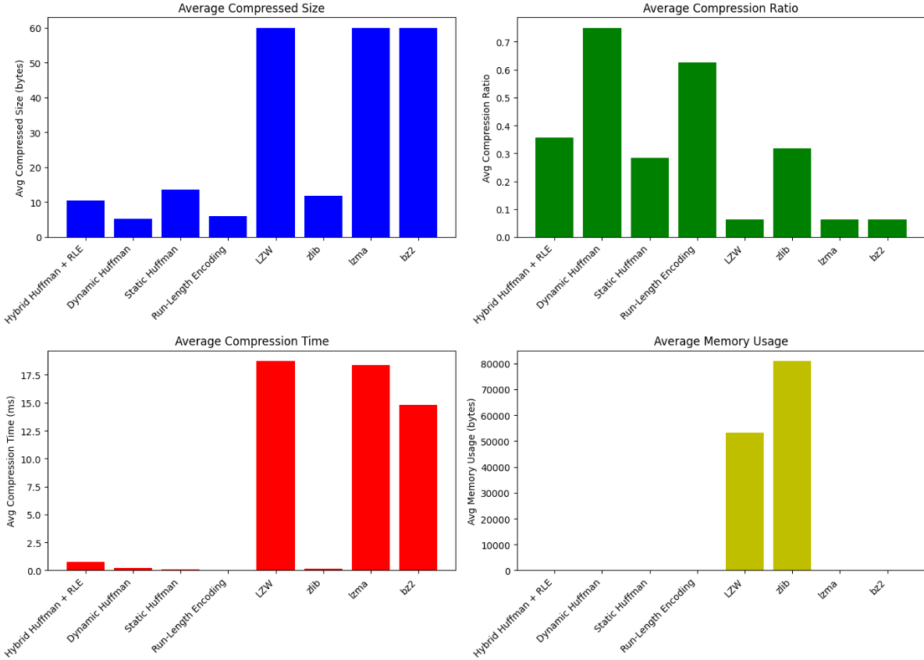
6

Slide 28
FUTURE SCOPE
Advanced Algorithm Development:
Combine multiple compression techniques to enhance overall performance.
Apply machine learning to predict and optimize compression parameters.
Expansion to New Domains:
Implement solutions for streaming real-time data in IoT devices.
Adapt algorithms for use in mobile and cloud-based platforms.
6

Slide 29
CONCLUSION
Key Findings:
Demonstrated varying efficiency and effectiveness across multiple compression algorithms.
Identified optimal algorithms based on specific performance metrics like size, speed, and memory usage.
Importance of Choosing the Right Algorithm:
Highlighted the necessity of algorithm selection based on data type and application requirements.
Emphasized that the right compression approach can significantly enhance data management and operational efficiency.
6

Slide 30
Thank
You

