Slide 1

Prison Building Contract(PBC)
A00325758
Vinit Sharma

Slide 2
Entity Relationship Diagram(ERD)
An ERD (Entity-Relationship Diagram) is a visual representation of entities, their attributes, and the relationships between them in a database system. It is commonly used in database design to model how data will be stored and interconnected.
Types of ERD:
1) An ERD without attributes is a high-level conceptual model that focuses solely on the entities and their relationships. It excludes the attributes of entities to provide a simplified view of the database structure.
2) An ERD with attributes is a detailed version that includes the properties of each entity

Slide 3
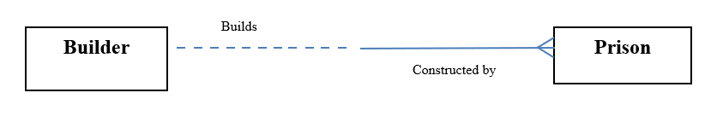
ERD Without attribute

Slide 4
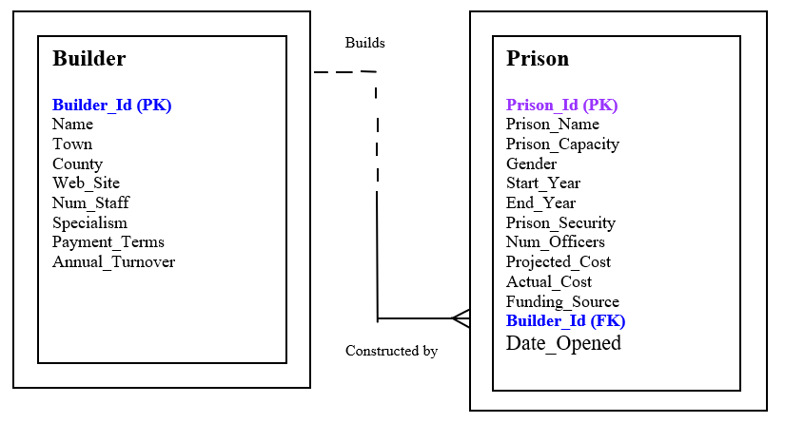
ERD With Attributes

