Slide 1


LIBRARY MANAGEMENT

Slide 2
Guided By : Shivangi Desai
PREPARED BY
NAME : PATEL VINKU MEGHRAJBHAI
ROLL NO: 209 DIV : S7
ENROLLMENTNO : 21002170110121

Slide 3
INDEX:-
INTRODUCTION
E-R DIAGRAM
WORKING OF PROJECT
MERIT AND DEMERIT

Slide 4
INTRODUCTION:-
Library Management Systems Are Designed To Manage The Movement Of Books And Maintain Records Of The Members In A Library
The Purpose Of A Library Management System Is To Operate A Library With Efficiency And At Reduced Costs.
The Library Management System Is Based On The Different Sections Or Classes Involved In The Operation Of A Library. The Functions And Attributes Of The Classes And Relationships Between Them Are Specified In A Class Diagram
Library Management Systems Are Designed To Manage The Movement Of Books And Maintain Records Of The Members In A Library
The Purpose Of A Library Management System Is To Operate A Library With Efficiency And At Reduced Costs.
The Library Management System Is Based On The Different Sections Or Classes Involved In The Operation Of A Library. The Functions And Attributes Of The Classes And Relationships Between Them Are Specified In A Class Diagram.

Slide 5
ER DIAGRAM:-
Memb_id
amount
Fine
Name
PAY
Member
Lib
Have
Bookid
Phone_no
Publication
Memb_id
Address
Noofcopies
Bookid
Has
Borrowed by
Bookid
Manage
Memb_id
Bookname
Bookid
Do_sub
Returns
Has
Subscription
Return_date
Author
Books
Memb_id
Available

Slide 6
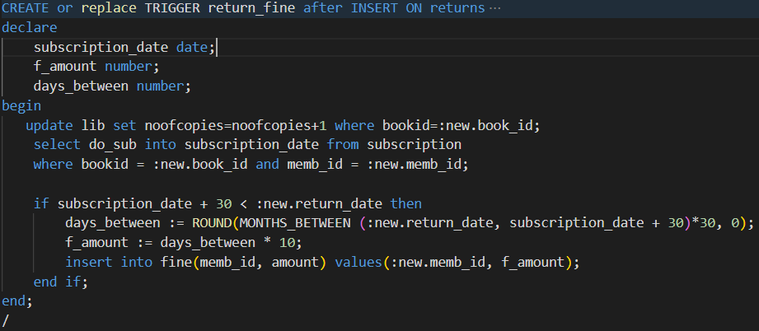
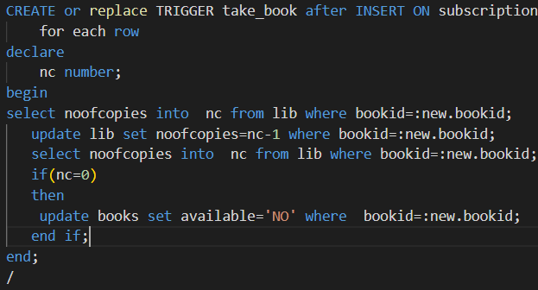
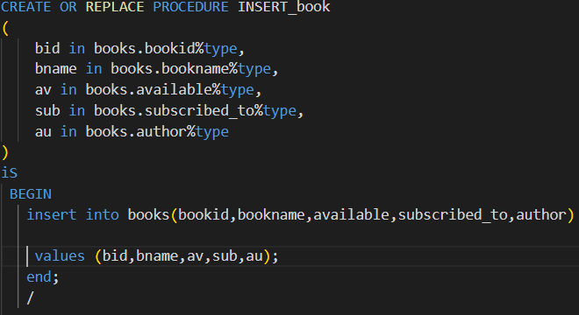
USE IN PROJECT:-
PROCEDURE:-
Insert_member
Insert_subscription
Insert_books
TRIGGER:-
Fine_return
Take_book
Tak_book

Slide 7
ADVANTAGES
DISADVANTAGES
Simple and easy to operate
Increase librarian’s efficiencies
Mobile access, anytime, anywhere
Search, add, update, and view library materials online
Helps to manage library functions constructively
Saves time and reduces overheads
Reduce library’s operating cost
Customized reports for better management
Remove manual processes to issue books and maintain records.
stored data is predisposed to cyber hacks. Opting for a reliable online system reduces the risk
sometimes it is complicated to operate for first-time users
Requires high-speed internet connectivity for a web-based system
Risk of computer virus
Unlike online systems that use cloud computing, Open source system stocks data on the computer’s hard drive. This raises the risk of data loss.

Slide 8
Thank You!
Any questions?
Prepered By:-
VINKU PATEL

