Slide 1

MINESWEEPER GAME
Prepared By:-
Guided By : Kavit Shah
Student Name: Radadiya Amit Kalubhai
Roll no: 84
Batch: A3 Branch: Computer Engineering
Student Name: Dankhra Zeel Hitendrabhai
Roll no: 92
Batch: A3 Branch: Computer engineering
Student IV Name: Patel Vinku Meghrajbhai
Roll no: 101
Batch: A3 Branch: Computer Engineering
Student IV Name: Soni Dhruvi Rupeshbai
Roll no: 103
Batch: A3 Branch: Computer Engineering
Student IV Name: Vaghela Divyarajsingh Birendrasigh
Roll no: 89
Batch: A3 Branch: Computer Engineering

Slide 2
INDEX:-
Introduction
Working of project
Conclusion

Slide 3
INTRODUCTION:-
Minesweeper Is Single-player Logic-based Computer Game Played On Rectangular Board Whose Object Is To Locate A Predetermined Number Of Randomly-placed "Mines" In The Shortest Possible Time By Clicking On "Safe" Squares While Avoiding The Squares With Mines.
If The Player Clicks On A Mine, The Game Ends . Avoid All The Mine And Expose All The Empty Spaces To Win Minesweeper.
We Use For Make Minesweeper Game List And Diffrent Function. And we use try and exception handling and clear.

Slide 4
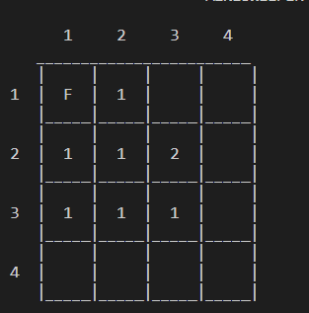
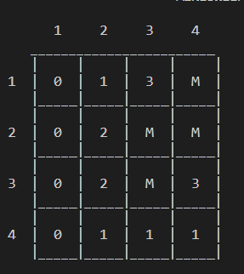
WORKING OF PROJECT:-
print_mines _layout()
This Function Will Print layout of mines
This Function Will Be Set Mine In Number List By Using Random
Set_mines()
Flag Will Be Use For Remember Where Position Have Mine
Flag
Set_valuess()
In This Function Check Position Have Up,down,left,right,top-left,top-right,below-right,below-left Mines And Increase Count When Mines Arrives Take The Value Of Count In Number List If The Position Have Not Mine

Slide 5
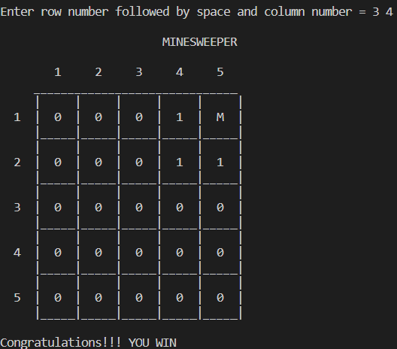
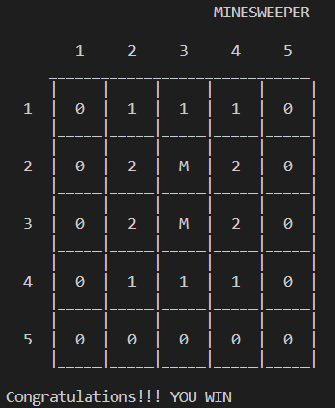
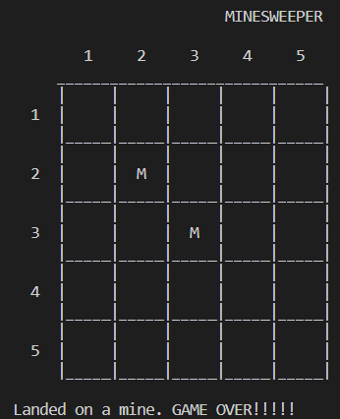
WORKING OF PROJECT:-
neighbours(r, Col)
If Landing On Cell With 0 Mines Then It Will Check Near Position 8 Cells If Cell With Not 0 Mine Then Print Postion Value.It Will Use Recursion
When win the game
When lose the game
Player Clears The Entire Board Without Detonating Any Mines, They Win.
If The Player Detonates A Mine, The Game Is Over And They Lose.

Slide 6
CONCLUSION:-
Creating A Minesweeper Game Using Python Is A Fun And Rewarding Project That Can Help You Develop Your Programming Skills While Also Providing Hours Of Entertainment For Yourself And Others.
With The Right Tools And Techniques, You Can Create A Polished And Professional-looking Game That Rivals Commercial Titles In Terms Of Gameplay And Presentation.

Slide 7
THANK YOU

