Slide 1

Airbnb
Team Members:-
Garima Vijay, Pranjali Desai, Pravalika Thota, Sindhuja Arivukkarasu, Vinmathi Iyappan

Slide 2

What is Airbnb?
Airbnb is an online marketplace that connects people who want to rent out their property with people who are looking for accommodations, typically for short stays.
Airbnb makes the bulk of its revenue by charging fees to both guests and hosts.
Airbnb seeks to optimize pricing strategies amid rising demand and supply. Utilizing a diverse dataset, predicting factors impacting pricing, user preferences, and market demand proves complex.
The challenge prompts the need for a robust predictive modeling solution, analyzing historical data to empower hosts with insights for effective pricing optimization and enhanced user satisfaction.

Slide 3

Research Questions
Can we analyze the trends in the short-term rental market?
How can hosts establish competitive Airbnb rates?
Can we determine the popular room types for hosting strategies?
Can we uncover the different patterns in the listings?

Slide 4

The Data Set
The dataset was obtained from Kaggle.
ID: Listing ID
Name: Listing Name
Host_id: Id of the host
Host_name: name of the host
Neighbourhood_group: It is a broader grouping or category of neighborhoods where the listing is situated.
Neighbourhood: It is a community where the listing is situated in a city/town.
Latitude
Longitude
Room_type: Type of accommodation is being offered.

Slide 5

Price: The price per night host is decided in USD.
Minimum_nights: Minimum number of nights that are required to book a listing
Number_of_reviews:-The total no of reviews a listing has
Last_review: Last date when the listing was rented.
Reviews_per_month: The total number of reviews a listing receives in a month
Calculated_host_listings_count: Number of Listings per host
Availabilty_365: The number of days a listing is available in a year
Number_of_Reviews_Itm: The total number of reviews a listing has in the last 12 months.
City: The city the listing is located in.

Slide 6
Data pre-processing
Dropped the columns that are not useful for the analysis - ID,name, Hostid, Host name
Dropped the Last_review, neighbourhood_groups, and reviews_per_month columns due to of missing values.
Removed outliers in the 'Price' variable by setting upper and lower bounds based on percentiles.

Slide 7
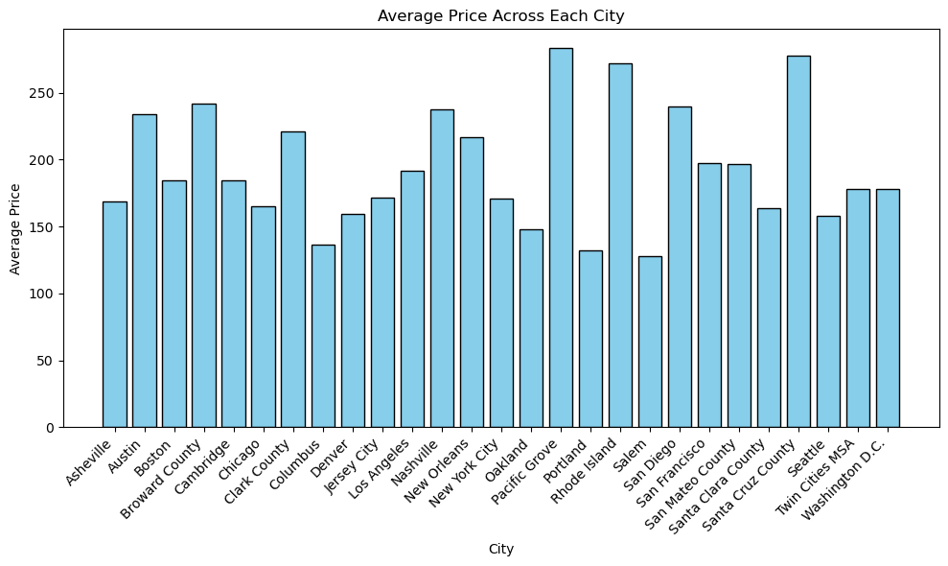
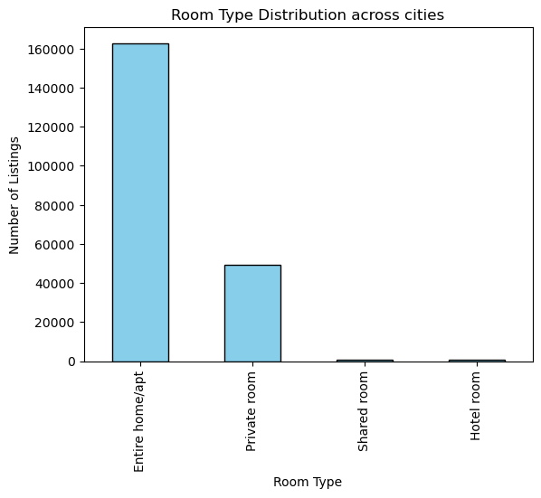
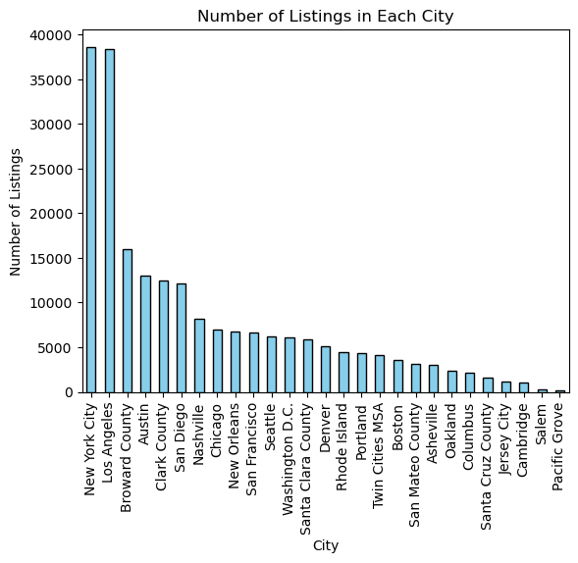
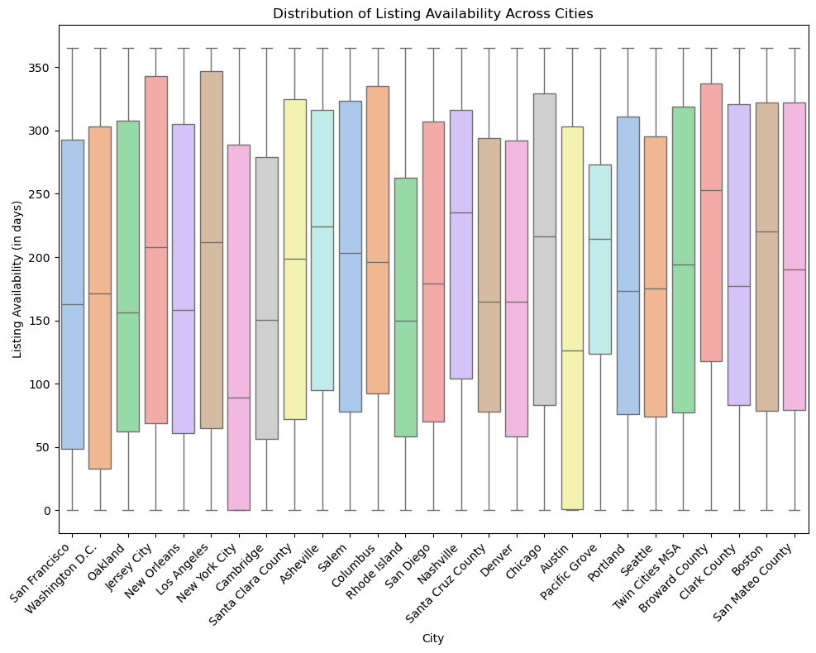
Data Visualization
Average price across each city
Room type distribution
Number of listings in each city
Distribution of listings across cities

Slide 8
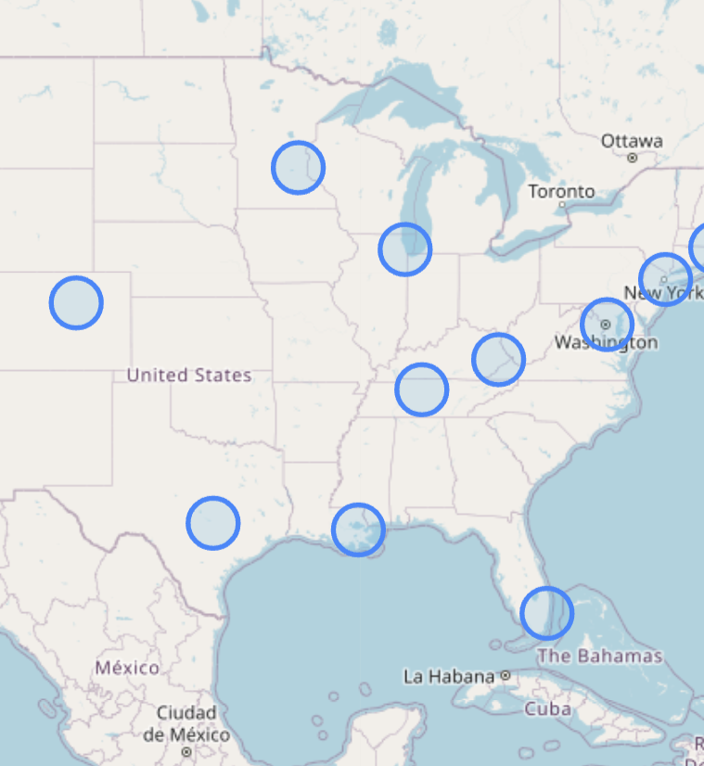
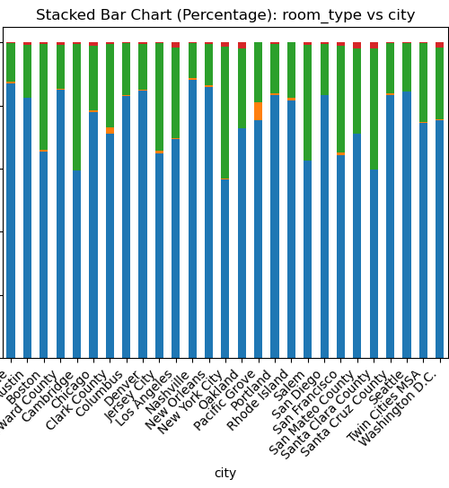

Slide 9
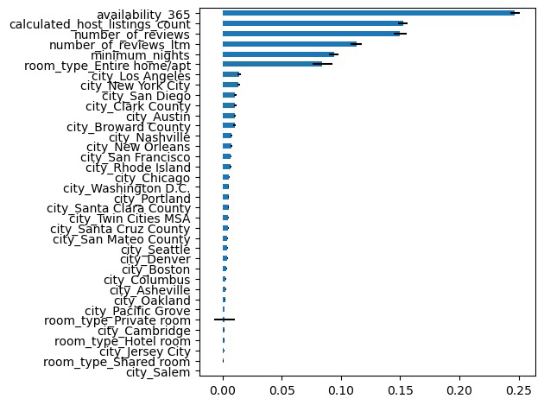
Price Prediction Using Multiple Linear Regression
Objective: Empower hosts with strategic pricing for competitive Airbnb rates through strategic pricing models.
Variable Importance Plot:
Performance Comparison:
Multiple Linear Regression | RMSE
Base Model with 34 variables | 137.07
Final Model with 4 variables | 140.14

Slide 10
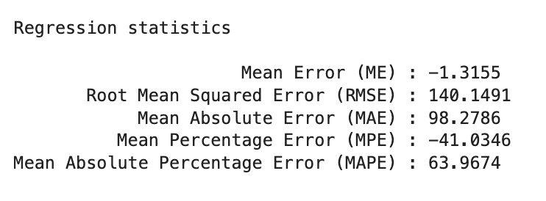
Results
Predictor Coefficients:
Availability_365 (0.08): Each additional unit of availability increases the 'Price' by 0.08 units.
Minimum_nights (-0.57): An increase in minimum nights results in a decrease of 0.57 units in 'Price.’
Number_of_reviews (-0.21): Each additional review is associated with a 0.21 unit decrease in 'Price.’
Room_type_Private room (-98.92): Listings with a private room type have a lower 'Price' by 98.92 units compared to other room types.
Simplifying the Final Model from 34 to 4 variables improves interpretability and practicality for price prediction. Despite a slight RMSE increase (137.07 to 140.14), this trade-off aligns with prioritizing a model better suited for real-world applications in predicting prices.

Slide 11
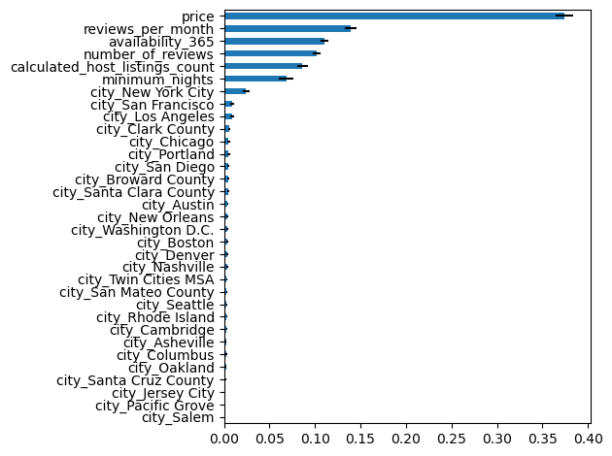
Classification Trees
Objective: To discern the most suitable room type for the host's listings by considering various relevant parameters.
Top indicators as per variable importance chart
Model comparisons
Models | Accuracy
Random forest (n_estimators = 500) | 0.8523
Grid search (max_depth = 10, min_impurity = 0, min_samples_split = 2000) | 0.8449
Boosted trees | 0.8559

Slide 12
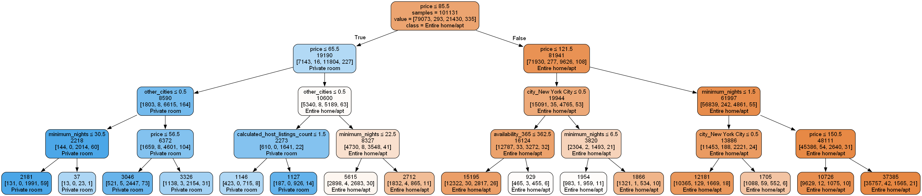
Price dominates as the key factor
In other cities, with prices between $ 85.5 and $121.5, entire home apartments are preferred
While in New York, if minimum nights is less than 6.5 than users are indifferent between entire home or private. But if they plan to stay for more, then entire home is preferred.
Irrespective of the cities, private room is preferred when prices are less than $65.5
In New York, with prices between $65.5 and $85.5, private rooms are preferred
In other cities, with prices between $65.5 and $85.5, entire home apartments are preferred
For prices greater than $85.5, entire home is preferred

Slide 13
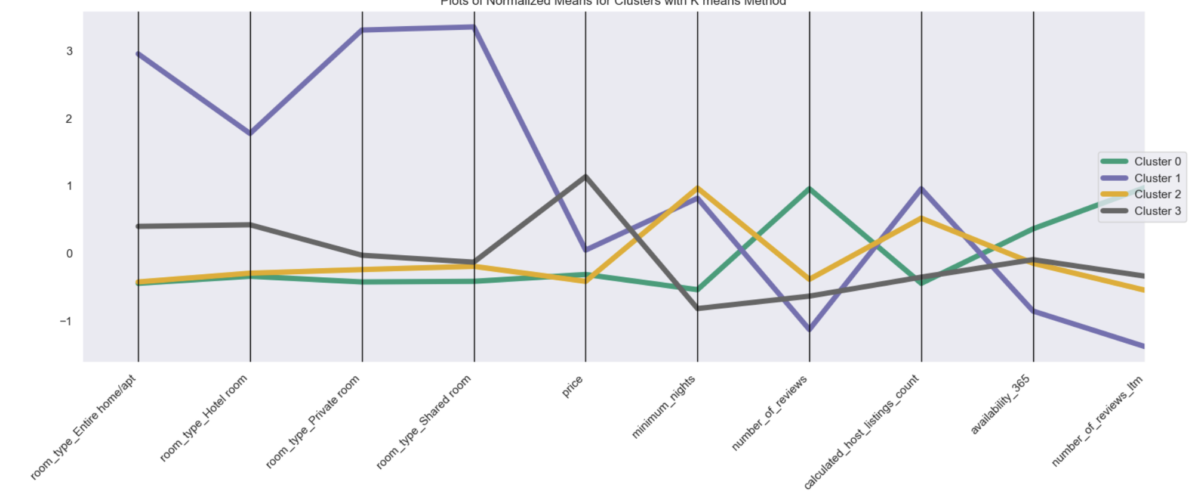
Clustering
Cluster 0:-“Highly reviewed dwellings”
This cluster includes houses with high review counts and a low number of private rooms
City: Asheville, Columbus, Nashville, New Orleans, Pacific Grove, Portland, Salem, San Mateo County, Santa Cruz County, Seattle
Cluster 1:-"Diverse Accommodations Hub“
This cluster represents cities with a wide variety of listings in terms of room types but has a lower overall review count, indicating a diverse range of options.
City: Los Angeles, New York City

Slide 14
Cluster 2:-“Extended Stay Options”
This cluster comprises houses for maximum number of nights with budget friendly price, suggesting a preference for accommodations suitable for extended stays.
City: Boston, Cambridge, Chicago, Denver, Jersey City, Oakland, San Francisco, Santa Clara County, Washington D.C.
Cluster 3:-"Upscale Retreats"
This cluster includes houses with higher prices and a lower minimum nights & and listings, indicating a focus on luxurious accommodations.
City: Austin, Broward County, Clark County, Rhode Island, San Diego, Twin Cities MSA

Slide 15
Recommendations
Hosts belonging to diverse accommodation hubs, can take steps towards getting customer reviews to stand out from the crowd.
Hosts belonging to upscale retreats, can provide a personalized experience to the customers that encourages customers to leave positive reviews.
Hosts belonging to extended stay, can showcase their amenities to attract the guests.
To set a competitive price, the host can make sure the property is available throughout the year. If the host offers private rooms, it is better to consider pricing them a bit lower than other room types to attract more guests.
For hosts looking to sub-lease a private room, it is recommended to set prices below $65.5, except in New York, where users are willing to pay between $65.5 and $85.5.
Regularly evaluate and adjust pricing based on market trends and guest feedback to ensure competitiveness and appeal for your Airbnb listings.

