Slide 1

VNR DESIGN-A-THON 2026
[FinSage : AI-Powered Personal Finance]
Team Name : BusyRN
1.1 Problem Statement : AI-Powered Personal Finance Intelligence System
Team Members :
Vinnakota Sashank
Sankalamaddi Sadwik Reddy

Slide 2
Agenda
Abstract
Introduction
Problem statement
Technical details
System Design
Conclusion
References

Slide 3
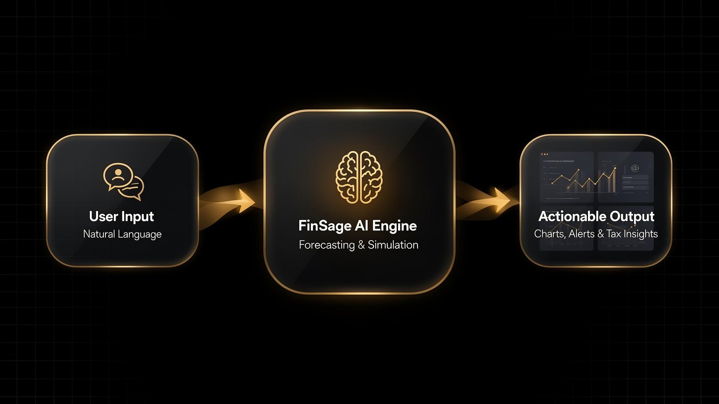
Abstract
"Wealth isn't just about making money; it's about understanding it before it's gone."
FinSage is an AI-powered "Personal CFO" that transforms static raw transactions into dynamic, actionable financial intelligence. Using Agentic AI, predictive forecasting, and scenario simulations, it allows users to query their finances in natural language. By automatically generating tailored visual analytics, proactive alerts, and tax optimizations, FinSage bridges the gap between historical tracking and future-focused wealth management.

Slide 4
Introduction
Why do we use 21st-century AI to write emails, but 20th-century spreadsheets to plan our life savings?
The Problem: Traditional personal finance apps are entirely backward-looking—they merely track historical spending without answering complex questions or predicting future outcomes.
Data Overload: The rapid rise of high-volume digital payments (like UPI) leaves users drowning in transaction data but starved for actionable insights.
The Planning Gap: Everyday users lack accessible tools for advanced scenario planning (e.g., buying a house), localized tax optimization, and proactive financial monitoring.
Our Solution: FinSage is an Agentic AI platform designed to act as a 24/7 “Personal CFO.”
The Innovation: We transform static, raw financial data into natural language conversations, auto-generating dynamic charts, proactive alerts, and predictive forecasts.

Slide 5
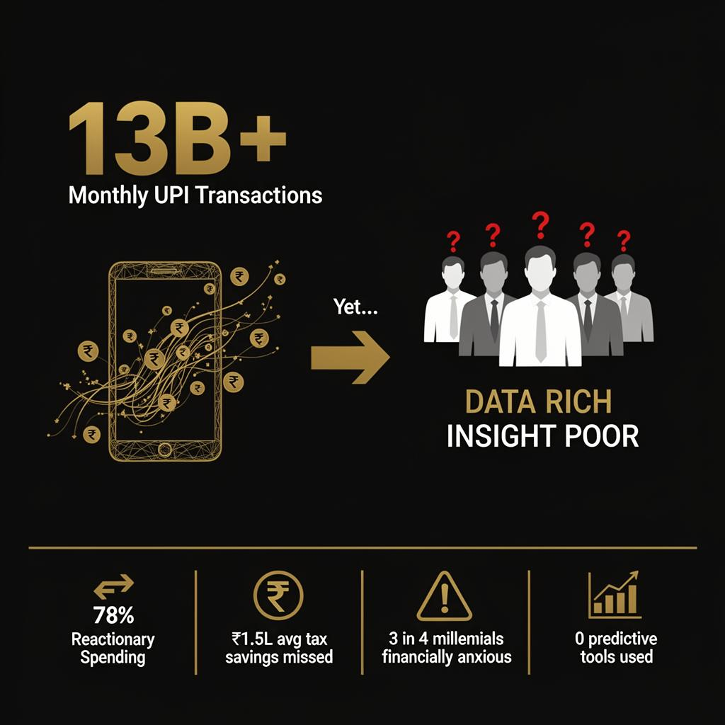
Problem statement
• The Core Problem: 13+ billion monthly UPI transactions create massive personal financial data, yet users lack actionable intelligence.
Money management is entirely reactionary - users know where their money went, but cannot predict or simulate future wealth.
• Target Audience: Indian working professionals and millennials navigating high-frequency spending, tax planning (80C/80D), and long-term goals.
• The Human Reality: A fragmented financial landscape leaves the majority of young professionals experiencing chronic financial anxiety.

Slide 6
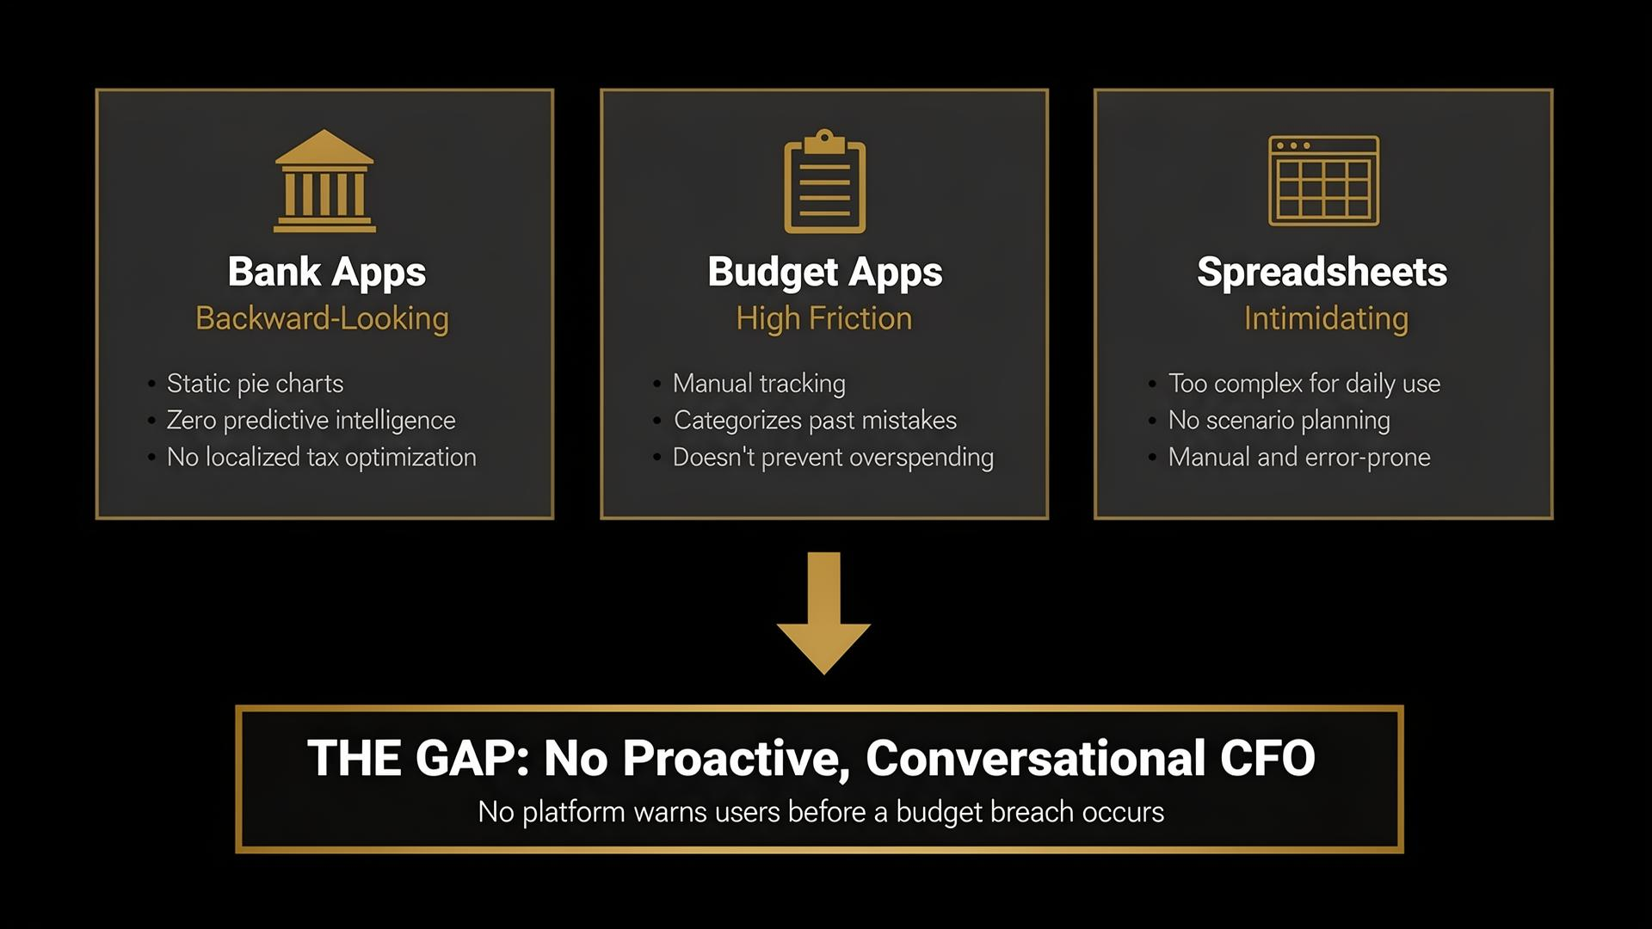
Existing solutions and their drawbacks

Slide 7
Technical Details
• Agentic Function Calling: Maps prompts to 10+ strict typed data functions, entirely preventing LLM hallucination.
• Dynamic Multimodal Output: AI logically evaluates queries to auto-generate and render the exact, correct visual chart type rather than just text.
• Proactive Anomaly Detection: Runs algorithmic background checks to organically identify and warn users of unprompted spending spikes.
• Probabilistic Forecasting: Runs 1,000+ Monte Carlo probability simulations for precise "what-if" long-term wealth projections and goal plotting.
Technology Stack:
Frontend • React 18 + Vite • Tailwind CSS • Recharts (Data Visualization)
Backend • Python FastAPI • SQL Model ORM • SQLite Database
AI & Analytics • Google Gemini 2.0 Flash (LLM) • Prophet (Time Series Forecasting) • NumPy Monte Carlo Simulation • SciPy Anomaly Detection
Infrastructure • WebSockets (Real-time Alerts) • JWT Authentication • Docker Deployment • Render Hosting • GitHub Version Control

Slide 8
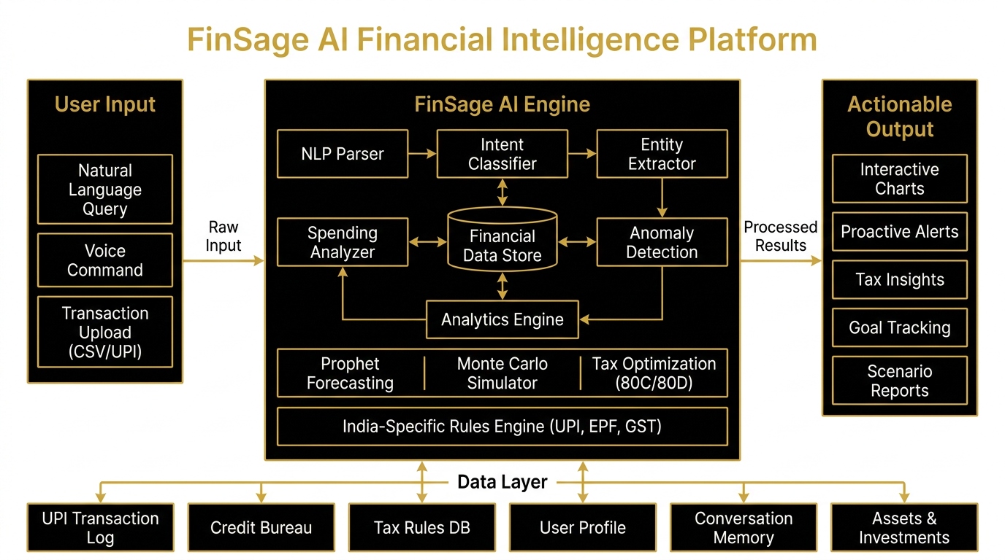
System Design
System Architecture Diagram
• Presentation Layer: React + Tailwind UI delivering unified Chat, Dynamic Dashboards (Recharts), and a Proactive Alert Center. • API Gateway Layer: FastAPI backend handling secure JWT authentication, websocket streaming, and REST routing. • AI Orchestration Layer: Gemini API strictly utilizing Function Calling to translate NLP into precise, structured SQL tool commands—preventing LLM hallucination. • Intelligence Modules: Specialized execution pipelines featuring Prophet (TimeSeries Forecasting), Monte Carlo (Simulation), and Statistical Anomaly testing (z-score). • Data & Storage Layer: Localized SQLite database processing 2,400+ rows of synthetic financial data prioritizing zero-egress localization laws.

Slide 9
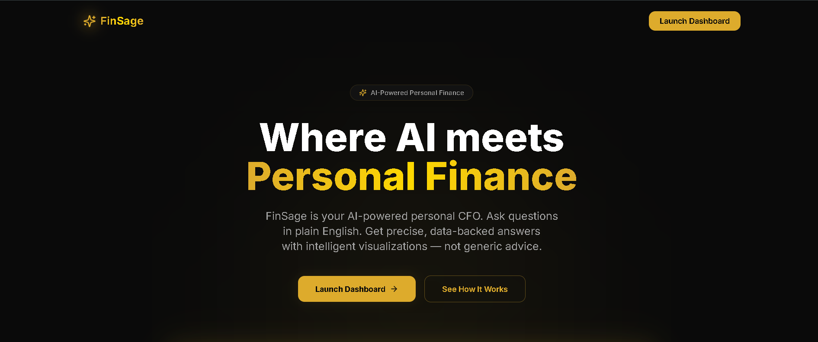
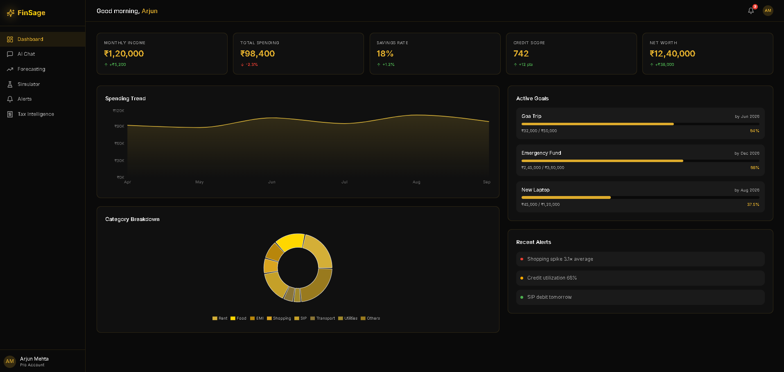
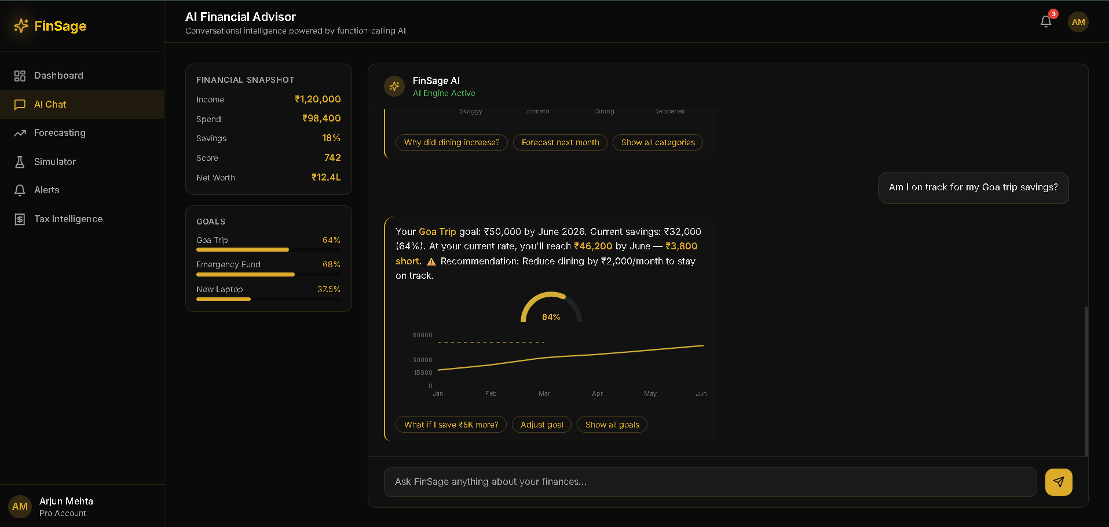
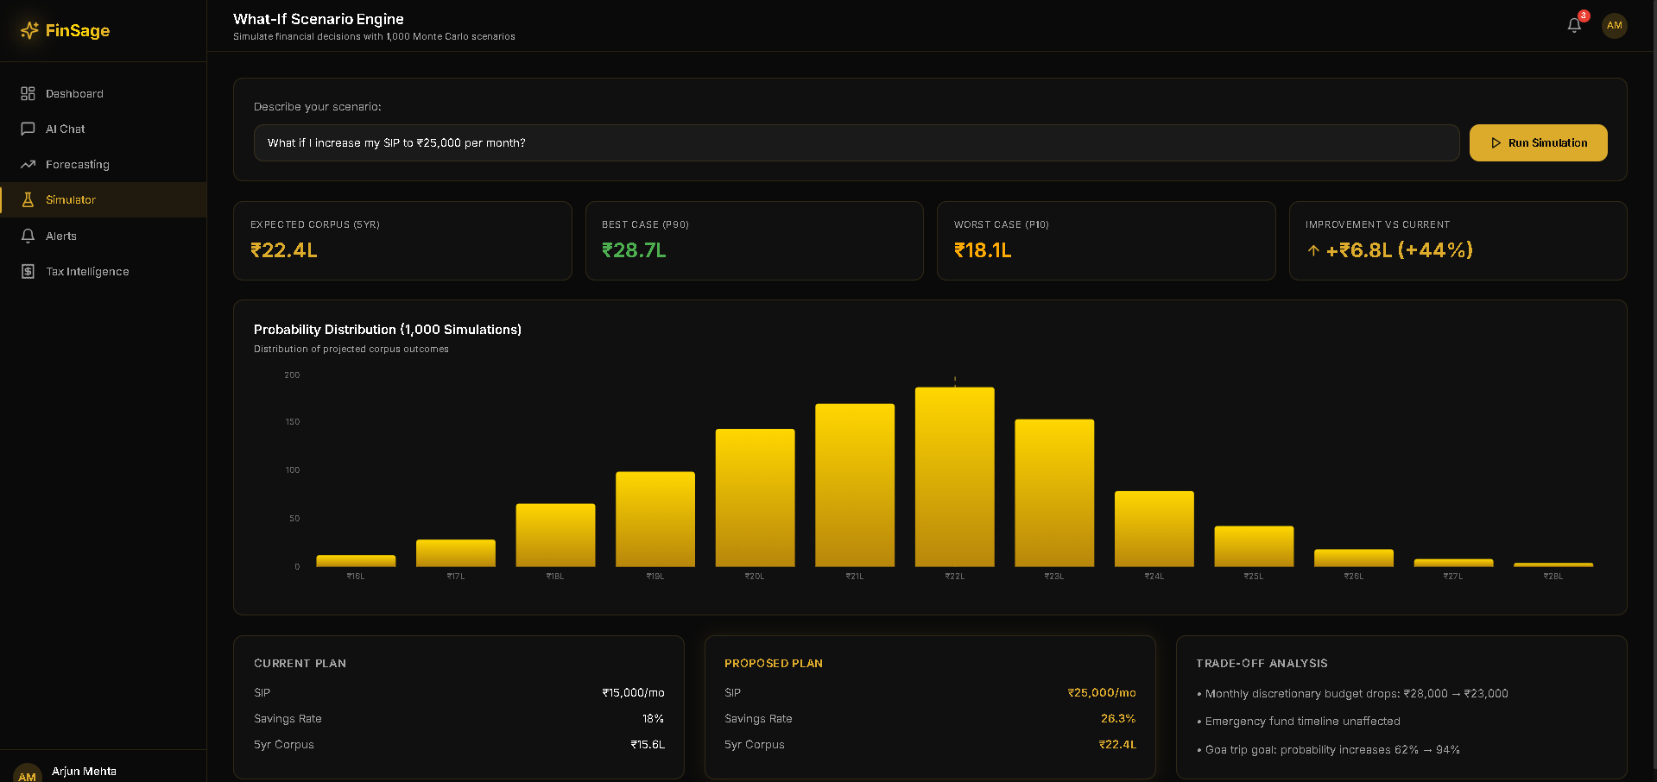
Prototype

Slide 10
We have successfully scaffolded and deployed the core frontend UI (React, Vite, Tailwind), creating the foundational routing for the Dashboard, Chat, Alerts, Simulator, and Tax pages. The project possesses a cohesive visual design, but currently relies largely on static mocked data and layouts.
What happened so far in the prototype:
Backend Initialization - Setup FastAPI & SQLite.
Synthetic Data Load - Generate 2,400+ transaction rows.
Core Tool Chain - Build first 5 data queries.
Gemini AI Integration - Enable LLM function calling.
Dynamic Chart Hookup - Connect AI logic to Recharts.
Prophet Engine Integration - Setup time-series forecasting.
Monte Carlo Engine - Code probability-based scenario simulators.
Anomaly Alerts System - Finalize Z-score proactive background triggers.
India-Specific Features - Add Tax, EPF, and UPI logic.
Remaining Steps:

Slide 11
Business Prospect
Target Users
Primary Users
• Young professionals (Age 22–35) • Income ₹5–25 LPA • Managing first salaries, loans, and investments
Secondary Users
• Dual-income households (Age 30–45) • Multiple income streams and financial goals Tertiary Users
• Freelancers & gig workers • Irregular income and tax complexities • Require financial planning and cash-flow info
Market Opportunity
• Account Aggregator Framework • RBI-regulated financial data sharing ecosystem • 400M+ monthly users generating real-time transaction data • Only 27% of adults financially literate
• No dominant AI finance assistant in India
Startup Vision
FinSage — Your AI CFO
• AI-powered personal financial intelligence platform • Conversational interface for natural financial queries • Spending analysis • Financial forecasting • Tax optimization • Investment insights

Slide 12
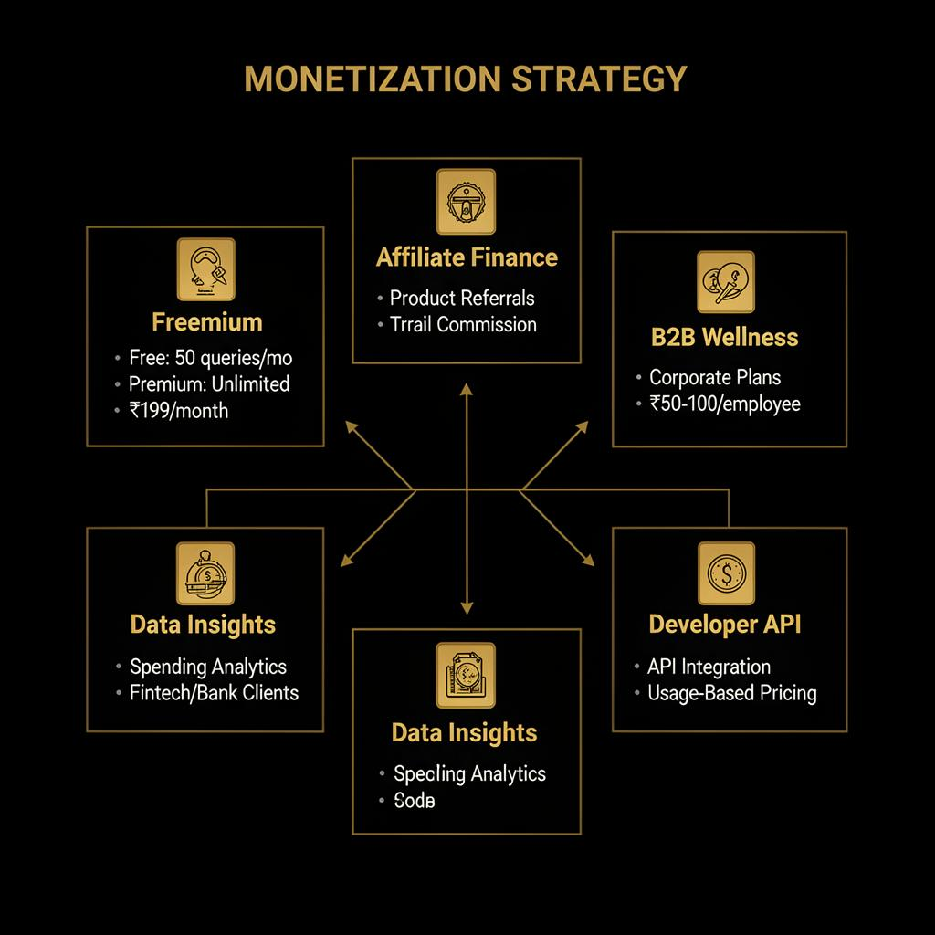

Slide 13
Conclusion
FinSage transforms static transaction data into a conversational AI CFO using agentic function calling and predictive modeling. It democratizes wealth management, empowering users to optimize taxes, simulate goals, and receive proactive spending alerts. Future scope includes scaling via India's Account Aggregator API for real-time bank syncing and expanding to B2B enterprise wellness programs. By tackling the UPI data overload, FinSage proves the future of wealth management is intelligently conversing with your money.

Slide 14
References
• Financial Literacy Data: S&P Global FinLit Survey. Global Financial Literacy Excellence Center (GFLEC). Referenced for the statistic that only 27% of Indian adults are financially literate. • Data Ingestion Framework: Reserve Bank of India (RBI). Master Direction - Non-Banking Financial Company - Account Aggregator (NBFC-AA) Directive. Used as the foundational model for secure, consent-based financial data aggregation. • Digital Payments Scope: National Payments Corporation of India (NPCI). UPI Ecosystem Transaction Volumes and Statistics. Referenced for market sizing (400M+ monthly users). • Tax Optimization Modeling: Income Tax Department, Government of India. Official Directives on Section 80C and 80D Deductions. Used to build the localized tax deduction logic engine. • Provident Fund Projections: Employees' Provident Fund Organisation (EPFO). Current Interest Rate & Contribution Guidelines. Sourced for accurate long-term retirement corpus simulations.

