Slide 1
Project Stage-2 Review -2
02/04/2026
Brain Stroke Detection Using ResNet-50
Under the Guidance
Presentation by
Mrs. N. Mownika M. Tech.
Mr. B. Bharath(22C11A6607)
Assistant Professor,
Department of CSE(AI & ML)
Mr. B. Vinay(22C11A663)

Slide 2
Index
Problem Statement
Proposed System
Architecture
Dataset Description
Data Preprocessing
Model
Training Process
System Implementation & Testing
Screens
Results & Performance Analysis
Conclusion & Future Scope
References

Slide 3
Problem Statement
Stroke diagnosis is time-critical and requires rapid decision-making
Manual CT scan analysis is time-consuming and depends on expert radiologists
Early-stage stroke features are subtle and difficult to detect
Increasing number of CT scans creates workload for medical professionals

Slide 4
Traditional ML methods rely on handcrafted features which leads to a low accuracy .
Early deep learning models struggle with accurate CT image analysis Poor generalization in complex medical datasets .
Need for an automated, accurate, and efficient detection system .

Slide 5
Proposed System
System takes CT scan image as input
Image undergoes preprocessing for consistency
Deep learning model extracts features automatically
ResNet50 is used as the primary backbone network

Slide 6
ResNet50 performs deep hierarchical feature extraction
Additional feature refinement is applied to improve accuracy
Model captures both structural patterns and fine details
Final classification predicts Stroke / No Stroke
Integrated into a web-based application

Slide 7
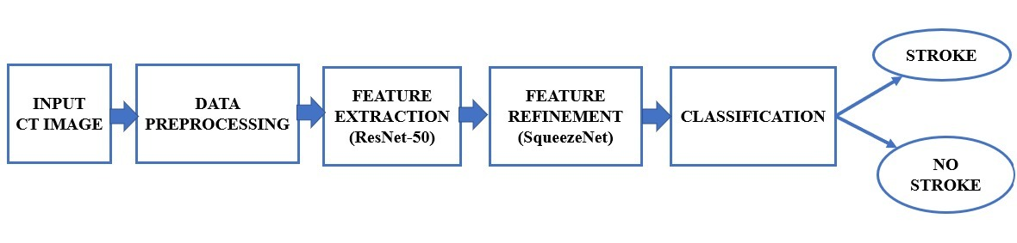
Architecture
Input CT Scan → Image Preprocessing → ResNet50 Model (Feature Extraction) → Fire Module (Feature Refinement) → Dense Layers (Classification) → Stroke / Normal Output → Web Application Interface

Slide 8
Dataset Description
Source: Kaggle
Size: Approximately 2500 CT images across 2 classes (Stroke , No Stroke)
Class Distribution: Slightly imbalanced, with No Stroke classe having more samples than Stroke
Sample Images: Includes real CT scans of Stroke-affected and normal brain images with variations in size, shape, and location
Train–Test Split: 80% training data and 20% testing data

Slide 9
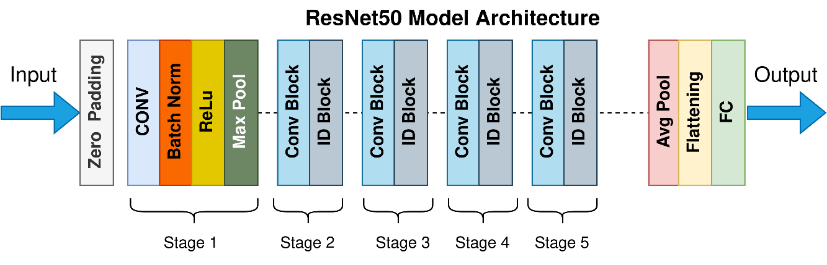
Model
Type of Model: CNNs (ResNet) :

Slide 10
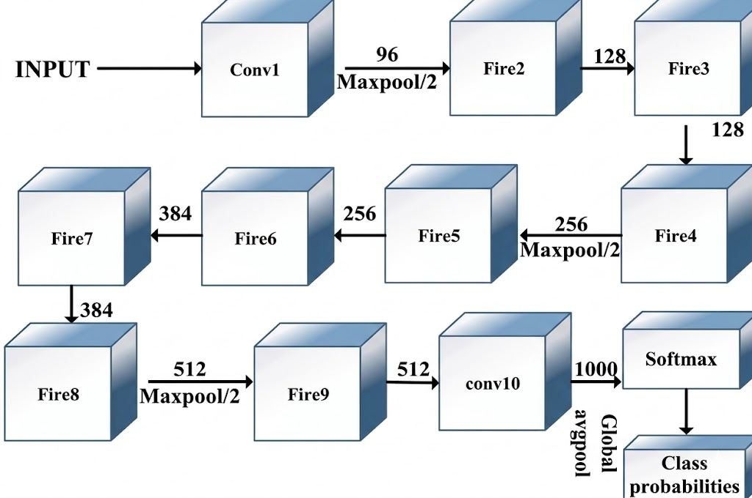
SqueezeNet :

Slide 11
Input CT scan image is processed through initial convolution layers with batch normalization and ReLU activation to extract basic spatial features.
Max-pooling is applied to reduce image dimensions and improve computational efficiency.
Deep feature extraction is performed using ResNet50 residual blocks, which help in learning complex patterns and avoid vanishing gradient problems . Additional feature refinement layers enhance fine-grained details for better stroke detection.
Final classification is done using fully connected layers with a sigmoid activation function to predict stroke or normal condition.

Slide 12
Training Process
Number of epochs set to 18 for efficient training
Batch size configured as 16 for optimal learning stability
Adam optimizer used for faster convergence
Learning rate initialized at 0.001
Loss function used: Binary Cross Entropy
Hardware Used
System RAM: 16 GB
Processor: Intel i5
GPU: Kaggle’s Cloud GPU (for accelerated training)

Slide 13
Training Strategy
Applied Early Stopping to prevent overfitting
Used Model Checkpoints to save best-performing model
Training Performance
Training curves show decreasing loss over epochs
Accuracy consistently improves during training
Model demonstrates minimal overfitting and good generalization

Slide 14
System Implementation & Testing
Backend of the system is developed using Flask, which includes files such as app.py for handling API requests, the trained ResNet50 model file (model.keras ), and preprocessing scripts for image handling.
The frontend is developed using React and consists of components such as Navbar, Home, Prediction, History, Login, and Register. Additional files like App.js and index.css are used for routing and styling of the application.

Slide 15
Functional Testing: Functional testing is performed to verify the correctness of the prediction results. The system ensures that the uploaded CT scan image is properly processed and the output (Stroke / No Stroke) is accurately displayed to the user.
Integration Testing: Integration testing is carried out to validate the communication between the frontend and backend. The system is tested for proper API interaction, smooth data flow, and complete end-to-end workflow from image upload to prediction result display.

Slide 16
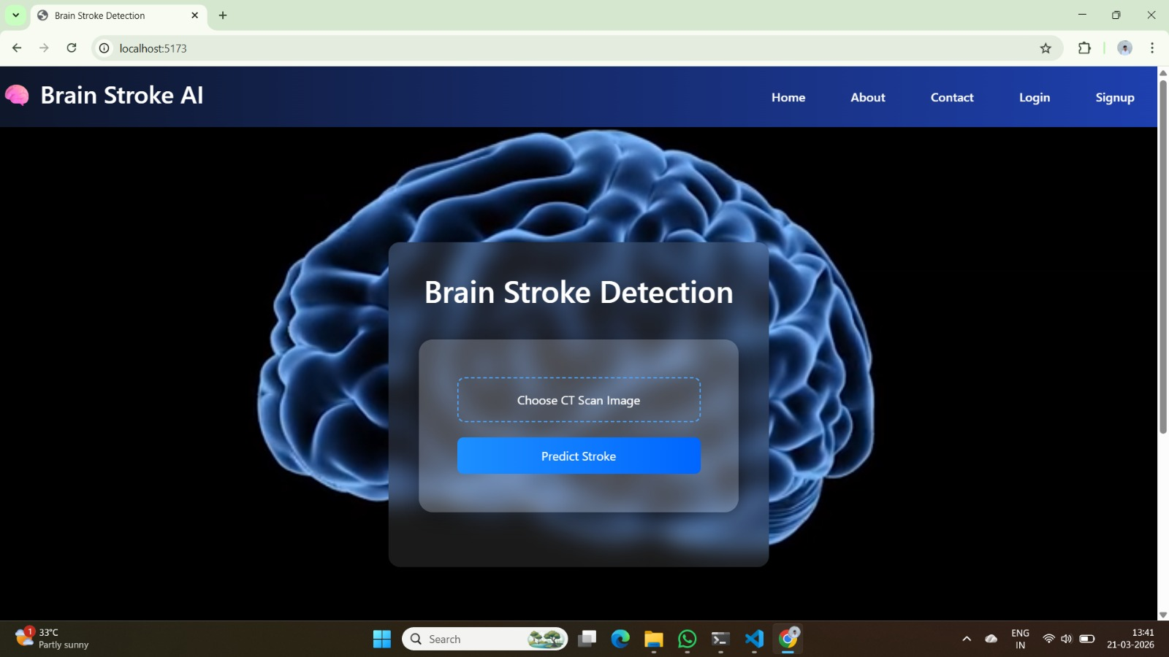
Screens
Home Page:

Slide 17
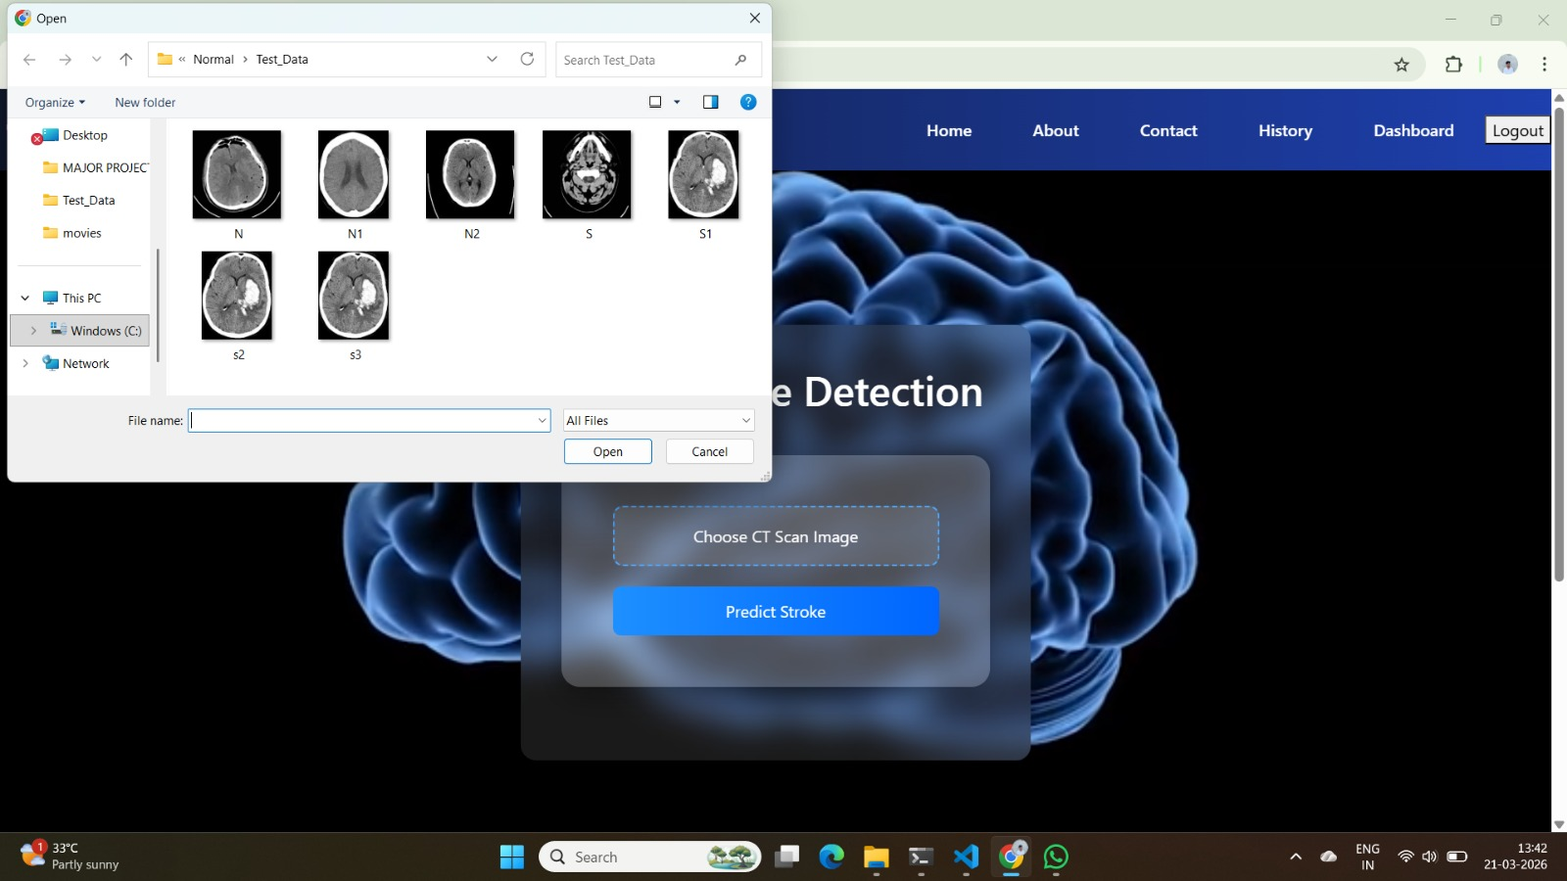
Image Upload and Input Handling:

Slide 18
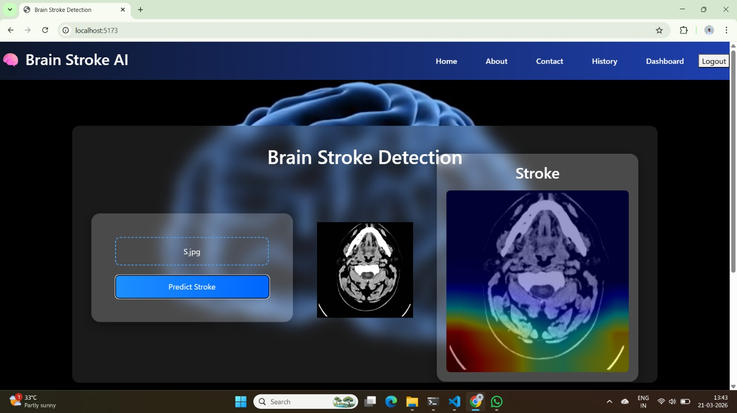
Stroke Prediction Result Interface :

Slide 19
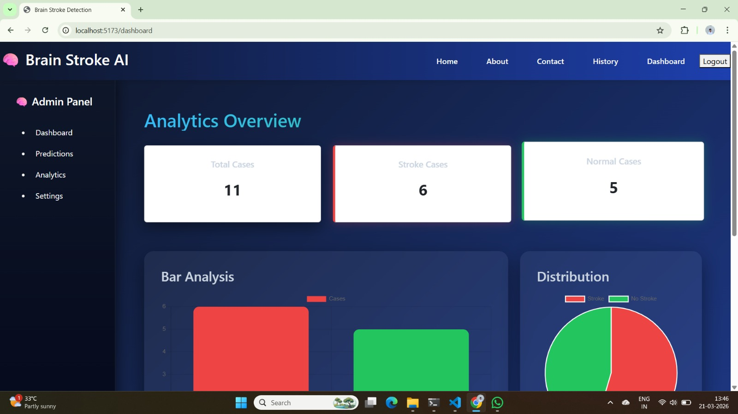
Admin Dashboard and Analytics:

Slide 20
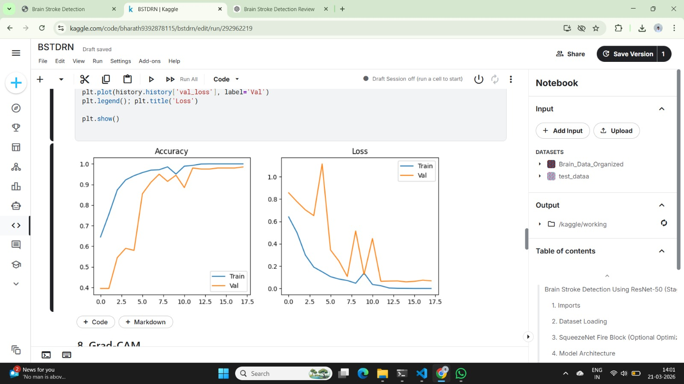
Accuracy Graph:

Slide 21
Loss Graph:

Slide 22
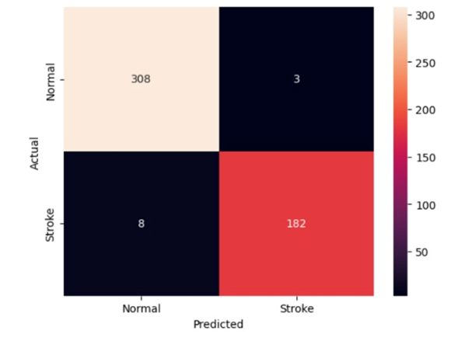
Confusion Matrix:

Slide 23
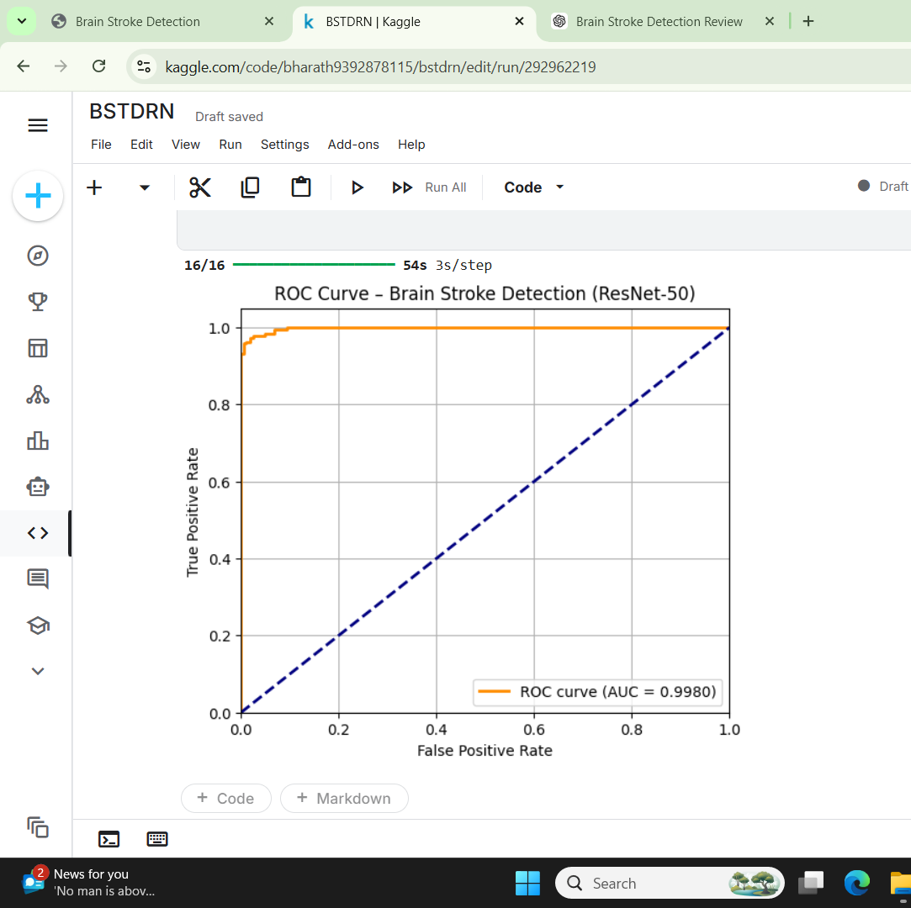
ROC Curves:

Slide 24
Results & Performance Analysis
Overall Accuracy:98.50%
Classification Report:
Class | Precision | Recall | F1-Score | Support
0 | 0.97 | 0.99 | 0.98 | 311
1 | 0.98 | 0.96 | 0.97 | 190

Slide 25
Comparsion with Existing Methods
Model | Accuracy | Precision | Recall | F1-Score | AUC
CNN | 0.97 | 0.96 | 0.92 | 0.94 | 0.94
VGG16 | 0.94 | 0.93 | 0.92 | 0.92 | 0.96
MobileNet | 0.96 | 0.95 | 0.94 | 0.94 | 0.97
ResNet50 (Proposed) | 0.98 | 0.98 | 0.97 | 0.98 | 0.99

Slide 26
Conclusion & Future Scope
Conclusion:
Designed and implemented an efficient brain stroke detection system using ResNet50 and deep learning techniques
Achieved strong classification performance with high accuracy and reliability on CT scan data
Effective preprocessing played a key role in improving model performance
Demonstrates the potential of AI in supporting early stroke detection and medical decision-making

Slide 27
Limitations of the Developed Project:
Performance may vary on unseen or real-world datasets
Accurate results depend on proper image preprocessing
Training is computationally intensive for large datasets
Scalability is limited without further optimization and deployment

Slide 28
Future Scope:
Utilize larger and real-time datasets to enhance model accuracy and robustness
Explore advanced deep learning architectures for improved performance
Develop a scalable web/mobile platform for real-world deployment
Integrate with healthcare systems for real-time monitoring and clinical use

Slide 29
References
[1] X. Hou, Y. Li, H. Wang, and Q. Li, “Deep learning based early detection of stroke using CT brain images,” IEEE Access, vol. 9, pp. 123456–123467, 2021.
[2] B. Tasci, O. Yildirim, and U. R. Acharya, “Automated detection of ischemic stroke using deep learning techniques and CT imaging,” Biomedical Signal Processing and Control, vol. 78, 2023.
[3] M. Gheibi, H. Khodadadi, and A. Mohammadi, “Deep residual convolutional neural networks for medical image classification and stroke detection,” Computer Methods and Programs in Biomedicine, vol. 220, 2023.
[4] S. Kulathilake, P. Jayawardena, and T. Fernando, “Hybrid deep learning models for brain stroke detection using medical imaging,” International Journal of Medical Informatics, vol. 172, 2025.
[5] S. Raj, P. Kumar, and A. Verma, “Artificial intelligence based systems for stroke diagnosis using CT brain scans,” Journal of Healthcare Engineering, vol. 2025, Article ID 987654, 2025.
[6] K. He, X. Zhang, S. Ren, and J. Sun, “Deep residual learning for image recognition,” in Proc. IEEE Conf. Computer Vision and Pattern Recognition (CVPR), 2016, pp. 770–778.

Slide 30
References
[7] F. Iandola, S. Han, M. Moskewicz, K. Ashraf, W. Dally, and K. Keutzer, “SqueezeNet: AlexNet-level accuracy with 50× fewer parameters and <0.5 MB model size,” arXiv preprint arXiv:1602.07360, 2016.
[8] F. Chollet, “Keras: Deep learning library for Python,” GitHub repository, 2015. [Online]. Available: https://keras.io
[9] M. Abadi et al., “TensorFlow: Large-scale machine learning on heterogeneous systems,” Google Research, 2016. [Online]. Available: https://www.tensorflow.org

Slide 31
Thank You

