Slide 1
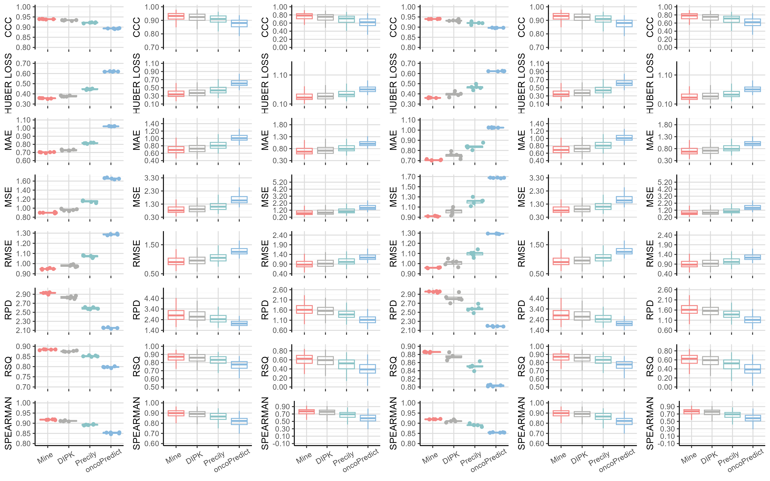
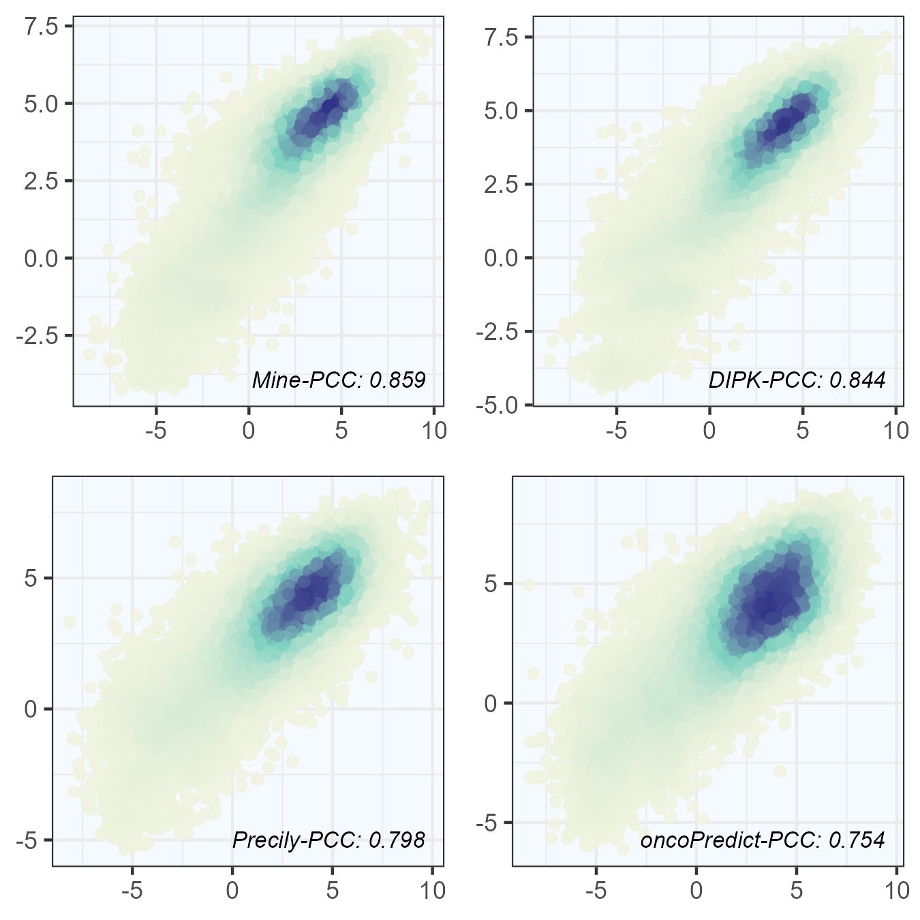
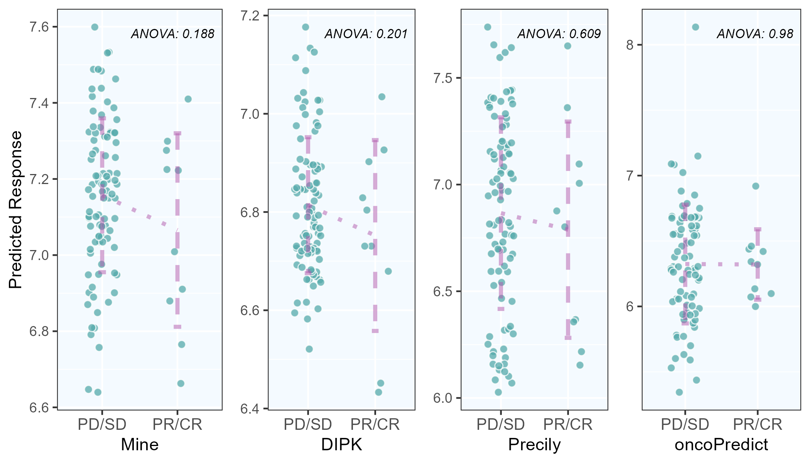
A
CCLE Dataset
GDSC Dataset
C-V
Cell
Drug
C-V
Cell
Drug
B
C
Predicted LN IC50
Measured LN IC50

