Slide 1

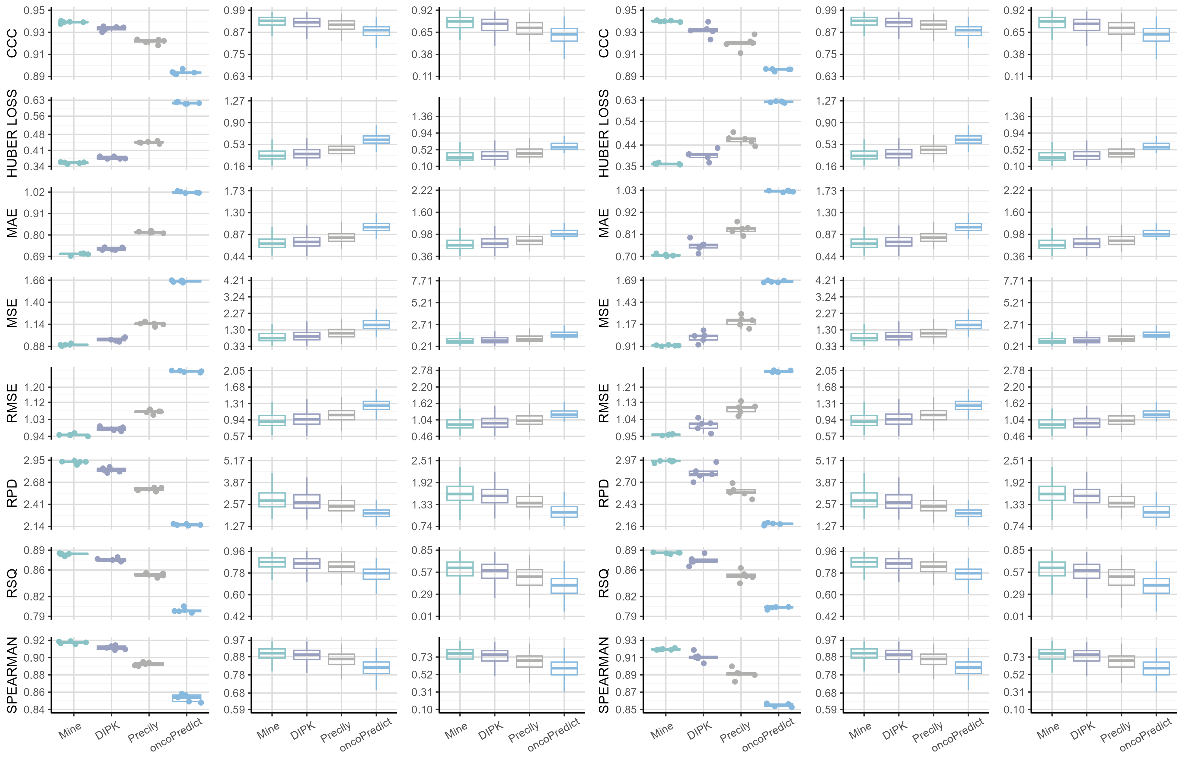
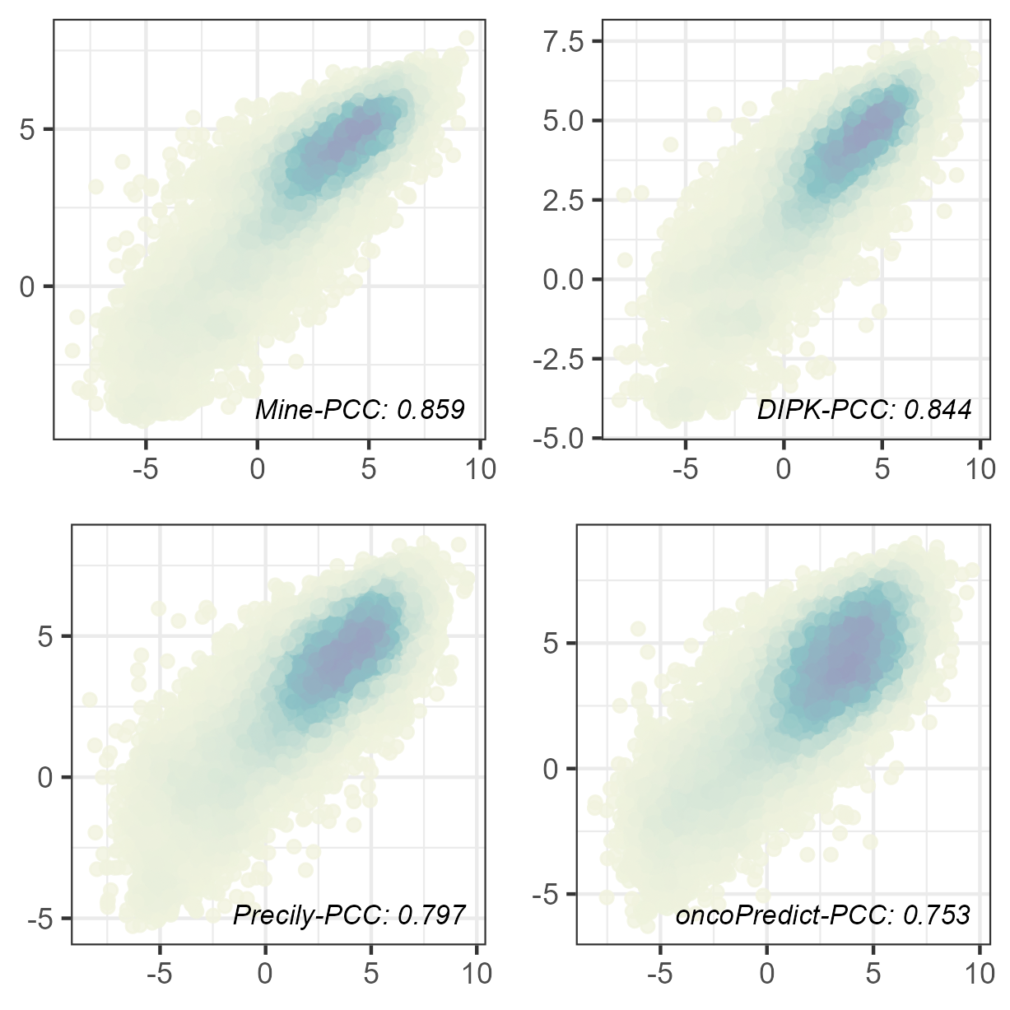
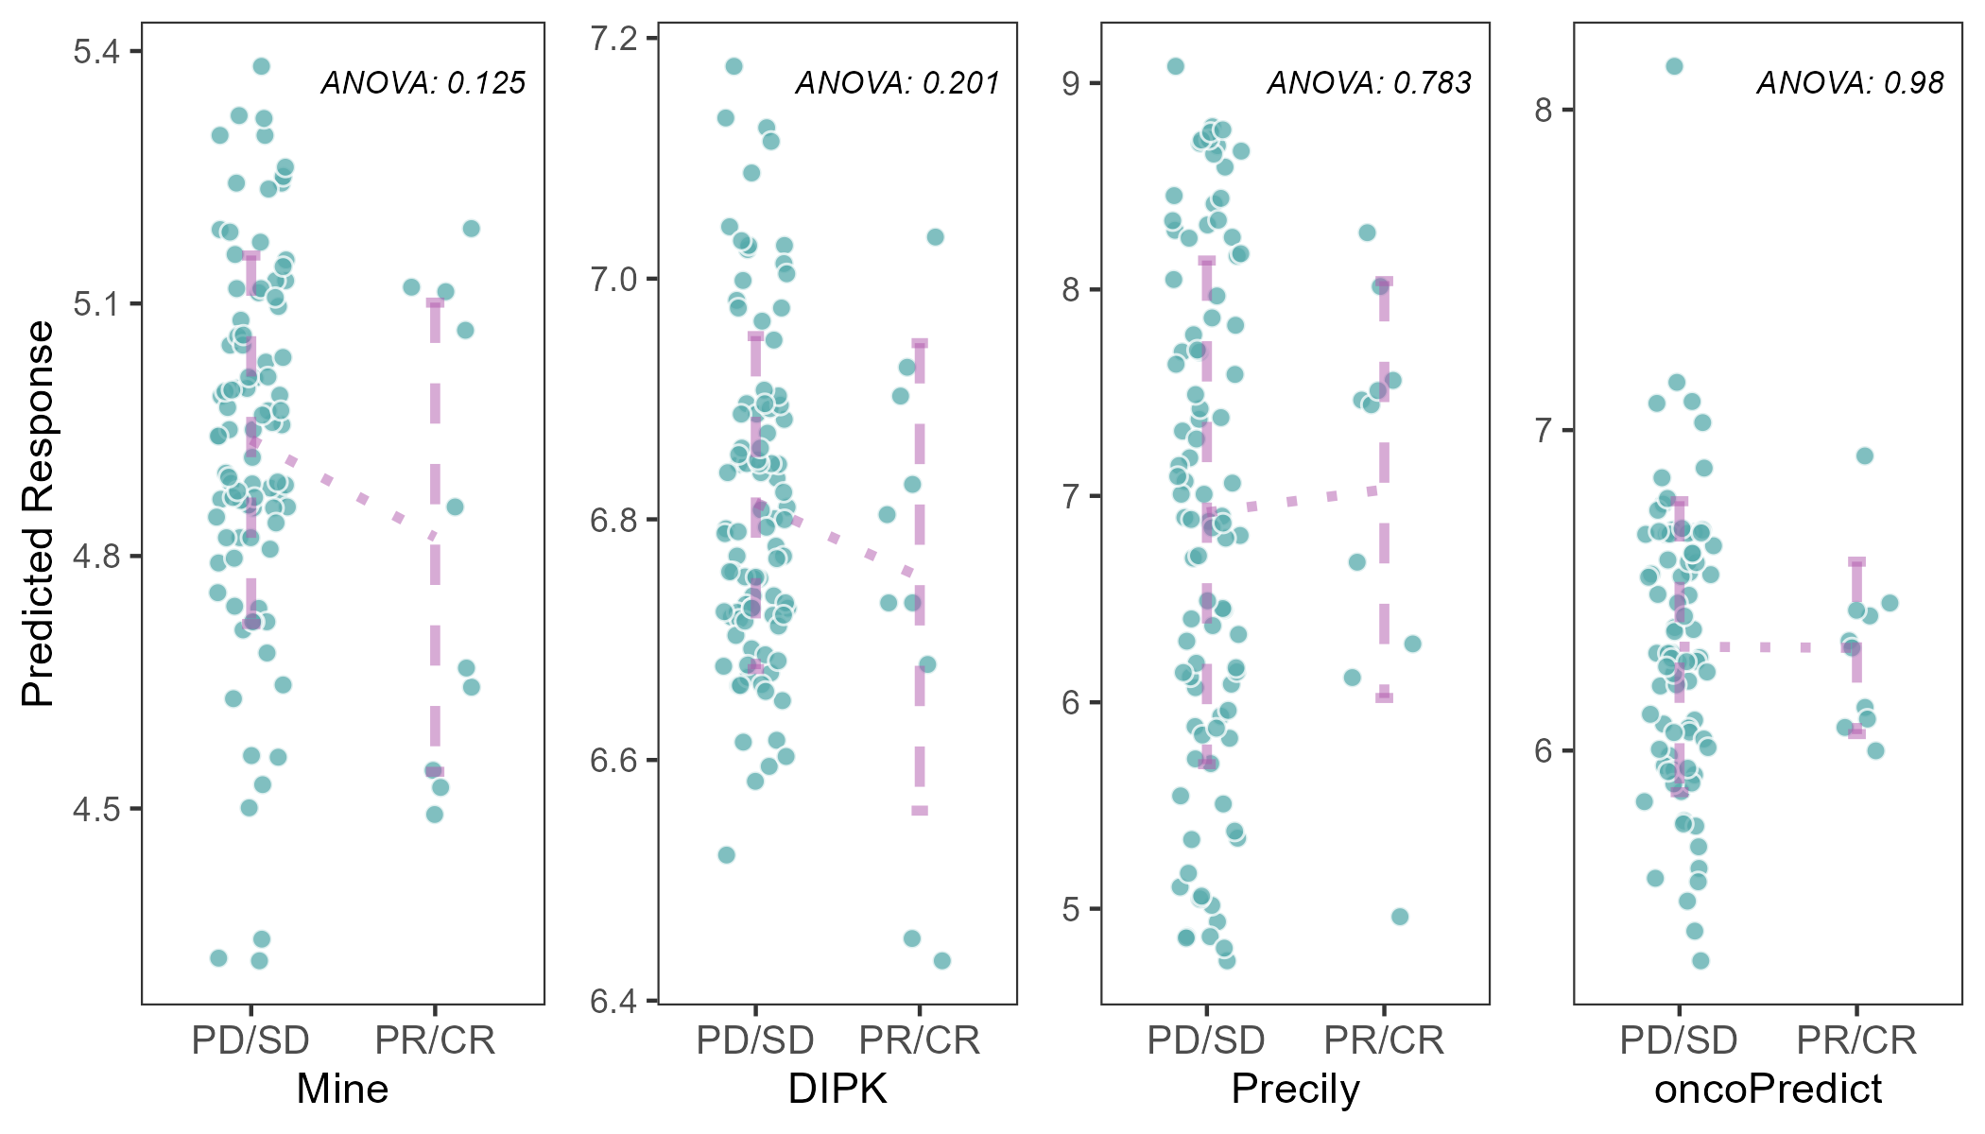
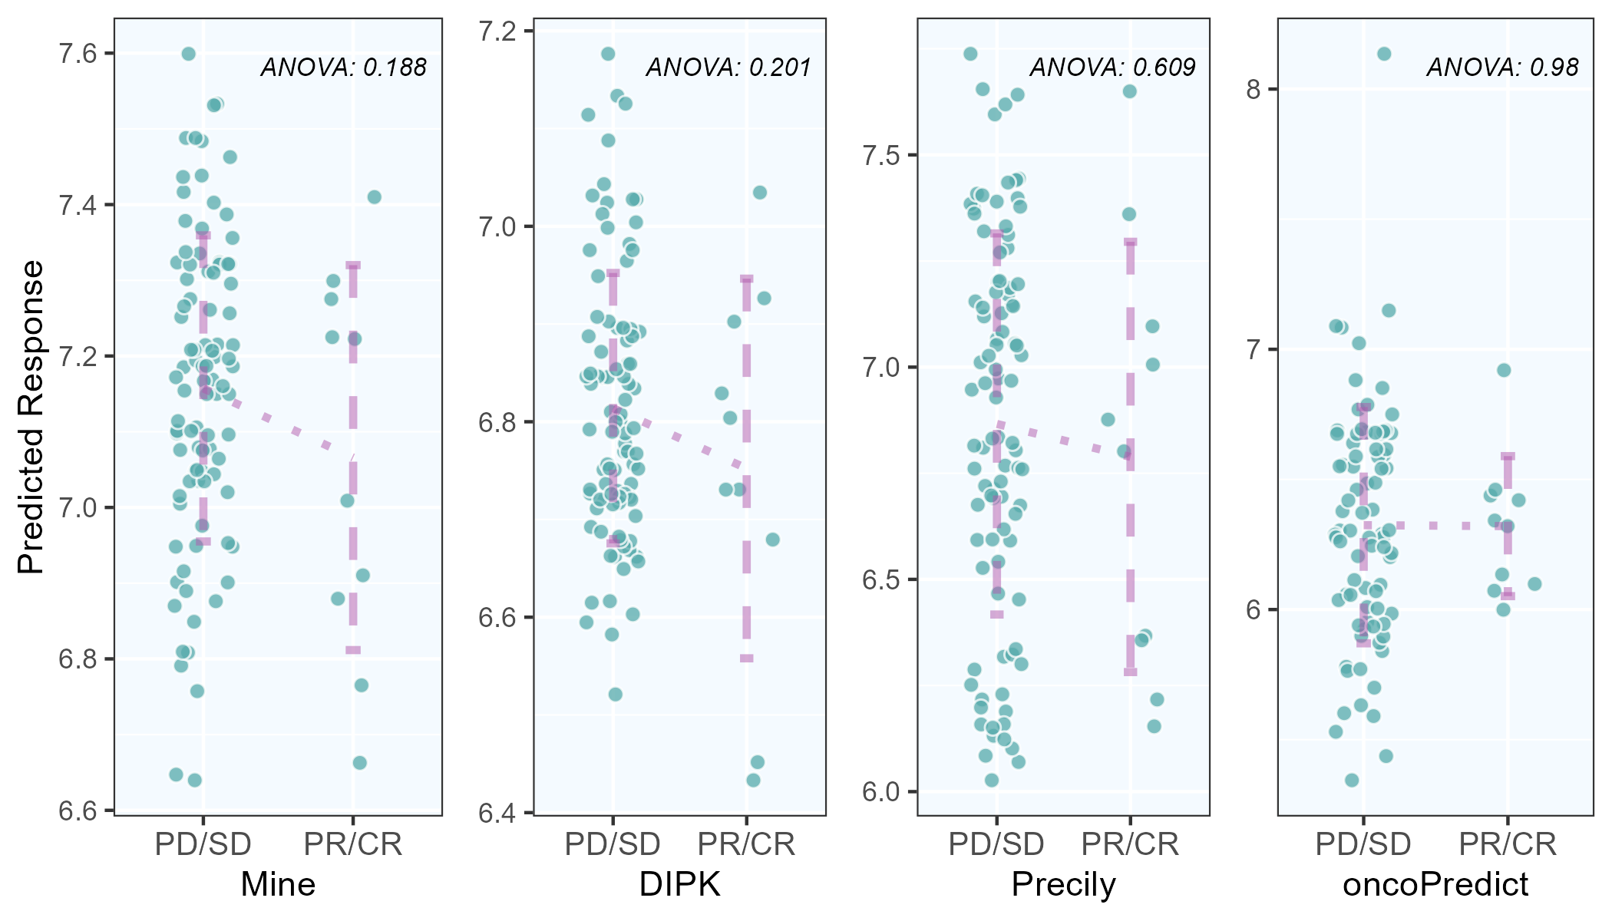
A
B
Benchmarking Performance of Mine Framework based on Five-Fold Cross-Validation
CCLE Dataset
GDSC Dataset
C-V
Cell
Drug
C-V
Cell
Drug
C
D
Testing Performance and Case Study of Mine Framework on Real-World Situations
Predicted LN IC50
Measured LN IC50

Slide 2
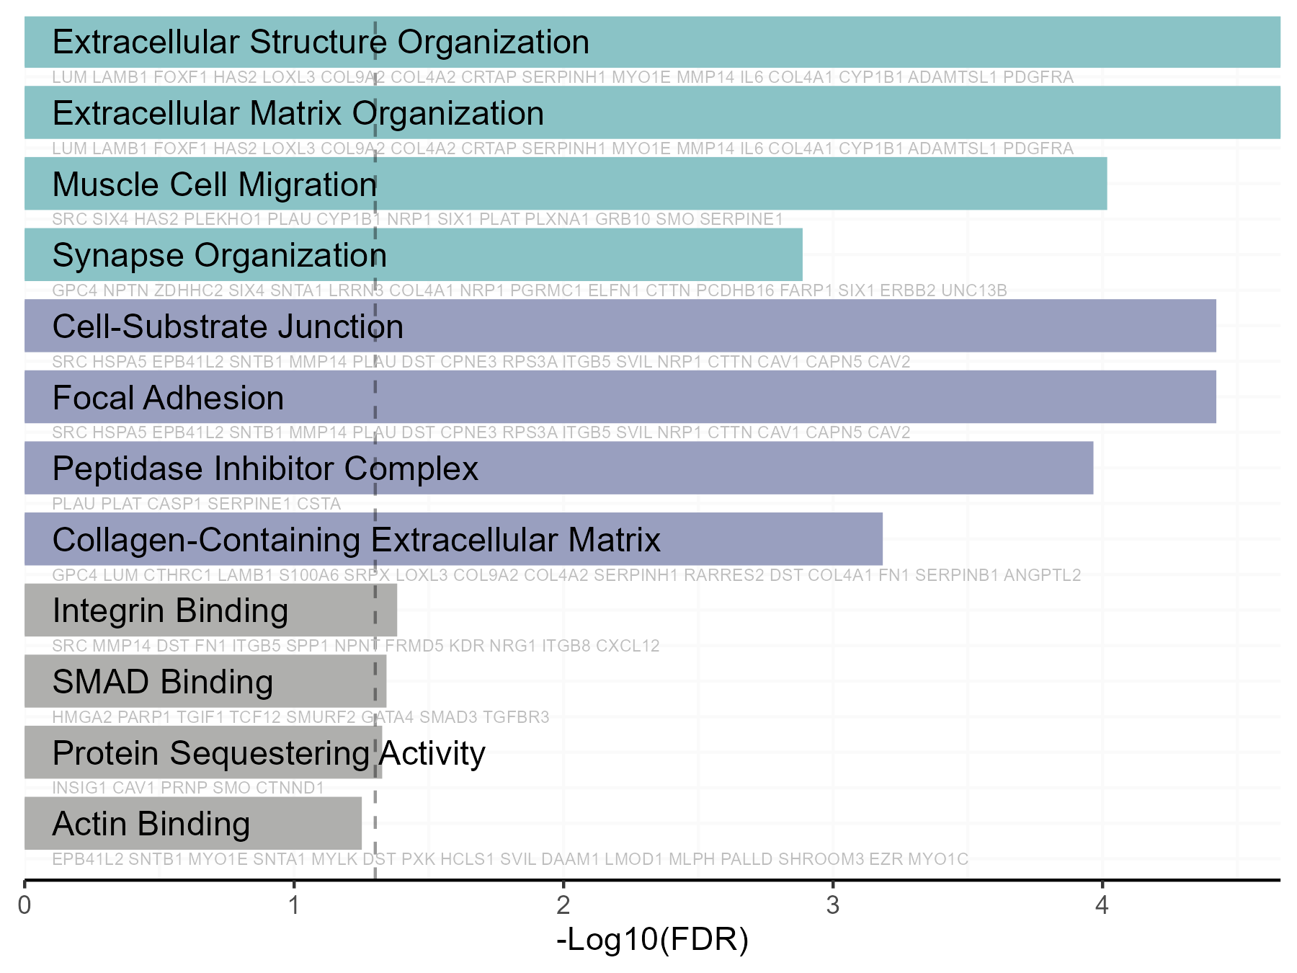
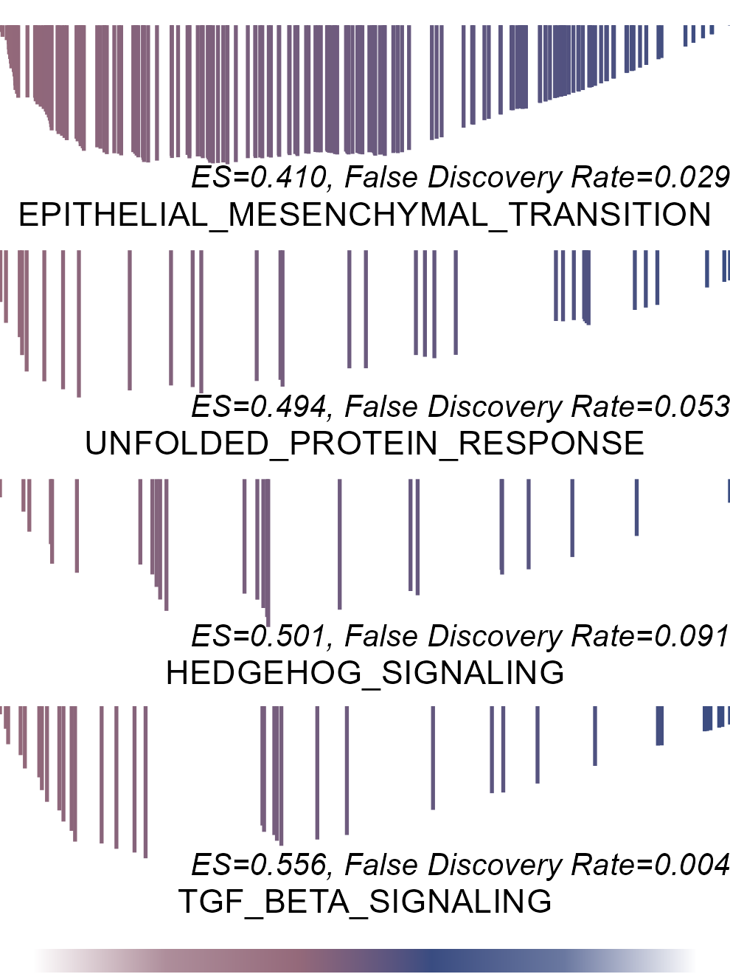
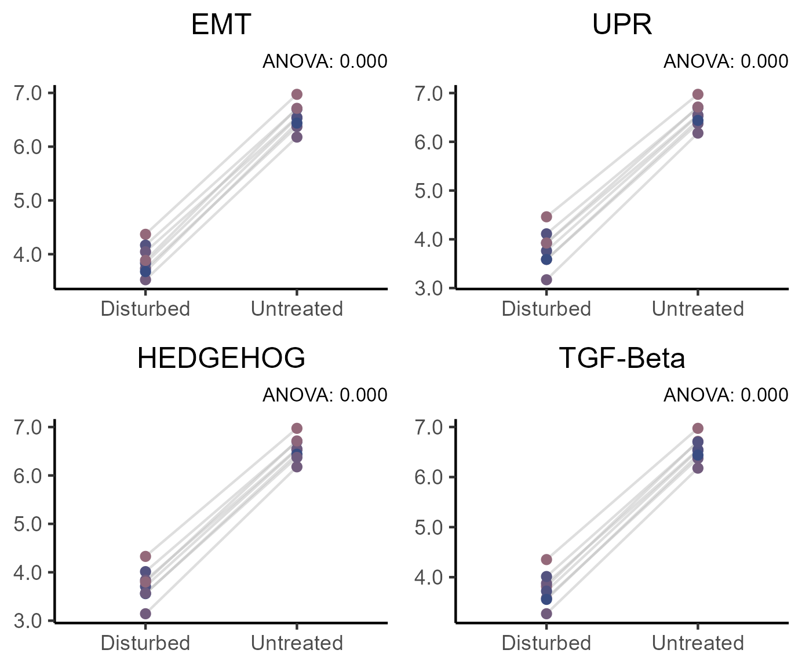
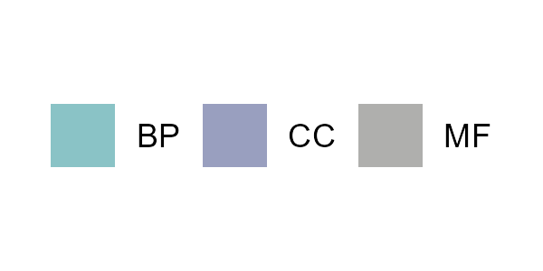
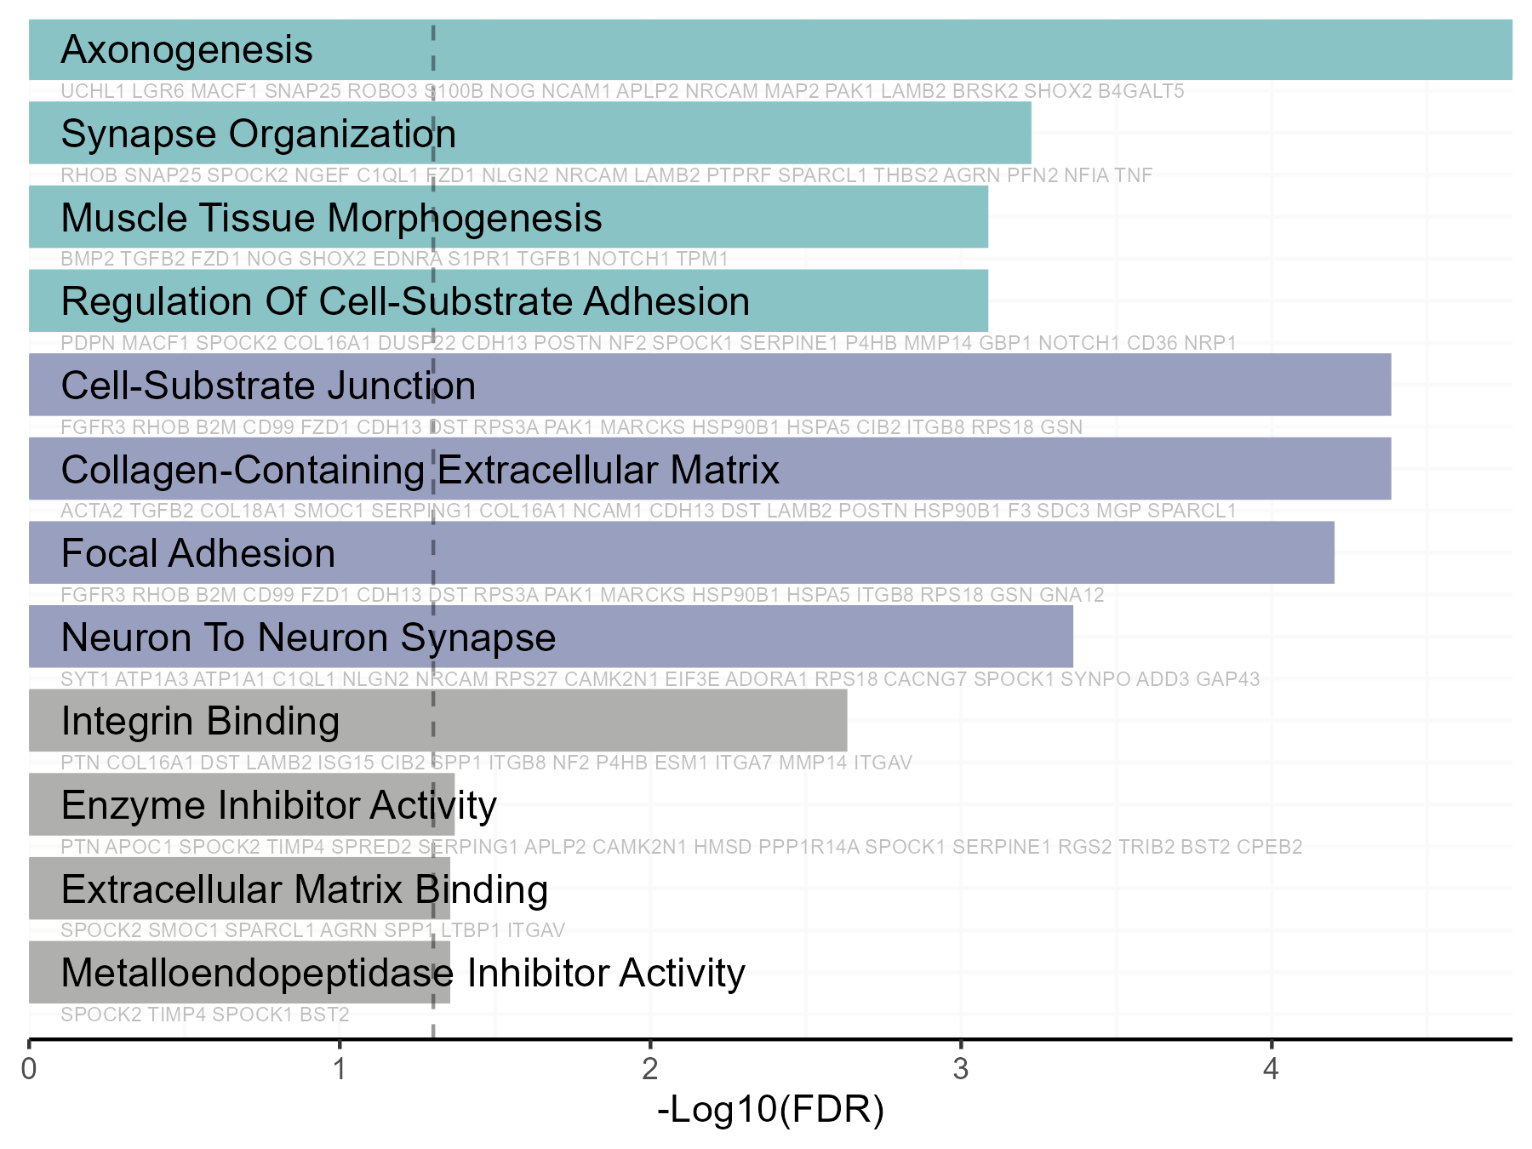
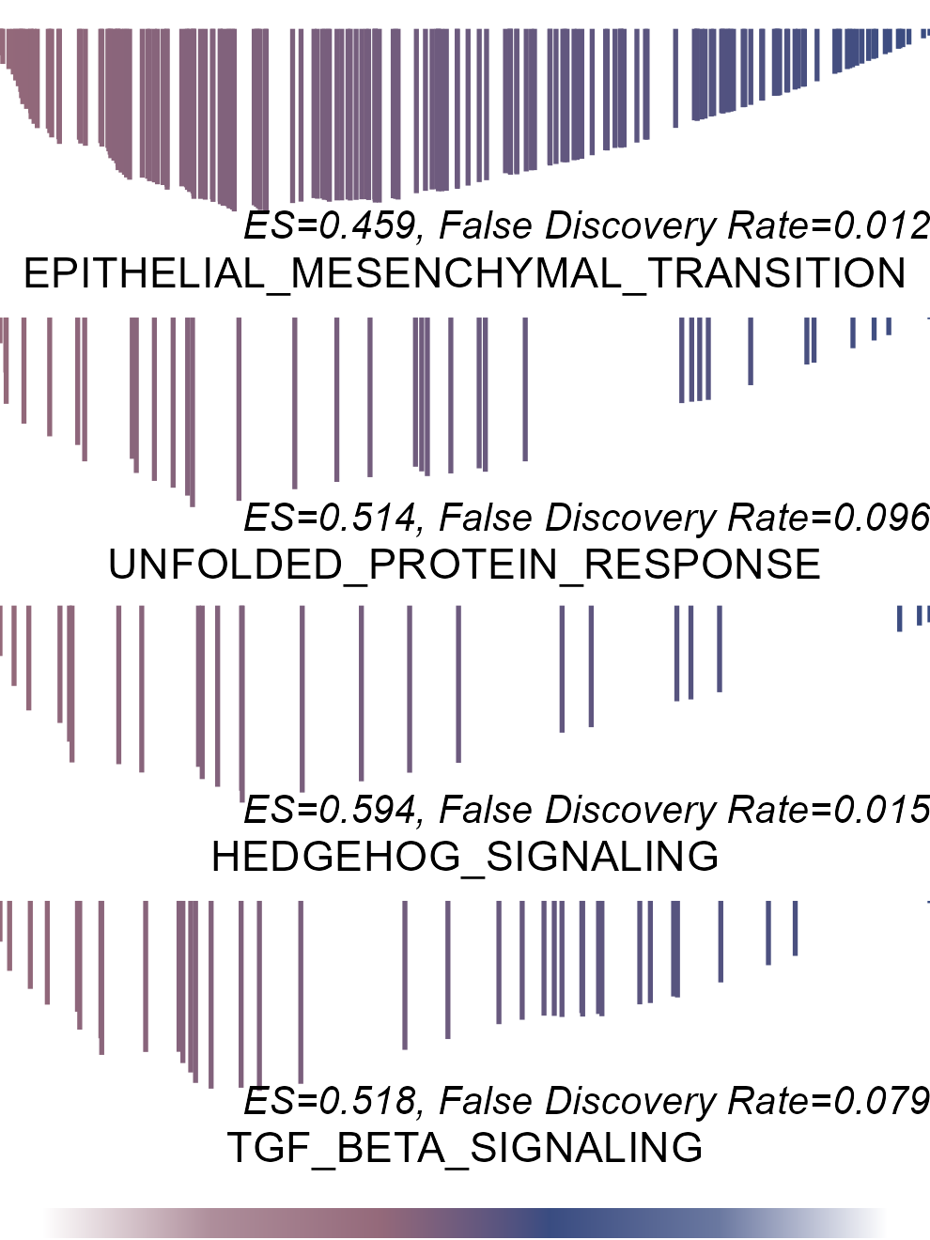
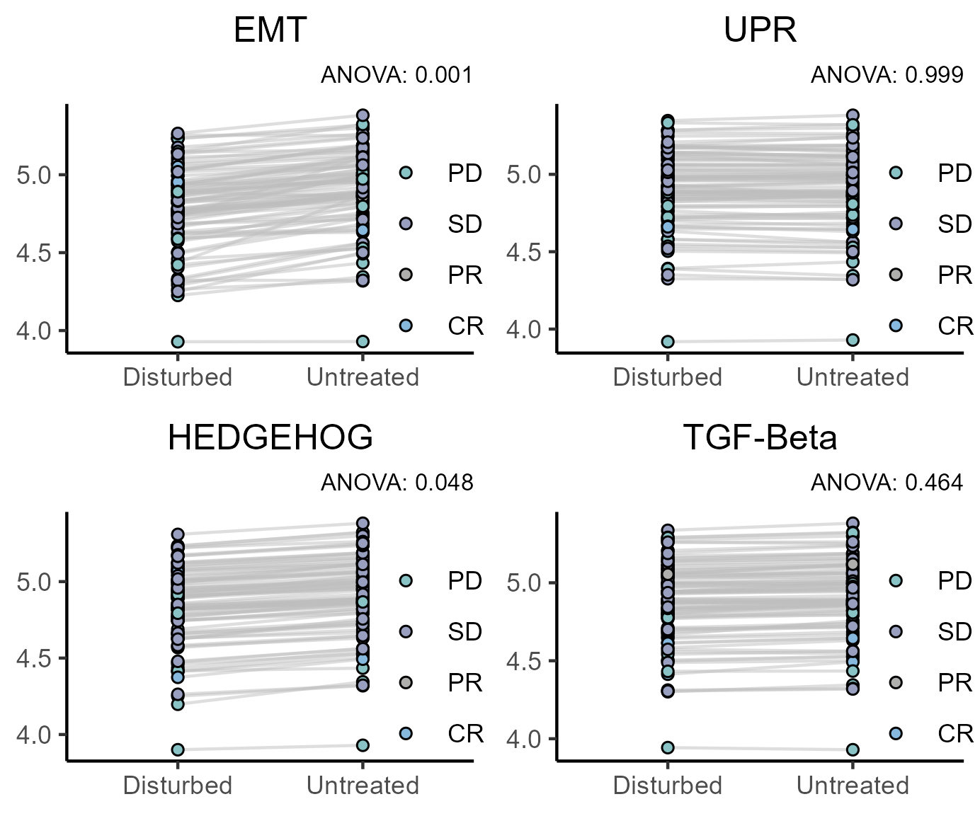
A
B
C
GDSC
Disturbed
Stable
D
E
F
TCGA
Disturbed
Stable

Slide 3
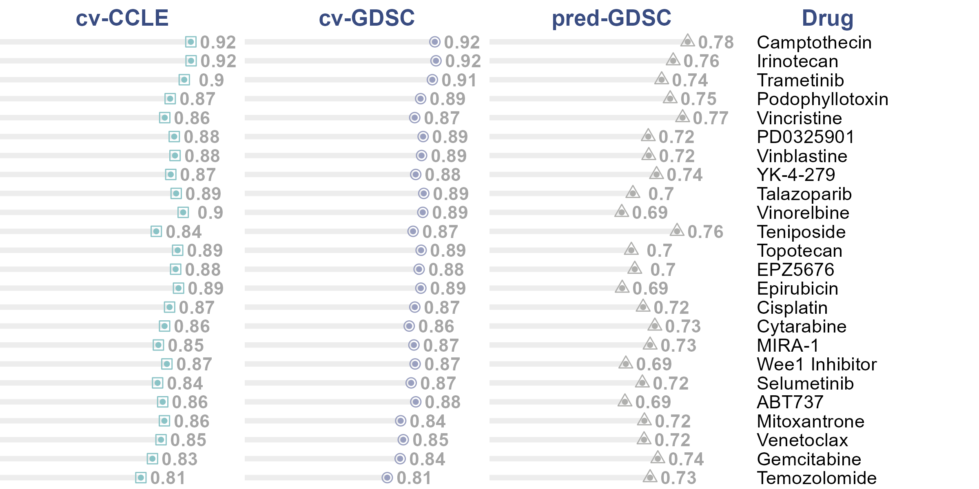

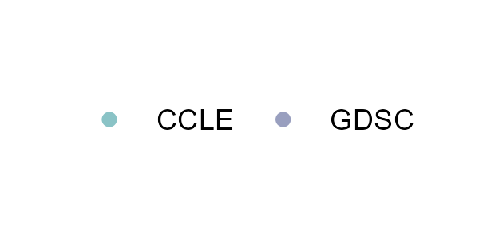
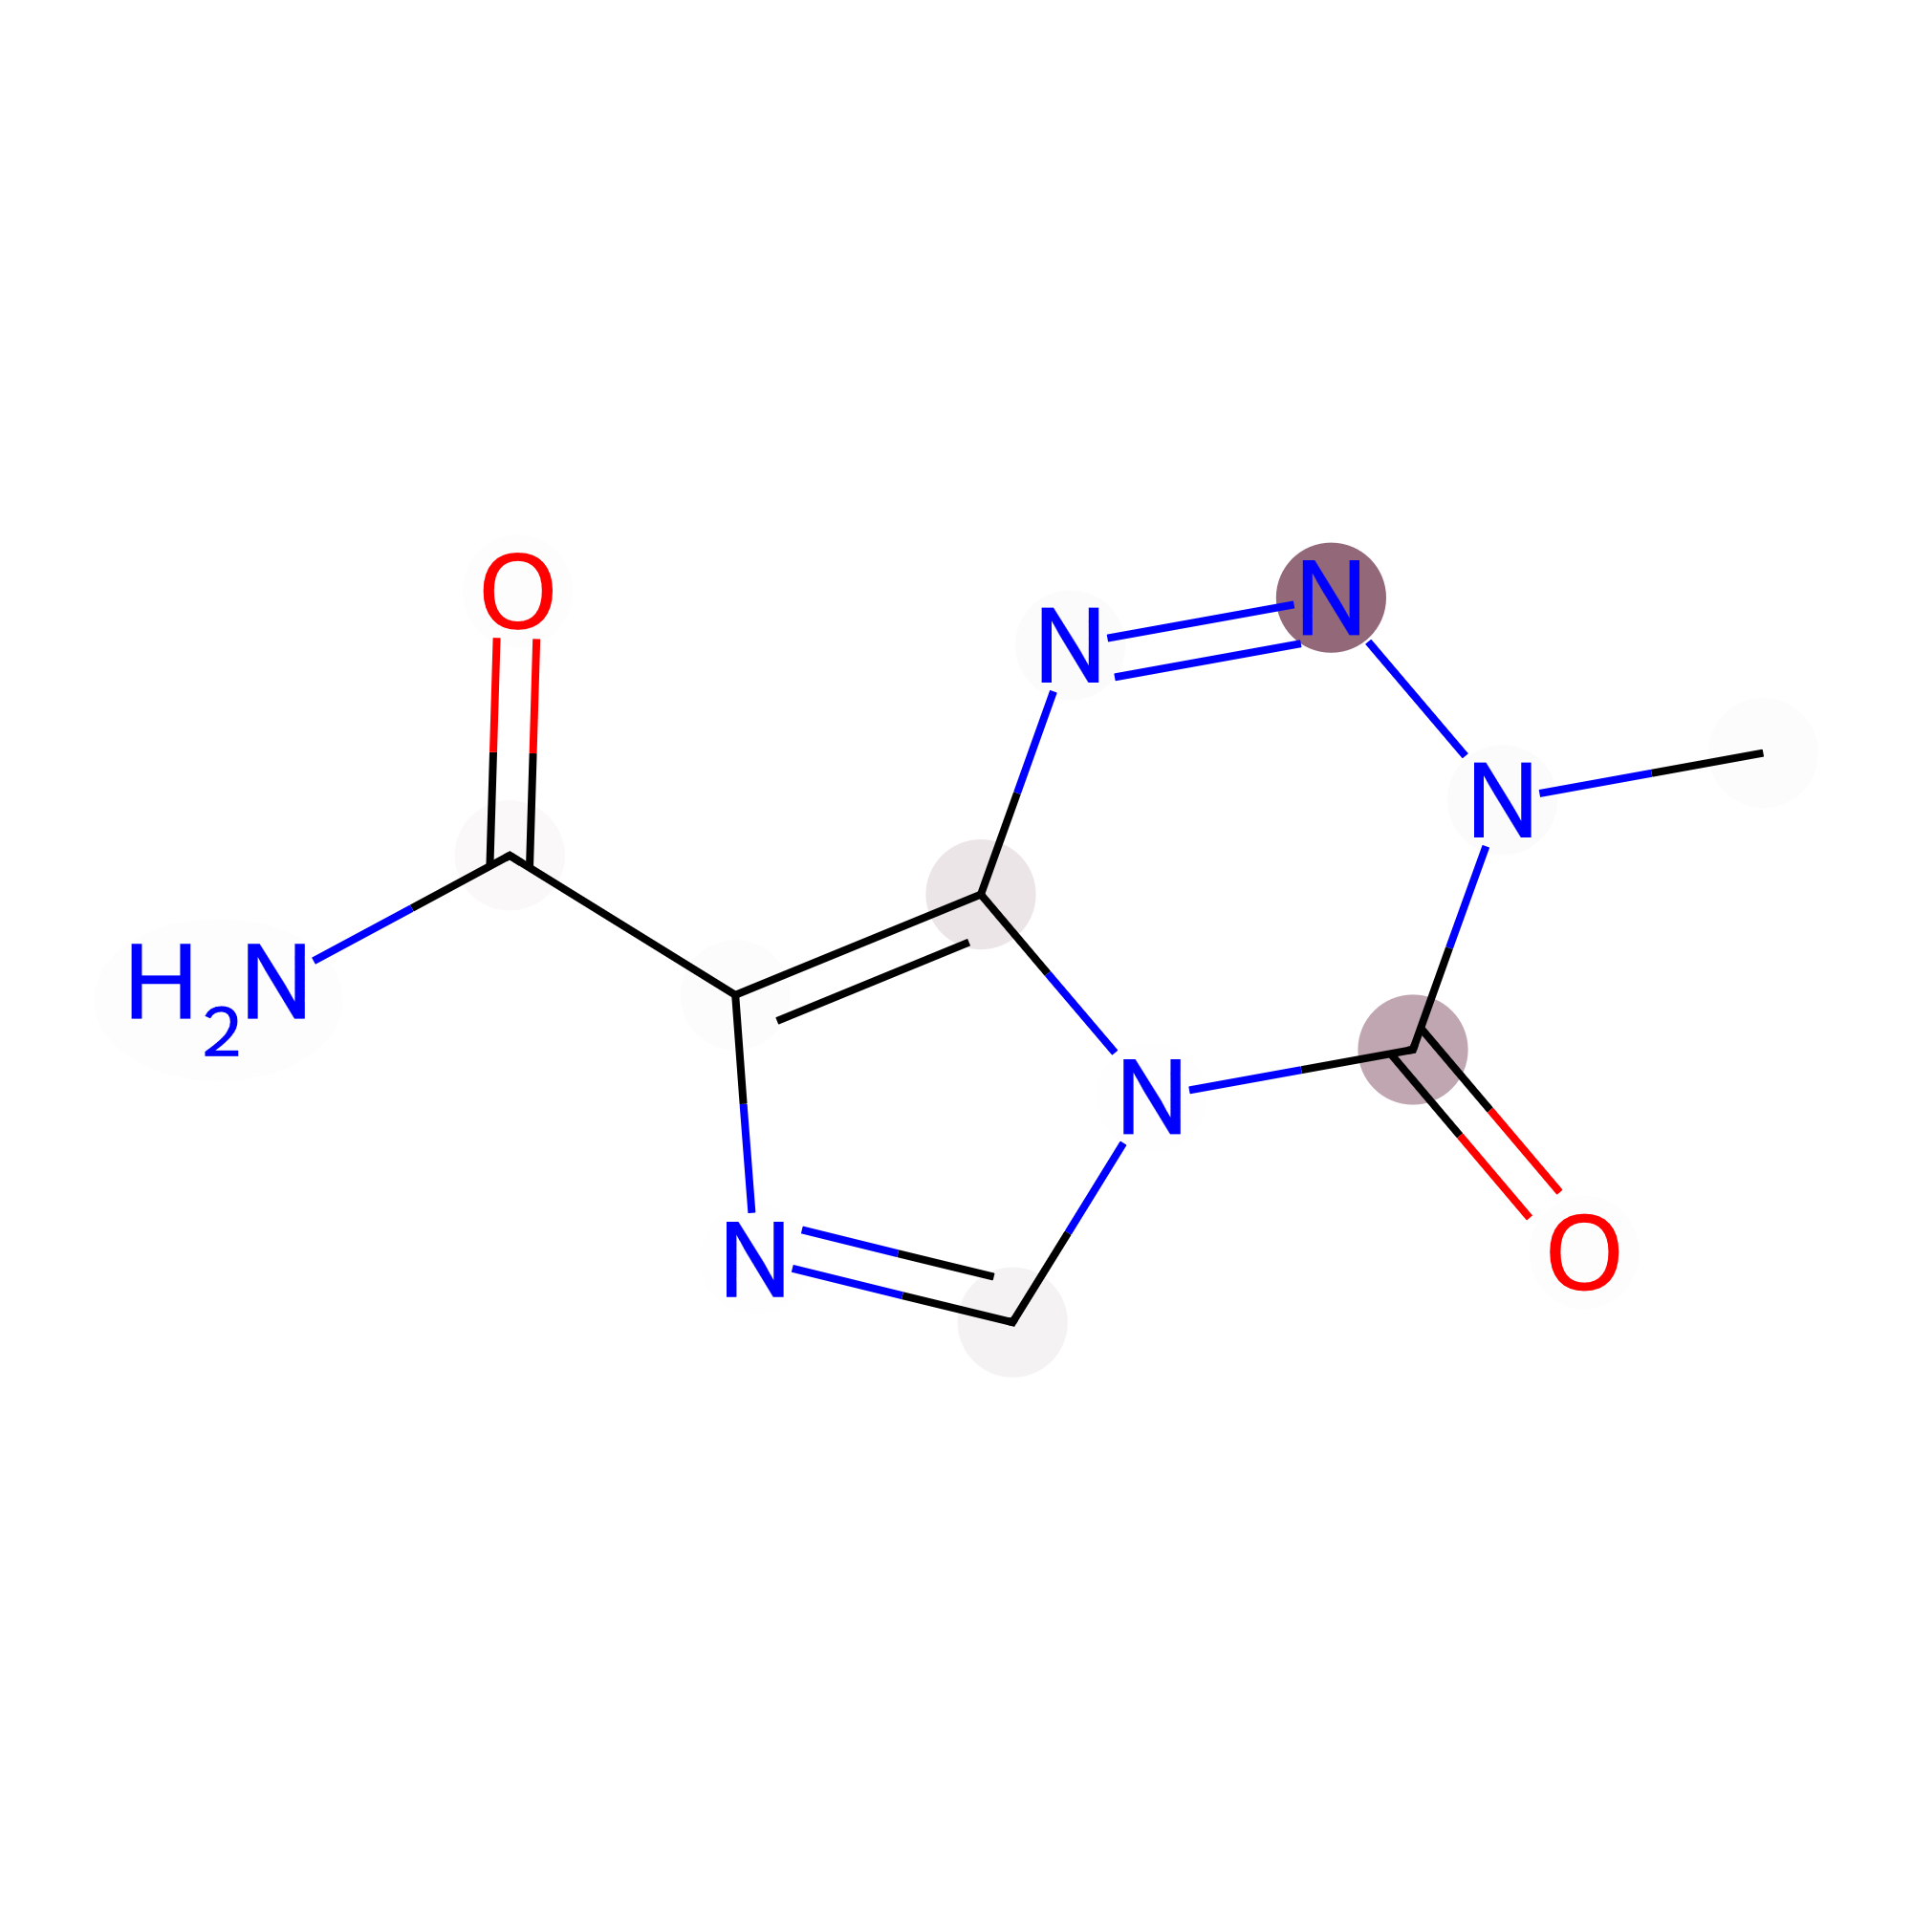

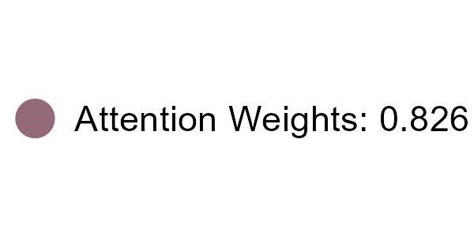





A
B
C
Consistency between the predicted value of virtual screening by Mine and GDSC tests
D
Captured by All Samples
in CCLE
Captured by Sensitive Samples
in CCLE
Captured by All Samples
in GDSC
Captured by Sensitive Samples
in GDSC

