Slide 1
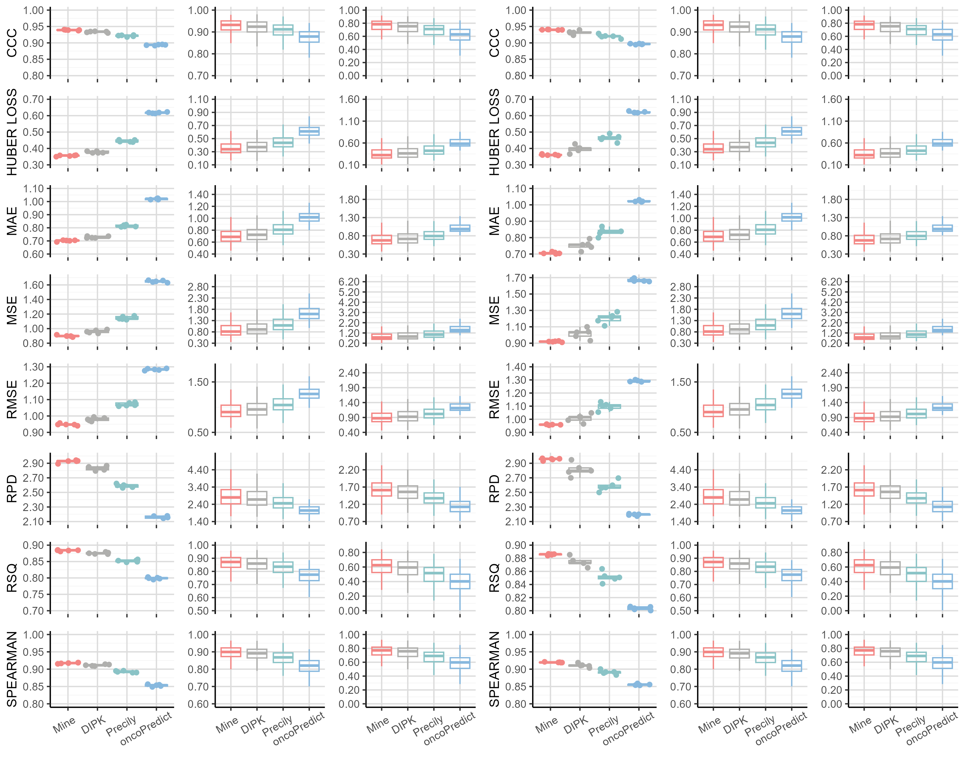
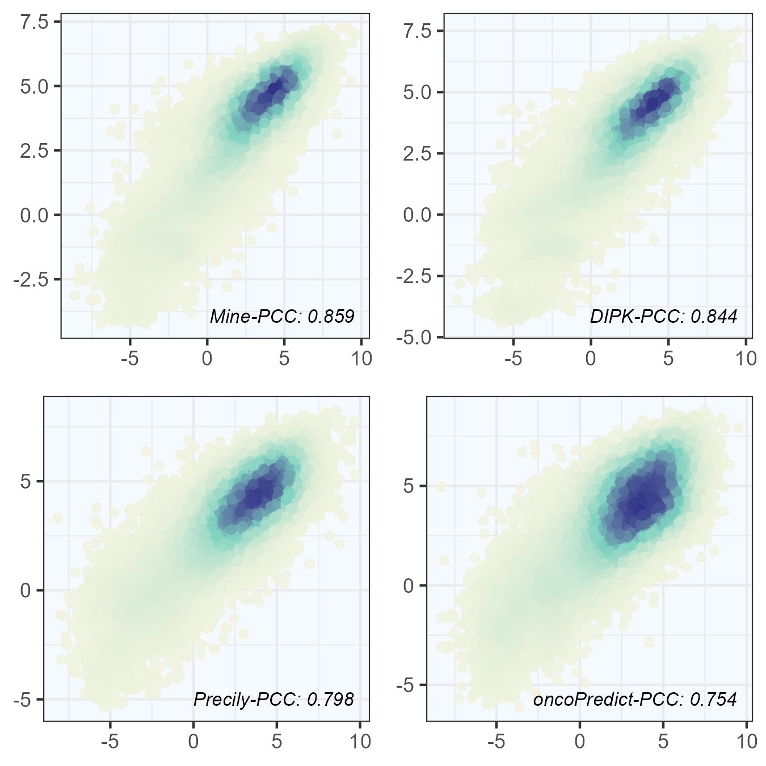
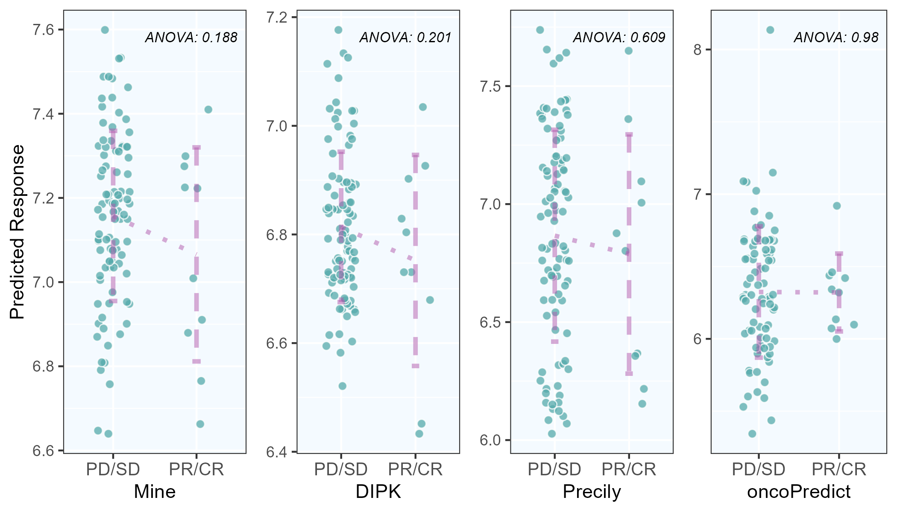
A
Benchmarking Mine Framework using five-fold cross-validation
CCLE Dataset
GDSC Dataset
C-V
Cell
Drug
C-V
Cell
Drug
B
C
Predictive performance in real-world situations and case studies
Predicted LN IC50
Measured LN IC50

