Slide 1

Predicting Customer Churn in a Telecom Company
Vinutha Hiremath (4477)
108b Batch
​

Slide 2
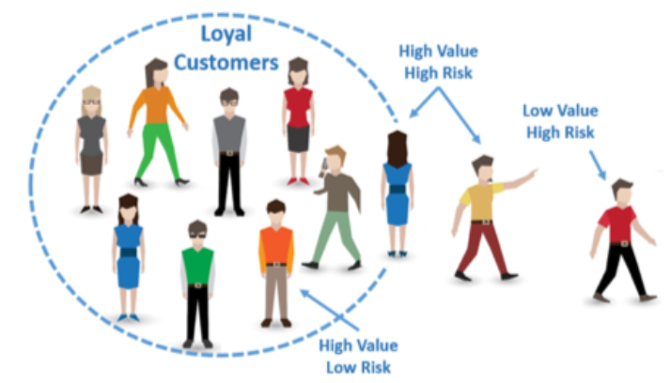
Problem Statement
A telecom company is facing a high customer churn rate and wants to reduce it.
Customer churn refers to the process where a customer stops doing business with a
company. In the telecom industry, customer churn is a major problem as acquiring new customers is more expensive than retaining existing customers. The company wants to use machine learning to predict which customers are likely to churn so that they can take proactive measures to retain them.

Slide 3




Steps of the Project
Reading the data.
Exploratory data analysis and cleaning.
Data Visualization.
Feature Engineering.
Splitting the dataset.
6. Model training with Algorithms.
7. Hyperparameter Tuning and model selection.
8. Docker Image Creation.
9. Jenkins Pipeline.
10. Developing Streamlit app.

Slide 4
Basic understanding from Problem statement
Predicting customer churn is of utmost importance for telecommunication companies as retaining existing customers is more cost-effective than acquiring new ones. Hence, large telecommunications corporations are investing in developing models that can predict which customers are likely to churn and take necessary actions to retain them.
In this , we have built a predictive model by analyzing customer characteristics, including demographic information, account information, and services information. The aim is to provide a data-driven solution that can effectively reduce churn rates, leading to higher customer satisfaction and increased corporation revenue.

Slide 5
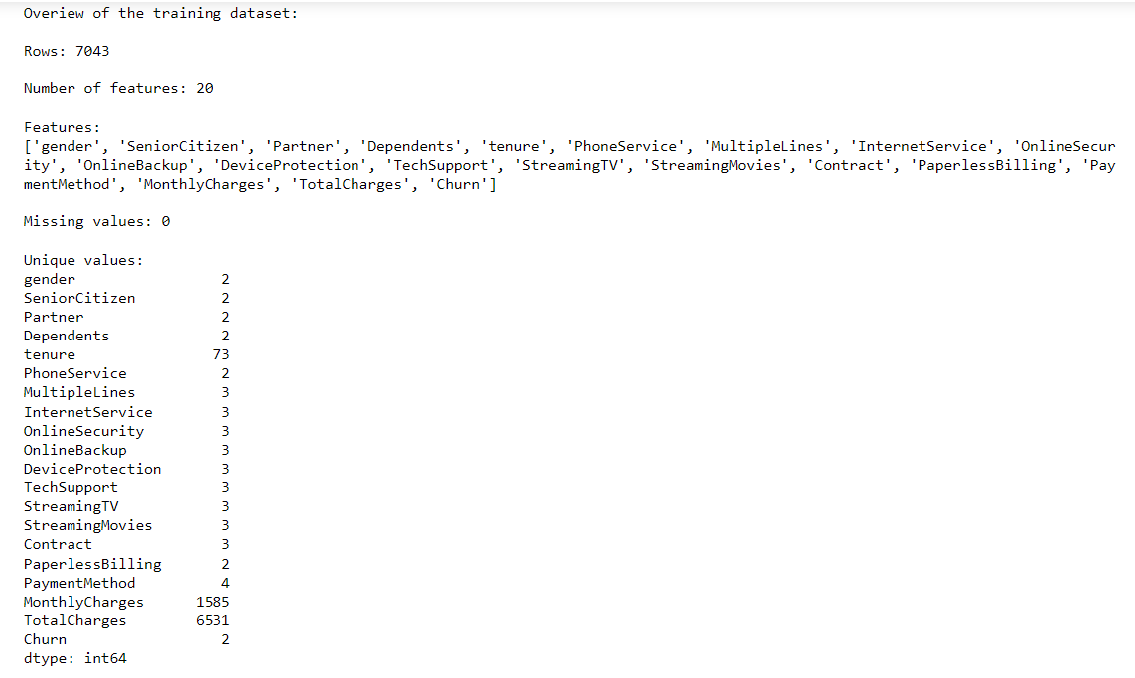

Slide 6
The given Data set can be classified into 3 groups:
Demographic Information
Gender: Whether the client is a female or a male (Female, Male).
Senior Citizen: Whether the client is a senior citizen or not ( 0, 1).
Partner: Whether the client has a partner or not (Yes, No).
Dependents: Whether the client has dependents or not (Yes, No).
(2) Customer Account Information
Tenure: Number of months the customer has stayed with the company (Multiple different numeric values).
Contract: Indicates the customer’s current contract type (Month-to-Month, One year, Two year).
Paperlessbilling: Whether the client has paperless billing or not (Yes, No).
Paymentmethod: The customer’s payment method (Electronic check, Mailed check, Bank transfer (automatic), Credit Card (automatic)).
Montlycharges: The amount charged to the customer monthly (Multiple different numeric values).
Totalcharges: The total amount charged to the customer (Multiple different numeric values).

Slide 7
(3) Services Information
PhoneService: Whether the client has a phone service or not (Yes, No).
MultipleLines: Whether the client has multiple lines or not (No phone service, No, Yes).
InternetServices: Whether the client is subscribed to Internet service with the company (DSL, Fiber optic, No)
OnlineSecurity: Whether the client has online security or not (No internet service, No, Yes).
OnlineBackup: Whether the client has online backup or not (No internet service, No, Yes).
DeviceProtection: Whether the client has device protection or not (No internet service, No, Yes).
TechSupport: Whether the client has tech support or not (No internet service, No, Yes).
StreamingTV: Whether the client has streaming TV or not (No internet service, No, Yes).
StreamingMovies: Whether the client has streaming movies or not (No internet service, No, Yes).

Slide 8
OVERVIEW OF THE TRAINING DATA:

Slide 9
Feature engineering is the process of extracting features from the data and transforming them into a format that is suitable for the machine learning model. In this project, we need to transform both numerical and categorical variables. Most machine learning algorithms require numerical values; therefore, all categorical attributes available in the dataset should be encoded into numerical labels before training the model. In addition, we need to transform numeric columns into a common scale. This will prevent that the columns with large values dominate the learning process. The techniques implemented in this project are described in more detail below. All transformations are implemented using only Pandas; however, we also provide an alternative implementation using Scikit-Learn. As you can see, there are multiple ways to solve the same problem .
Label encoding is used to replace categorical values with numerical values. This encoding replaces every category with a numerical label.
Data Normalization is a common practice in machine learning which consists of transforming numeric columns to a common scale. In machine learning, some feature values differ from others multiple times. The features with higher values will dominate the learning process; however, it does not mean those variables are more important to predict the target. Data normalization transforms multiscaled data to the same scale. After normalization, all variables have a similar influence on the model, improving the stability and performance of the learning algorithm.
In this project, we will use the min-max method to rescale the numeric columns.
Then, we can use the train_test_split function from the sklearn.model_selection package to create both the training and testing sets.

Slide 10
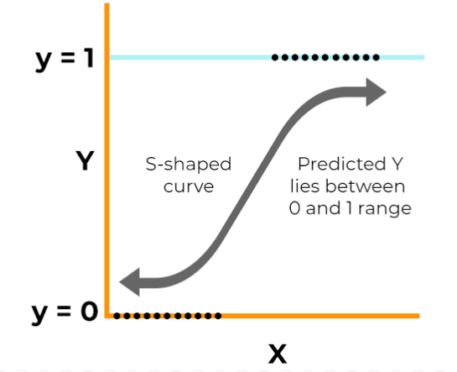
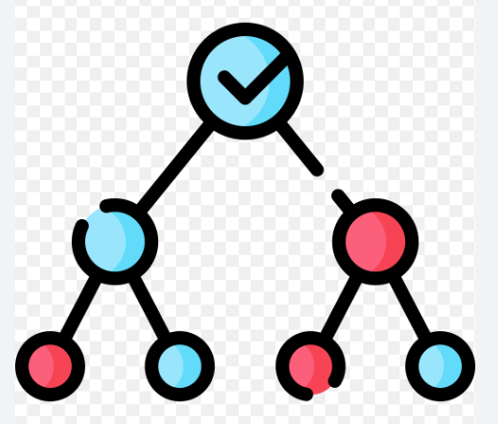
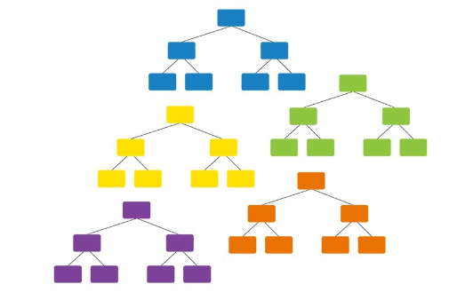
Algorithm selection is a key challenge in any machine learning project since there is not an algorithm that is the best across all projects. Generally, we need to evaluate a set of potential candidates and select for further evaluation those that provide better performance.
Logistic Regression
Decision Tree
Random Forest

Slide 11

ALGORITHM 1
Logistic Regression
Before Hyperparameter
Tuning
After Hyperparameter
Tuning
​
Accuracy: 0.7980121386727523
Precision: 0.6792452830188679
Recall: 0.579088471849866
F1 Score: 0.6251808972503617

Slide 12


ALGORITHM 2​
Decision Tree
Before Hyperparameter
Tuning
After Hyperparameter
Tuning
​

Slide 13


ALGORITHM 3
Random Forest
Before Hyperparameter
Tuning
After Hyperparameter
Tuning
​
Best hyperparameters
'max_depth': 10, 'min_samples_leaf': 4, 'min_samples_split': 10, 'n_estimators': 50}

Slide 14

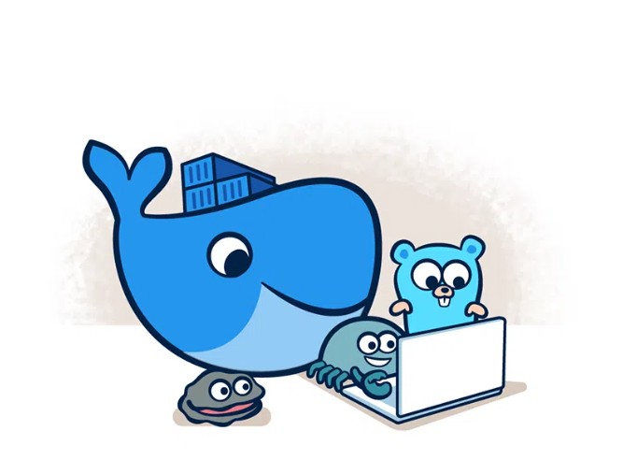

What is Docker and it’s use?
Docker is a software platform that allows you to build, test, and deploy applications quickly. Docker packages software into standardized units called containers that have everything the software needs to run including libraries, system tools, code, and runtime.
Build
Share
Run

Slide 15
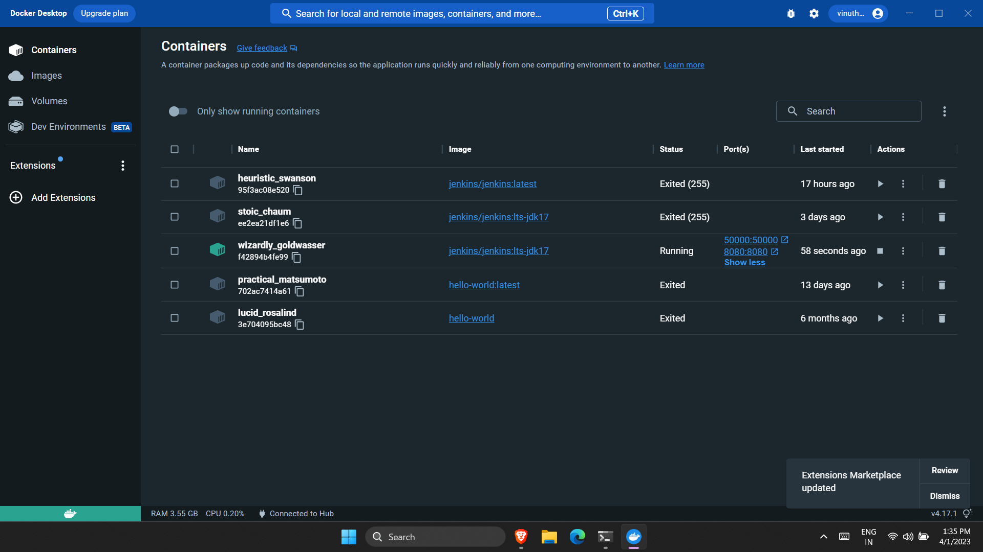
Docker Container

Slide 16
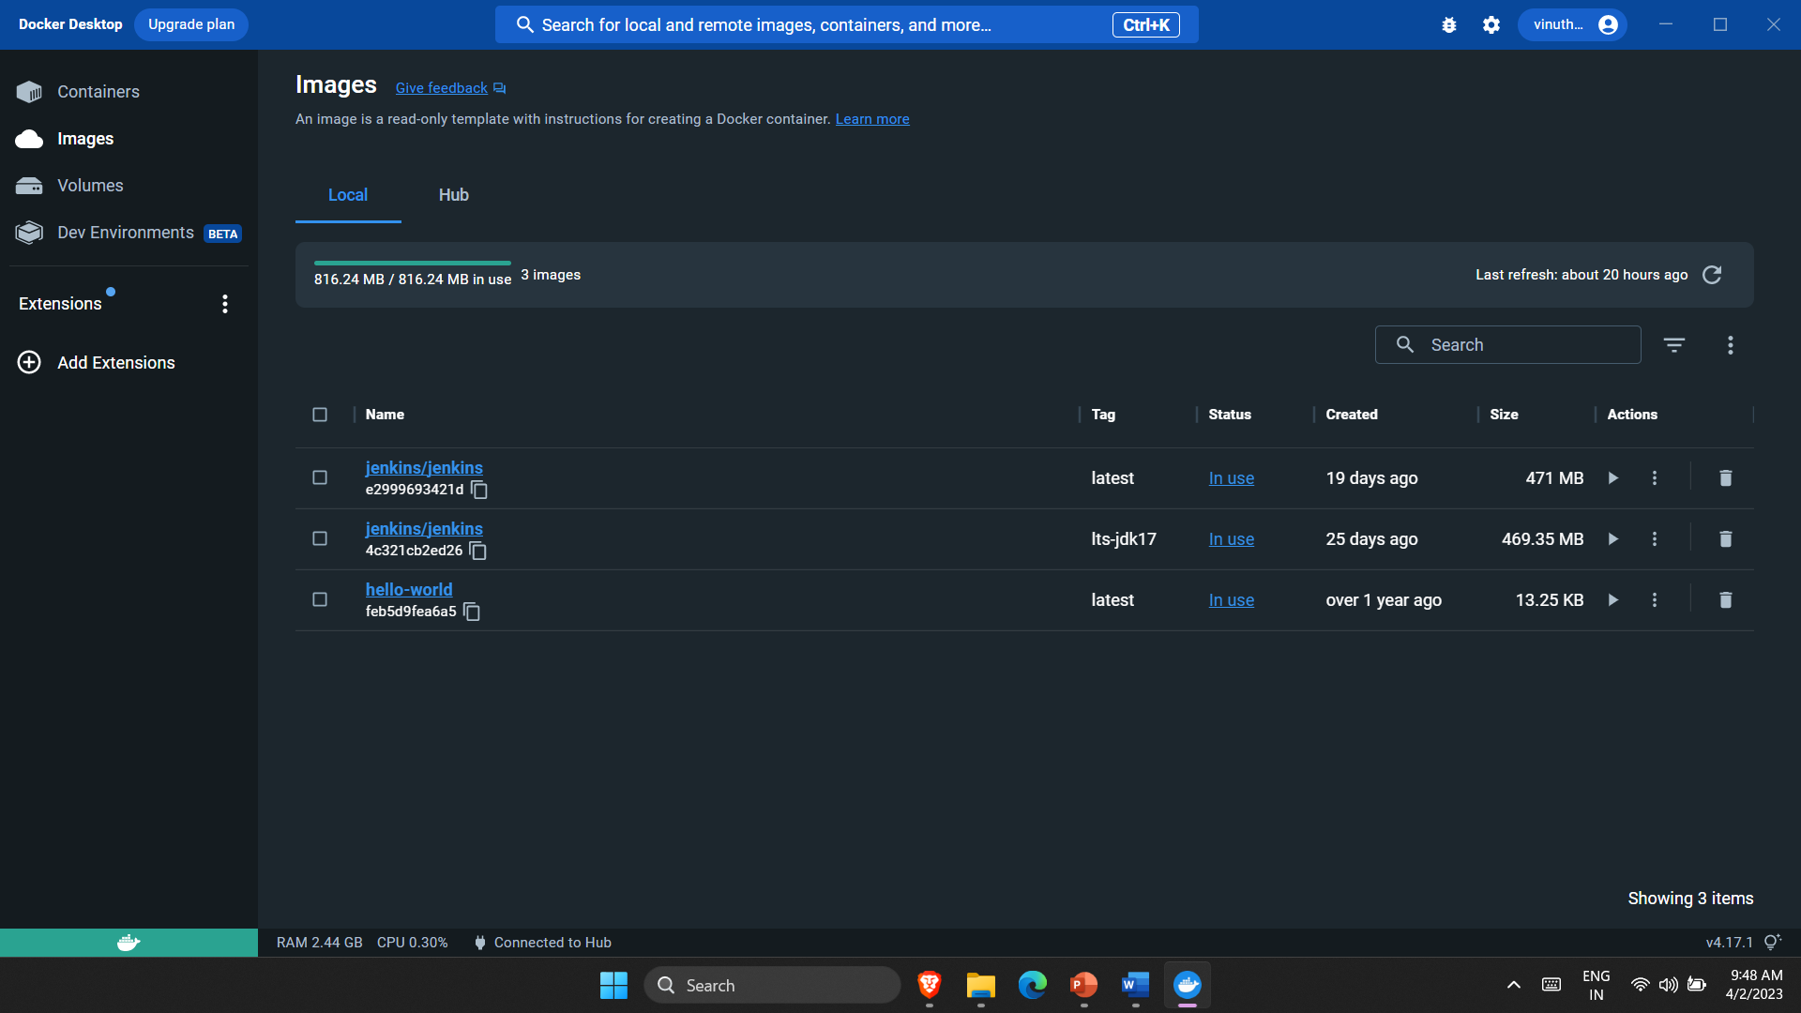
Docker Image

Slide 17
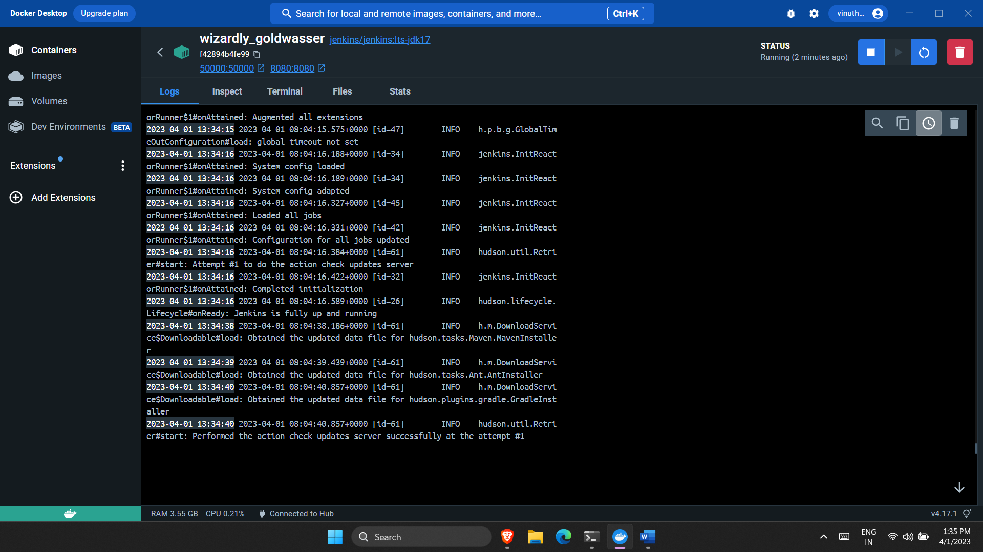
Logs are shown

Slide 18

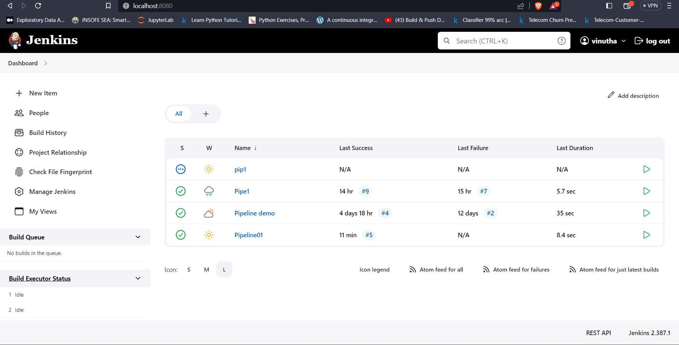
What is Jenkins and it’s use?
Jenkins is defined as an open-source solution comprising an automation server to enable
continuous integration and continuous delivery (CI/CD), automating the
various stages of software development such as test, build, and deployment.
Jenkins Dashboard

Slide 19
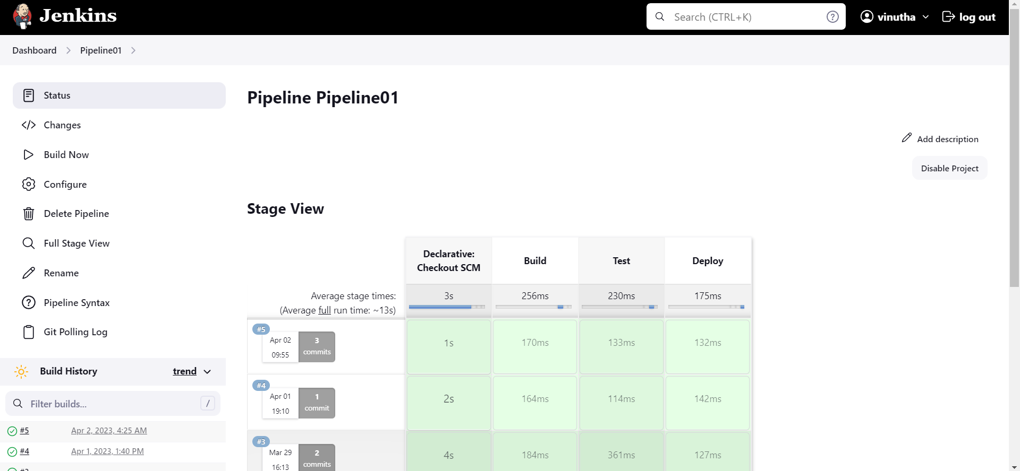

Slide 20
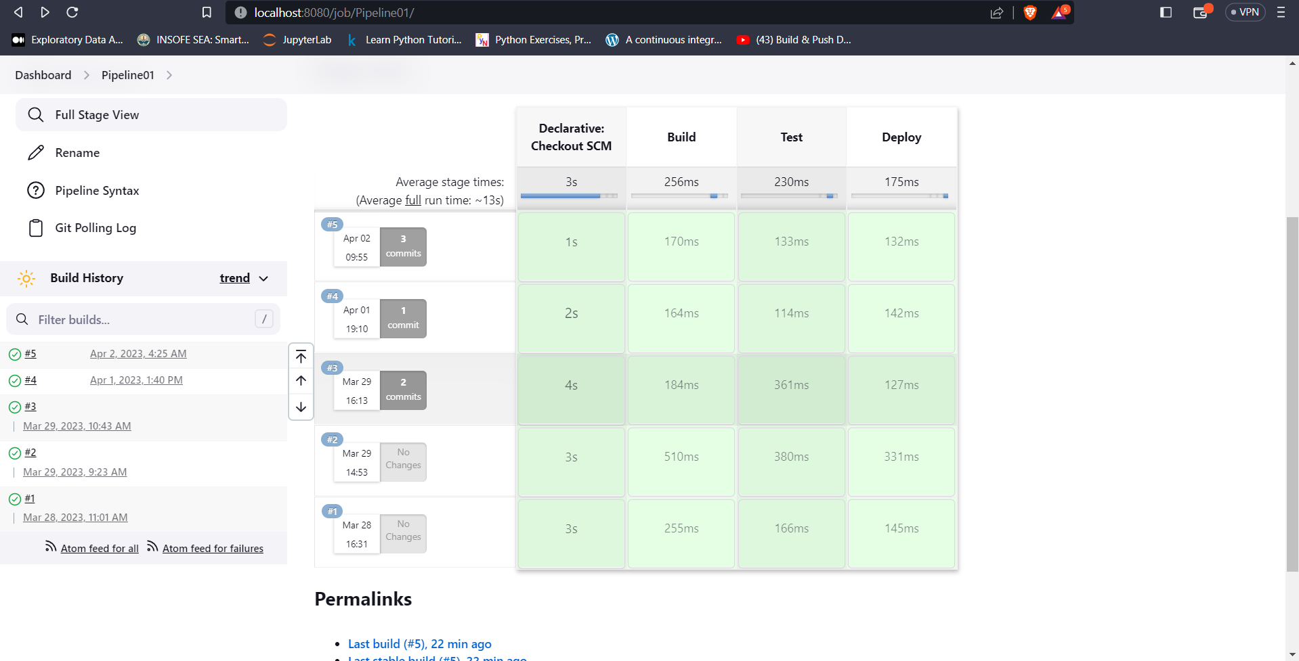

Slide 21

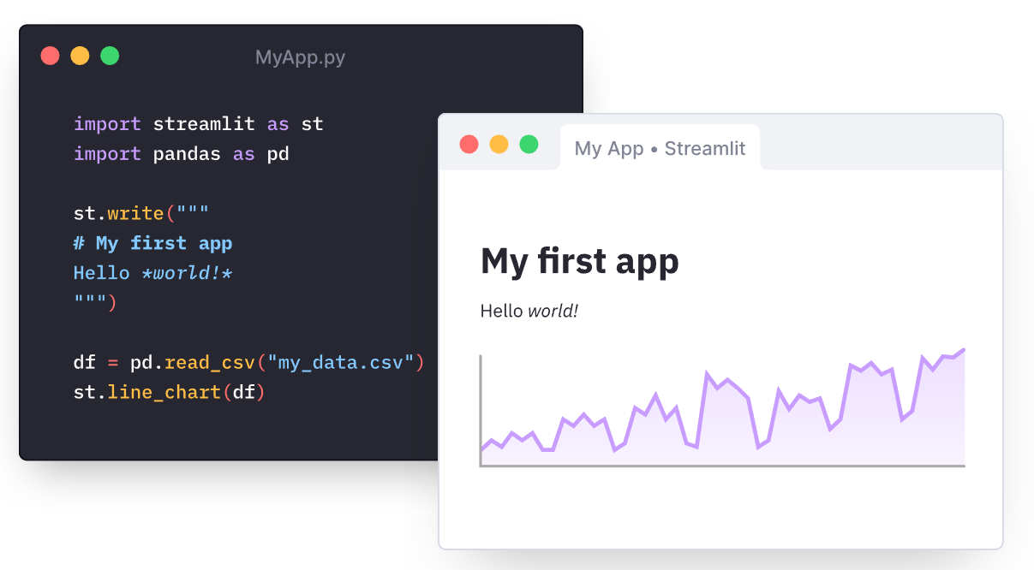
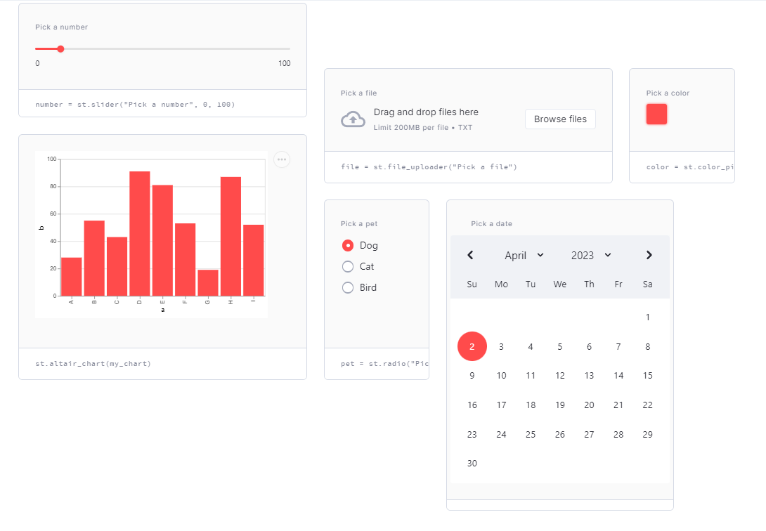
Streamlit Deployment
Streamlit is an open-source Python library that makes it easy to create and share beautiful, custom web apps for machine learning and data science. In this we can build and deploy powerful data apps.
Embrace scripting
Build an app in a few lines of code with simple API. Then see it automatically update as you iteratively save the source file.
Weave in interaction
Adding a widget is the same as declaring a variable declaring a variable. No need to write a backend, define routes, handle HTTP requests, connect a frontend, write HTML, CSS, JavaScript.

Slide 22
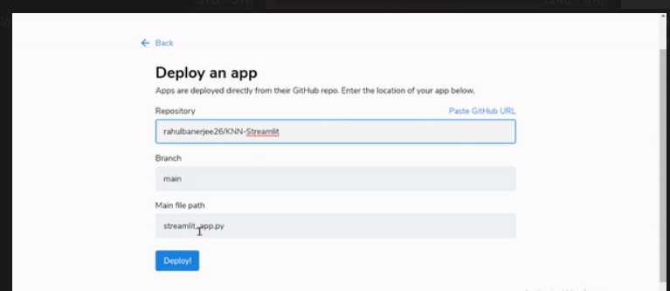
Deploy instantly
Effortlessly share, manage and deploy your apps, directly from Streamlit.

Slide 23
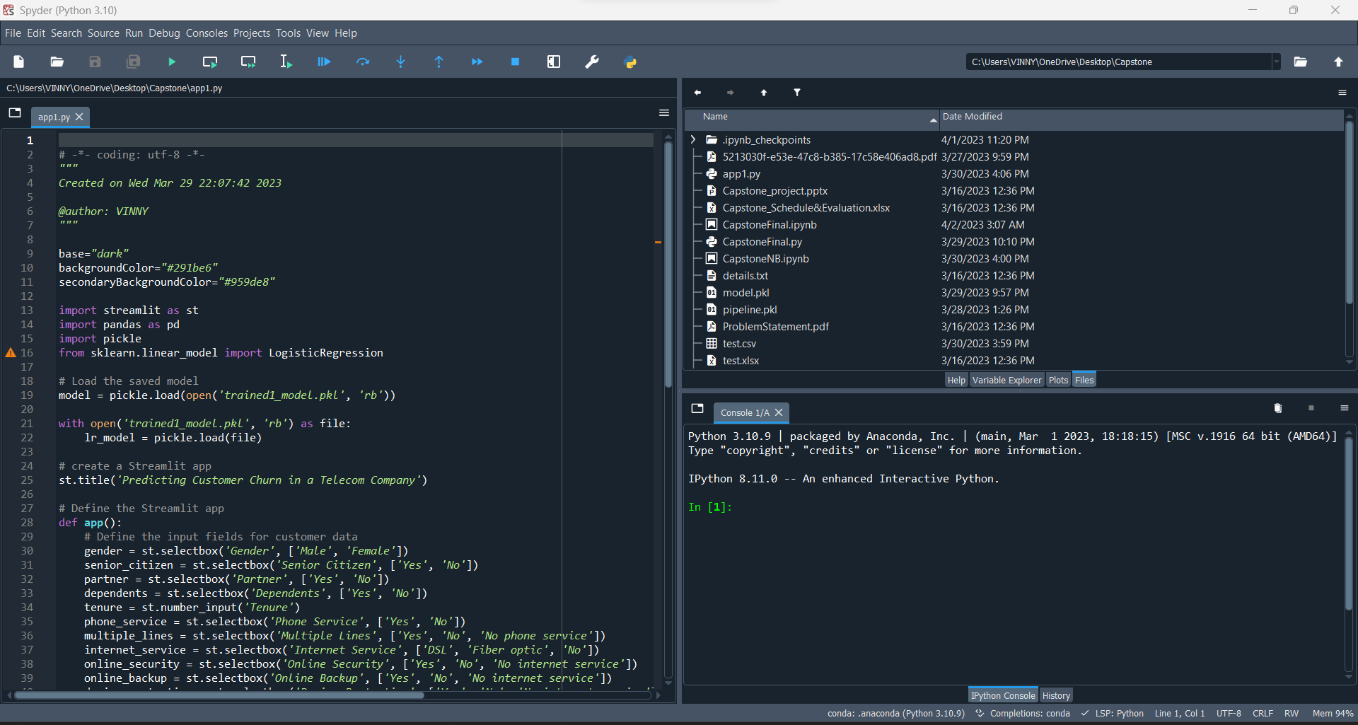
IDE USED:
Spyder

Slide 24
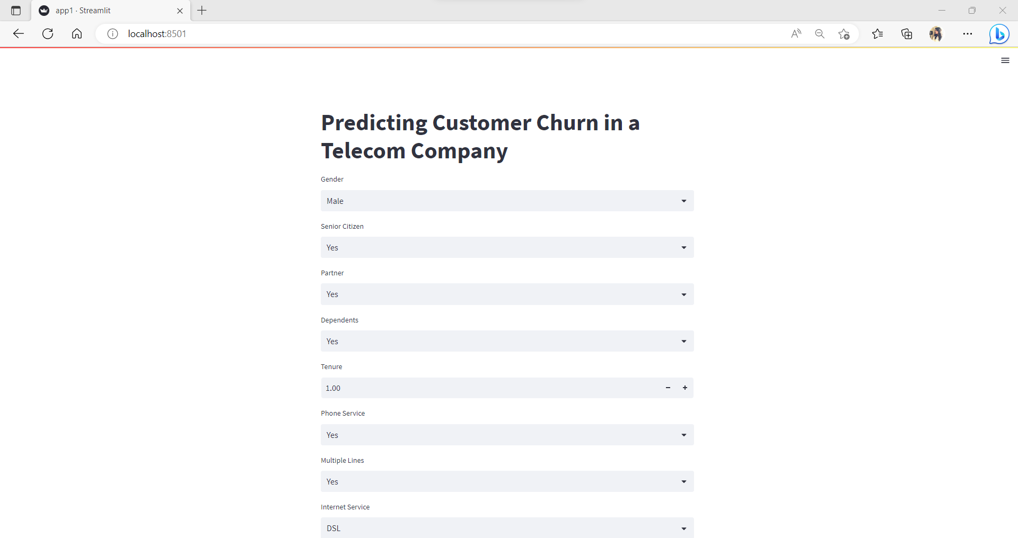
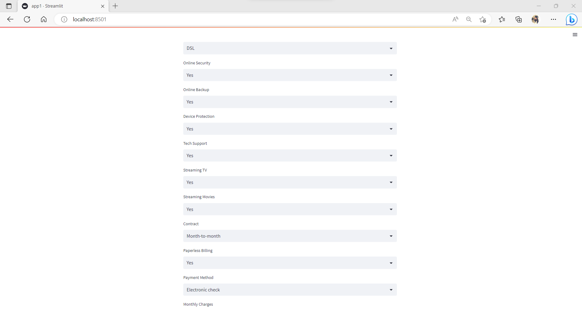

Slide 25
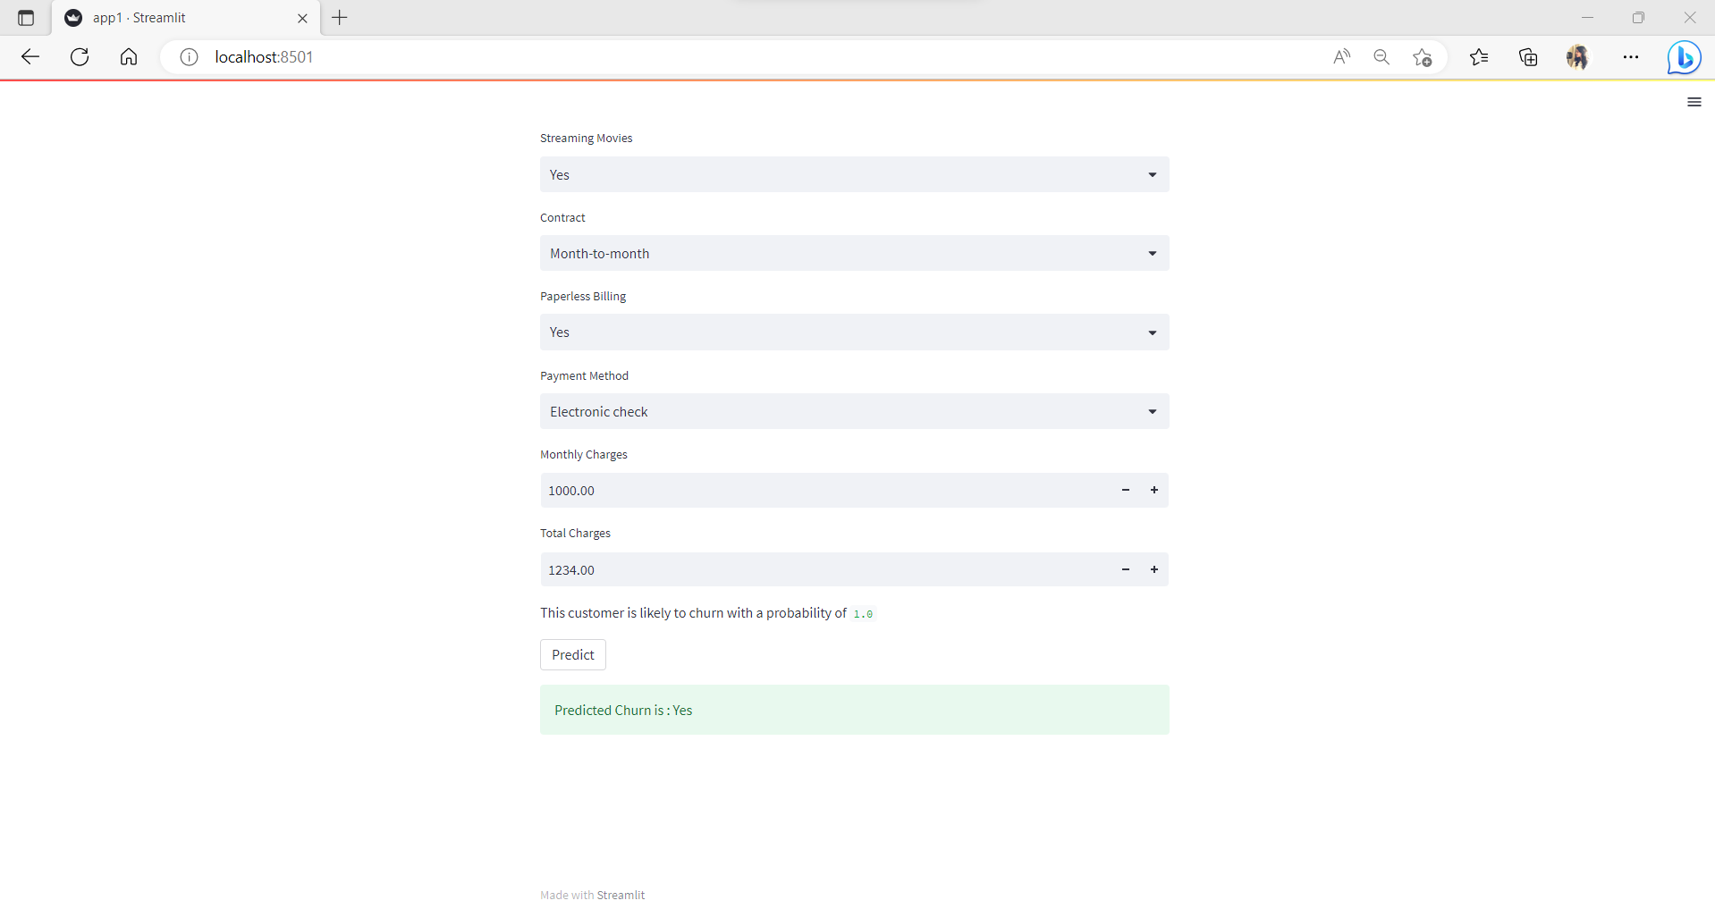

Slide 26


