Slide 1
Git Commands - Steps & Explanations
A step-by-step guide with commands and snapshots

Slide 2
Install Git
Go to https://git-scm.com/downloads/win
Select your operating system and download the .exe file.
Run the installer and follow the installation steps.
Create environment variable for Git (optional for command line access).

Slide 3
Configure Git user info
Run: git config --global user.name "your_name"
Run: git config --global user.email "your_github_email"
Verify with: git config --list

Slide 4
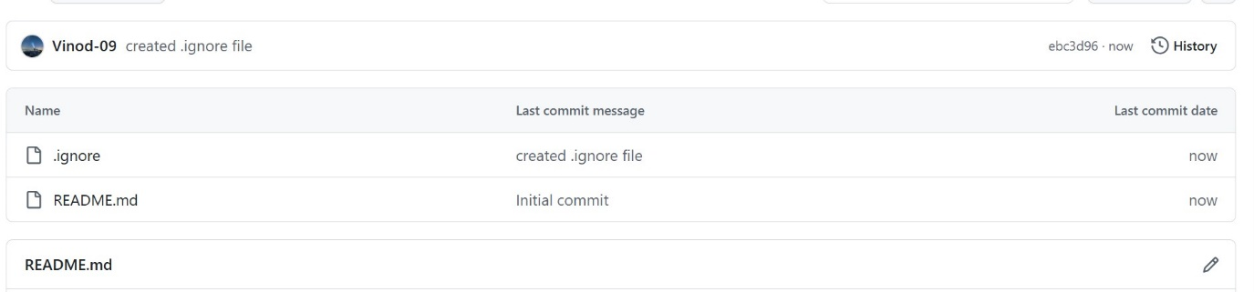
Create a repo with Readme file
Go to GitHub home page
Click New or Add symbol → new repository
Inside repo u will have → Add file

Slide 5
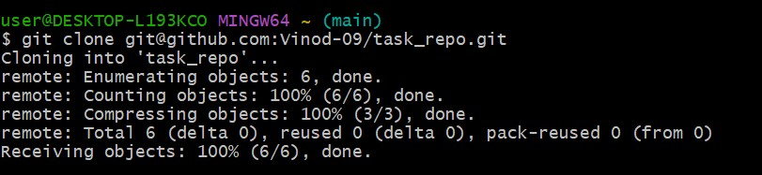
Clone Repo to Local
Use git clone command pass GitHub repo ssh or http link as an argument to that command.

Slide 6
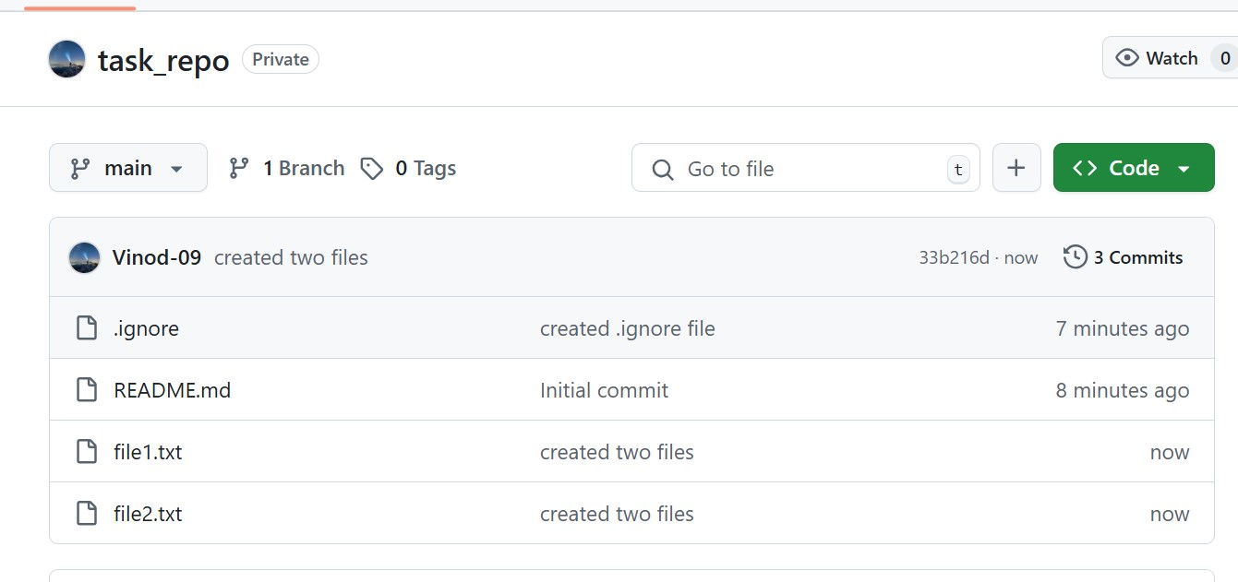
Creating file in local & pushing to GitHub
mkdir file_name
edit file using vi or redirection .
Run: git add <file>
Run: git commit -m "Add file in branch"
Run: git push origin main

Slide 7
Create branch local push to central repo
Git <branch name> or
Git checkout –b <branch name> -- it creates branch and checkout.
Git push –to push changes to current branch
Git push origin <branch name> --push specific branch.

Slide 8
Cloning newly created branch to Local
If you're cloning the whole repo for the first time.
→git clone https://github.com/username/repo.git
cd repo
git checkout branch-name
If you already cloned the repo, but the new branch was created later
git fetch origin → Fetch all remote branches
Git checkout branch name

Slide 9
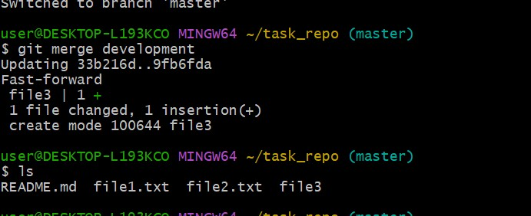
Merging the created branch with master in git local
Switch to master branch → git checkout master
Merge your feature/development branch into master
→ git merge your-branch-name

Slide 10
Merge branch on GitHub via Pull Request
Go to GitHub repo.
Click 'Compare & pull request' for your branch.
Review and create the pull request.
Merge pull request.

Slide 11
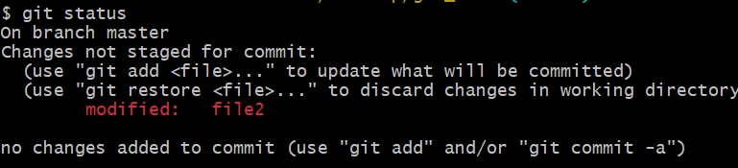
Checking git status
Git status → git status
Shows the status of git

Slide 12
Resolving merging conflicts
A merge conflict happens when:
Two branches have edited the same part of the same file, and
Git can’t decide which version to keep.
So, Git stops and asks you to resolve it manually.
Check git status
Open file that has conflict
It shows :
<<<<<<< HEAD
console.log("Welcome to the app");
=======
console.log("Welcome to our awesome app");
>>>>>>> feature-branch
Resolve and add and commit

Slide 13
Git rebasing
Rebase = “re-writing the history” by placing your commits as if they were made on top of another branch.
Command to switch to the branch u want to rebase onto :
Git checkout <branch name>
Command (rebase a specific branch): git rebase <branch to rebase>

Slide 14
Git Tagging
git tag <tag name> ->creates a lightweight tag
If we want to give message and metadata to tag → git tag –a <tag name> -m “message”
If we want to tag a specific commit
git tag –a <tag name> <commit hash> -m “message”.
List all tag → git tag
Git push origin –tags → push all tags
git tag –d tag → to del tag in local
git push origin :refs/tags/v1.0 → del tag in remote

Slide 15
Git reset
Git reset – moves your branch pointer (HEAD) to a different commit and optionally updates your staging area and working directory to match that commit.
commit3 (HEAD) ← edit file1
|
commit2 ← add file2
|
commit1 ← add file1
Total 3 commits I made here
Case 1: Undo all commits and go back to commit1 completely
git reset --hard <commit1_id>
1. HEAD now points to commit1
2. working directory is also reset to how it looked at commit1
3. destructive: history is lost unless you saved it elsewhere.
Case 2: Undo commits but keep the changes (soft or mixed reset)
Git reset –soft <commit id>
1. Changes from commits after that are kept in staging area.
Good for rewriting commits.
Git reset –mixed <commit id>
1. HEAD moves back & 2. changes go to working directory

Slide 16
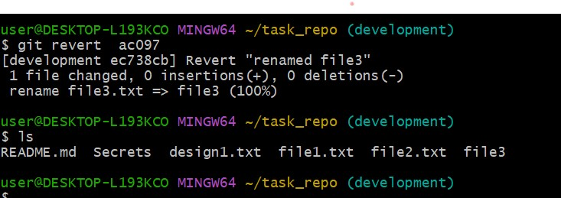
Git revert
If we want to undo the effect of specific past commit , git revert is right command to use.
It doesn’t delete history – it adds new commit that bring back previous state.
Git revert HEAD – revert latest commit
Git revert <commit> - revert a specific commit.
Git revert HEAD ~2 – revert a commit further back in history

Slide 17
Generate SSH key and configure GitHub
Run: ssh-keygen -t rsa -b 4096 -C "your_email@example.com"
Add SSH key to GitHub: Settings > SSH and GPG keys > New SSH key.
Test: ssh -T git@github.com

Slide 18
Configure webhooks
On GitHub repo: Settings > Webhooks.
Click 'Add webhook' and provide payload URL.
Set content type as application/json and choose events.

