Slide 1
Git Commands - Steps & Explanations
A step-by-step guide with commands and snapshots

Slide 2
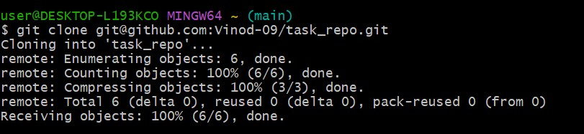
Install Git
Go to https://git-scm.com/downloads/win
Select your operating system and download the .exe file.
Run the installer and follow the installation steps.
Create environment variable for Git (optional for command line access).

Slide 3
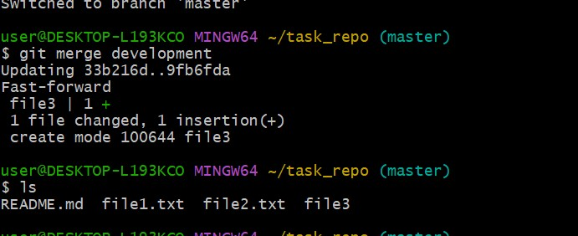
Configure Git user info
Run: git config --global user.name "your_name"
Run: git config --global user.email "your_github_email"
Verify with: git config --list

Slide 4
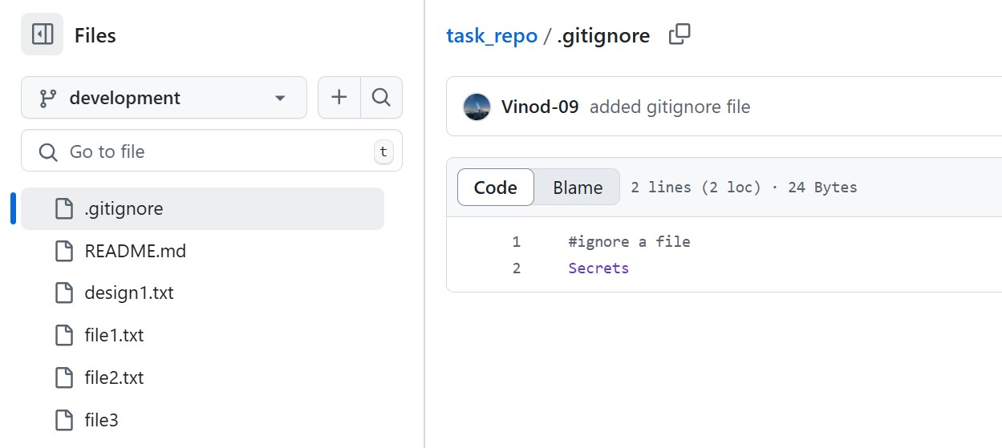
Clone repository
On GitHub, copy the repo URL.
Run: git clone <repo_url>
Navigate into repo: cd <repo_name>

Slide 5
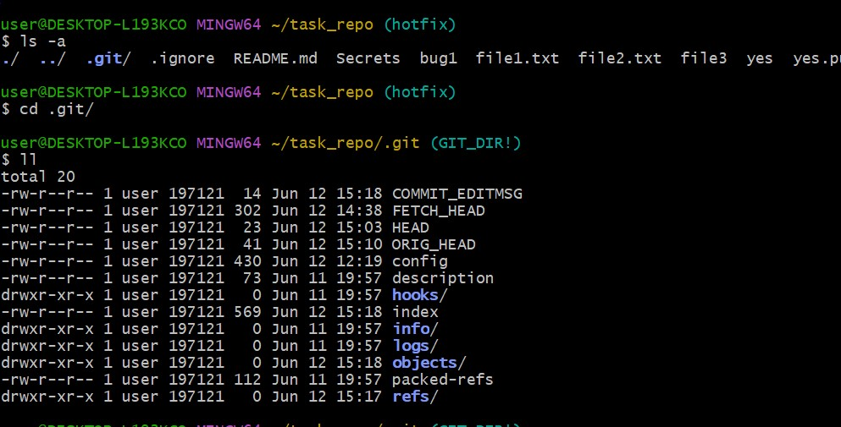
Create, commit, and push files
Create files in repo folder.
Run: git add .
Run: git commit -m "Add files"
Run: git push origin main

Slide 6
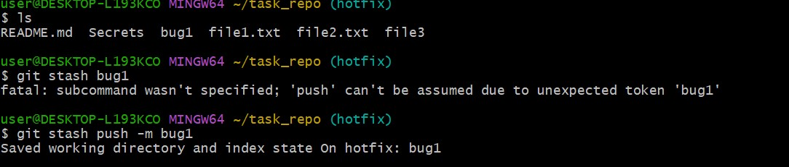
Create branch, add file, push
Run: git checkout -b new_branch
Create and edit a file.
Run: git add <file>
Run: git commit -m "Add file in branch"
Run: git push origin new_branch

Slide 7
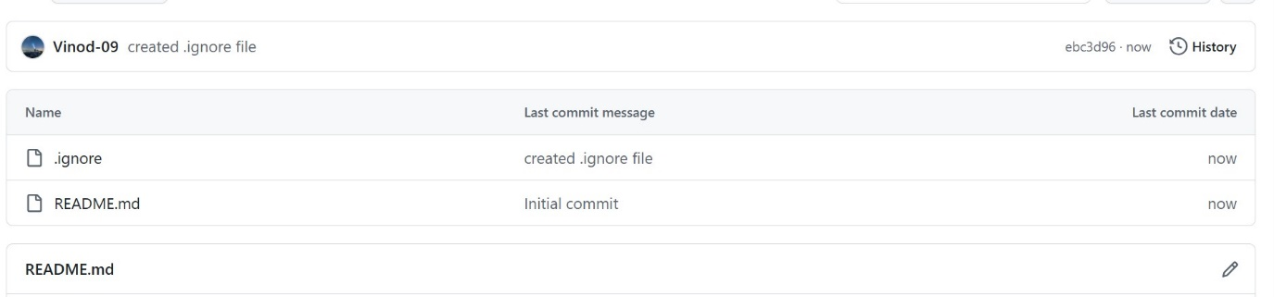
Merge branch locally
Switch to main: git checkout main
Run: git merge new_branch
Resolve conflicts if any, then commit.

Slide 8
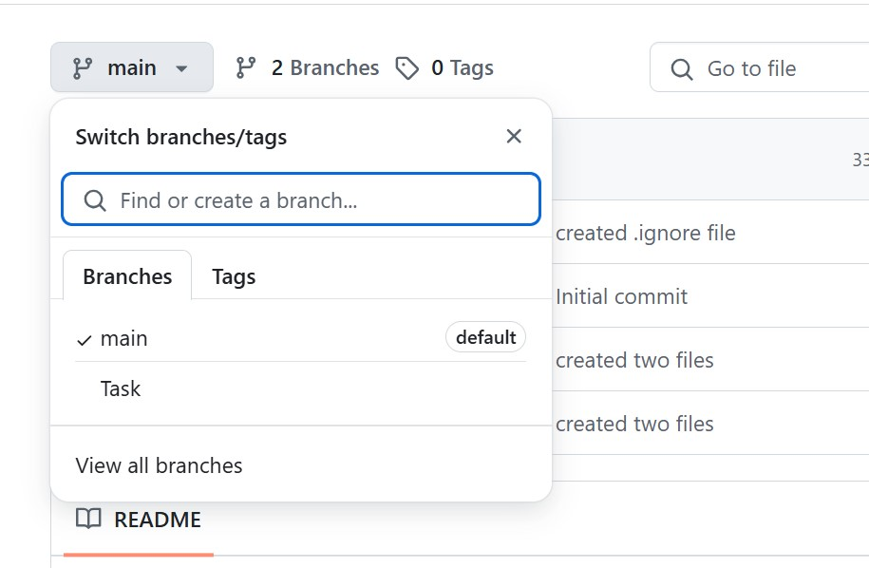
Merge branch on GitHub via Pull Request
Go to GitHub repo.
Click 'Compare & pull request' for your branch.
Review and create the pull request.
Merge pull request.

Slide 9
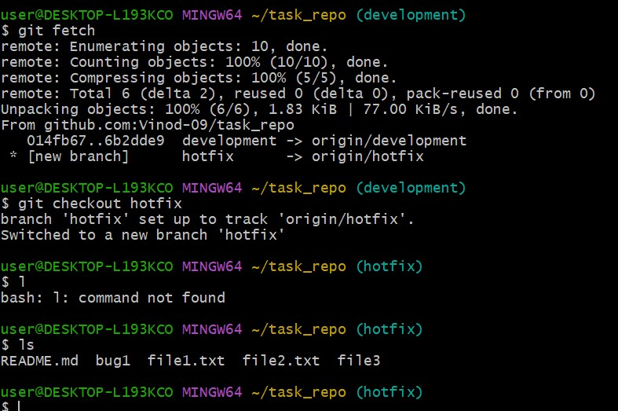
Generate SSH key and configure GitHub
Run: ssh-keygen -t rsa -b 4096 -C "your_email@example.com"
Add SSH key to GitHub: Settings > SSH and GPG keys > New SSH key.
Test: ssh -T git@github.com

Slide 10
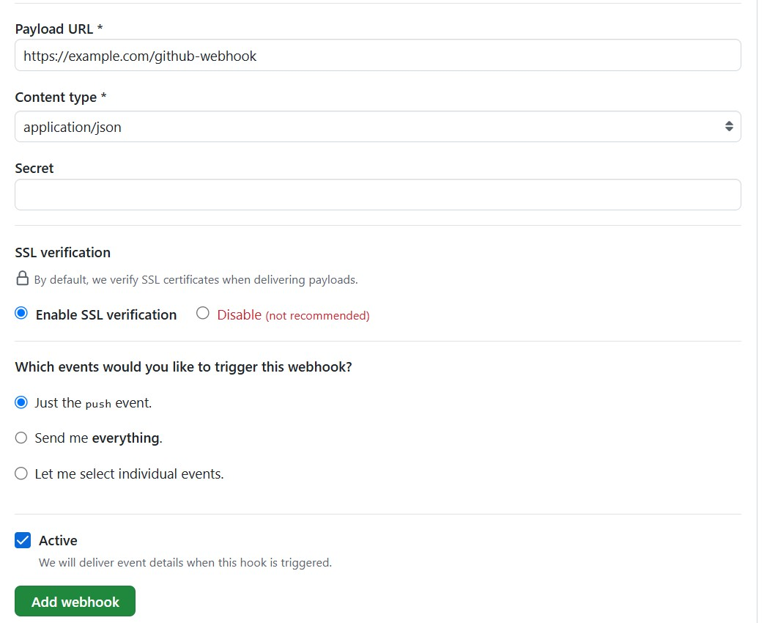
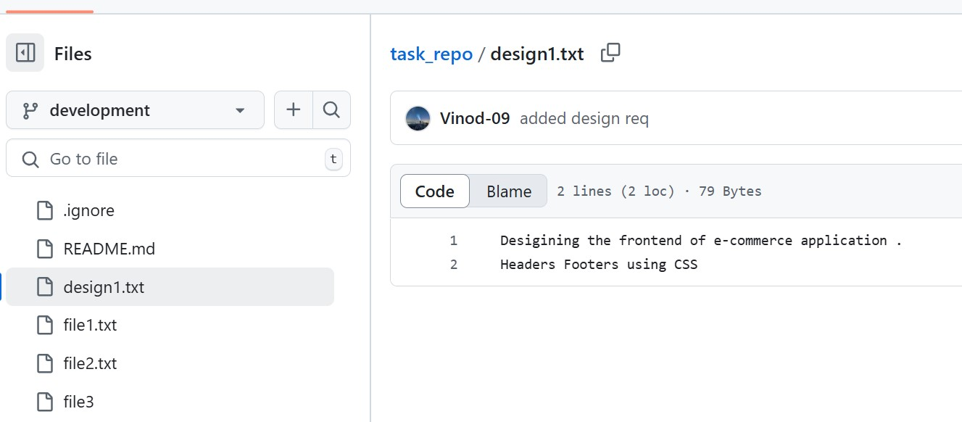
Configure webhooks
On GitHub repo: Settings > Webhooks.
Click 'Add webhook' and provide payload URL.
Set content type as application/json and choose events.

