Slide 1


News Source
Classification
CIS 5190 Project - Spring 2025

Slide 2

Group Members
Ashay Katre
Vinod Ghanchi
Shashank Kambhatla

Slide 3
Introduction
Part 01

Slide 4


Overview
Overview of the project
Objective: Classify article headlines by source (Fox News vs. NBC) using machine learning.
Motivation: Capture subtle linguistic cues reflecting editorial and political differences.
Dataset:
~5,000 headlines scraped from a curated URL list + Extra Scrapping
Augmented for class balance and diversity.

Slide 5


Data collection
Part 02

Slide 6
Data Collection Methods
Initial + Expansion
Headline Extraction
Cleaning, Validation
3,805 article URLs from Fox News and NBC (provided CSV).
+700 NBC and +500 Fox News headlines scraped manually.
Tools used: requests and BeautifulSoup, Selenium
Parsed HTML using outlet-specific structures:
Fox News: headlines in <h1> tags with class headline speakable.
NBC: required fallbacks like meta tags, alt text, or various <h1> formats.
Verified HTTP status codes.
Removed duplicates and failed scrapes.
5,200 total headlines.
Evenly balanced between Fox News and NBC.

Slide 7
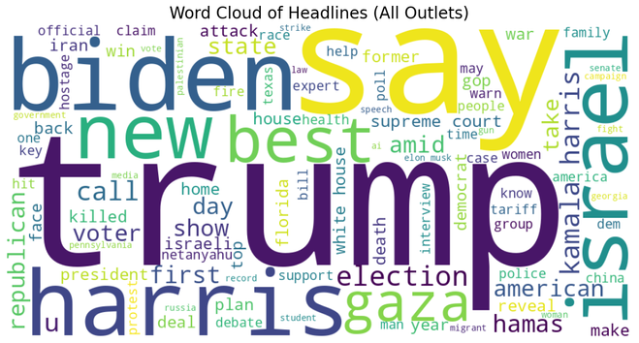
Data Preprocessing
Lowercasing: Standardized all headlines to lowercase for normalization.
Stopword Removal Strategy:
Custom Stopword List:
Manually created list targeting non-informative words tied to branding/layout (e.g., "fox", "nbc", "news", "update") along with default NLTK stopwords.
Saved to custom_stopwords.txt for consistent use across all models and vectorizers.
Character Sanitization:
Removed HTML tags, escape characters, and extra spaces.
Applied stemming/lemmatization selectively for performance comparison.
Final Dataset Schema: Columns: title, outlet, label, url.

Slide 8

Initial Design and Modelling
Part 03

Slide 9
Initial Design
Baseline Model: Logistic Regression + TF-IDF Unigrams
Chosen for simplicity, interpretability, and proven performance in short-text tasks.
Baseline Performance: ~66% test accuracy — confirmed that even simple models detect outlet-specific linguistic cues.
Limitations Identified:
Unigrams may be too shallow.
May lack capacity to model editorial framing or editorial nuance.

Slide 10
Feature Representation Experiments
We experimented with a few different text vectorization strategies:
TF-IDF Vectorizer:
Main feature encoding method.
Tuned with various n-gram ranges and vocab sizes (5,000).
Bigrams improved performance by capturing editorial phrases.
CountVectorizer: Used mainly with Naive Bayes; raw counts sometimes outperform TF-IDF.

Slide 11
Feature Representation Experiments
HashingVectorizer:
Explored for memory efficiency.
Performs well in tree models but lacked interpretability.
Sentence Embeddings (MiniLM-BERT):
Used all-MiniLM-L6-v2 from sentence-transformers.
Tested with Logistic Regression & Random Forest.
Underperformed due to headlines’ short length and sparse context.

Slide 12
Modeling and Optimization Process
We also explored a few different models in conjunction with the vectorizers:
Logistic Regression:
Tuned with C, solver, and iterations.
Bigram TF-IDF and larger vocab improved results significantly
Multinomial Naive Bayes:
Paired with CountVectorizer & TF-IDF.
Fast and interpretable; useful for identifying key predictive tokens.

Slide 13
Modeling and Optimization Process
Support Vector Machines (SVM):
Explored both linear and RBF kernels.
RBF offered higher ROC-AUC but was slower.
Bigram TF-IDF + RBF performed best achieving near 80% accuracy
Random Forest & XGBoost:
Very effective and decent accuracy, but not as good as SVM
Tuned max_depth, n_estimators, and learning_rate (XGBoost).

Slide 14

Evaluation
Part 04

Slide 15
Evaluation Protocol
Train-Test Split:
80-20 stratified split to maintain class balance.
All training and tuning confined to the training set to prevent data leakage.
Cross-Validation:
Employed k-fold CV via GridSearchCV for all models.
Ensured robust, average-based performance and reduced overfitting risk.
Evaluation Metrics:
Accuracy – Overall correctness.
F1-score – Balances precision & recall across classes.
ROC AUC – Measures class separability across decision thresholds.

Slide 16
Evaluation Protocol
Held-Out Test Set:
All final evaluations done on untouched 20% test split.
Diagnostic Visuals Used:
Confusion matrices – Identified misclassification patterns.
ROC, PR curves – Evaluated model discrimination across thresholds.
Outcome: Visual and metric insights directly informed final model selection and guided further exploration.

Slide 17
Logistic Regression
TF-IDF unigrams - Baseline model with 66% accuracy.
TF-IDF bigrams - Accuracy increased to 77% with better F1-scores.
Model Performance
SVM + TF-IDF bigrams
Reached 78–79% accuracy.
Strong performance, but slower to train.
Random Forest & XGBoost
Achieved ~76% accuracy.
ROC AUC near 0.85 — strong at class separation

Slide 18
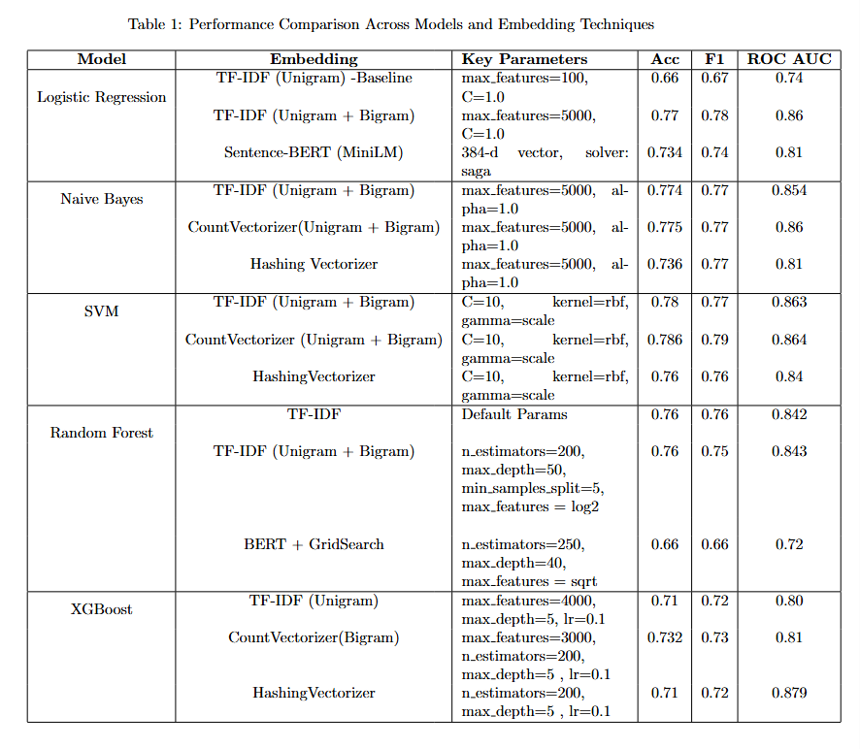
Model Performance

Slide 19
Which vectorizer performs best?
Expectation: Expected TF-IDF or Sentence-BERT to outperform CountVectorizer due to richer semantic capture.
Key Findings:
TF-IDF (with bigrams) outperformed all others across models.
Sentence-BERT underperformed due to short input length limiting semantic modeling.
CountVectorizer was consistently weaker than TF-IDF.
Limitations
Did not test Word2Vec due to data size constraints.
Sentence-BERT was not fine-tuned, which may explain subpar results.
Further gains may require contextual tuning or longer inputs.

Slide 20
Do bigrams significantly improve classification performance?
Expectation: Prior NLP work suggests bigrams add semantic depth and improve performance in sparse text settings.
Key Results:
Logistic Regression: Accuracy rose from 66% to 77%.
SVM & XGBoost: Gained 2–4% in Accuracy and AUC.
Confirmed that bigrams capture meaningful editorial context (e.g., “white house”, “border crisis”).
Limitations:
Bigrams increase dimensionality and sparsity, which may harm performance in smaller or imbalanced datasets.
Trigrams were not tested due to runtime costs, though they might offer marginal improvement.

Slide 21

Conclusion
Part 04

Slide 22

TF-IDF WITH BIGRAMS CONSISTENTLY OUTPERFORMED OTHER EMBEDDINGS (INCLUDING SENTENCE-BERT)
PROVING THAT CLASSIC LEXICAL FEATURES REMAIN HIGHLY EFFECTIVE FOR SHORT HEADLINE CLASSIFICATION.
Support Vector Machines (SVM) with RBF kernel achieved the best overall performance — with
~78.6% accuracy and 0.864 ROC AUC
outperforming even Random Forest and XGBoost in generalization and on the Random subset Test Data Provided
Feature design and preprocessing (e.g., custom stopwords) had as much impact as model complexity, reinforcing the importance of data-centric approaches in applied ML tasks.
Feature Extraction Methods
Best Model
Feature Design Impact

Slide 23
Vinod Ghanchi
Contributions of the
Project
HANDLED DATA AUGMENTATION BY DEVELOPING WEB SCRAPING PIPELINE, AND CREATING SCUSTOM STOPWORDS. FOCUSED ON RANDOM FOREST MODELING AND HYPERPARAMETER TUNING. ASSISTED WITH
PREPARING VISUALIZATIONS
Ashay Katre
LED SVM, LOGISTIC REGRESSION, AND NAIVE BAYES CLASSIFIER MODELING. DESIGNED EX-
PLORATORY EXPERIMENTS, FEATURE COMPARISON FRAMEWORK, AND MANAGED REPORT WRITING AND REFINEMENT
Shashank Kambhatla
WORKED ON XGBOOST CLASSIFIER, AND CONTRIBUTED TO EDA AND EXPLORATORY
QUESTION EVALUATIONS, AS WELL AS PREPARATION OF SLIDES.

Slide 24


