Slide 1
Stroke Risk Prediction Using Data Mining Techniques
Project Deliverable 4: Final Insights, Recommendations, and Presentation
Advanced Data Mining for Data-Driven Insights and Predictive Modeling
Vinod
MSCS 634
April 18, 2026
Notes:
Hello everyone. Today I’m excited to present my final project for MSCS 634: Stroke Risk Prediction Using Data Mining. I used a real Kaggle healthcare dataset with over 5,100 records to go through the full data mining lifecycle. In the next few minutes, I’ll walk you through the dataset, key findings from every deliverable, visualizations, recommendations, and ethical considerations. Let’s get started!

Slide 2
Project Overview & Dataset Justification
Dataset: Stroke Prediction Dataset (Kaggle)
5,110 records, 12 attributes
Target: stroke (0 = No Stroke, 1 = Stroke) – only 4.87% positive cases
Why chosen: Meets all project requirements and has real-world medical value
Notes:
I selected the Stroke Prediction Dataset because it perfectly matches the assignment criteria: more than 500 records, 12 rich attributes, and a clear binary target. Stroke is a major global health issue, so this project has practical importance for hospitals and public health programs. The dataset is imbalanced, which made the modeling especially interesting.

Slide 3
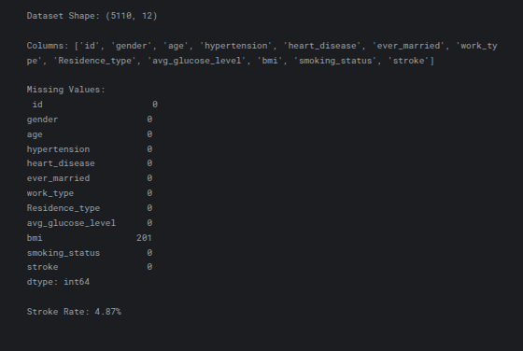
Dataset Summary
Dataset Description

Slide 4
Data Preprocessing & EDA (Deliverable 1)
Dropped irrelevant 'id' column
Imputed 201 missing BMI values with median
EDA Highlights (Figure 1):
Age distribution is multimodal (peaks at 40–50 and 60–70)
Severe class imbalance: 95.13% non-stroke vs 4.87% stroke
Notes:
First, I cleaned the data by removing the ID column and filling missing BMI values with the median to keep the distribution realistic. The age histogram shows stroke risk clearly increases after middle age. The bar chart on the right reveals the big challenge of this project — extreme class imbalance — which influenced every modeling decision I made later.

Slide 5
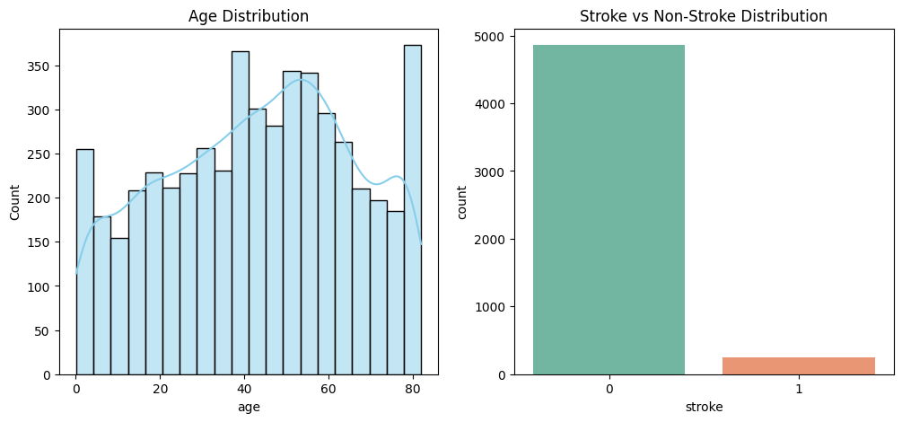
Age Distribution and Stroke Distribution

Slide 6
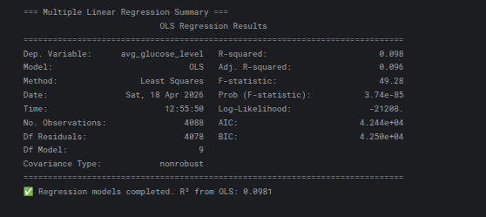
Regression Modeling (Deliverable 2)
Target: avg_glucose_level (continuous)
Model: Multiple Linear Regression (OLS)
Result: R² = 0.0981
Insight: Age, hypertension, and heart disease explain only ~10% of glucose variance
Notes:
In Deliverable 2 I built a regression model to predict average glucose level. After encoding categorical variables, the OLS model gave an R-squared of just 0.0981. This modest result taught me that linear models have limits in complex health data and pushed me toward classification and unsupervised techniques in the next phase.

Slide 7
Classification Results (Deliverable 3)
Tuned Decision Tree (best model)
Accuracy: 92.27%
F1-score: 0.1684
Confusion Matrix (Figure 2): Strong on non-stroke, weaker on actual strokes
ROC Curve (Figure 3): AUC = 0.607
Notes:
For classification I trained Decision Tree and k-NN models, then tuned the Decision Tree with GridSearchCV. It reached 92% accuracy but only 0.1684 F1-score because of imbalance. Looking at the confusion matrix, the model catches most healthy patients but misses many actual strokes. The ROC curve with AUC 0.607 shows we’re better than random but still have room to improve.

Slide 8
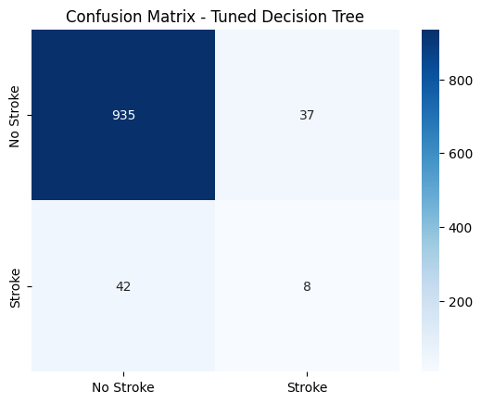
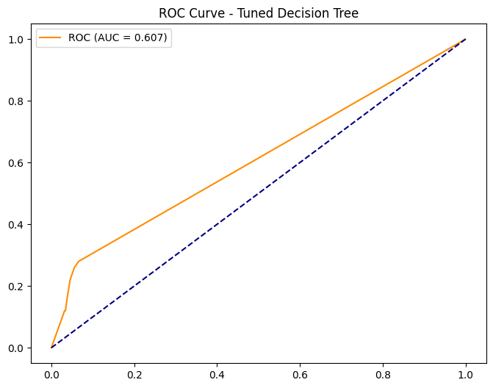
Confusion matrix and ROC curve
Confusion matrix and ROC curve

Slide 9
Clustering & Association Rules (Deliverable 3)
K-Means: 4 clusters chosen via Elbow Method (Figure 4)
PCA visualization (Figure 5) shows clear patient groups
Highest-risk cluster: 13.4% stroke rate
Top association rules link young unmarried males with low BMI and unknown smoking status
Notes:
Clustering was one of my favorite parts. The Elbow plot showed k=4 as optimal. The PCA scatter plot reveals four distinct patient segments, with one cluster having a 13.4% stroke rate — very useful for targeted prevention. Association rule mining then gave me interpretable rules, such as strong links between specific demographics and stroke probability.

Slide 10
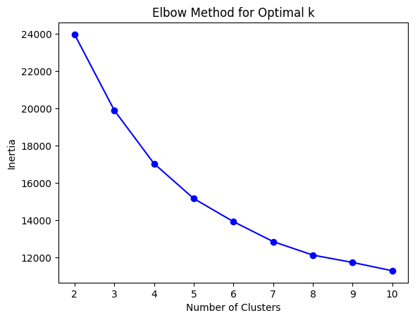
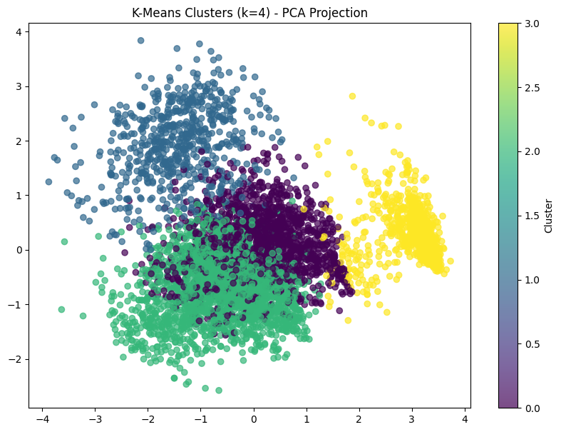
Elbow plot and PCA plot
Elbow plot and PCA plot

Slide 11
Key Insights, Recommendations & Ethics
Dominant predictors: age, hypertension, glucose level
Practical recommendations:
Deploy Decision Tree as hospital screening tool
Target high-risk Cluster 1 for prevention programs
Use rules for public health campaigns
Ethical focus: Privacy protected, fairness via F1-score and stratified sampling
Notes:
Putting everything together, age and hypertension consistently stood out. I recommend using the Decision Tree in clinics and focusing prevention on the highest-risk cluster. On the ethics side, I used an anonymized dataset, applied consistent preprocessing, and focused on F1-score to avoid bias toward the majority class.

Slide 12
Conclusion & Future Work
Successfully completed full data mining lifecycle
Actionable insights for stroke prevention
GitHub repo: MSCS_634_Project (includes notebook, report, video)
Future improvements: Ensemble methods, deep learning, fairness metrics
Notes:
In conclusion, this project showed me how powerful data mining can be in healthcare. I started with raw data and ended with clear, visual, and actionable insights. All code, visualizations, and this report are in my public GitHub repository. For future work I’d like to try ensemble models and add fairness checks. Thank you for watching! I’m happy to answer any questions.

