Slide 1


VISVESVARAYA TECHNOLOGICAL UNIVERSITY BELAGAVI, KARNATAKA – 590018
S.J.P.N TRUST’S
HIRASUGAR INSTITUTE OF TECHNOLOGY, NIDASOSHI – 591236
Department of Electronics And Communication Engineering
A Mini Project Presentation On
“AUTOMATIC CAR PARKING SYSTEM USING ARDUINO UNO”
Presented by:
Mr. Chetan Yarabandi USN: 2HN21EC016
Mr. Shubham Ghatawade USN: 2HN21EC040
Mr. Vikas Dhavane USN: 2HN21EC048
Mr. Vinod Adavi USN: 2HN21EC049
Under The Guidance Of
Dr. S. S. Ittannavar

Slide 2
CONTENTS
Introduction
Block Diagram
Hardware & Software Requirements
Advantages
Applications
Conclusion
References

Slide 3
INTRODUCTION
In urban environments where parking space is increasingly scarce, efficient utilization of available parking spots is crucial. Automatic car parking systems provide a promising solution by optimizing space and reducing the hassle of manual parking.
The Arduino Uno serves as the central control unit in this automatic parking system. It interfaces with various sensors to detect the presence of vehicles, controls motorized mechanisms for parking slot allocation, and manages the overall operation of the system.
Key components of this system include ultrasonic or infrared sensors for vehicle detection, The Arduino Uno processes data from sensors to determine the availability of parking spaces and guides.
We explore the design and implementation of an automatic car parking system using Arduino Uno, emphasizing its role in improving urban parking management and promoting smart city initiatives.

Slide 4
BLOCK DIAGRAM
Slot 1
Slot 2
Slot 3
Slot 4
Arduino Uno
16x2 LCD Display
IR Sensor
Servo Motor
5v2a
Adaptor
IR Sensor Entry

Slide 5
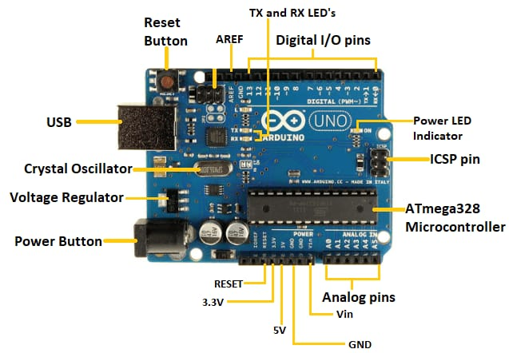
HARDWARE REQUIREMENTS
Arduino UNO:
Microcontroller (ATmega328P)
Operating Voltage (5V)
Input Voltage (recommended 7-12V)
Digital I/O Pins (14)
Analog Input Pins (6)

Slide 6
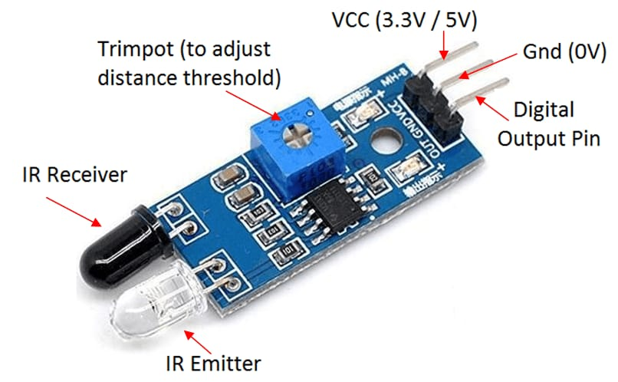
IR Sensor:
An IR sensor detects infrared radiation emitted or reflected by objects. It converts this radiation into an electrical signal, enabling applications in proximity sensing, motion detection, and temperature measurement. Used widely in automation, security systems, and consumer electronics, IR sensors offer non-contact detection capabilities based on heat signatures.

Slide 7
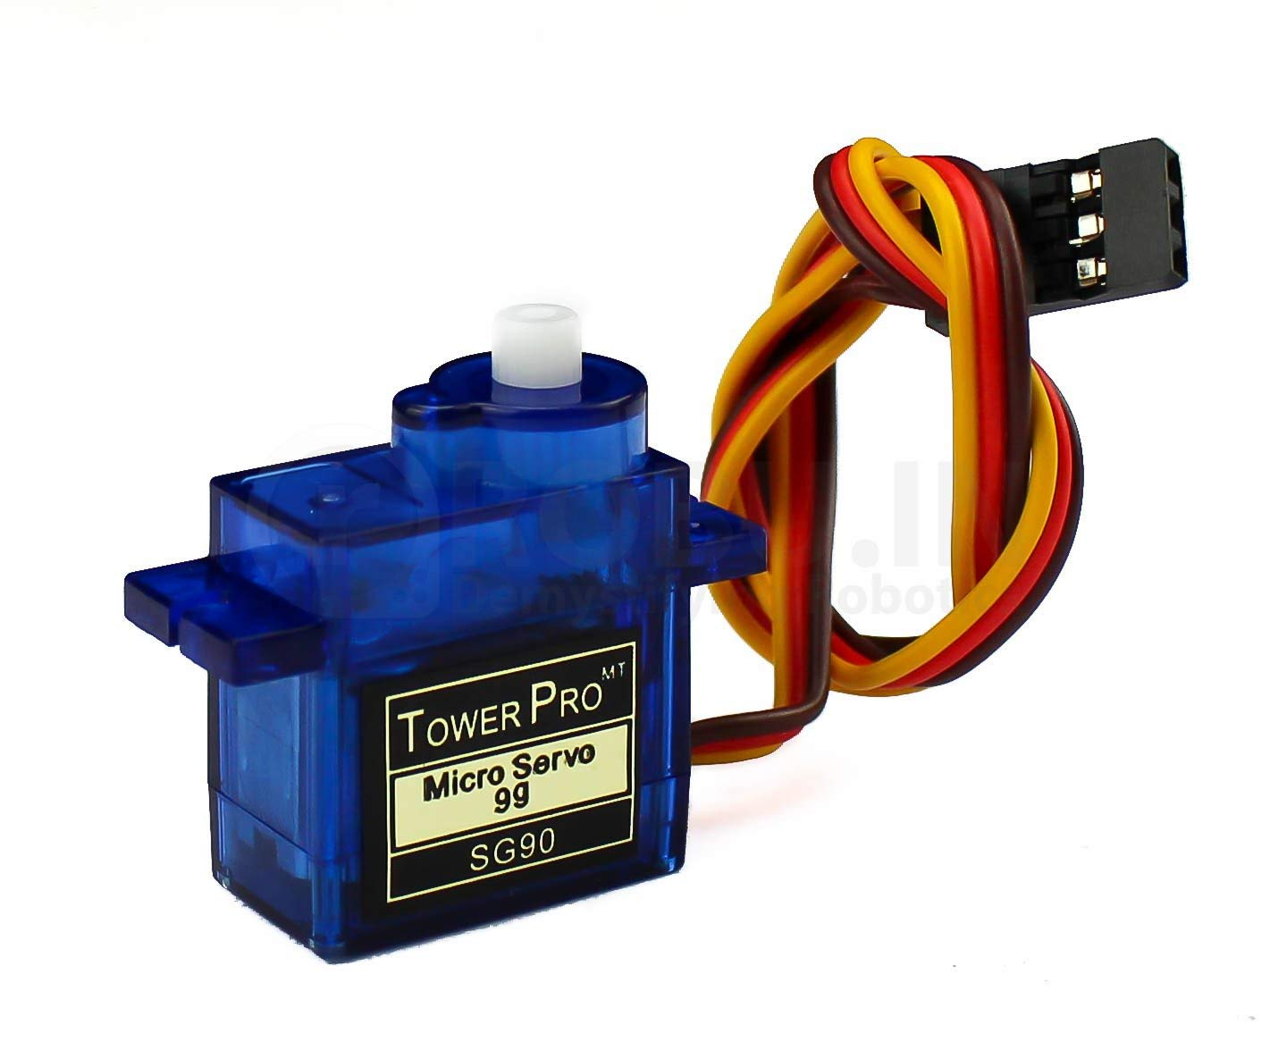
Servo Motor:
A servo motor is a rotary actuator that allows precise control of angular position, acceleration, and velocity. It operates based on feedback from an encoder or potentiometer, ensuring accurate positioning. Servo motors are used in robotics, CNC machinery, remote-controlled vehicles, and various industrial and consumer applications requiring precise motion control.

Slide 8
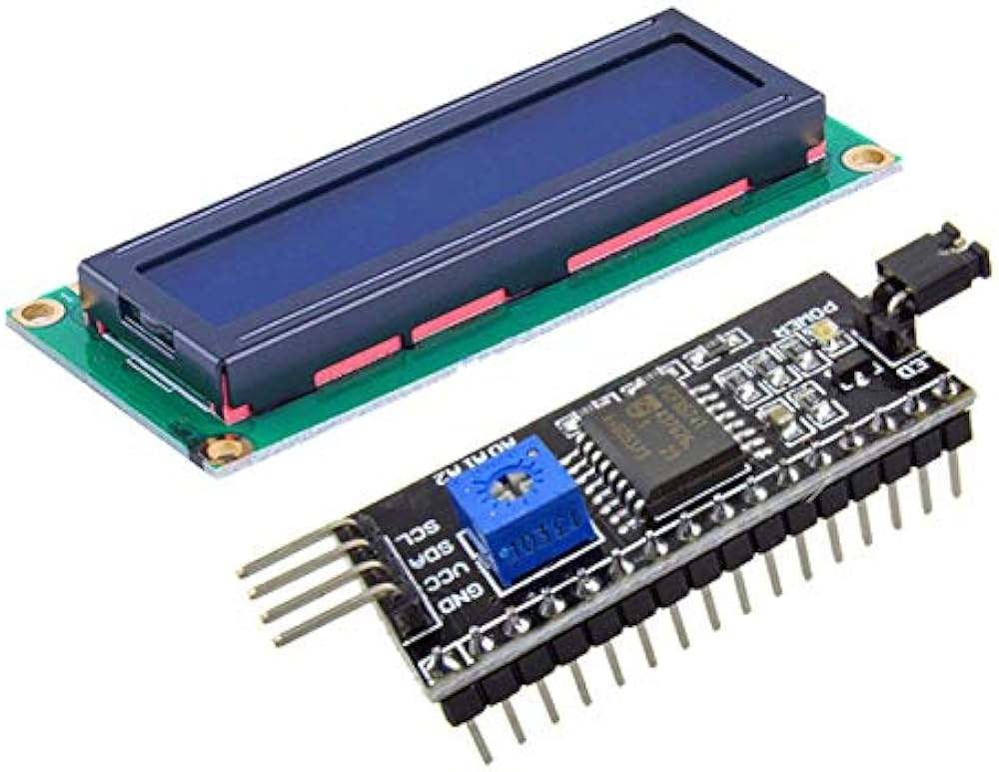
16x2 LCD Display With I2c Module
A 16x2 LCD display with an I2C module combines a standard LCD screen with an integrated I2C interface, requiring minimal wiring (SDA, SCL, VCC, GND). It simplifies communication with microcontrollers, enabling precise text display and backlight control. This setup is popular in projects needing compact, efficient display solutions, such as IoT devices, robotics, and DIY electronics where space and simplicity are critical.

Slide 9
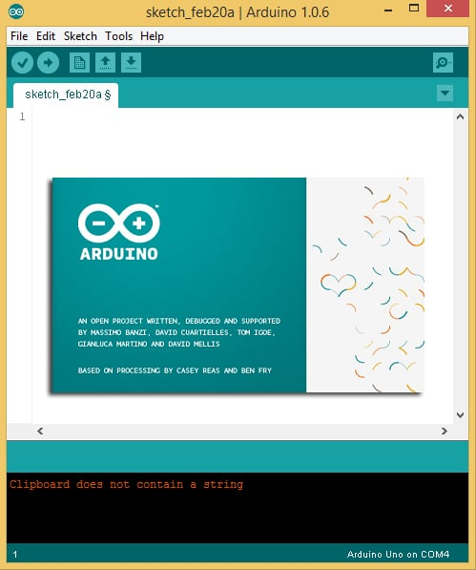
Software Requirements:
Arduino IDE:
The Arduino IDE is an open-source software, which is used to write and upload code to the Arduino boards. The IDE application is suitable for different operating systems such as Windows, MacOS X, and Linux. It supports the programming languages C and C++. Here, IDE stands for Integrated Development Environment.

Slide 10
ADVANTAGES
Space Efficiency
Time Saving
Scalability
Safety
Cost Effective

Slide 11
APPLICATIONS
Commercial Parking Lots
Public Parking Facilities
Smart Cities
Hotels and Resorts
Hospital and Healthcare Facilities

Slide 12
CONCLUSION
Building an automatic car parking system with Arduino integrates sensors, servo motors, and LEDs. It combines hardware skills in sensor interfacing and motor control with programming for real-time decision-making. This project enhances understanding of robotics, automation, and IoT applications, offering practical benefits like optimized space use and reduced parking errors. It's an ideal educational project for learning hands-on engineering and programming skills.

Slide 13
REFERENCES
Suvarna Nandyal, Sabiya Sultana “Smart Car Parking System using Arduino UNO” International Journal of Computer Applications (0975 – 8887) Volume 169 – No.1, July 2017.
Oindrila Chakraborty, Nalini N “Automated Toll and Parking Systems” International Journal of Advanced Research in Computer Science and Software Engineering, ISSN: 2277 128X, Volume 7, Issue 5, May 2017.
Y. Agarwal, P. Ratnani, U. Shah, and P. Jain, "IoT based smart parking system," Proc. 5th Int. Conf. Intell. Comput. Control Syst. ICICCS 2021.

Slide 14
THANK YOU

