Slide 1
A Frequent Pattern Mining Algorithm for Feature
Extraction of Customer Reviews
0
Seyed Hamid Ghorashi, Roliana Ibrahim,
Shirin Noekhah,
Niloufar Salehi Dastjerdi

Slide 2
0
Introduction
Uses H-mine frequent pattern mining algorithm to extract the frequent Fetures.
Features can be : Nouns and Nouns Phrases.
Does not take care of infrequent fetures (appears in the review database less than the threshold/support value)
Infrequent features can be extracted using Opinion words in the review sentence.

Slide 3
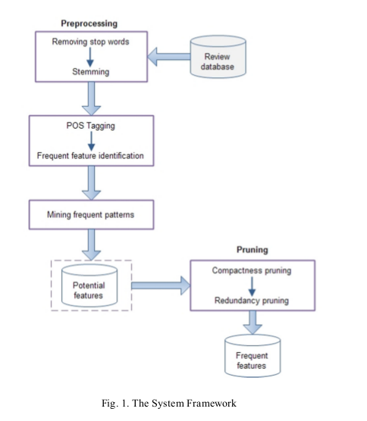

Proposed Techniques

Slide 4
Proposed Techniques
Preprocessing : removal of stop words and stemming
Part-of-Speech-Tagging :
original sentence:
“The camera is very easy to carry.”
Tagged sentence:
camera/NN easy/JJ carry/VB
Each sentence is filtered by the identified noun tags
and the result is saved in our review dataset.

Slide 5
Proposed Techniques
Frequent Feature Identification :
Run Frequent Pattern algorithm to extract the frequent item sets (H-Mine)
The minimum support value of the algorithm is set to 1% meaning that all the patterns
that can be found in at least 1% of the review sentences are considered as frequent features.

Slide 6
Proposed Techniques
Pruning :
Association mining algorithms does not consider the position of the items in a given transaction.
it generates a number of
candidates that may not be genuine features.

Slide 7
Pruning Algorithm
For each sentence in the review database {
      If (a feature phrase found) {
        For each feature in the sentence {
        Measure the distance between every
        two words;
        If (words distance > 3)
        Remove the feature from the list;
        }
      }
}

