Slide 1


Li-Fi Enabled Vehicle Tracking for Accident Prevention
AY 2020-24
GITAM UNIVERSITY
Major Project
Project ID: 19EEC492
A University should be a place of light, of liberty, and of learning.
Department of Electrical Electronics and Communication Engineering
Project Team:
322010401029- K.Lakshmi Narasimha
322010401010-Y.V Karthik Reddy
322010401012-N.Vinod Kumar
322010401047-G Bharath Kumar
Project Mentor:
Dr.C.Kamalanathan
Associate Professor/EECE
www.gitamedu.com

Slide 2





Project Group – Details
Photo
Track
Roll No
Name
ECE
322010401010
Y.V Karthik Reddy
ECE
322010401012
N Vinod Kumar
ECE
322010401029
K.Lakshmi Narasimha
ECE
322010401047
G. Bharath Kumar

Slide 3
2023
2024
Project Plan
Report to co-ordinator
Theoretical part
Conducted a detailed survey on required hardware and software
Dec 12
Dec 23
Analysing Key Software in Arduino IDE
Hardware Implementation
Project Title Selection
Abstract
Jan21
Feb 6
Dec 5
Dec 26
Understanding the Operation of a Li-Fi Transceiver
Coding Part
Mar 10
Preparing for 1st Review
Feb 10
By weekly Report
Making project report
Jan 2
Jan 30
Feb 14
Mar 21
Resource Gathering
1st Review
2nd Review
Dec 19
Jan 9
Mar 1
Dec
Jan
Feb
Mar
Dec 5
Topic Selection

Slide 4
Objective and Goals
Objective
To Develop a robust V2V communication system by imposing Li-Fi technology to facilitate real-time exchange of crucial information among connected vehicles.
To identify various potential dangers and to monitor driving conditions by combining the sensor data with Li-Fi communication to improve the road safety.
Goals
To improve Road Safety and utilize V2V communication and Li-Fi technology to prevent accidents by enabling real-time data exchange and collision avoidance measures between vehicles.
To enhance hazard detection and equip vehicles with required sensing modules to detect potential hazards, enabling identification of obstacles.

Slide 5
Literature Survey
Key Publications
Vehicle Collision Avoidance System Using Li-Fi[June-2021]
P.M. Benson Mansingh, G. Sekar and T. Joby Titus
ACCIDENT ANALYSIS AND AVOIDANCE BY V2V COMMUNICATION USING LIFI TECHNOLOGY [March-2020]
S. Sivakumar*1, A. Alagumurugan*2, G. B.Baala Vignesh*3, S. Dhanush*4
LIFI BASED ADVANCED ACCIDENT DETECTION SYSTEMS[June-2020]
Dr.S.CHINNAPPARAJ, 2ARCHANA M, 3BASKAR G, 4KARTHIGA DEVI M, 5MOHAN RAJ S
Key Resources
Vehicle to vehicle data transfer and communication using LI-FI technology[November-2021]
R.Anbalagana,M.ZahirHussaina,D. Jayabalakrishnanb,D.B.NagaMurugab,M.Prabhahar.
LiFi for Vehicle to Vehicle Communication.[December 2020]
Rahul George, Srikumar Vaidyanathan, Amandeep Singh Rajput, K Deepa.

Slide 6
SWOT- Analysis
Strengths
Weaknesses
W1. Weather Dependence
W2.Dependence on Line of Sight
S1. High speed
S2. Quick Response Time
S3. Security
Threats
Opportunities
T1.Resource Constraints
T2. Cost of Implementation
O1.Collaboration with Automotive Industry
O2.Integration with Smart City Initiatives

Slide 7
Analysis – 4W1H
Why: With the increasing number of vehicles on roads leading to more accidents, there's a need for innovative solutions. By using Li-Fi, which is faster and less crowded than traditional Wi-Fi, accidents can be prevented through quick communication between vehicles
What: The project aims to enhance road safety by implementing a system that allows vehicles to communicate with each other using light or Li-Fi technology.
Where: The project will be implemented in vehicles worldwide, particularly in areas with high traffic congestion and accident rates.
When: The project is set to commence immediately and will progress through various phases, including planning, development, testing, and deployment, each with its own specific timeline
How: The project will use a combination of hardware components and software (Arduino IDE) to create a system where vehicles can exchange crucial information quickly. This information includes data about nearby objects, environmental conditions, and potential collisions. The system will then trigger alerts to drivers to prevent accidents.

Slide 8
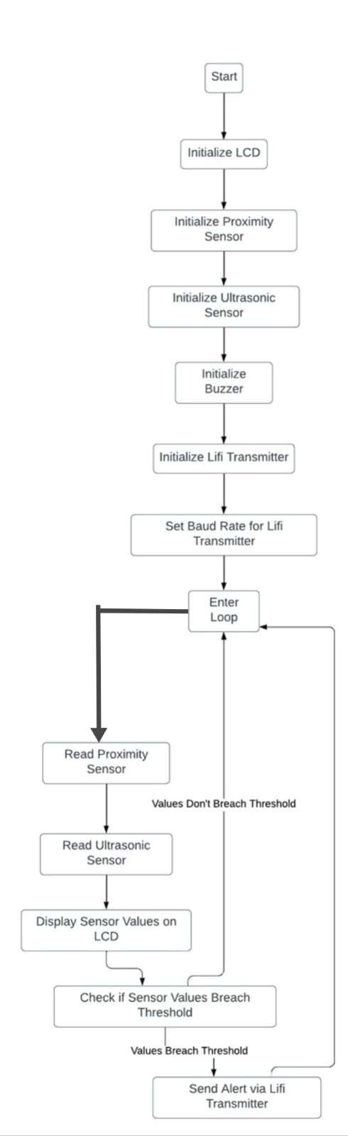
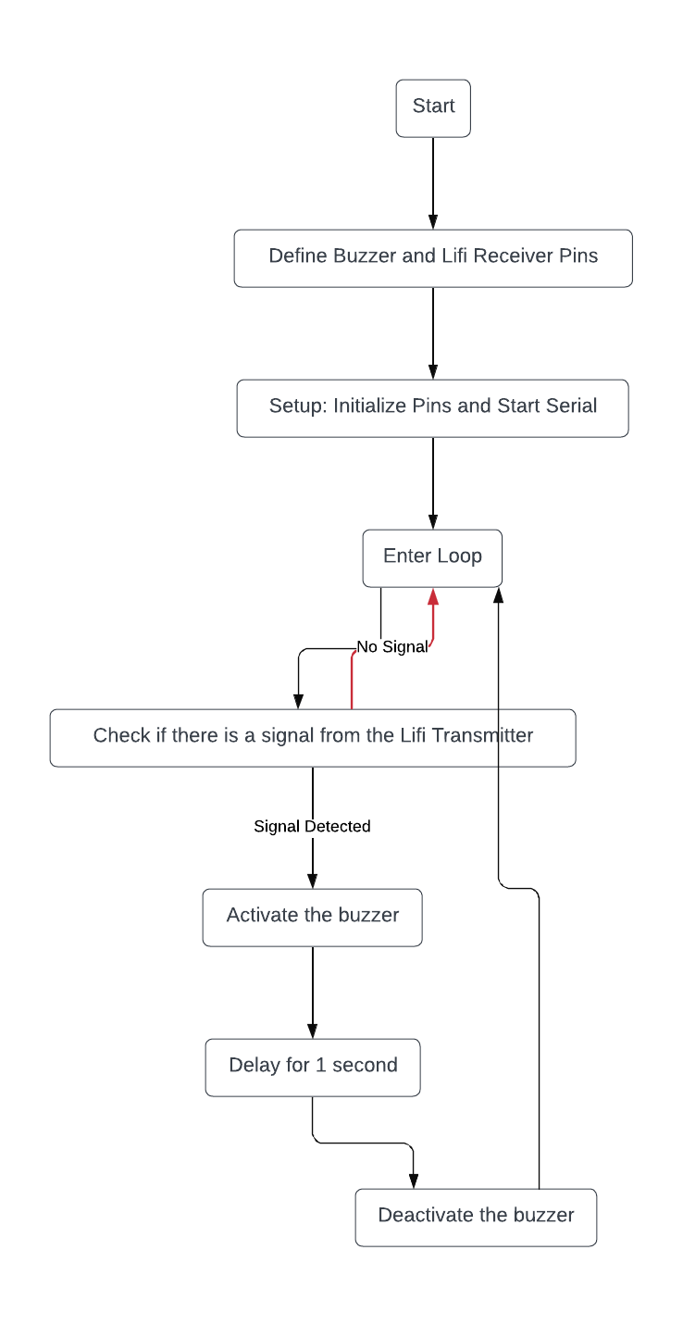
Flow Chart
Transmitter side
Receiver side

Slide 9
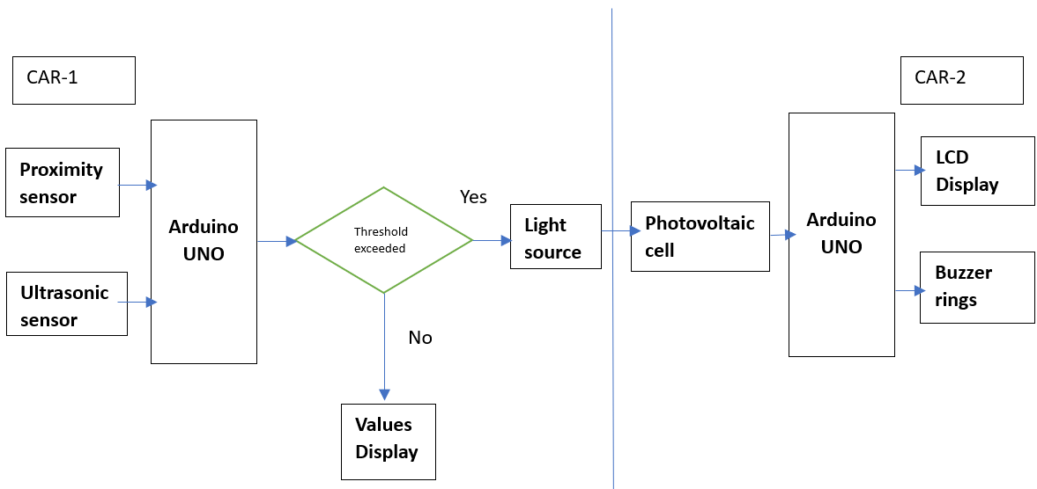
Architecture

Slide 10
Use Cases & Testing
Use Cases:
Collision Avoidance:
Vehicles communicate with each other to detect potential collisions and automatically adjust their speed or direction to avoid accidents.
Emergency Vehicle Alert:
When an emergency vehicle approaches, nearby vehicles receive instant alerts, enabling drivers to yield and make way for the emergency vehicle to pass through quickly.
Highway Driving: Vehicles communicating with each other to maintain safe distances, avoid collisions, and coordinate lane changes on highways.
Test Cases:
Communication Range Test:
Verifying that vehicles can communicate effectively within the specified range or not
Collision Detection Test:
Simulate potential collision scenarios and verify that the system accurately detects and alerts drivers to impending collisions.
Alert Mechanism Test:
Test the effectiveness of the alert mechanisms (e.g., buzzer, LED) in capturing drivers' attention during critical situations

Slide 11
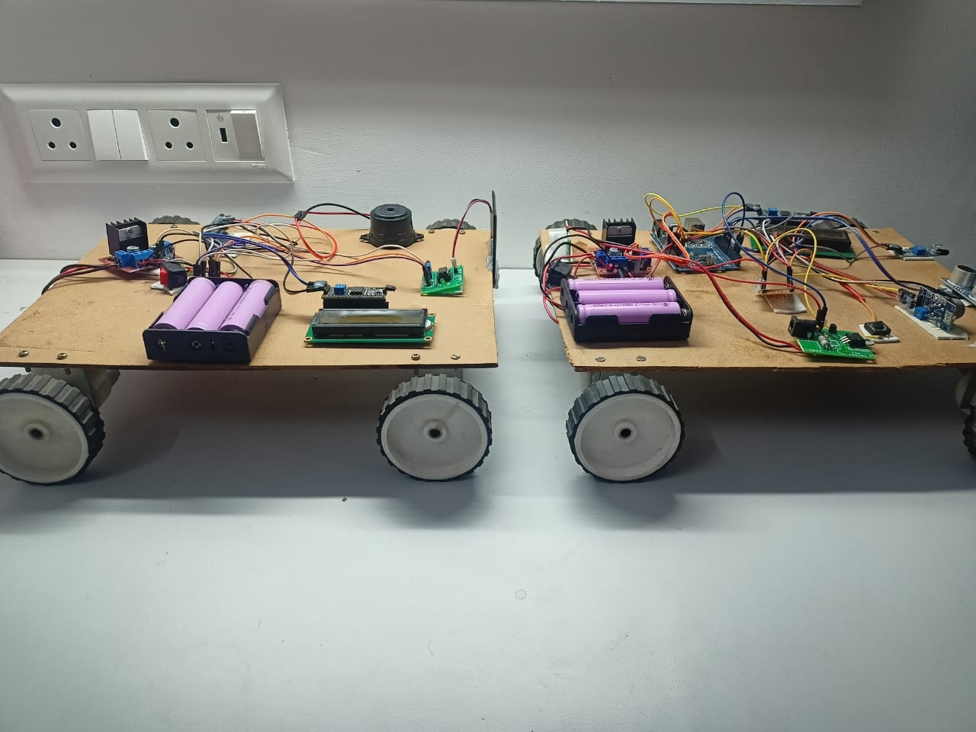
Implementation

Slide 12
Contribution
Team Progress
We had researching Li-Fi technology and its applications in V2V Communication.
We did literature survey based on above research.
Identified the major objectives of the project to achieve.
Understood about how Li-Fi Transceiver works.
Conducted a detailed survey and discussion on hardware components and software to achieve the desired objective.
The next step to integrating all hardware and software component and test the prototype which will be done iteratively before final review.
Individual Contribution
Key contributions: K.L Narasimha
Technical Part
Arduino Programming
Resource Gathering
Key contributions: G. Bharath Kumar Reddy
Project Management
Resource Gathering
Technical support
Key contributions: Y.V Karthik Reddy
Resource Gathering
Arduino Programming
Key contributions N Vinodh kumar
Project Management
Resource Gathering
Technical Part

Slide 13
Conclusion & Future Scope
Summary and Conclusion:
Our project utilizes Li-Fi technology for Vehicle-to-Vehicle (V2V) communication, aiming to improve road safety. By employing Li-Fi instead of traditional Wi-Fi, we can enhance the speed and reliability of communication between vehicles, crucial for V2V communication. Ultimately, our project's goal is to prevent accidents and create a safer driving environment. By combining Li-Fi technology with a comprehensive set of sensors and alert systems, we aim to significantly reduce the number of accidents on the roads. Our methodology is simple and efficient, making it accessible for widespread adoption, and contributing to a significant improvement in road safety worldwide
Future Scope:
Integration with Autonomous Vehicles: Explore opportunities to integrate the Li-Fi V2V system with autonomous vehicles, facilitating seamless communication and collaboration between human-driven and self-driving cars.
Real-Time Traffic Management: Develop capabilities for real-time traffic monitoring and management, allowing the system to dynamically adjust traffic flow and optimize route planning based on current conditions.

Slide 14

THANK YOU

