Slide 1
Face Mask Detector
Jaya Gupta
Vinod Malleshappa
Narendra Tondam

Slide 2
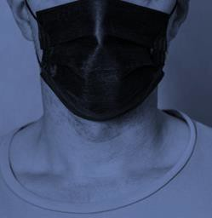
Motivation
Wearing a face mask is generally accepted to be a simple but effective health and safety precautionary measure for slowing the spread of COVID-19.
However forgetting to wear a mask, taking the mask off or wearing the mask incorrectly in vulnerable areas can threaten the safety of a given individual, their colleagues and co- workers.
This project was done with the objective of developing a face mask detector that can help automatically monitor vulnerable areas and identify individuals not wearing a mask or the ones wearing a mask incorrectly such that they can be reminded not to do so in future!

Slide 3
A simple Face Mask Detector
Downloading N numbers of images for all three classes of face mask.
Train the model on all three classes.
Split a video into its constituent frames
Apply an image recognition algorithm to each frame
Import the dataset.

Slide 4
Face mask detection
Load datasets having more than 20k images
Image preprocessing
Data augmentation
Train with MobileNetV2 model
extract unique characteristics & features from images.
Build model.
Converts image dataset into format that model expects.
Classify images (0: mask, 1: no mask, 2: incorrect)
Convert output pixel value between 0 & 1.
Performs normalization by dividing image pixel by 255.
Resize image (224, 224) which model expects.
Haar feature of algorithm, traverse pixel by pixel in the image and finds edge, line or any structure in image, where there is sudden change of intensities.
Pass live video as input to model
Predict images with trained model
Apply Haar-Cascade algorithm
Draws green square around faces having correct mask.
Draws red square around faces having incorrect/no mask.
Classify input image as correct mask, no mask or incorrect mask.

Slide 5


1. Collecting Dataset
This dataset will contain images belonging to the 3 classes. The classes will be:
With mask;
Without mask;
Mask worn incorrectly.
Based on these classes, the dataset will be trained.
Training dataset
Validation dataset
1561 images
531 images

Slide 6
2. Creating a CNN using “MobileNet V2” as a base
Data Augmentation layers
Google’s MobileNet V2 –
Pre-Trained CNN
The top layers of MobileNet V2 was unfrozen and re-trained to recognize masked and no mask or incorrectly
masked images
Average Pooling layer Flattening layer
Dense layer with 128 units and ReLU activation Early Stopping Checkpoint for model
Output layer with softmax activation function

Slide 7
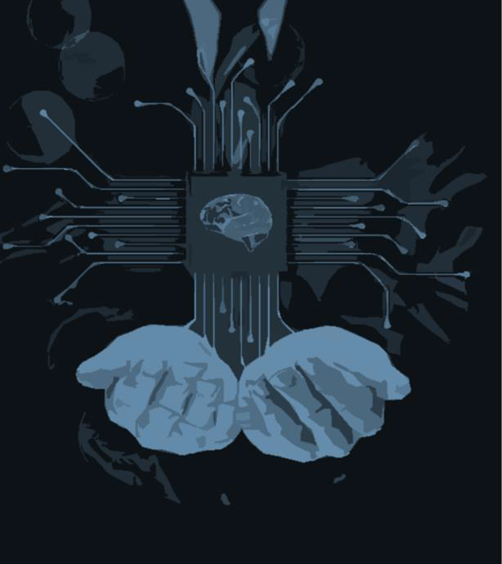


3. Compiling the CNN and Training
Learning Rate: 10𝒆^{−𝟓}
Optimizer: Adam
Metrics: Accuracy
Epochs: 10

Slide 8
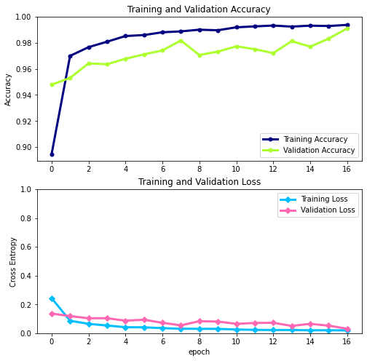
Training Results

Slide 9

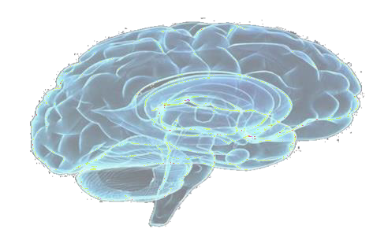


Using Open CV- Python for face recognition
4
“No Mask or Incorrectly Masked”
Prediction
Frontal Face
Recognition
+
Image capture
Image Classification and predicting the probability of “No Mask or Incorrectly Masked or Masked ”
Mask

Slide 10



Tools/technology :
Python
TensorFlow
Jupiter notebook

