Slide 1

FleetPro
Your whole transport business — trucks, drivers, trips and money — in one simple app
Client overview
Notes:
Welcome. In the next few minutes we will walk through FleetPro screen by screen. No technical knowledge is needed — if you run trucks, you already understand everything in this app.

Slide 2





Why FleetPro?
Today, without FleetPro
With FleetPro
Trip details written in registers
Every trip saved in one place, searchable
Payments tracked on phone and WhatsApp
Money received and pending shown per trip
Profit worked out by hand at month end
Profit calculated automatically, any time
Insurance or licence expiry noticed too late
Automatic reminders before papers expire
Notes:
Most transporters today keep trip details in a register, payments in WhatsApp chats and expenses in a notebook or Excel. Papers expire without anyone noticing. FleetPro brings all of it into one place and does the maths for you.

Slide 3






Everything a transporter needs, in six parts
Trucks
Drivers & Agents
Trips
Every vehicle and its papers
Your drivers and the parties who give loads
Going and return loads, km, rate, deal
Money
Reminders
Reports
Payments received, expenses, pending
Alerts before any paper expires
Profit & loss, Excel export, print
Notes:
These are the six main parts of FleetPro. We will look at each one with a real screen from the app.

Slide 4

How it works, in five simple steps
1
2
3
4
5
Add trucks & drivers
Create a trip
Record expenses
Record payments
See your profit
Once, at the start
Pick truck, driver, route and load
Diesel, toll, repairs — with bill photo
Advance and balance from the party
Calculated automatically
Notes:
This is the normal daily flow. Step 1 is done only once per truck or driver. Steps 2 to 4 happen for every trip. Step 5 — the profit — is calculated by FleetPro automatically.

Slide 5
Getting started
Logging in and your home screen

Slide 6
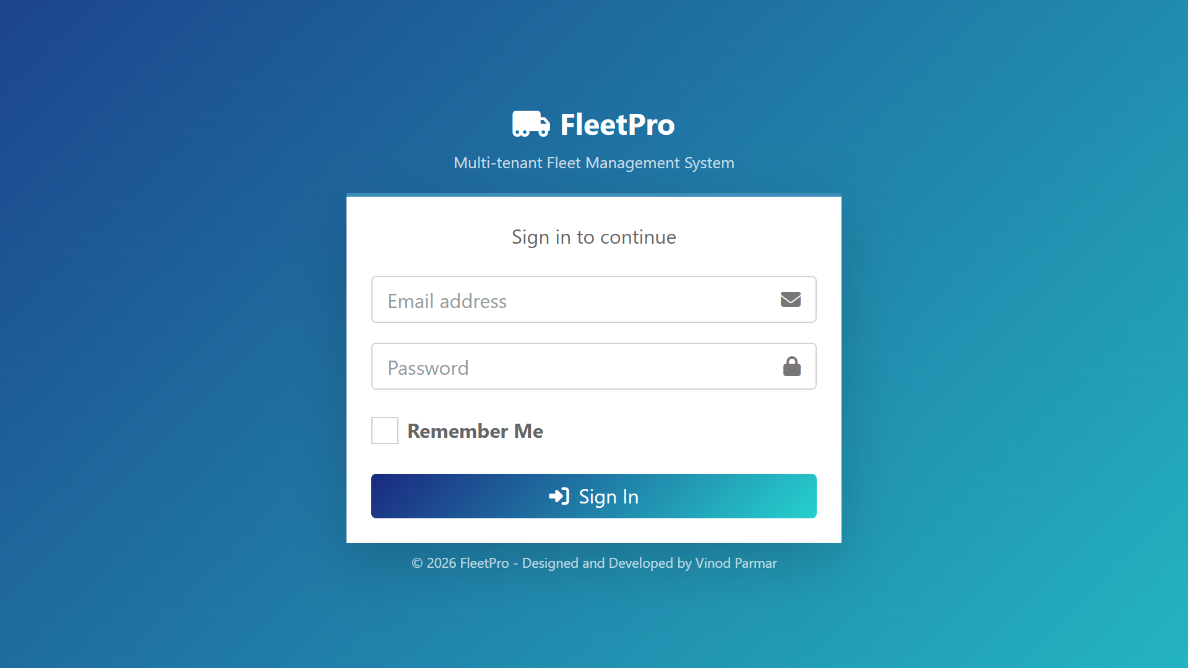
Safe and private login
1
Your own login
Every staff member gets their own email and password.
2
Auto screen lock
If the screen is left idle, it locks itself until the password is entered.
3
Your data stays yours
Each company sees only its own trucks, trips and money.
Notes:
Every person signs in with their own email and password. If someone walks away from the computer, the screen locks itself. Most importantly: your data is private. Another transport company using FleetPro can never see your trucks, trips or money.

Slide 7
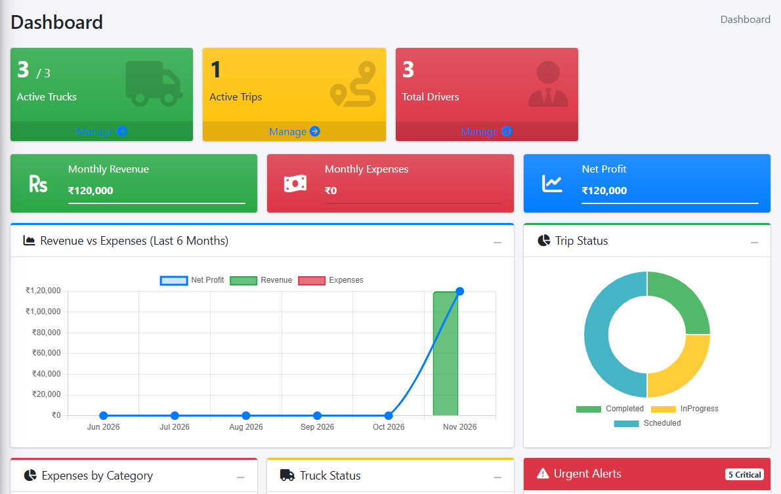
Dashboard — your business at a glance
1
Today’s picture
How many trucks are active, trips running and drivers on the team.
2
This month’s money
Revenue, expenses and net profit — updated by itself.
3
Charts and urgent alerts
Six-month trend, trip status and papers that need attention.
Notes:
This is the first screen after login. At the top: trucks, active trips and drivers. Below that: this month's revenue, expenses and profit. The charts show the last six months and the red box lists urgent reminders. You don't enter anything here — it fills itself from your trips.

Slide 8
Your fleet
Trucks, drivers and agents

Slide 9
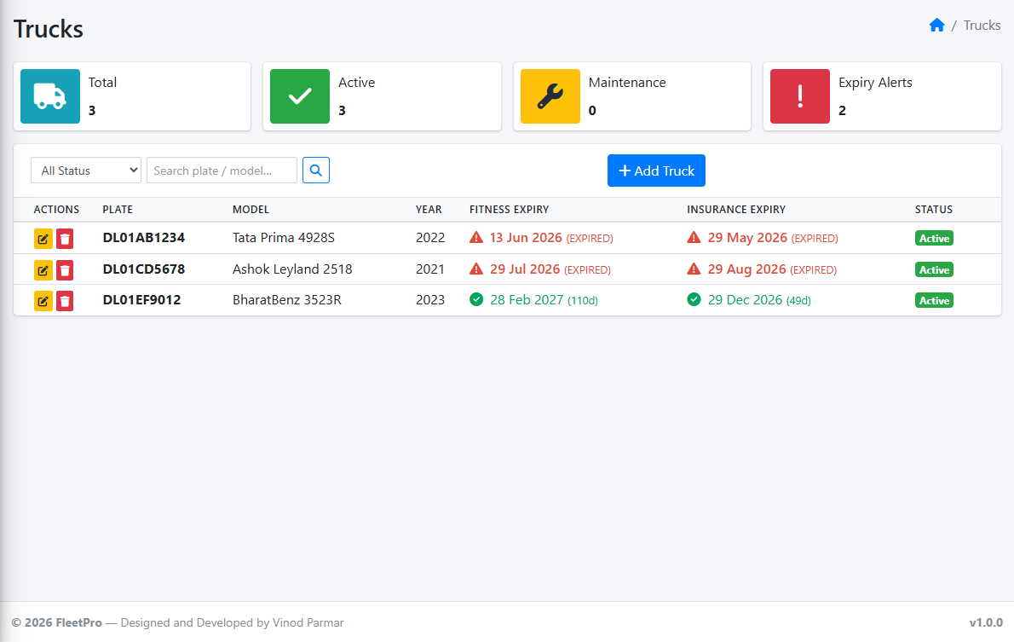
Trucks — every vehicle and its papers
1
All trucks in one list
Number plate, model, year and status — search in seconds.
2
Paper expiry dates
Fitness, insurance, tax, permit, PUC and authorization.
3
Colour tells the story
Green means fine. Red means expired — act now.
Notes:
Here you see all your trucks. The most useful part is the expiry columns: green means the paper is valid, red means it has expired. The top boxes show totals, and how many trucks need attention.

Slide 10
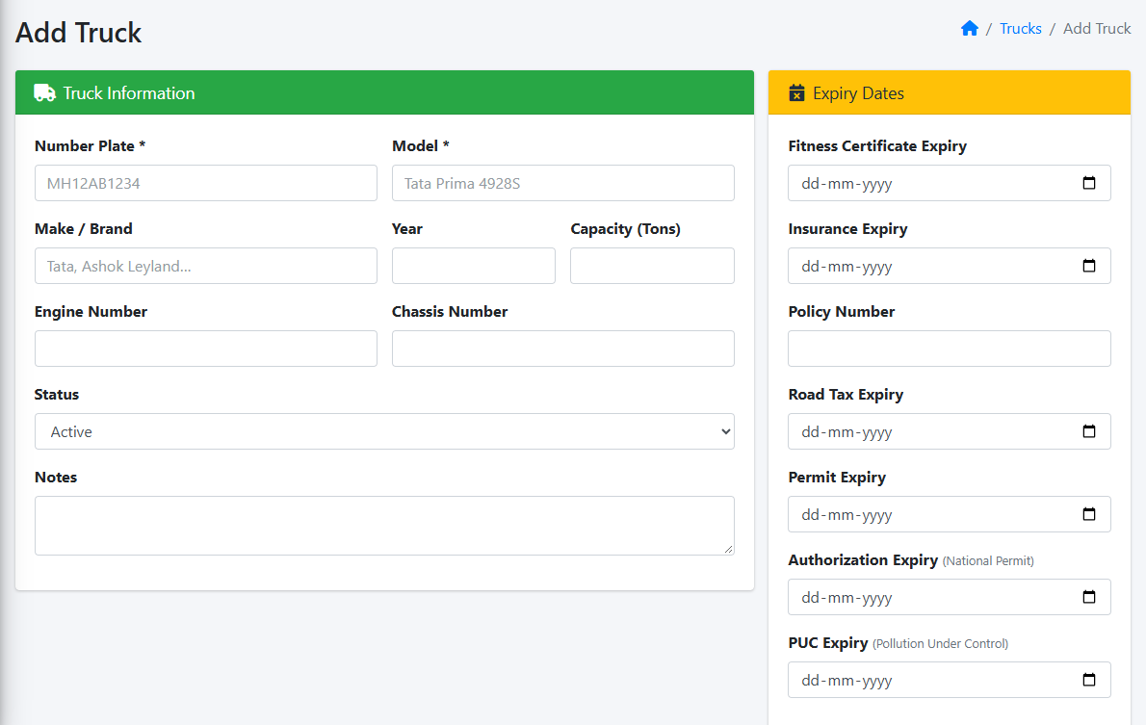
Adding a truck takes one simple form
1
Fill it once
Number plate, model, make and load capacity.
2
Enter paper dates
FleetPro will remind you before each one expires.
3
Change any time
Edit details whenever a paper is renewed.
Notes:
Adding a truck is one form. Enter the number plate and model, and the dates of each paper. That's all — from now on FleetPro watches those dates for you.

Slide 11
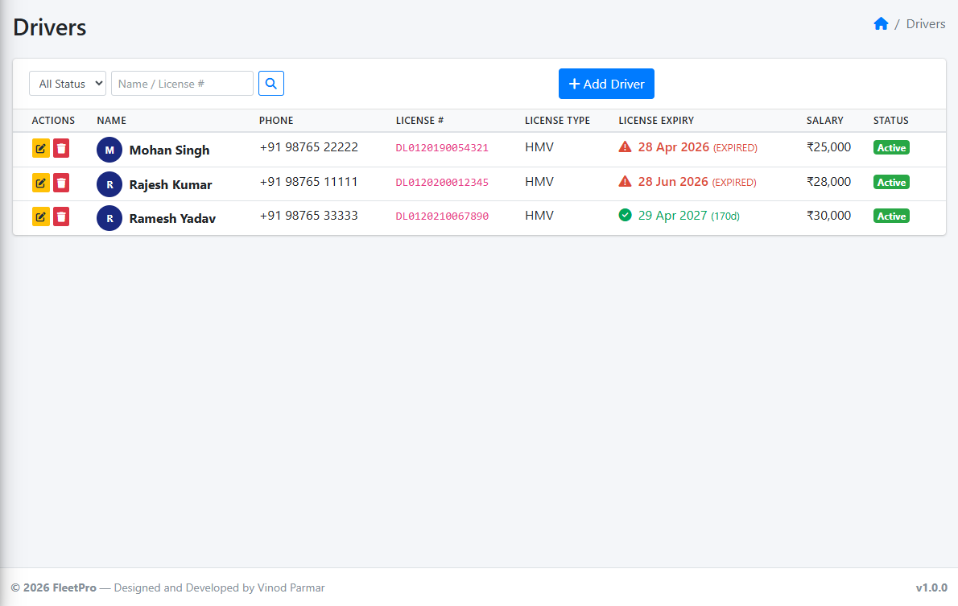
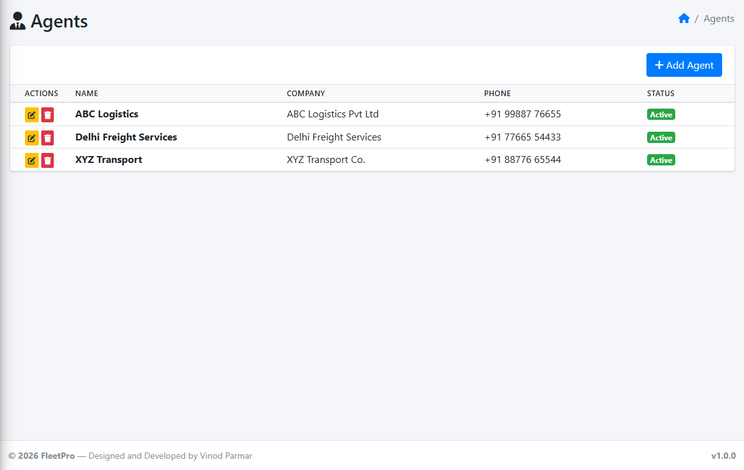
Drivers and agents
Drivers
Agents (brokers / parties)
Licence and expiry, phone, monthly salary and bank details.
Who gives you loads — pick them when creating a trip.
Notes:
Drivers: keep licence number and expiry, phone, salary and bank details in one place. Agents are the brokers or parties who give you loads — keep their contact details here so you can pick them when creating a trip.

Slide 12
Trips and money
From loading to final payment

Slide 13
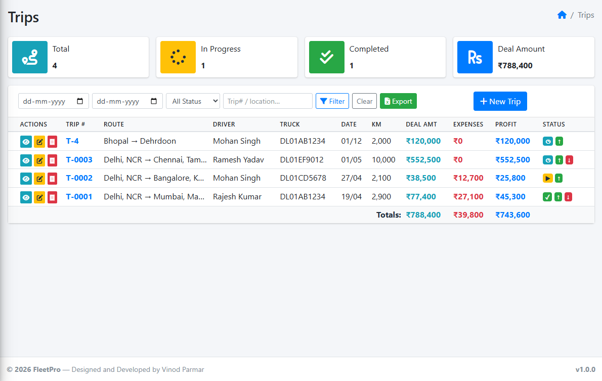
Trips — every journey in one list
1
Full picture per trip
Route, driver, truck, km, deal amount, expenses and profit.
2
Find anything fast
Filter by date or status, or search by trip number or city.
3
Export to Excel
One click gives you the list as an Excel file.
Notes:
Every trip is one row. You can see at a glance how much each trip earned, how much was spent and what profit it made. The totals row at the bottom adds everything up.

Slide 14
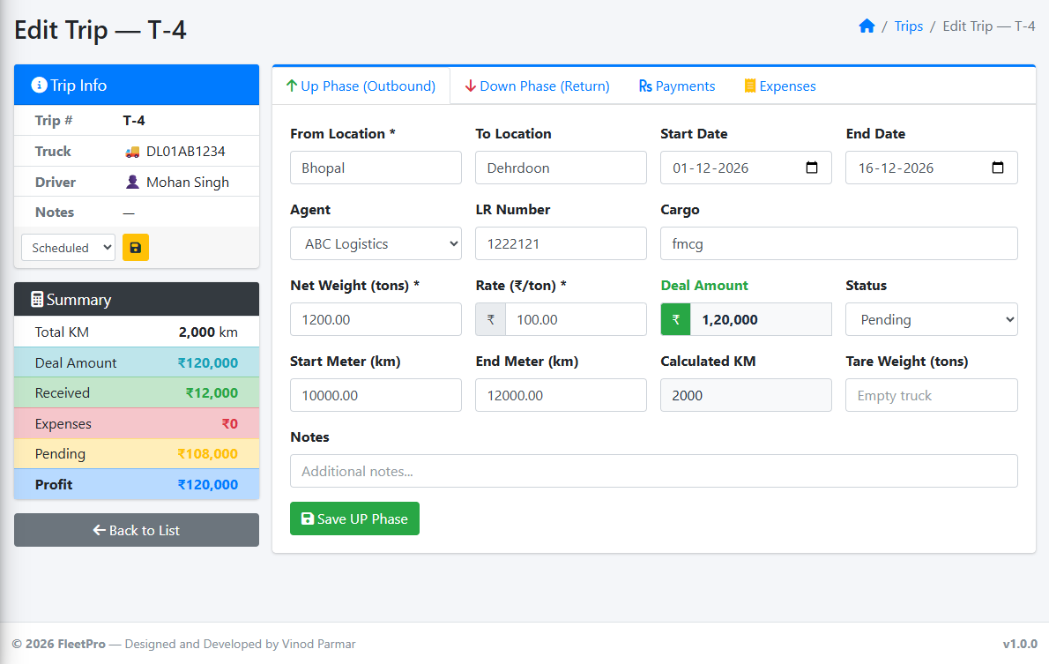
Going and return load — both in one trip
1
Up and Down journey
“Up” is the going load, “Down” is the return load.
2
Maths done for you
Weight × rate gives the deal amount. Meter readings give the km.
3
Live summary
Left box shows deal amount, received, pending and profit.
Notes:
A trip has two parts: the going load (Up) and the return load (Down). Enter the weight and rate, and FleetPro calculates the deal amount. Enter start and end meter readings and it calculates the kilometres. The summary on the left updates by itself.

Slide 15
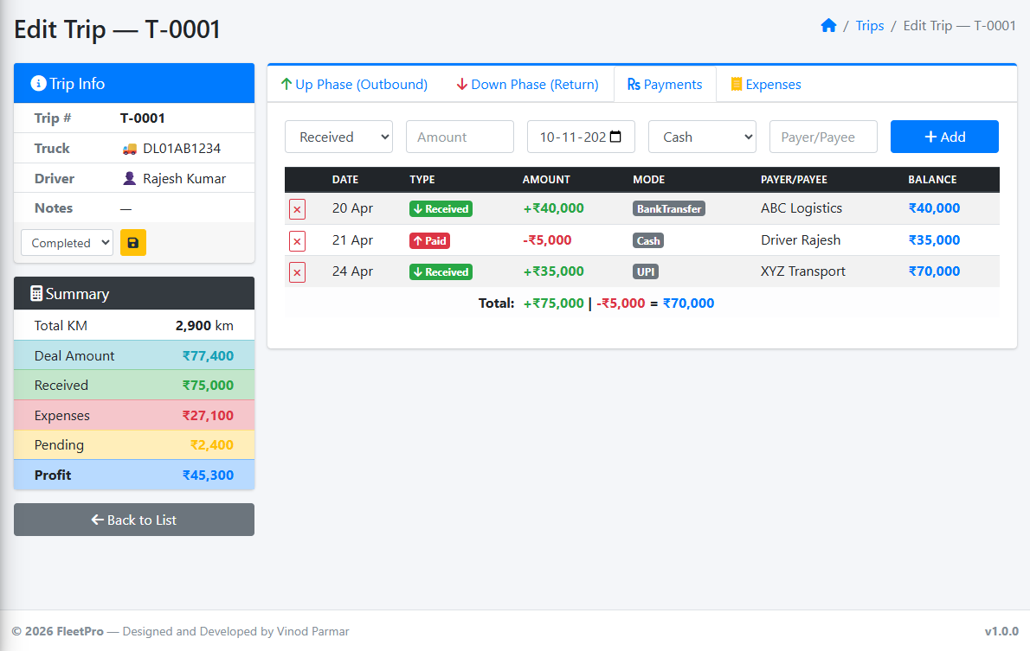
Payments — know exactly what is pending
1
Money in
Record advance and balance received from the party.
2
Money out
Record amounts paid, for example to the driver.
3
Pending amount
FleetPro shows how much the party still owes on this trip.
Notes:
Every payment for the trip is recorded here — cash, UPI or bank transfer. Money received is green, money paid is red. The summary shows how much is still pending from the party, so nothing is forgotten.

Slide 16
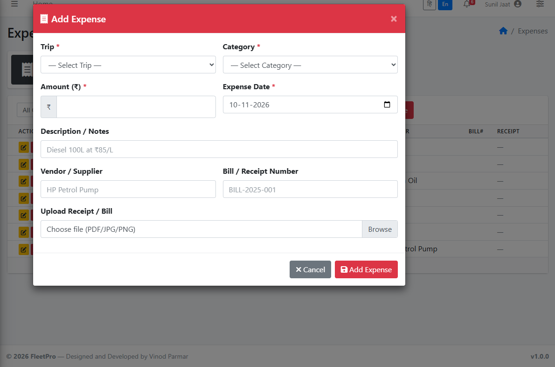
Expenses — with a photo of the bill
1
Quick pop-up form
Pick the trip and the type: diesel, toll, repair and more.
2
Attach the bill
Upload a photo or PDF of the receipt as proof.
3
Profit updates itself
The expense is added to the trip and profit is recalculated.
Notes:
Expenses are added from a small pop-up. Choose the trip and the expense type, enter the amount, and attach a photo of the bill. The trip's profit is updated straight away.

Slide 17
Stay in control
Reminders, reports, language and team

Slide 18
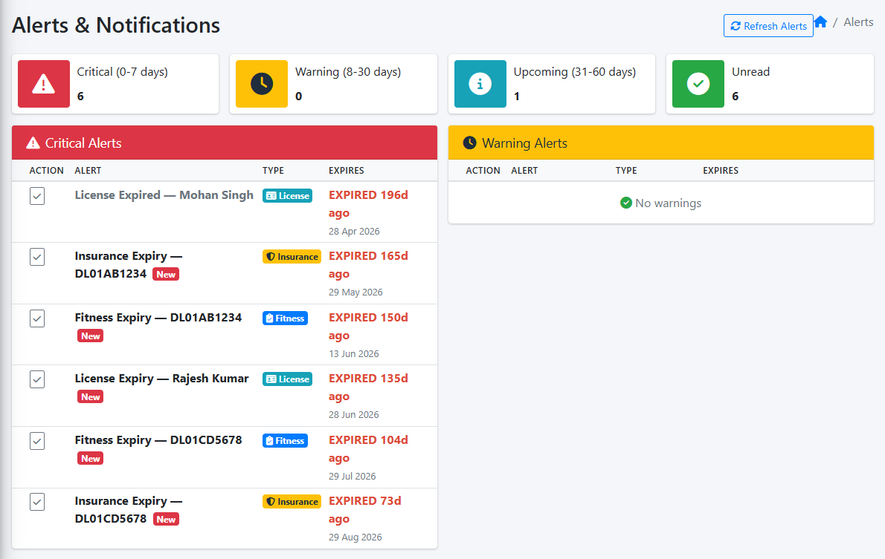
Reminders before papers expire
1
Automatic alerts
For truck insurance, fitness and driver licences.
2
Easy colours
Red: 0–7 days. Yellow: 8–30 days. Blue: 31–60 days.
3
Bell on every screen
The red number on the bell shows unread alerts.
Notes:
FleetPro checks every date for you. Anything expiring within 7 days — or already expired — is red. 8 to 30 days is yellow, and 31 to 60 days is blue. No more fines because a paper expired unnoticed.

Slide 19
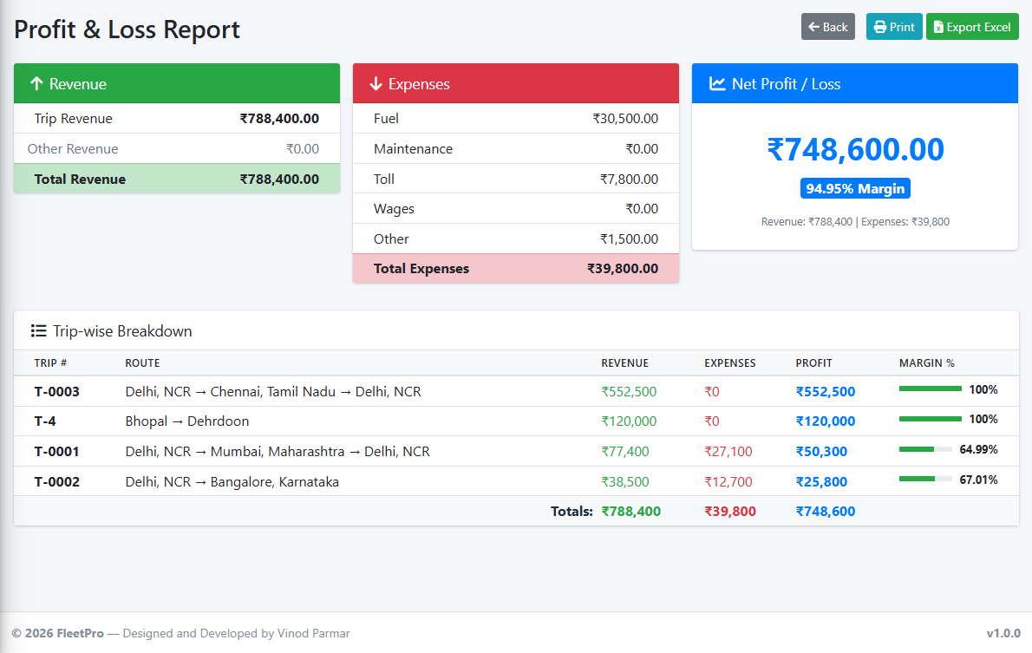
Profit & loss report in one click
1
Pick any dates
This month, last quarter or the whole year.
2
Where money went
Revenue against fuel, toll, maintenance, wages and others.
3
Print or Excel
Share it with your accountant or partner.
Notes:
Choose a date range and FleetPro builds the profit and loss statement: total revenue, expenses by type, and the net profit with margin. The table below shows profit trip by trip. Print it or download it as Excel.

Slide 20
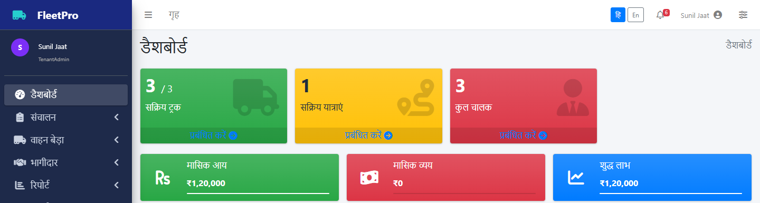
Works in Hindi and English
1
One click to switch
2
Whole app changes
3
Remembered
Use the हि / En buttons at the top right.
Menus, labels and buttons appear in Hindi.
Each person’s choice is saved for next time.
Notes:
Every user can switch between Hindi and English with one click at the top of the screen. Menus, labels and buttons change language. The choice is remembered for next time.

Slide 21
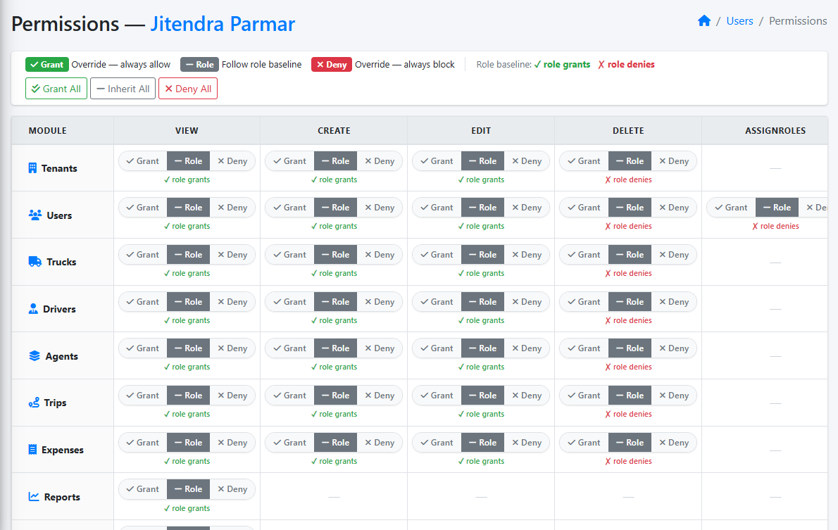
Your team, with the right access
1
Add your staff
Each person gets a login under your company.
2
Ready-made roles
Admin: everything. Data entry: add and edit, no delete. Viewer: only see.
3
Fine-tune per person
Allow or block any single action with Grant / Deny.
Notes:
You decide who can do what. Choose a role — Admin, Data Entry or Viewer — and, if needed, allow or block individual actions for one person. For example, a data-entry person can add expenses but not delete trips.

Slide 22
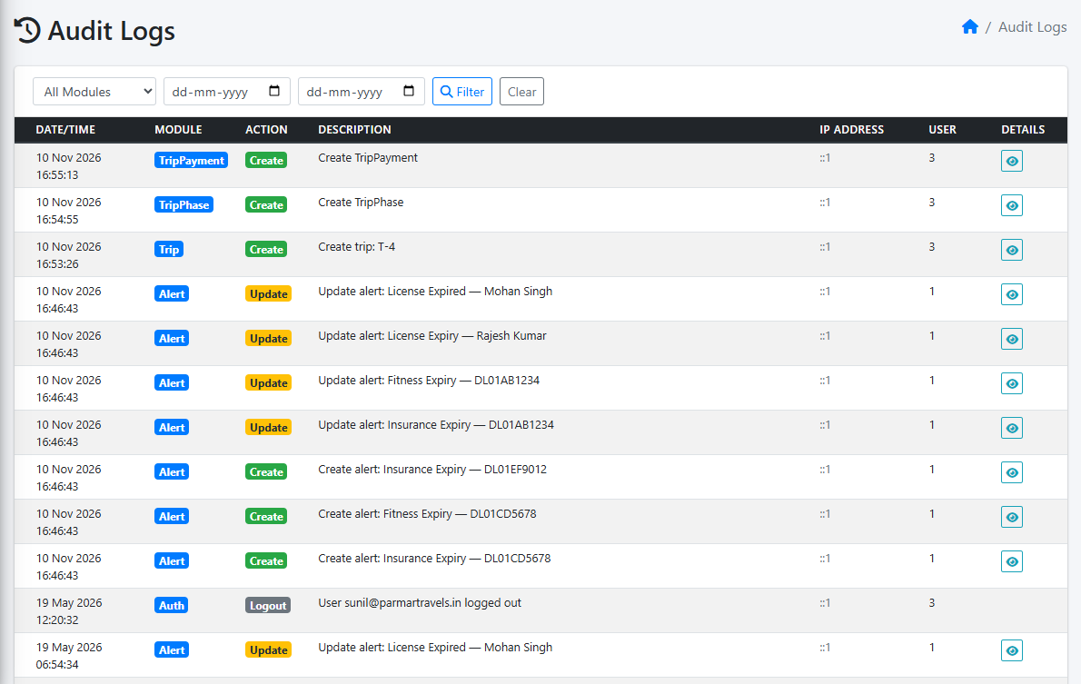
A full history of every change
1
Who, what, when
Every add, edit and delete is recorded automatically.
2
Filter and search
By module and date range.
3
Peace of mind
Nothing changes silently — you can always check.
Notes:
The audit log records every change: who did it, what they changed and when. It is useful when two people remember something differently, or when you want to check what a staff member did.

Slide 23
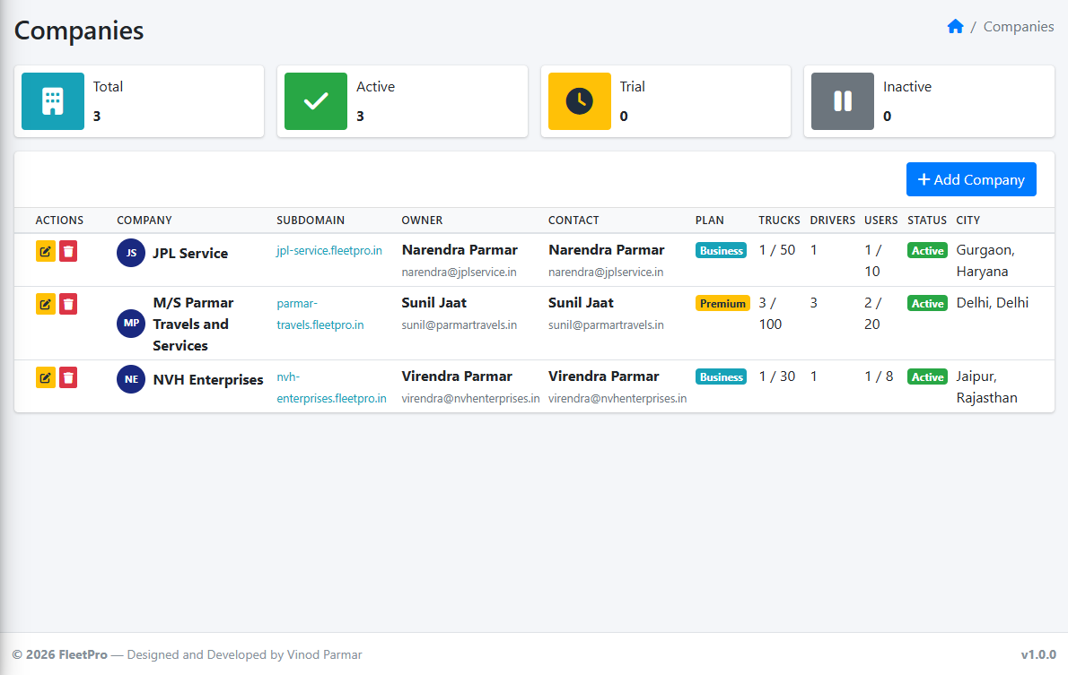
One platform for many transport companies
1
Separate company accounts
Each transporter has its own private space and logins.
2
Plans and limits
Each company has a plan with a truck and user limit.
3
Central control
The owner manages companies, roles and expense types.
Notes:
FleetPro is built so many transport companies can use it at the same time, each with complete privacy. The platform owner can add new companies, set their plan and limits, and manage common settings such as expense types.

Slide 24
What FleetPro gives you
Every trip, payment and expense in one place
Profit and pending money — calculated automatically
Reminders before any paper expires
Ready reports to print or send as Excel
Thank you — questions welcome
Notes:
To sum up: one place for trips, money and papers; profit worked out for you; reminders before anything expires; and reports ready to share. Happy to answer any questions or give a live demo.

