Slide 1

Shri Dharmasthala Manjunatheshwara College of Engineering & Technology
Department of Electronics and Communication Engineering
GESTURE CONTROL ROBOTIC ARM
MINOR PROJECT - 1
(22UECL505)
Guided By : Assistant Prof. Raghuram. K. M

Slide 2
GROUP OF MEMEBERS IN PROJECT
Sl.NO | NAME OF STUDENTS | USN
01 | Sourab R | 2SD24EC409
02 | Naveen | 2SD23EC066
03 | Shankar M T | 2SD24EC406
04 | Vinod patil | 2SD24EC413

Slide 3

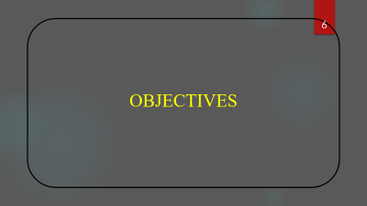

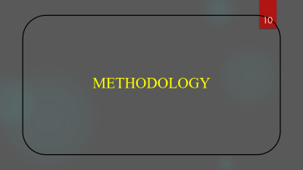
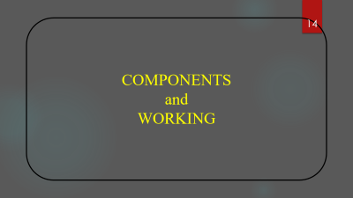





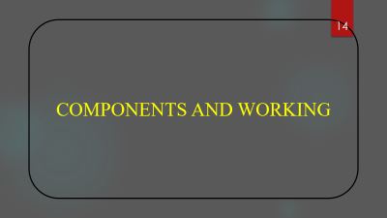
CONTENTS

Slide 4
INTRODUCTION

Slide 5
INTRODUCTION
Robots are evolving from pre-programmed machines to interactive systems.
Gesture control enables robots to respond to natural human movements.
Gestures (like hand motions) act as commands for robot control.
Creates a bridge between human behavior and machine response.
Improves user-friendliness and natural communication.
Uses sensors (accelerometers, cameras) to detect gestures.
Microcontrollers/computers process signals to move the robotic arm.
Applications: Industrial automation, medical aid, prosthetics, VR.
The experiment explores gesture-based control instead of buttons or remotes.
Beneficial for non-technical users and assistive applications.

Slide 6
OBJECTIVES

Slide 7
OBJECTIVES
To design a robotic arm that responds accurately to human hand gestures.
To develop a system that reduces the need for manual operation through gesture recognition.
To utilize sensors (like accelerometers) for real-time gesture detection.
To enhance human–machine interaction through intuitive and contactless control.
To improve efficiency and precision in handling objects remotely.
To create a cost-effective and user-friendly robotic control system.
To demonstrate the integration of hardware and software for motion control.
To explore applications in industries, healthcare, and hazardous environments.
To minimize human effort in repetitive or risky tasks.
To promote innovation in automation and robotics using gesture-based technology.

Slide 8
LITERATURE REVIEW

Slide 9
LITERATURE REVIEW
Earlier gesture-controlled systems used basic image-processing methods, which were slow and highly affected by lighting changes.
Researchers later introduced machine-learning–based hand detection, improving accuracy but requiring high computational power.
Google MediaPipe became a widely used framework because it provides fast and reliable hand-landmark detection suitable for real-time applications.
Studies show that MediaPipe-based gesture recognition significantly improves gesture accuracy, stability, and responsiveness.
Previous robotic arm projects often used buttons, joysticks, or wired controllers, which limited human–robot interaction.

Slide 10
METHODOLOGY

Slide 11
METHODOLOGY
Problem Identification: Recognize the need for a contactless and intuitive method to control robotic arms using human gestures.
System Design: Develop a framework integrating a camera module, microcontroller, and robotic arm mechanism.
Image Capture: Use a webcam or camera to continuously capture real-time hand gesture images..
Feature Extraction: Identify key points of the hand, such as finger positions and palm orientation.
Gesture Recognition: Implement machine learning or deep learning algorithms to classify gestures.
Signal Transmission: Convert recognized gestures into corresponding control signals.
Arduino Interface: Send these signals to the arduino to control the robotic arm’s movements.
Testing and Calibration: Test system accuracy, responsiveness, and adjust sensitivity parameters.
Performance Evaluation: Analyze results for speed, precision, and reliability to ensure optimal control.

Slide 12
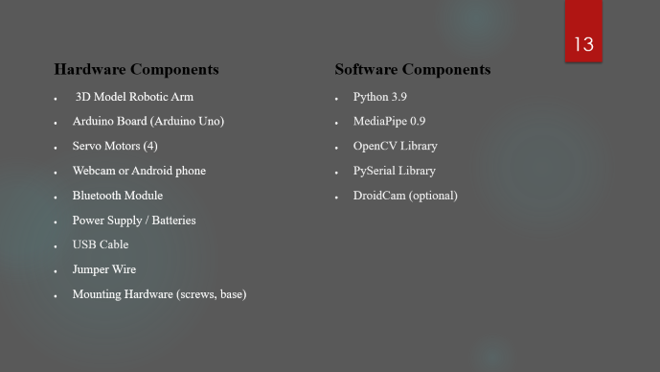
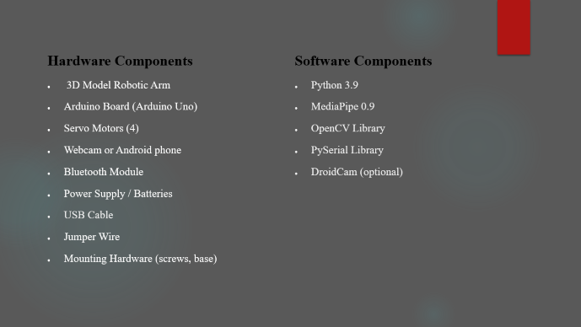
COMPONENTS USED FOR THIS PROJECT :

Slide 13
Hardware Components
3D Model Robotic Arm
Arduino Board (Arduino Uno)
Servo Motors (4)
Webcam or Android phone
Bluetooth Module
Power Supply / Batteries
USB Cable
Jumper Wire
Mounting Hardware (screws, base)
Software Components
Python 3.9
MediaPipe 0.9
OpenCV Library
PySerial Library
DroidCam (optional)

Slide 14
COMPONENTS AND WORKING

Slide 15
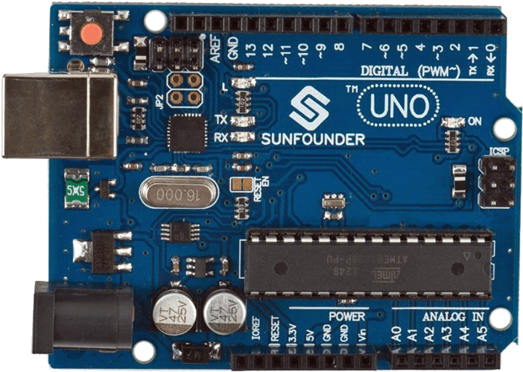
HC-05 BLUETOOTH
SERVO
MOTORS
CABLES
N
WIRES
MEARM
ROBOTIC ARM
ARDUINO
UNO
co
co
co
WEBCAM

Slide 16
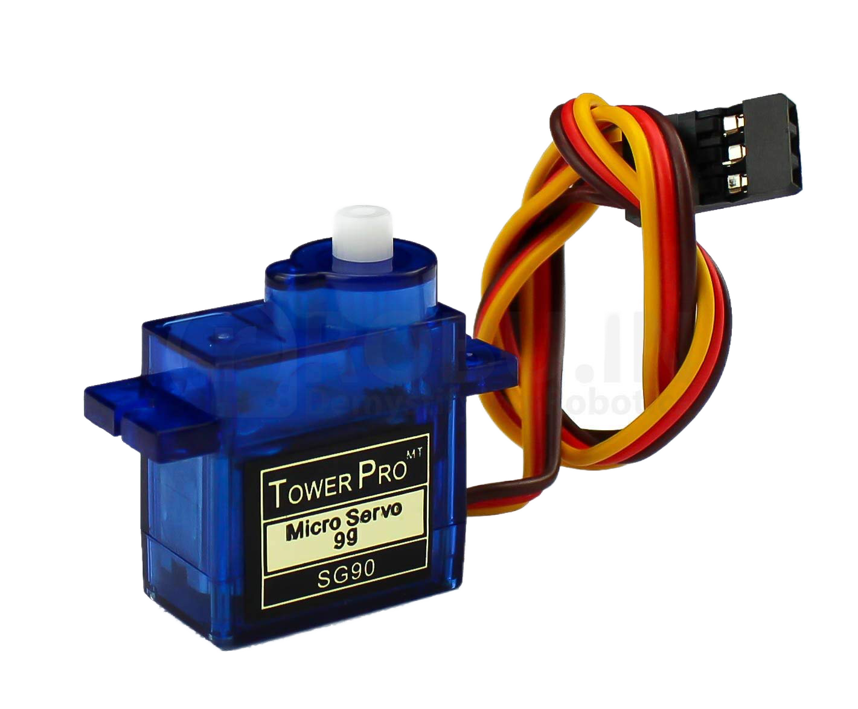
CABLE AND WIRES
HC-05
BLUETOOTH
SERVO
MOTORS
co
co
co
ARDUINO
UNO

Slide 17
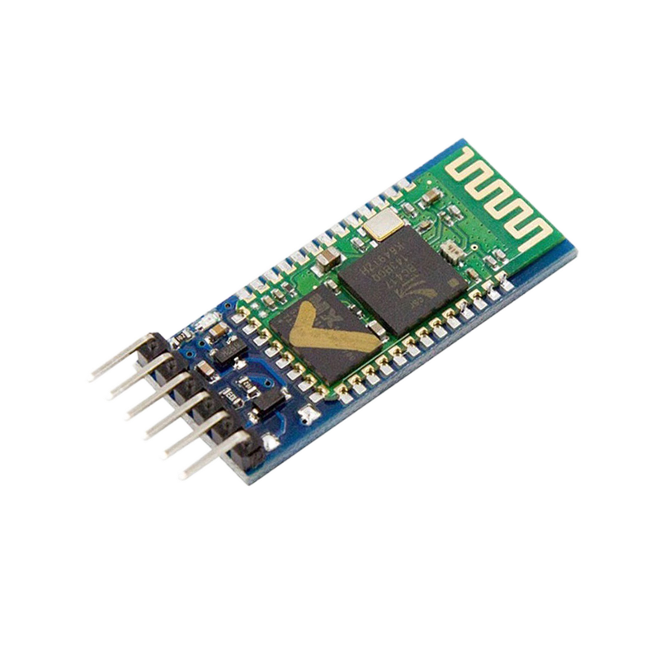
webcam
Robotic Arm
HC-05
BLUETOOTH
co
co
co
SERVO
MOTORS
Arduino
uno

Slide 18
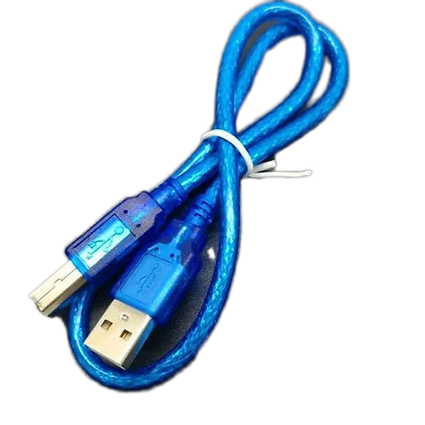
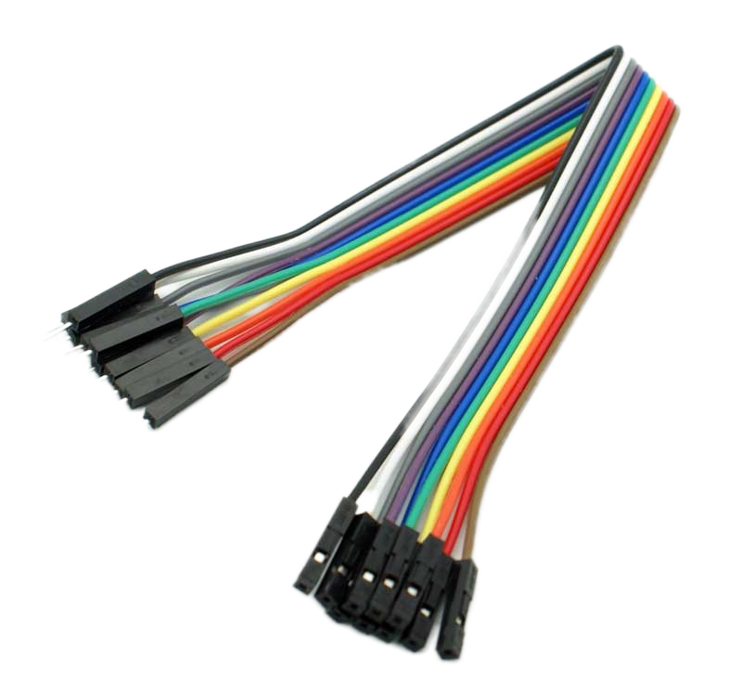
webcam
Robotic Arm
Cables
co
co
co
HC-05
BLUETOOTH
Servo
motor

Slide 19
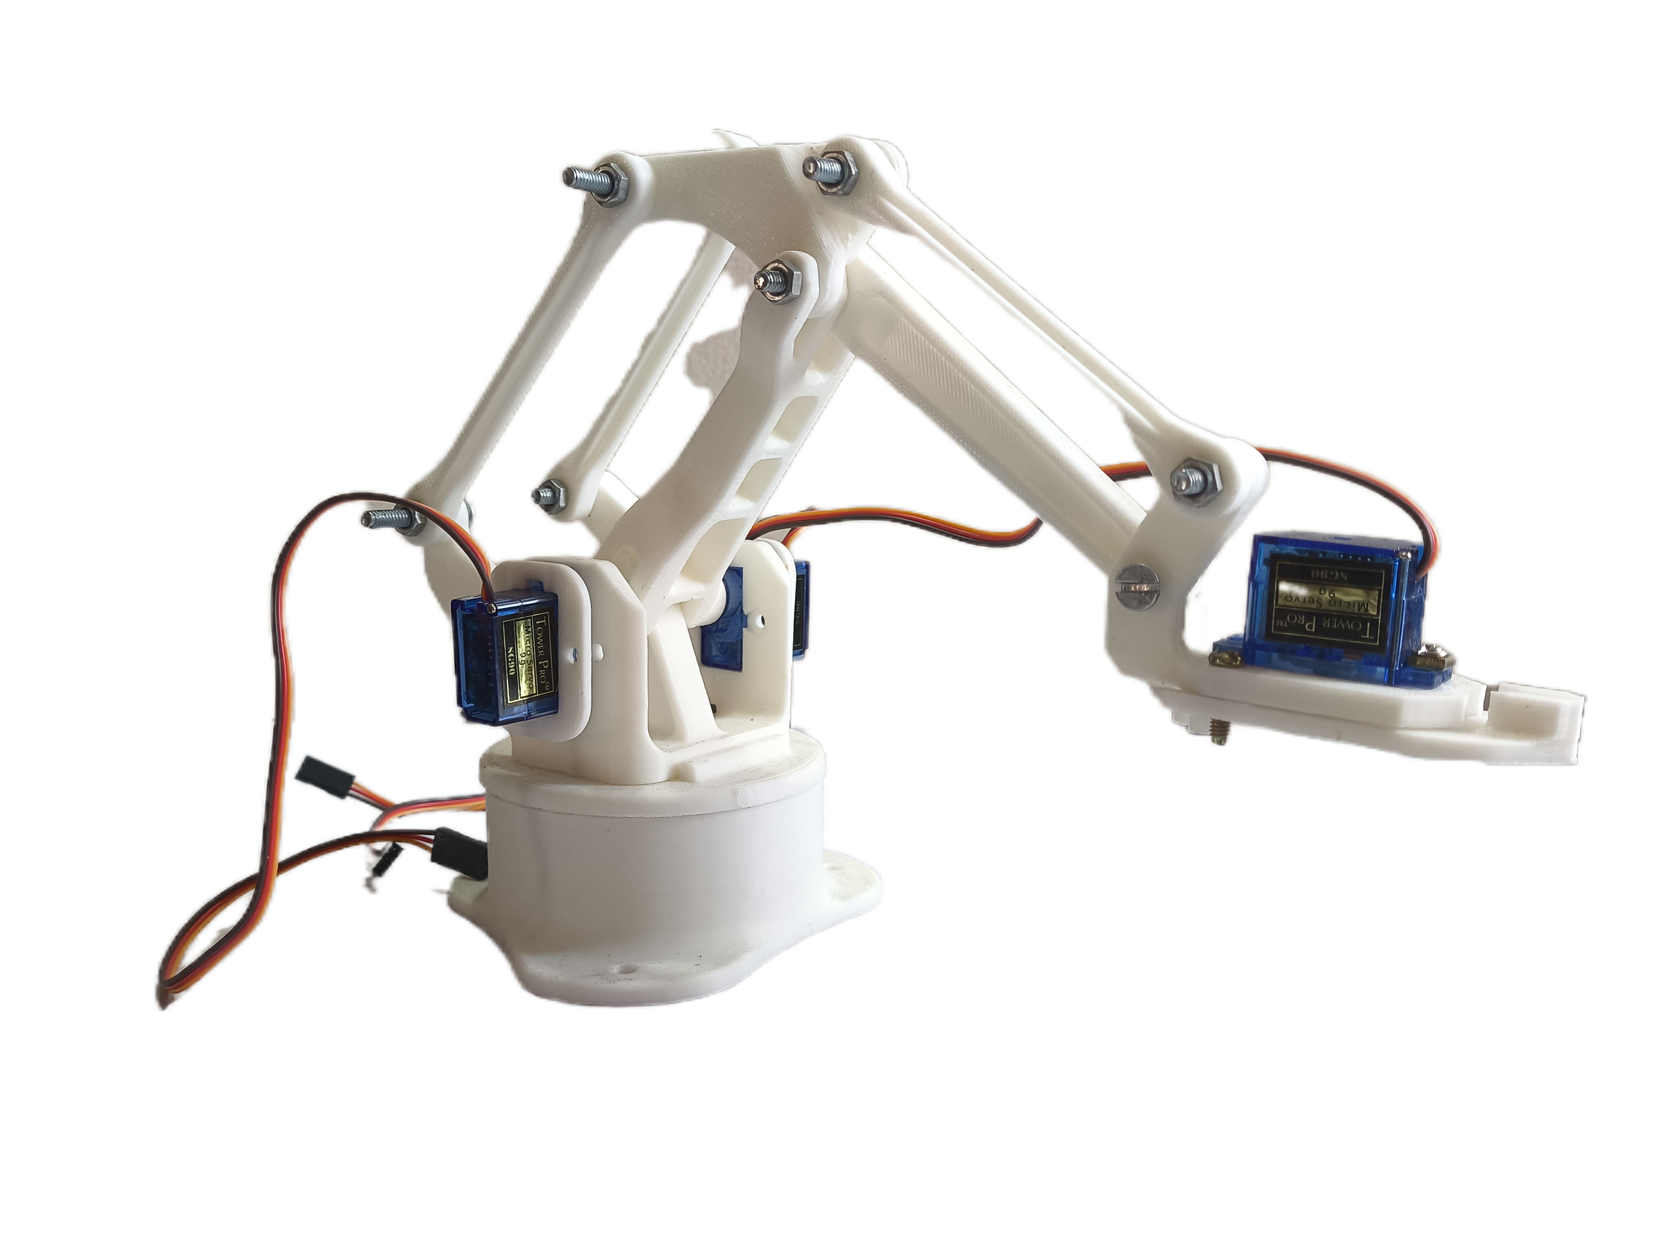
Webcam
Robotic Arm
co
co
co
Cables
HC-05
bluetooth

Slide 20
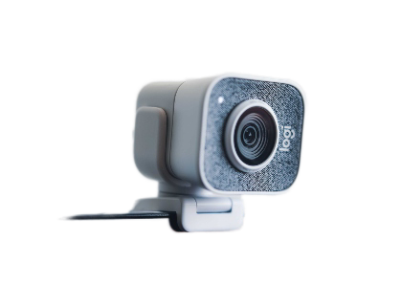
Webcam
co
co
co
Robotic Arm
Cable
wires

Slide 21
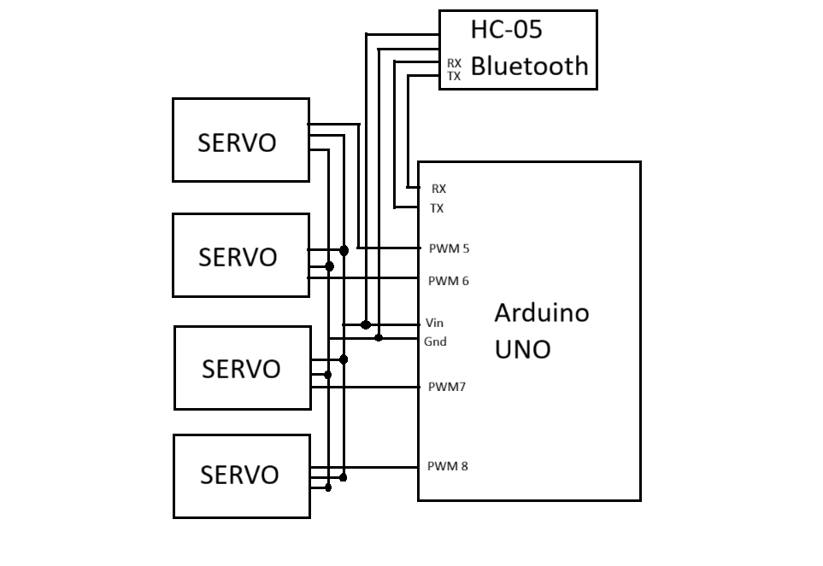
BLOCK DIAGRAM

Slide 22

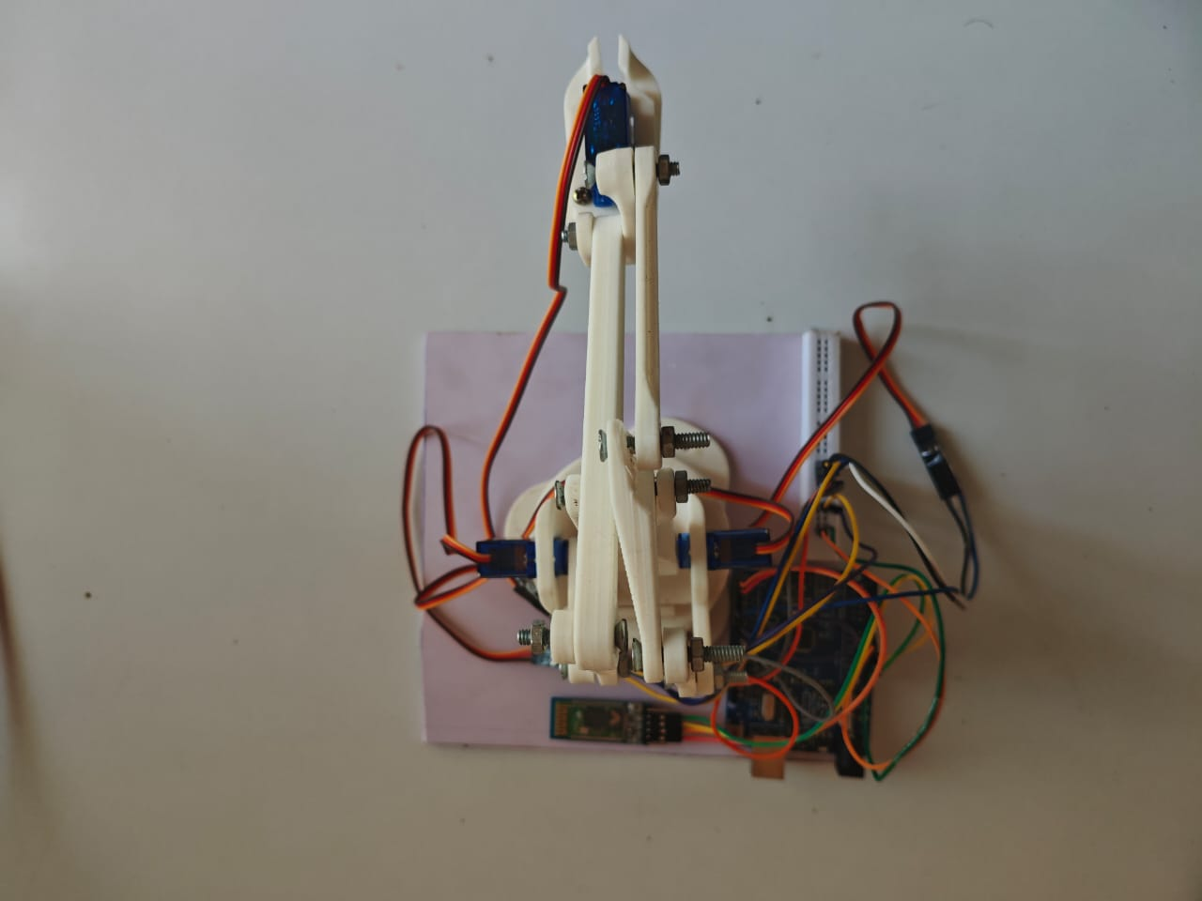
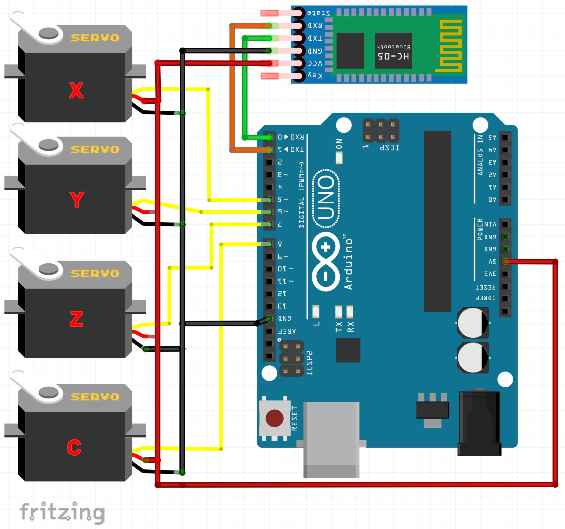
WORKING
This is a gesture recognition program for the Arm. It uses the MediaPipe to detect hand gestures
and control the Arm.
Uses Bluetooth module for communication .
Serial communication with Arduino uno .(ser = serial.Serial(COM10,9600)).

Slide 23
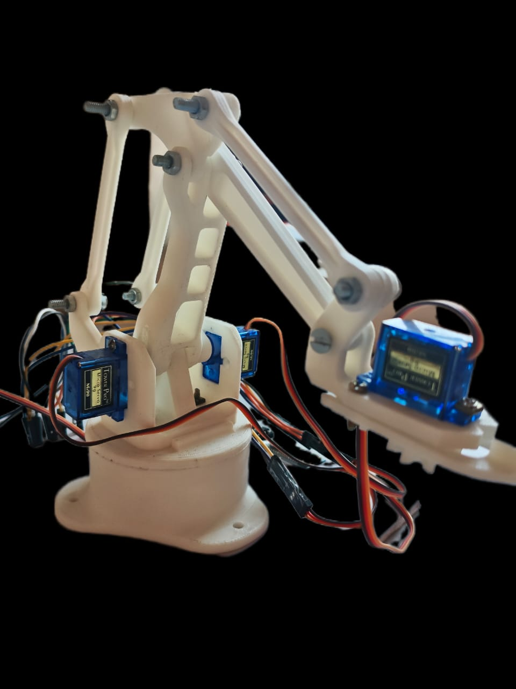
Code:
x_min = 0 x_mid = 75 x_max = 150
y_min = 0 y_mid = 90 y_max = 180 z_min = 10 z_mid = 90 z_max = 180
Software:
Python 3.9
Arduino IDE
MediaPipe 0.9
OpenCV Library
PySerial Library
Z
Y
C
X

Slide 24
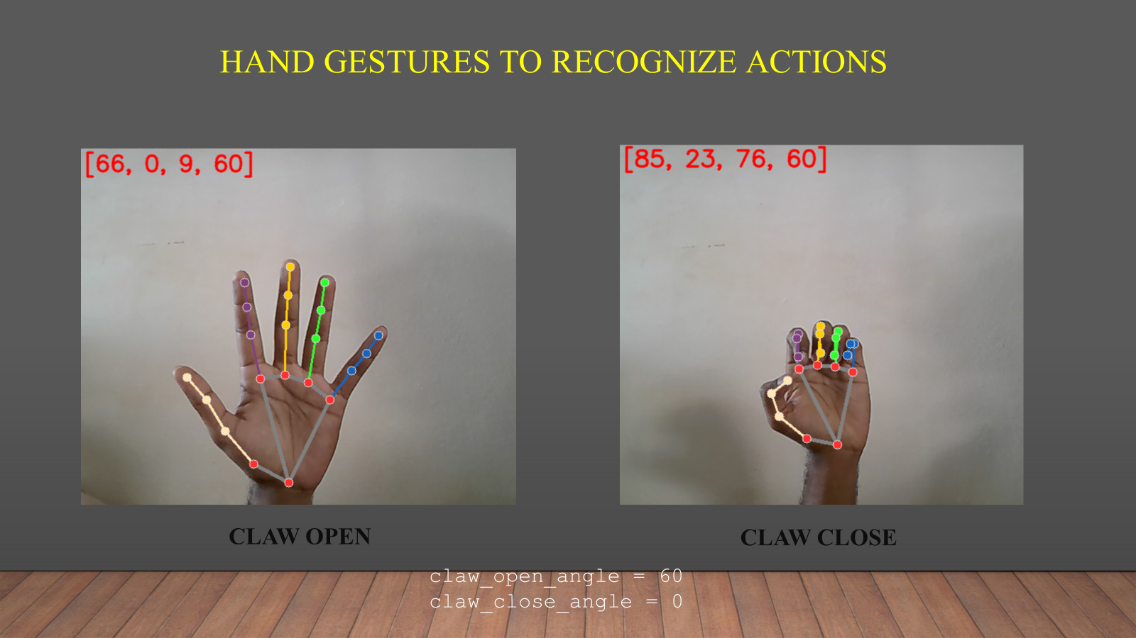
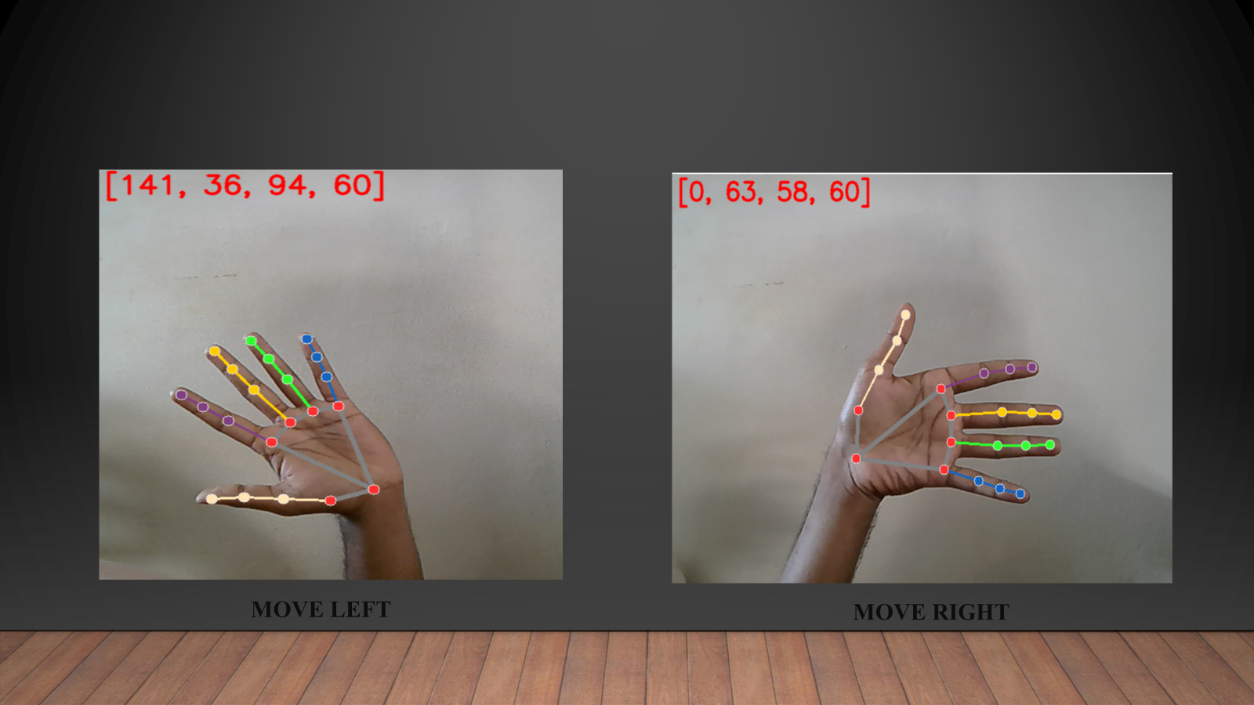
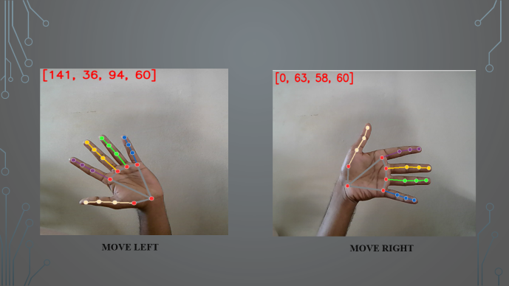

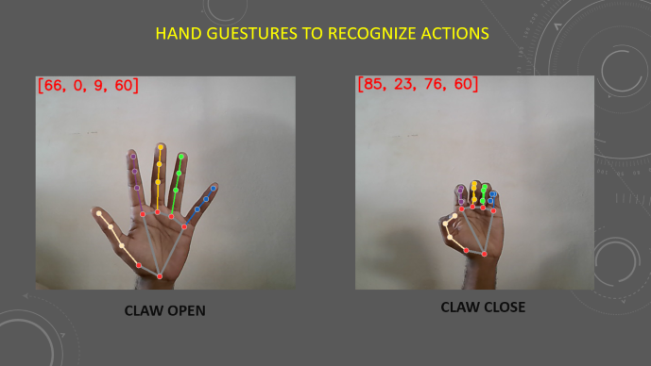
HAND GESTURES TO CONTROL ARM :

Slide 25
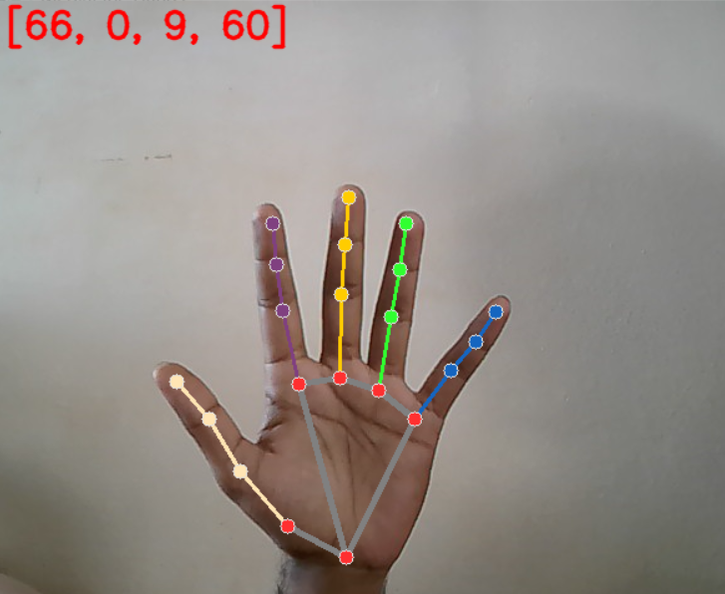
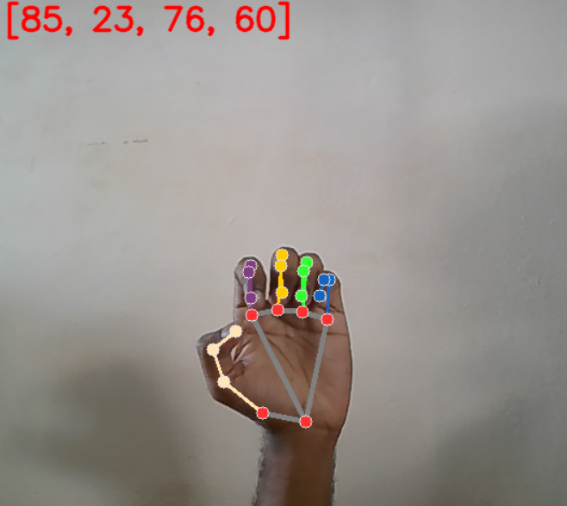
HAND GESTURES TO RECOGNIZE ACTIONS
CLAW OPEN
CLAW CLOSE
claw_open_angle = 60 claw_close_angle = 0

Slide 26
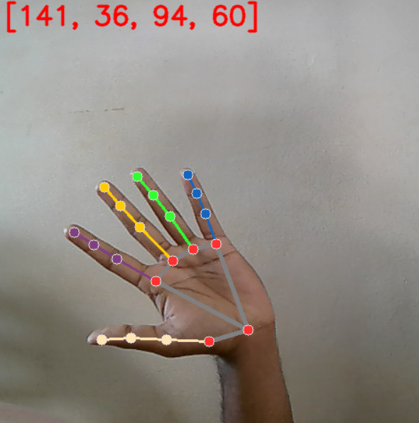
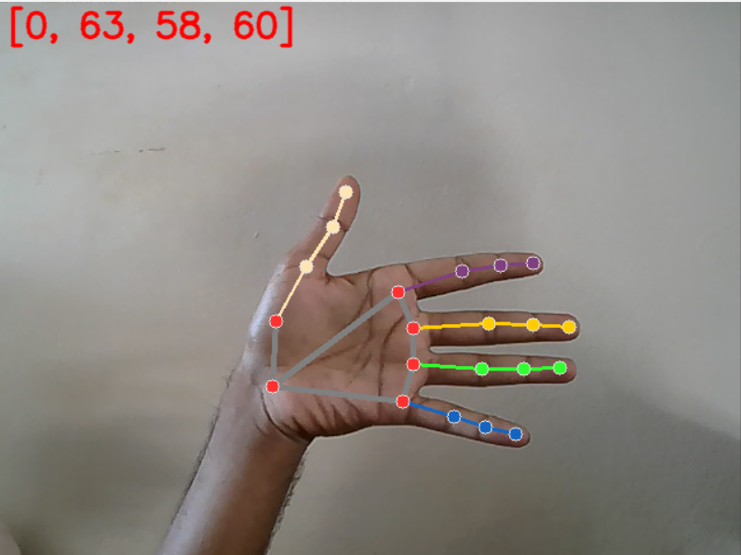
MOVE LEFT
MOVE RIGHT

Slide 27
APPLICATIONS OF PROJECT

Slide 28
APPLICATIONS OF PROJECT
Nuclear plants
Chemical industries
Fire affected zones
Helpful for older citizens and helping physically challenged people to move the objects
Hazardous Industrial works
One time investment
Reduce human effort and increases productivity

Slide 29
LIMITATIONS

Slide 30
Limitations
Dependent on Lighting Conditions
Limited Gesture Recognition Accuracy
Limited Operating Range
Latency in Wireless Communication

Slide 31
CONCLUSION

Slide 32
CONCLUSION
The gesture-controlled robotic arm was successfully designed and implemented using computer vision and embedded systems. Hand gestures were detected in real time using a camera-based vision system. MediaPipe and OpenCV were used to extract hand landmarks and recognize gestures accurately. Recognized gestures were mapped to corresponding movements of the robotic arm. Python-based algorithms effectively controlled the microcontroller and servo motors. The system demonstrated smooth and responsive arm movement with minimal delay. Experimental testing confirmed reliable operation for basic pick-and-place tasks. The project validated the feasibility of gesture-based human–robot interaction. The modular design allows easy hardware and software expansion in the future. Overall, the system shows strong potential for automation and assistive applications

Slide 33
REFERENCES

Slide 34
REFERENCES
J. Paterson and A. Aldabbagh, “Gesture-controlled robotic arm utilizing OpenCV,” in IEEE Xplore, 2013.
D. G. Michels et al., “Real-Time Hand Gesture Control of a Robotic Arm with Programmable Motion Memory,” 22nd International Conference on Informatics in Control, Automation and Robotics (ICINCO 2025).
Oudah, M., Al-Naji, A., & Chahl, J. (2020). Hand gesture recognition based on computer vision: a review of techniques. journal of Imaging, 6(8), 73.
Chaitanya, D., Suhasini, Y. A., & Nagarjun, G. (2017). Home Appliances Control Based on Hand Motion Gesture. International Journal of Emerging Technologies in Engineering Research, 5(11), 110-114.
Rao, M. An integrated system design interface for operating 8-DoF robotic arm.2021 The 21st International Conference on Control, Automation and Systems (ICCAS 2021) Ramada Plaza Hotel, Jeju, Korea, Oct. 12∼15, 2021

Slide 35
THANK YOU

