Slide 1
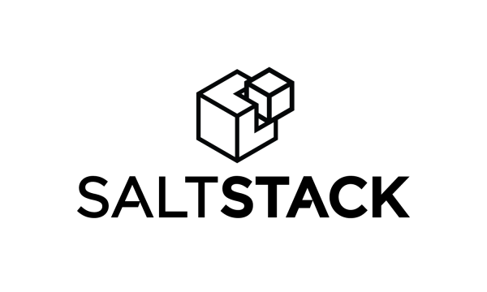
Truesight Pulse Meter Salt - Formula
Vinod Verma

Slide 2
What is Salt ?
SaltStack platform or Salt is a Python-based open-source configuration management software and remote execution engine. Supporting the "Infrastructure as Code" approach to deployment and cloud management, it competes primarily with Puppet, Chef, and Ansible.

Slide 3
What is Salt Stack-formula?
A central collection of formula repositories for SaltStack
Repo URL : https://github.com/saltstack-formulas

Slide 4
Why Salt Stack-formula ?
# To Automate Deployment, DevOps Team Integrate Truesightpulse-formula to their Saltstack Configuration.
# Truesightpulse-formula to be contributed into Saltstack-formula community for publically available for Customer.

Slide 5
Truesightpulse-formula ?
Formulas to set up and configure BMC Truesight Pulse Meter agent on server.
Repo URL : https://github.bmc.com/vinverma/truesightpulse-formula
Supported OS :
OS Ubuntu Centos Debian Redhat
Version 12/14 6/7 7/8 7

Slide 6


























Graphic Elements Icon Colors can be changed
Graphic Elements

Slide 7



Additional Graphic Elements
For easiest layout choose device layouts from layout menu
Images can be added behind device
Images can be added behind device
Images can be added behind device
add

