Slide 1
Zillow Housing Data Analysis
Vinod Sharma
19CE36009
IIT Kharagpur

Slide 2
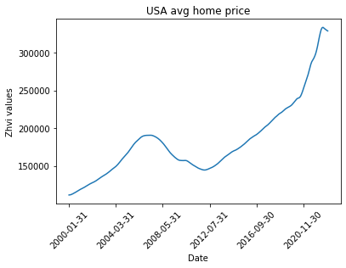
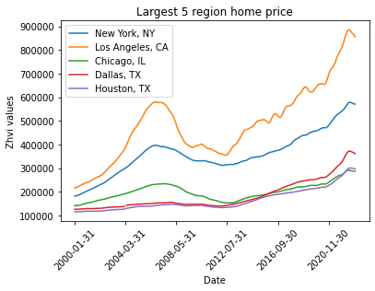
General Trend Analysis
Key insights:
There is an increasing trend in house prices in US with faster increment in last 5 yr
There is a great dip in housing prices during 2008 signifying great depression

Slide 3
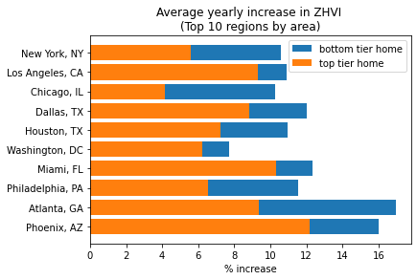
Comparing returns between top and bottom tier homes
Key insights:
Better to invest in bottom tier homes as annual increase in ZHVI is more for them
Also bottom tier homes are better to invest because they need less capital
Probable reason for better returns
Homes have two components
Basic land plot (price increases)
Cost of interior (price decreases)
For bottom tier plot contributes larger part so they see higher returns

Slide 4
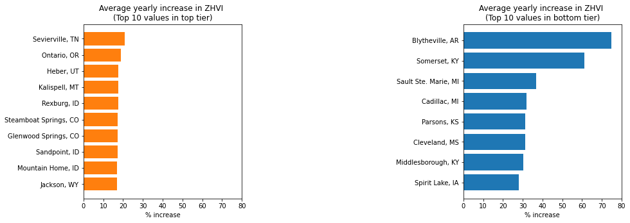
Comparing returns between top and bottom tier homes
Key insights:
The best possible return in top tier homes is about 25% in Sevierville region
The best possible return in bottom tier homes is about 75% in Blytheville region

Slide 5
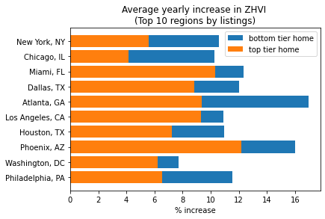
Comparing returns between top and bottom tier homes
In real estate buying is not an easy process
it may be better to invest in region with more numbers of listings
So plotting returns in top ten regions with maximum listings

