Slide 1
NEOBANK
AI POWERED
BANKING OPERATIONS
& AI FRAUD
MONITORING
FINANCIAL FRAUD
DETECTION SYSTEM
PROJECT TEAM
Vinodd V • 25BCE1221
Varun Krishna • 25BCE1530
Arjun Karthikeyan • 25BCE1467
BACSE202 | DBMS
Fall Semester 2026–2027

Slide 2
WHY THIS PROJECT?
THE PROBLEM
THE MOTIVATION
OUR APPROACH
Suspicious transfers can involve unfamiliar devices, new IP addresses, unusual amounts or recently added beneficiaries.
These signals are connected. A graph model helps trace relationships among customers, accounts, transactions and login context.
Combine role-based banking workflows with graph-based transaction monitoring and configurable risk decisions.
PROJECT OBJECTIVES
• Build separate workspaces for Admin, Manager, Teller, Fraud Analyst, Support and Customer.
• Store banking and security entities as connected nodes and relationships in Neo4j.
• Evaluate transfers and demonstrate SUCCESS, PENDING_OTP and BLOCKED outcomes.
• Give staff controlled tools to monitor transactions, review cases and support customers.
2

Slide 3
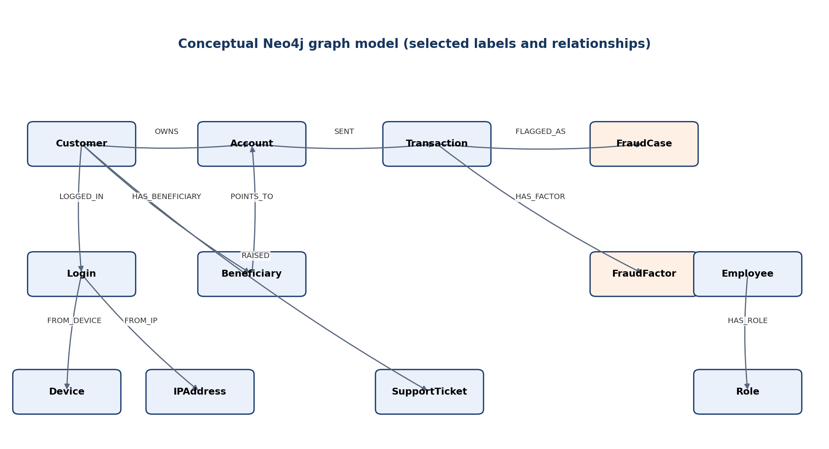
SYSTEM DESIGN
USERS
FRONTEND
FASTAPI
NEO4J
DECISION
6 role types
HTML • CSS • JS
Auth • APIs • Risk
Nodes • Edges
Success / OTP / Block
CORE BANKING GRAPH
Customer • Account • Beneficiary • Transaction • Branch
SECURITY & OPERATIONS
Login • Device • IPAddress • FraudCase • FraudFactor • Employee • Role
3

Slide 4
DATA MODEL & DATABASE DESIGN
CORE ENTITIES
KEYS & CONSTRAINTS
NORMALIZATION
CUSTOMER(Customer_ID, Name, Email, Phone)
ACCOUNT(Account_ID, Acc_No, Balance, Status)
TRANSACTION(Txn_ID, Amount, Time, Status, Risk_Score)
EMPLOYEE(Employee_ID, Name, Role_ID)
Unique identifiers: Customer_ID, Account_ID, Employee_ID, Transaction_ID.
Validate required fields, positive amounts, allowed roles/statuses and valid relationships.
Separate Customer, Account, Transaction, Beneficiary and FraudCase concepts to avoid repeating all details in one record.
Neo4j itself is a property graph—not a relational table system.
EXAMPLE FUNCTIONAL DEPENDENCIES
SELECTED GRAPH RELATIONSHIPS
• Customer_ID → Name, Email, Phone
• Account_ID → Acc_No, Balance, Status
• Transaction_ID → Sender, Receiver, Amount, Time, Status
• Employee_ID → Name, Email, Phone, Role_ID
• Customer — OWNS → Account
• Account — SENT → Transaction — RECEIVED_BY → Account
• Transaction — HAS_FACTOR → FraudFactor
• Transaction — FLAGGED_AS → FraudCase
4

Slide 5
IMPLEMENTATION & DATABASE OPERATIONS
FRONTEND
BACKEND
DATABASE
HTML, CSS and JavaScript provide dashboards and role-specific navigation.
Python FastAPI handles login, authorization, transfers, risk scoring and API calls.
Neo4j stores nodes and relationships queried through parameterized Cypher.
IMPORTANT CYPHER OPERATIONS
MATCH (c:Customer)-[:OWNS]->(a:Account)
RETURN c.id, c.name, a.acc_no, a.balance;
RISK DECISION PATH
< 35 → SUCCESS
35–69 → PENDING_OTP
≥ 70 → BLOCKED
Risk factors include unfamiliar device/IP, large transfer, new beneficiary, unusual time and rapid repeated transfers.
MATCH (a:Account)-[:SENT]->(t:Transaction)
-[:RECEIVED_BY]->(b:Account)
RETURN a.acc_no, b.acc_no, t.amount, t.status;
MATCH (t:Transaction)-[:HAS_FACTOR]->(f:FraudFactor)
RETURN t.id, t.fraud_score, f.name, f.points;
5

Slide 6
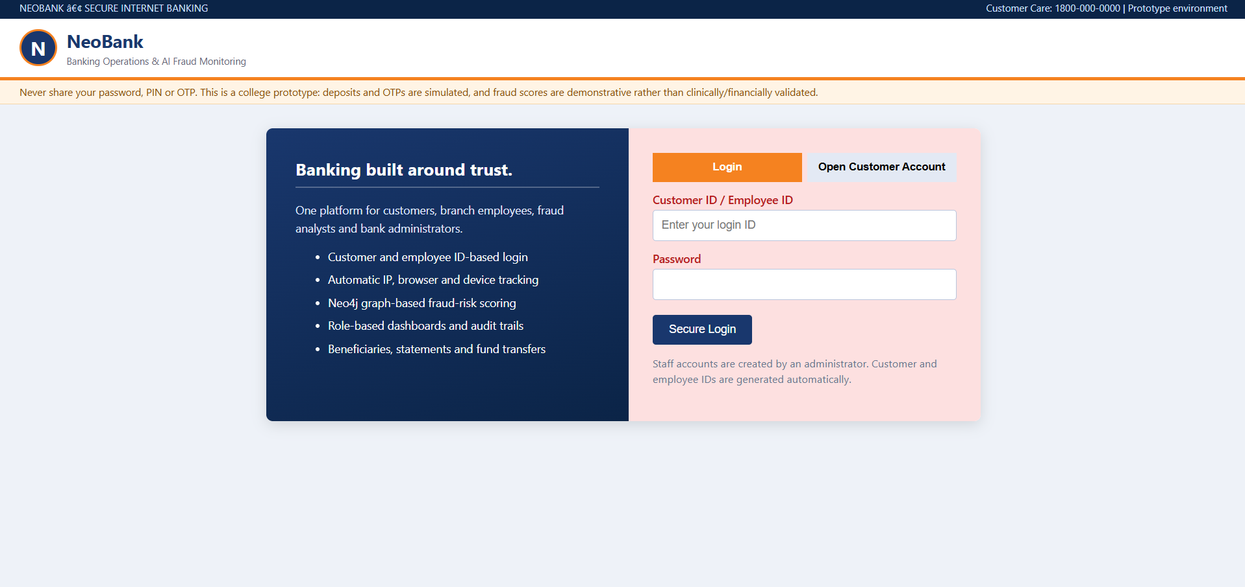
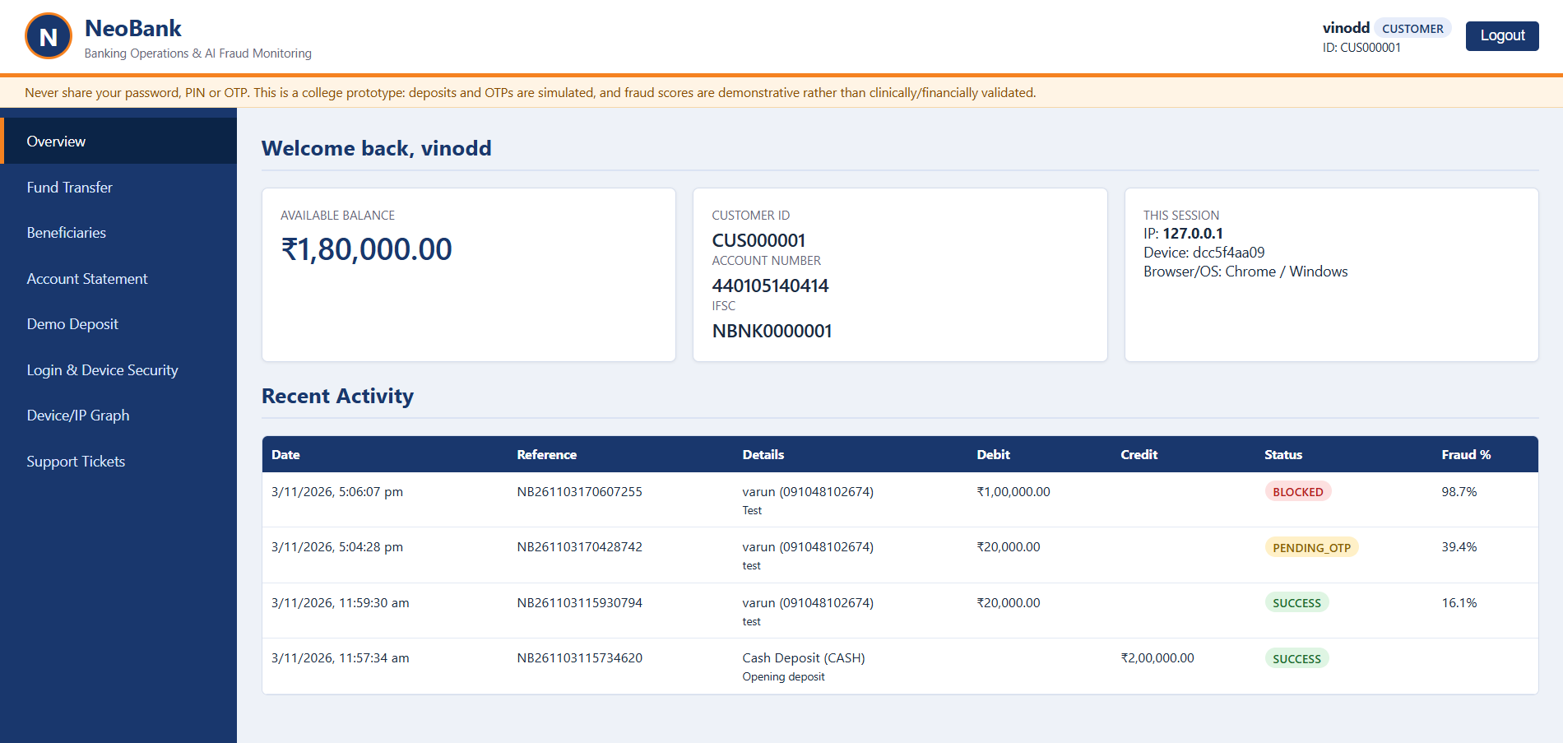
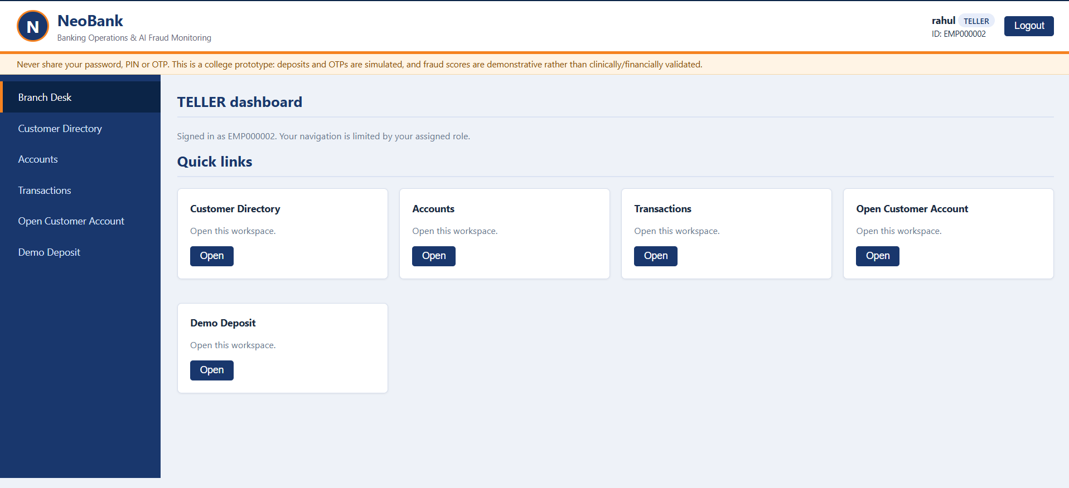
WORKING APPLICATION
CUSTOMER / STAFF LOGIN
CUSTOMER DASHBOARD
TELLER DASHBOARD
6

Slide 7
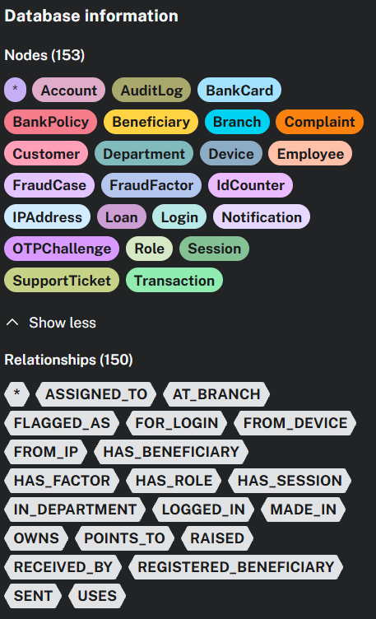
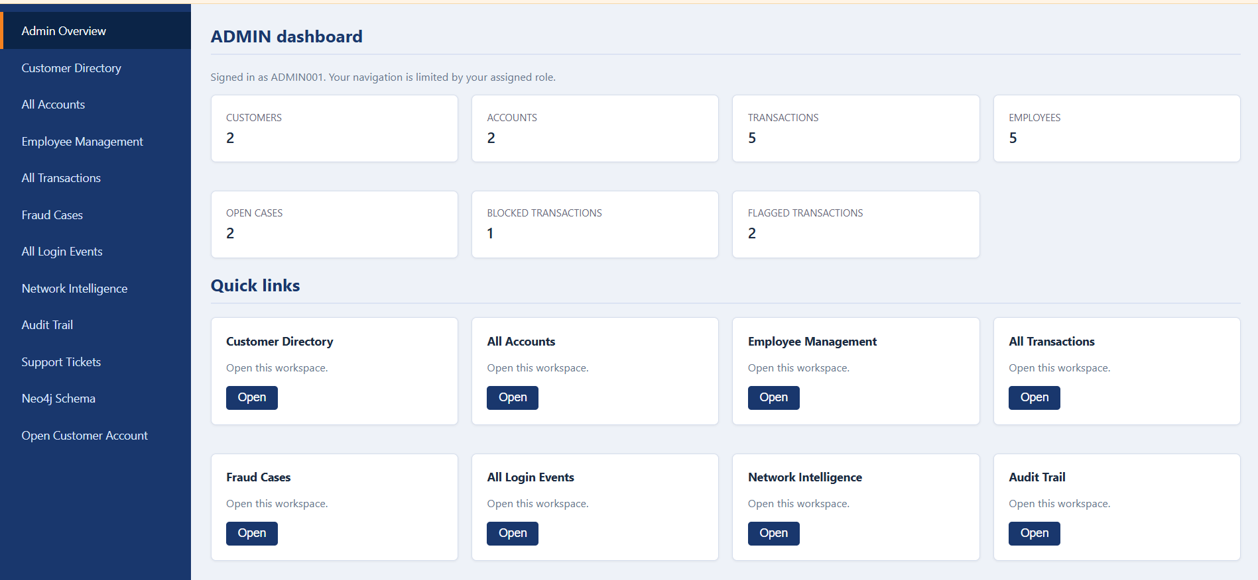
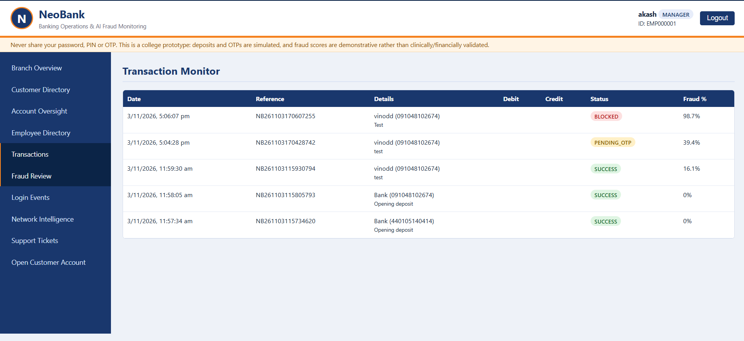
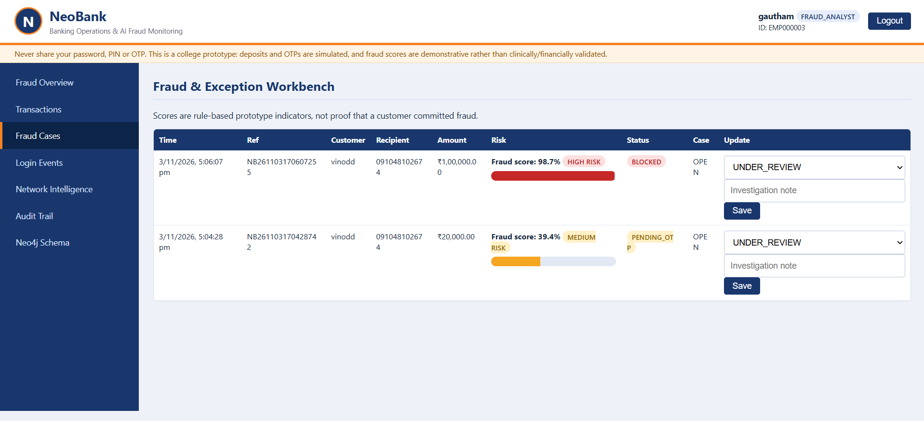
STAFF DASHBOARDS & FRAUD INVESTIGATION
ADMIN OVERVIEW
MANAGER TRANSACTION MONITOR
FRAUD ANALYST WORKBENCH
NEO4J GRAPH SCHEMA
Observed example: 16.1% → SUCCESS | 39.4% → PENDING_OTP | 98.7% → BLOCKED
7

Slide 8
TESTING, FINDINGS & NEXT STEPS
TESTING RESULTS
KEY FINDINGS
LIMITATIONS
Role-based login and dashboards
Account and beneficiary workflows
Cypher retrieval and graph links
Low / medium / high-risk transfer paths
Neo4j connects transaction and login context.
Medium-risk transfers trigger simulated OTP.
High-risk transfers are blocked at the configured threshold.
Academic prototype only.
Demo deposits and OTP; no real payment rails.
Rule-based scores are not validated production AI/ML.
FUTURE ENHANCEMENTS
• Train and validate an ML classifier using labelled transaction data; report precision, recall, F1 and ROC-AUC.
• Add secure OTP delivery, streaming monitoring, alerts and stronger device intelligence.
• Introduce production-grade encryption, secrets management, rate limiting, backups and privacy controls.
8

