Slide 1




Vinodh Kumar TD
Data Architect, Agilisium Consulting
Microsoft Certified Trainer
C# Corner MVP
Blogger

Slide 2
Snowflake
Snowflake is for public cloud only and is a true SaaS offering meaning no hardware (virtual/physical) to select, install, configure, or manage. Maintenance, management, upgrades, and tuning are handled by Snowflake.
Snowflake is not a packaged software offering that can be installed by a user. Snowflake manages all aspects of software installation and updates.
Unlike databricks or any other big data technologies, Snowflake is not built on any existing database tech or big data platforms such as Hadoop. Instead, Snowflake combines a completely new SQL query engine with innovative architecture natively designed for cloud.

Slide 3
How Snowflake works?
Snowflake uses virtual compute instances for its compute needs and a storage service for persistent storage of data.
Snowflake uses a central data repository for persisted data that is accessible from all compute nodes in the platform. But similar to shared-nothing architectures, Snowflake processes queries using MPP (massively parallel processing) compute clusters where each node in the cluster stores a portion of the entire data set locally.
In Database Storage layer, when data is loaded into Snowflake, it only reorganizes this data into its internally optimized, compressed, columnar format. Snowflake stores this optimized data in cloud storage.

Slide 4
The data objects stored by Snowflake are not directly visible nor accessible by customers; they are only accessible through SQL query operations run using Snowflake.
In Query Processing layer, Snowflake processes queries using “Virtual Warehouses”. Each virtual warehouse is an MPP compute cluster composed of multiple compute nodes allocated from your cloud provider. Each VW is an independent compute cluster that does not share compute resources with other VW.
In Cloud Services layer, This will tie together all of the different components of Snowflake in order to process user requests, from login to query dispatch.

Slide 5
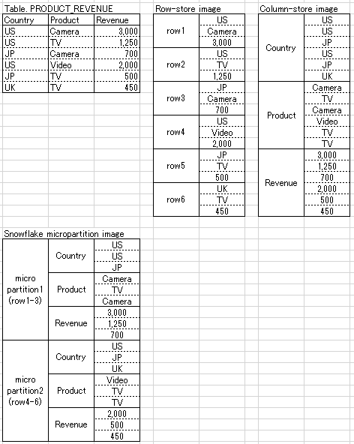
How Snowflake stores the data?
Snowflake splits the micropartition with multiple lines, although a row will always be in the same micro-partition, so that one row is not split.
The columns in the micropartition are stored in a column-oriented.

Slide 6
Loading Data: Semi-structured
Snowflake can import semi-structured data from JSON, Avro, ORC, Parquet, and XML formats and store it in Snowflake data types designed specifically to support semi-structured data. Depending upon the structure of the data, the size of the data, and the way that the user chooses to import the data, semi-structured data can be stored in a single column or split into multiple columns.
Semi-structured data types supported by snowflake
Demo at the end: Loading and Querying semi-structure(JSON) data in snowflake

Slide 7
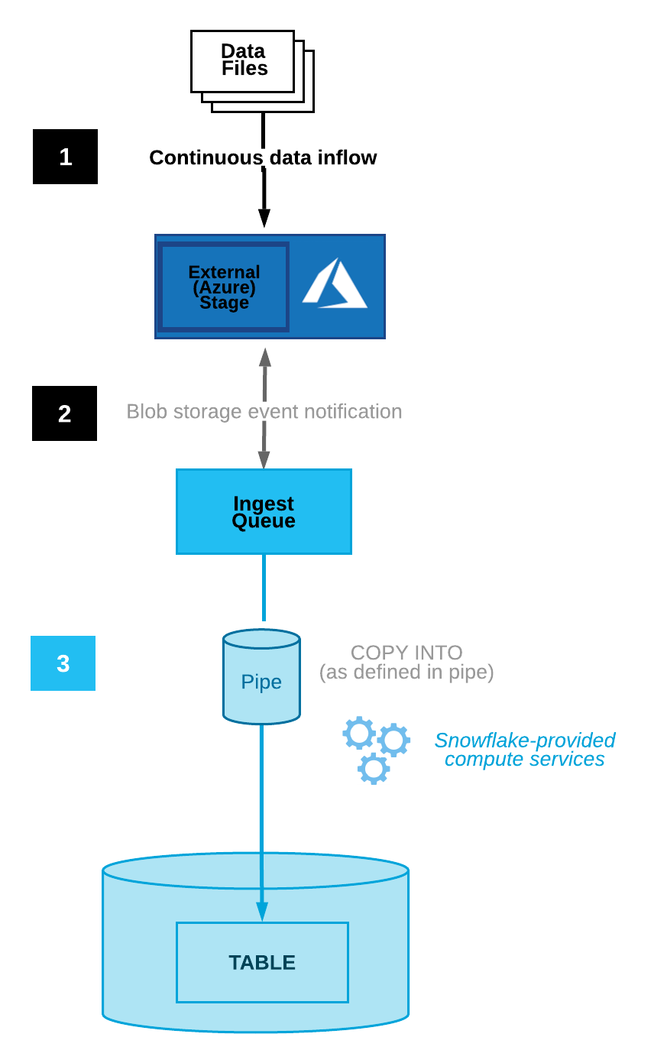
Loading Data: Incremental
Snowflake supports both bulk data loading and continuous data loading using Snowpipe feature.
Snowflake supports loading data from files staged in any of the following locations, regardless of the cloud platform for your Snowflake account.
Amazon S3
Google Cloud Storage
Microsoft Azure blob storage

Slide 8
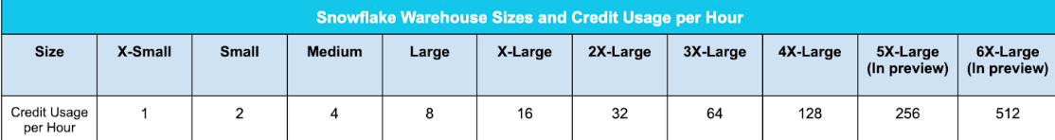
Pricing
Snowflake costing is measured based on credits
A Snowflake credit is a unit of measure, and it is consumed only when a customer is using resources, such as when a virtual warehouse is running, the cloud services layer is performing work, or serverless features are used.
For instance., compute costs are $0.00056 per second for each credit consumed on Standard Edition, while the Enterprise Edition costs $0.0011 per second for each credit consumed
Snowflake users can enable any number of VW(Virtual Warehouses), which are logical groupings of compute resources that power query execution
Performance on Snowflake is linear, where doubling the size of a warehouse typically halves the amount of time it takes to do an operation, resulting in the same cost.

Slide 9
Warehouse Size
Running Time | Credits (X-Small) | Credits (X-Large) | Credits (5X-Large)
0-60 seconds | 0.017 | 0.267 | 4.268
61 seconds | 0.017 | 0.271 | 4.336
2 minutes | 0.033 | 0.533 | 8.532
10 minutes | 0.167 | 2.667 | 42.668
1 hour | 1.000 | 16.000 | 256.000
 | XS | S | M | L | XL | 2XL | 3XL | 4XL | 5XL* | 6XL*
Credits consumed per hour | 1 | 2 | 4 | 8 | 16 | 32 | 64 | 128 | 256 | 512
Compute: The charge for compute is based on the number of credits used to run queries or perform a service
Storage: The charge for storage is based on the number of bytes stored per month and data movement across regions
Total $Cost= Compute+Storage

Slide 10
Auto-Stop and Start
By default, auto-suspend is enabled. Snowflake automatically suspends the warehouse if it is inactive for the specified period of time.
By default, auto-resume is enabled. Snowflake automatically resumes the warehouse when any statement that requires a warehouse is submitted, and the warehouse is the current warehouse for the session.
Snowflake Editions
Standard
Enterprise
Business Critical
Query Processing and Concurrency
The number of queries that a warehouse can concurrently process is determined by the size and complexity of each query.
As queries are submitted, the warehouse calculates and reserves the compute resources needed to process each query. If the warehouse does not have enough remaining resources to process a query, the query is queued, pending resources that become available as other running queries complete.

Slide 11
Demo
Create snowflake trail account with $400
Create warehouse
Create database
Ingest sample data from azure blob into database table
Query using SQL
Export data from database to azure blob
Data sharing
Security & Governance.
Replication & Failover.

Slide 12
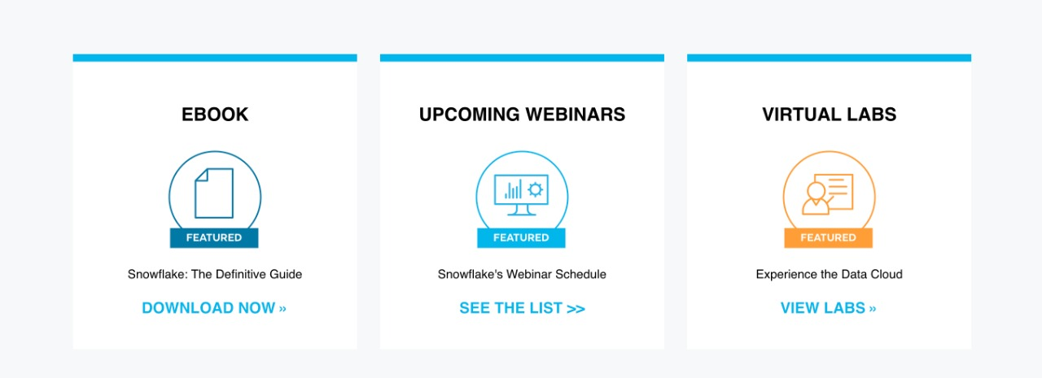
https://www.snowflake.com/resource/snowflake-definitive-guide/
https://www.snowflake.com/about/webinars/
https://www.snowflake.com/virtual-hands-on-lab/

