Slide 1
Git Presented by: Vilas Varghese

Slide 2
Git
Introduction to Git
Create a github account
Getting a remote repository
Updating the repository
Making Changes
Branching
Merging
Fast-forward merging
Merging divergent branches
Resolving conflicts
Rebasing
Updating Development environment with remote changes

Slide 3
What is Git
Directory content management system
Tree history storage system
Stupid content tracker
A toolkit
Not an evolution from any previous VCS

Slide 4
Install Git
Linux
Debian
sudo apt-get install git
Fedora/CentOs
sudo yum install git
Ubuntu
https://www.atlassian.com/git/tutorials/install-git#linux
Mac
https://www.atlassian.com/git/tutorials/install-git
Windows
https://www.atlassian.com/git/tutorials/install-git#windows

Slide 5
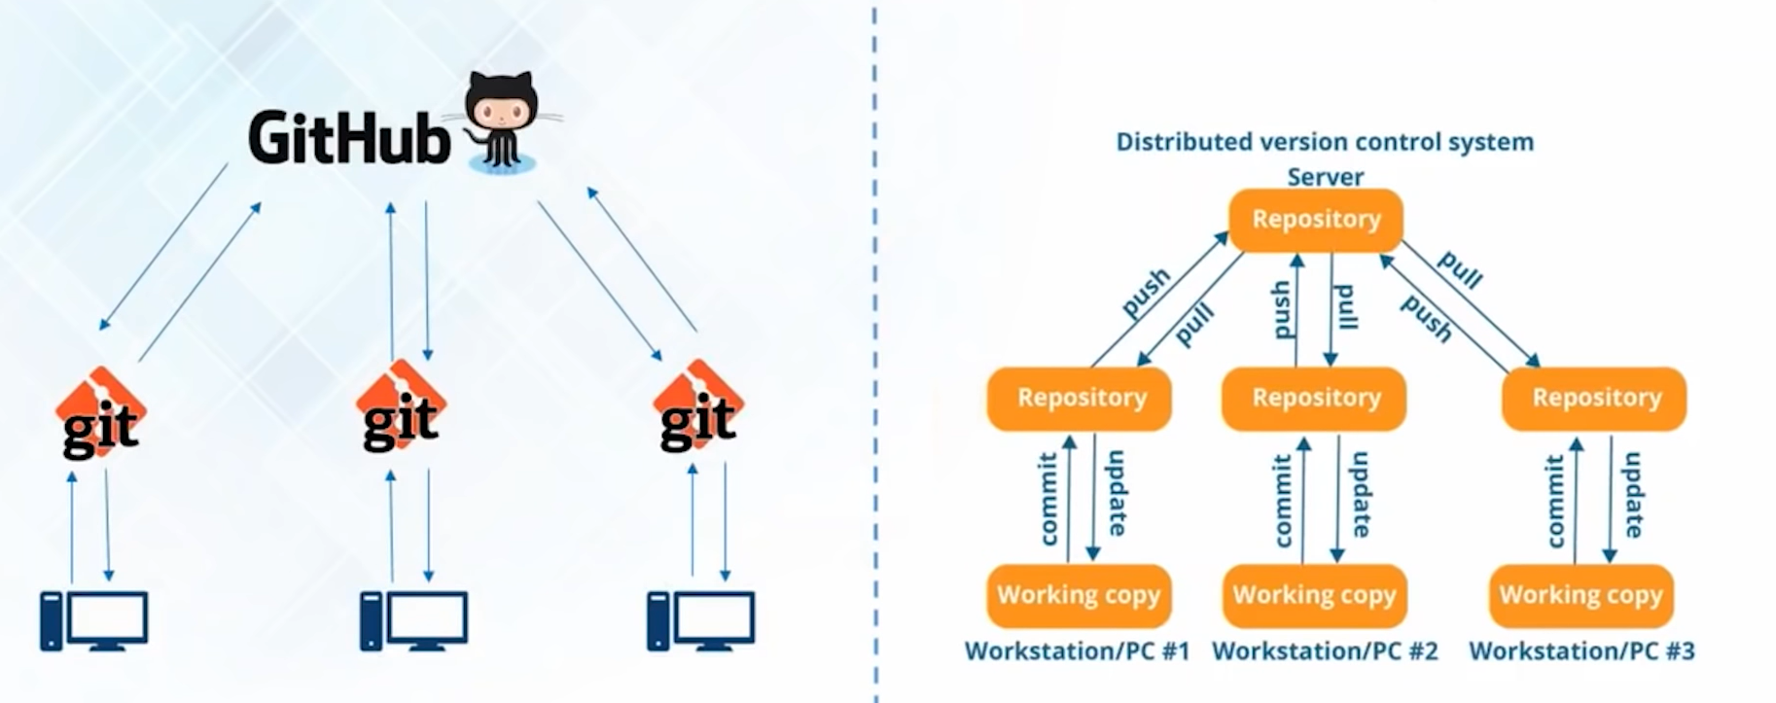
Git operations

Slide 6
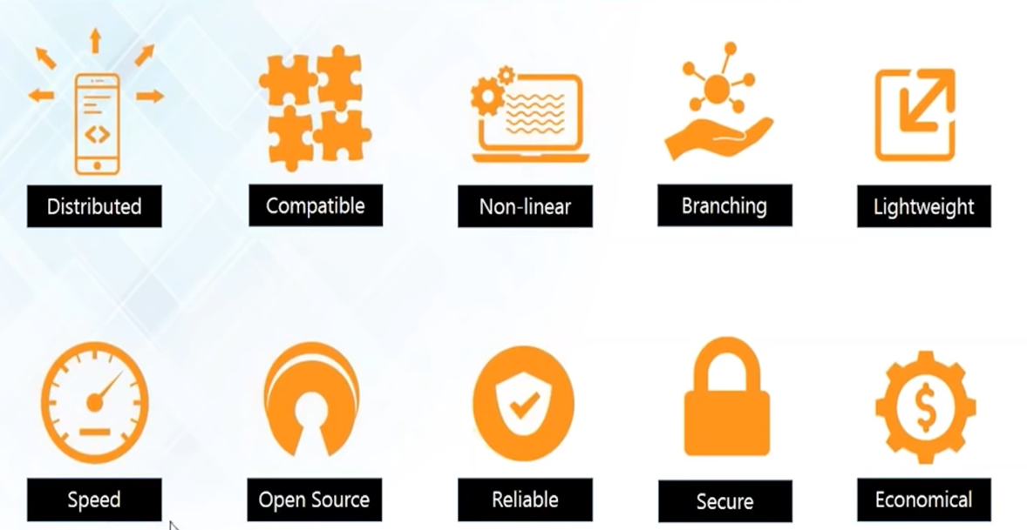
Git Features
Notes:
Git supports cherry picking into a branch. So it is Non-Linear

Slide 7
Advantages of Git
Distributed
You have a local copy of entire dev. history.
Compatible to migration
Compatible with other VCS like SVN
Compatible with existing system and protocol
Compatible with different OS, platforms ect.
Nonlinear dev. of s/w
Creates a tree graph.
Supports various ways to navigate and visualize non-linear dev. history.
This is done using branching.
Branching lets git to stand out of all other competitors
Lightweight
Uses lossless compression technique to compress data on the client side.
Doesn't take a lot of space.
Only the changes you are making is copied to your workspace.
When you save the changes are again compressed and saved back to the local repo.

Slide 8
Advantages of Git
Speed
Very fast as you have a local repo.
So getting files from local repo. to workspace is lightning fast.
Mozilla performance test.
git is 10 times faster than other tools.
git coded in c which is very fast compared to other options.
Open Source
Designed by Linus Torvalds
Used it in linux development.
Reliable
Central server crashes can be restored from anybody's copy.
Notes:
These trends are taken from
https://hackernoon.com/8-devops-trends-to-be-aware-of-in-2019-b4232ac8f351

Slide 9
Advantages of Git
Secure
SHA1 to name and identify objects.
When you commit and push changes it is secured. It is extremely difficult to remove a push that has went in.
SHA1 is a message digest algorithm (uses algo like MD4 and MD5) which is really secured.
Economical
Released under general public license.
Released for free.
Notes:
These trends are taken from
https://hackernoon.com/8-devops-trends-to-be-aware-of-in-2019-b4232ac8f351

Slide 10
Git trends - Industry Adoption
Git
Market share
In 2018
55%
In 2019
71%

Slide 11
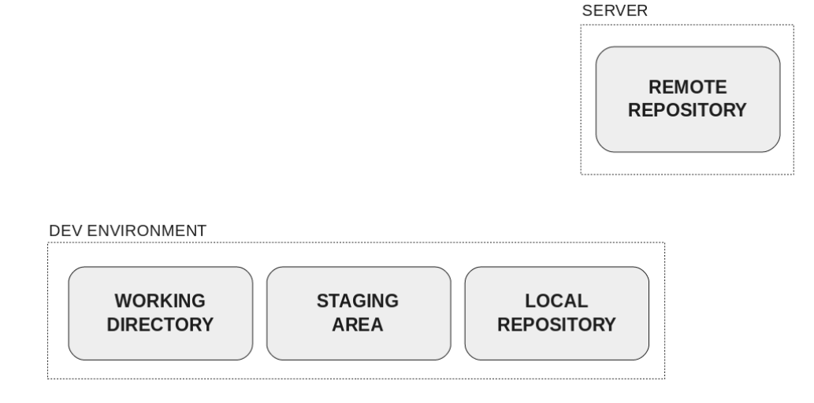
Git Architecture
Notes:
Repo: A directory or storage space where your project can live. Staging is sometimes referred to as index cache.

Slide 12
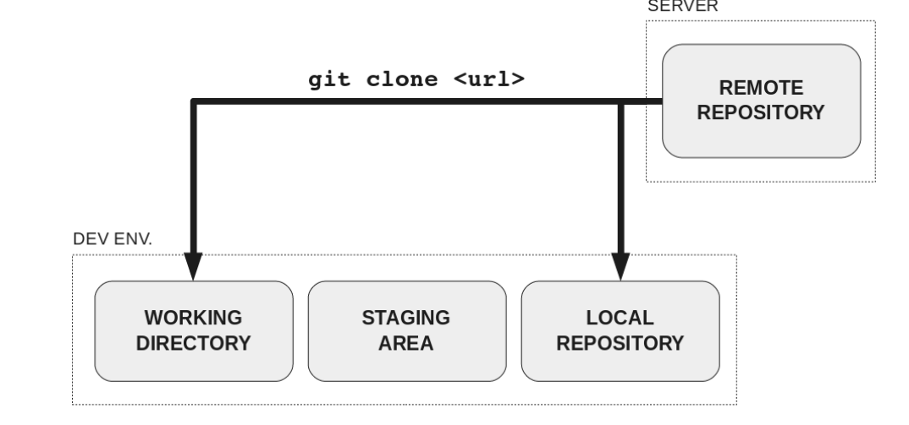
Git Clone

Slide 13
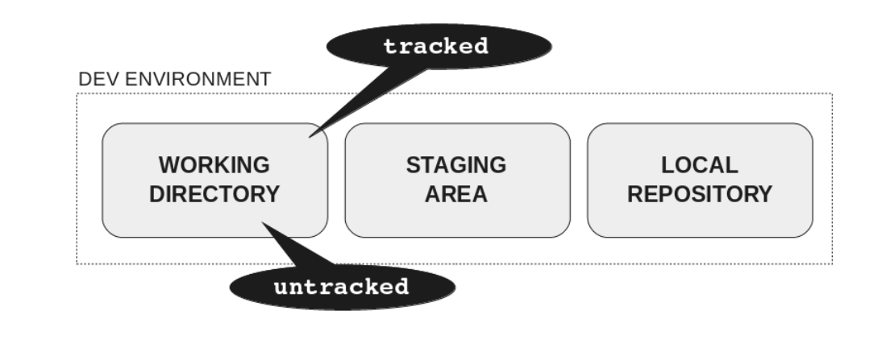
Making changes to working directory
Tracked: files added to Git.
Untracked: files that have still not been added, so Git doesn’t know about

Slide 14
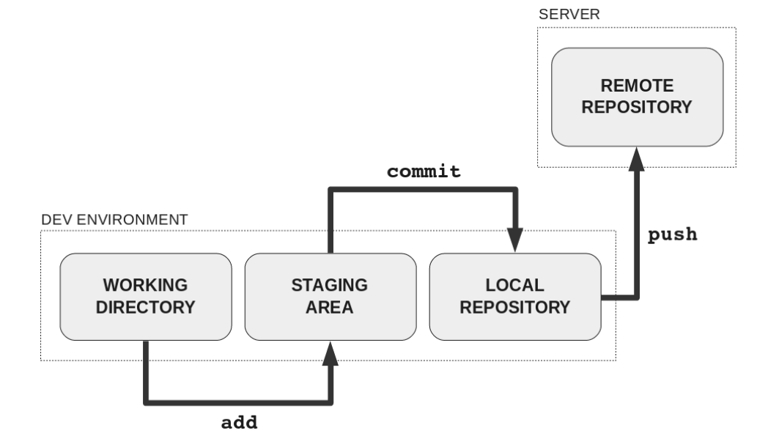
Merging your changes

Slide 15
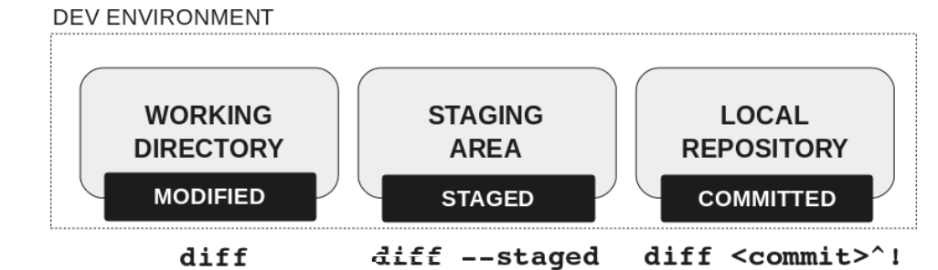
Find differences
git diff: compares working directory with index, i.e. shows the changes that are not staged yet.
git diff HEAD: compares working directory with local repository. shows the list of changes after your last commit.
git diff –cached/git diff --staged: compares index with local repository. shows the diff between your last commit and changes to be committed next.
Notes:
List git commits:
git log --oneline --all --graph --decorate $(git reflog | awk '{print $1}')
git log --oneline --all --graph –decorate
Git diff # find difference in working area
Git diff –staged # find difference in staging area
Git diff <commit>^! # find different in local repo.
Modify an existing file and execute
-> git diff
-> git diff –staged
git commit
git diff
git diff –staged
git diff HEAD
If git diff <commit>^! Doesn’t work, then do
Git diff <commit1> <commit2> To understand this.
Create a new file
-> git diff #no diff.
-> git diff -–staged #no diff
->git add *
-> git diff #no diff.
-> git diff -–staged #changes are shown
Make some changes to the file added just now
-> git diff #shows the changes just now made.
-> git diff -–staged #changes are shown
-> git diff HEAD #shows the file checked in and the changes we made just now.

Slide 16
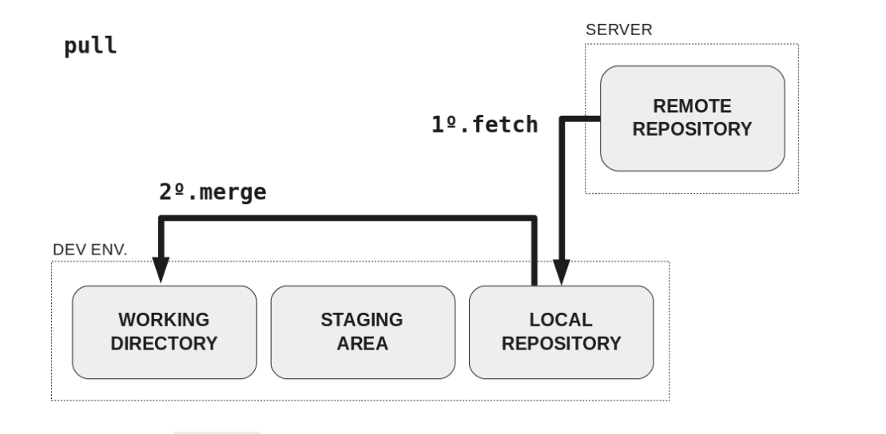
fetch and pull
Notes:
List git commits:
git log --oneline --all --graph --decorate $(git reflog | awk '{print $1}')
git log --oneline --all --graph –decorate
Git reflog

Slide 17
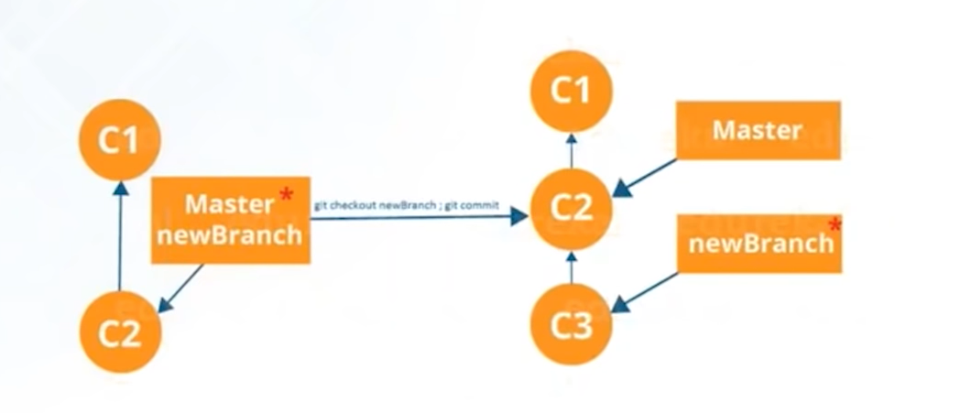
Git – branching

Slide 18
Branching
Master: Main and default branch
Lives in both local and remote repository.
Working directory and staging doesn’t care.
Pointer pointing to a series of commits.
Your working branch is where HEAD points.
Creating branches
git branch <name> #create but not get in.
git branch –a # list all branches
Refresh github and you may not see the branch
Not automatically taken to <name> branch.
Create and move inside a branch
Git checkout <name>
Push changes
git checkout <name>
git add *
git commit –m “message”
git push –set-upstream origin <name>

Slide 19
Merging – Fast forwarding
Happens when there are no change to the branch where it is getting merged to.
i.e. Destination branch doesn’t have any changes
git branch test
git checkout test
make changes in test and ensure no changes happen in master
Return back to master
git checkout master
Merge <name> to master
git merge <name>

Slide 20
Merging – Divergent branches
Happens when the source and destination branches have changes.
git branch test1
git checkout test1
Make changes to both test1 and test2
Return back to master
git checkout master
Merge <name> to master
git merge test1

Slide 21
Merging – Resolving Conflicts
Happens when the source and destination branches have changes in same line of same file.
git branch test2
Make changes to a file
git checkout test2
Make changes to same file same line.
Return back to master
git checkout master
Merge <name> to master
git merge test1
Conflict
Fix the conflict manually
Follow the same checkin and merge procedure.

Slide 22
Merging – Rebasing
Happens when the source and destination branches have changes in same line of same file.
git branch test3
git checkout test3
Make changes to a file.
Rebase
git rebase master
Refer the diagram in the next page.

Slide 23
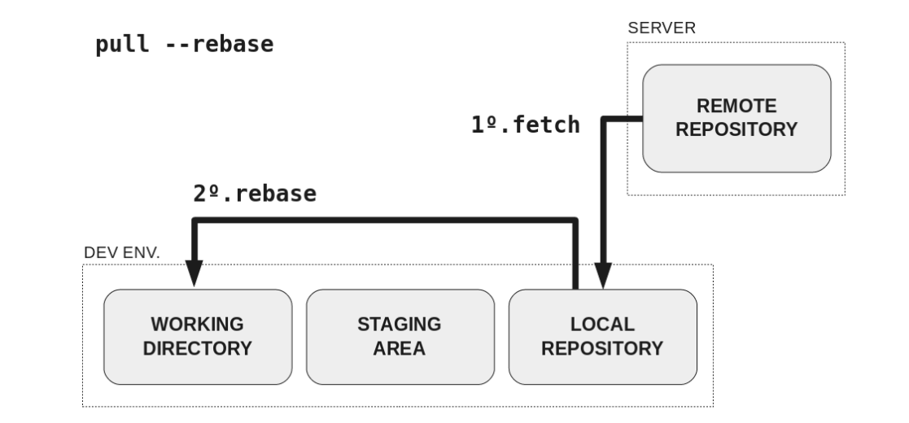
Rebase

Slide 24
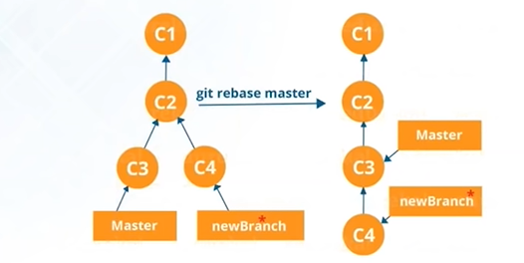
Git – rebasing

Slide 25
Git – remove
Remove a file committed not pushed
git rm –cached <file> #stage file but leave it on the disk
Commit this change using –amend –CHEAD
git commit –amend –CHEAD #Simple commit may not help
Push your commits to GitHub
git push

Slide 26
Git – remove
https://git-scm.com/docs/git-rm
https://help.github.com/en/github/authenticating-to-github/removing-sensitive-data-from-a-repository

Slide 27
Bonus
Git Head
The pointer to the last commit.
Head on local machine points to local last commit
Head on remote machine points to remote last commit
Git Master
Default branch
Git origin
"origin" is a shorthand name for the remote repository that a project was originally cloned from

