Slide 1

Growth and Insights-Telangana Government

Slide 2
Agenda
Introduction about Telangana state
Goals and objectives
Problem statement and insights
Recommendation for economic growth
Dashboard

Slide 3
Telangana is a state in south-central India that was formed in 2014 after being created by separating the north-central and northeastern portions of Andhra Pradesh.
The capital of Telangana is Hyderabad, which is also the capital of the neighbouring state of Andhra Pradesh.
The state has a diverse economy, with the IT sector being one of its major contributors to growth. Other key industries include agriculture, manufacturing, and tourism.
Telangana has a long history of political and social movements, including the Telangana movement which sought to create a separate state. The movement was successful in 2014 when Telangana was formed.

Slide 5
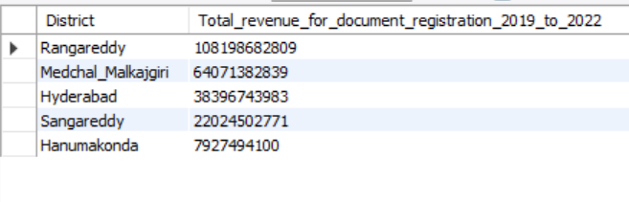
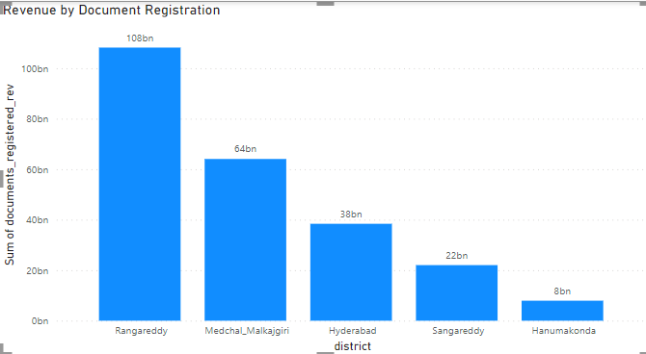
1. How does the revenue generated from document registration vary across districts in Telangana? List down the top 5 districts that showed the highest document registration revenue growth between FY 2019 and 2022.
Top 5 districts for document registration revenue
Insight: Rangareddy shows highest revenue of 108 billion rupees followed by Medchal Malkajgini, Hyderabad, Sangareddy and Hanumakonda

Slide 6
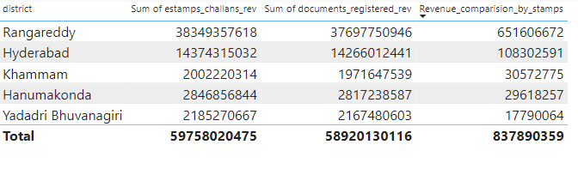
2. How does the revenue generated from document registration compare to the revenue generated from e-stamp challans across districts? List down the top 5 districts where e-stamps revenue contributes Significantly more to the revenue than the documents in FY 2022?
Top 5 districts for e-stamp challans
Insight: Rangareddy shows highest revenue generated in both estamps challans and document registration and has highest estamps challans revenues than document registered revenue with 651.60 million rupees

Slide 7
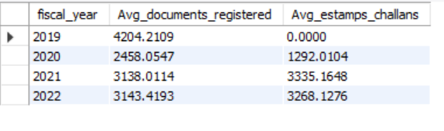
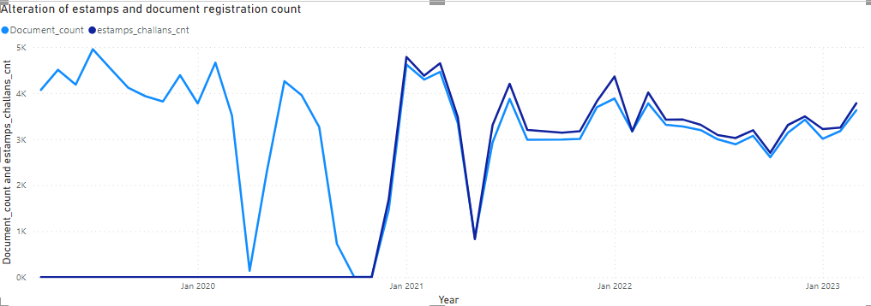
3. Is there any alteration of e-Stamp challan count and document registration count pattern since the implementation of e-Stamp challan? If so, what suggestions would you propose to the government?
Alteration of e-Stamp challan count and document registration count
Insight: After the implementation of estamp , the count has drastically increased and shows higher counts in year 2021 and 2022 continues in 2023 than documents registered . There is a likelihood that many rural people will use estamps challans if the government raises knowledge of them.

Slide 8
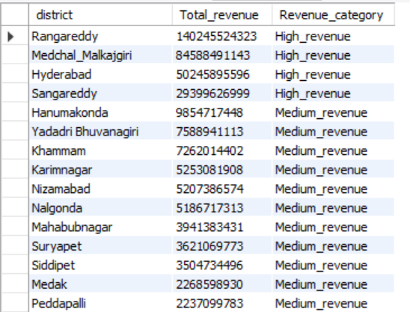
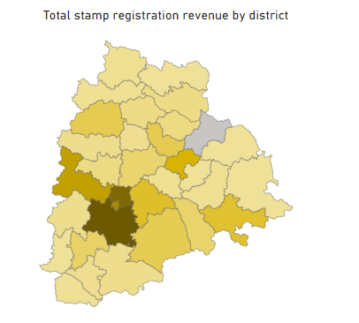
4. Categorize districts into three segments based on their stamp registration revenue generation during the fiscal year 2021 to 2022.
Categorizing stamp registration revenue
Insight: I categorised districts with more than 100 billion as high revenue, between 10 -100 billion as medium revenue and finally less than 10 billion as low revenue districts.

Slide 9
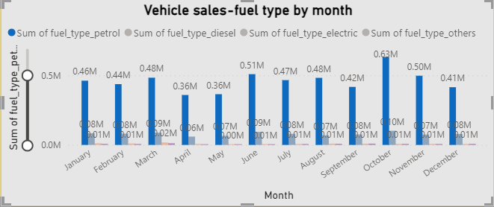
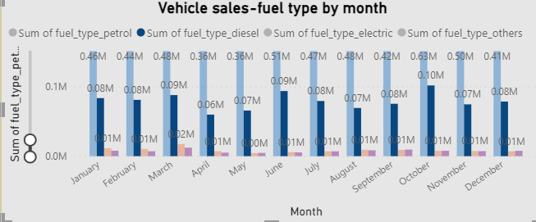
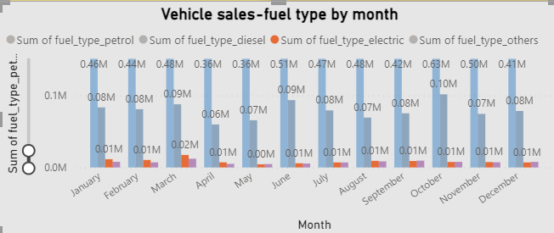
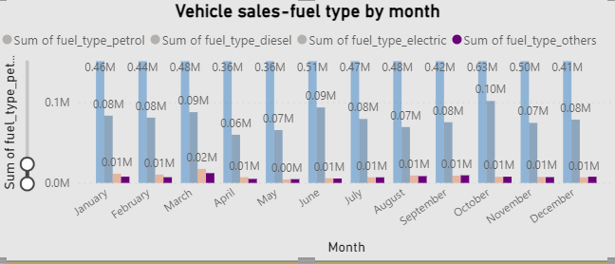
Correlation between vehicle sales
5. Investigate whether there is any correlation between vehicle sales and specific months or seasons in different districts. Are there any months or seasons that consistently show higher or lower sales rate, and if yes, what could be the driving factors? (Consider Fuel-Type category only)
Insight: On considering fuel type category:
Petrol: High – Oct, Low- April and may
Diesel: High – March and June, Low- April
Electric and others:
High- March, Low - May

Slide 10
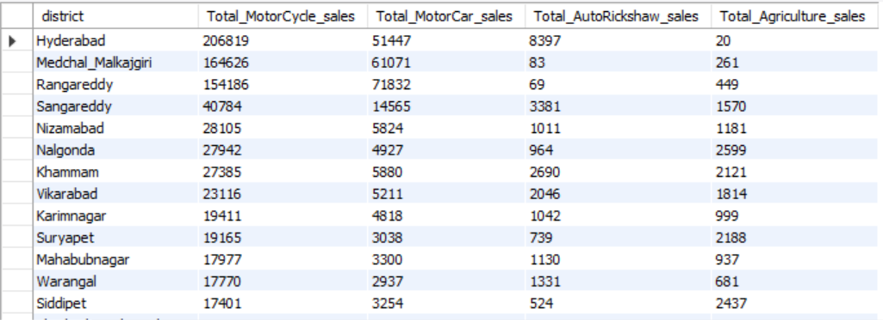
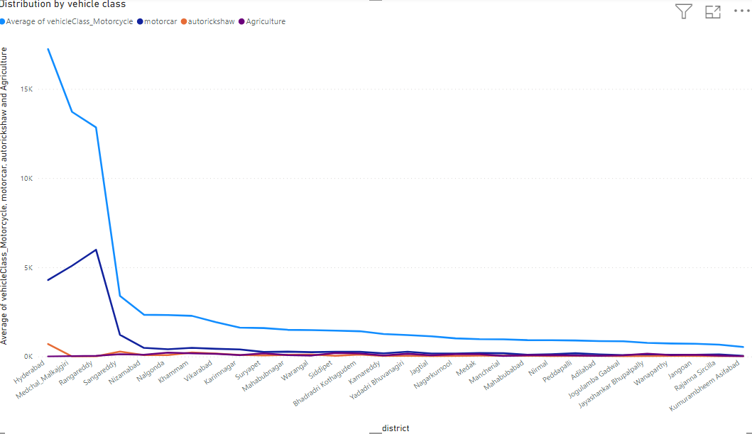
Distribution of vehicles
6. How does the distribution of vehicles vary by vehicle class (Motorcycle, Motorcar, Autorickshaw, Agriculture) across different districts? Are there any districts with a predominant preference for a specific vehicle class? Consider FY 2022 for analysis.
Insight: For the fiscal year 2022, motorcycle considered to be used by most of the population, followed by motorcar. Hyderabad shows highest motorcycle sales 206819 whereas motor car is 51447 , which is in 4:1 ratio.

Slide 11
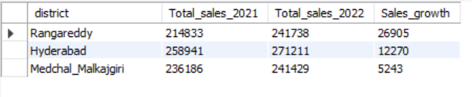

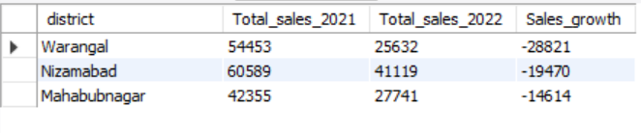

Highest and lowest vehicle sales growth-2022
7. List down the top 3 and bottom 3 districts that have shown the highest and lowest vehicle sales growth during FY 2022 compared to FY 2021? (Consider and compare categories: Petrol, Diesel and Electric)

Slide 12
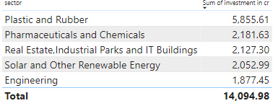
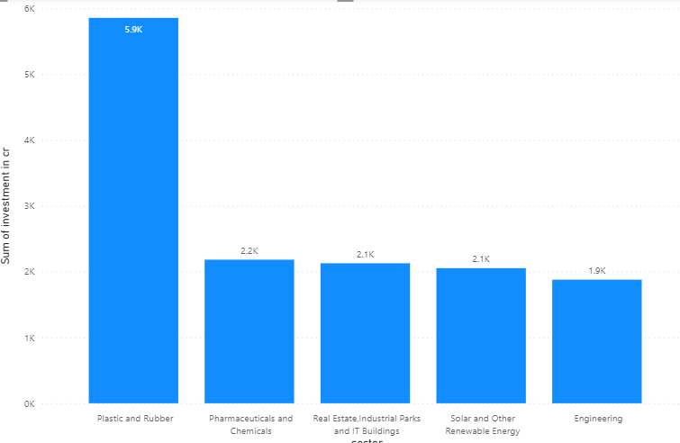
Top 5 sectors with most significant investments in FY 2022.
8. List down the top 5 sectors that have witnessed the most significant investments in FY 2022.

Slide 13
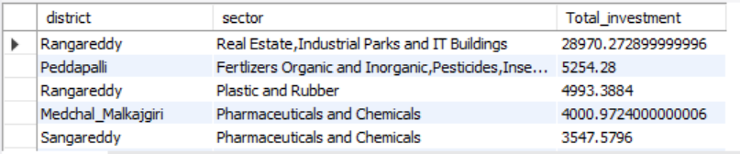
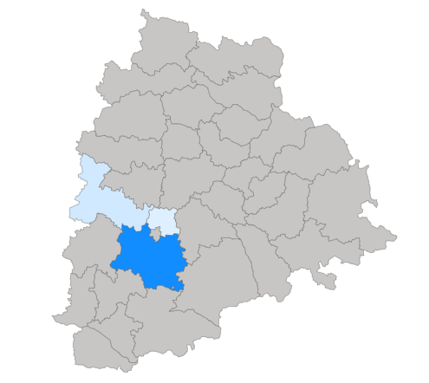
Top 3 districts with most significant sector investments
9. List down the top 3 districts that have attracted the most significant sector investments during FY 2019 to 2022? What factors could have led to the substantial investments in these particular districts?
Insight: Rangareddy shows 28.970k crore total investment in Real estate, Industrial parks and IT Buildings, followed by Peddapalli and Rangareddy also stands third in Plastic and Rubber sector.

Slide 14
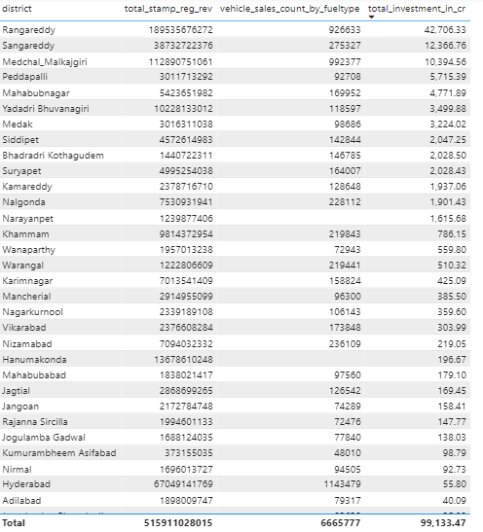
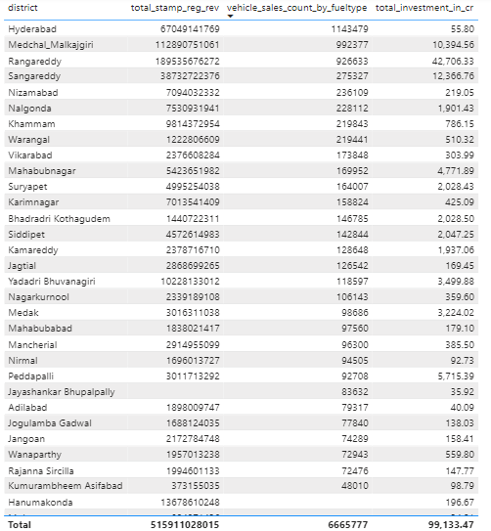
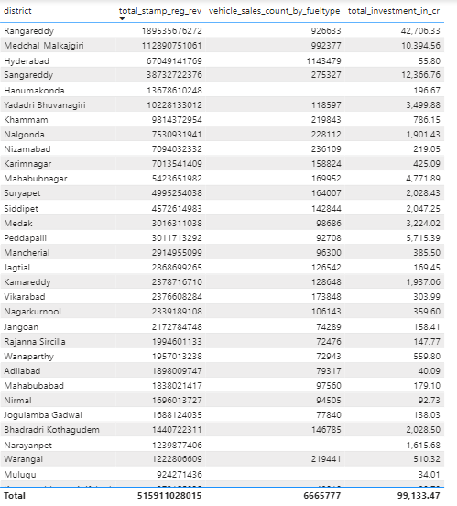
10. Is there any relationship between district investments, vehicles sales and stamps revenue within the same district between FY 2021 and 2022?

Slide 15
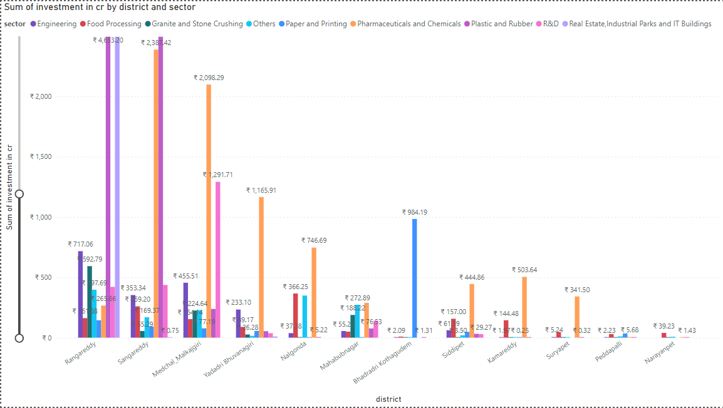
Sector with Investment in multiple districts- 2021-2022
11. Are there any particular sectors that have shown substantial investment in multiple districts between FY 2021 and 2022?
Insight: From the analysis, Pharmaceuticals and Chemicals sectors shows substantial investment in multiple districts, followed by Food Processing sector Between the year 2021 and 2022.

Slide 16
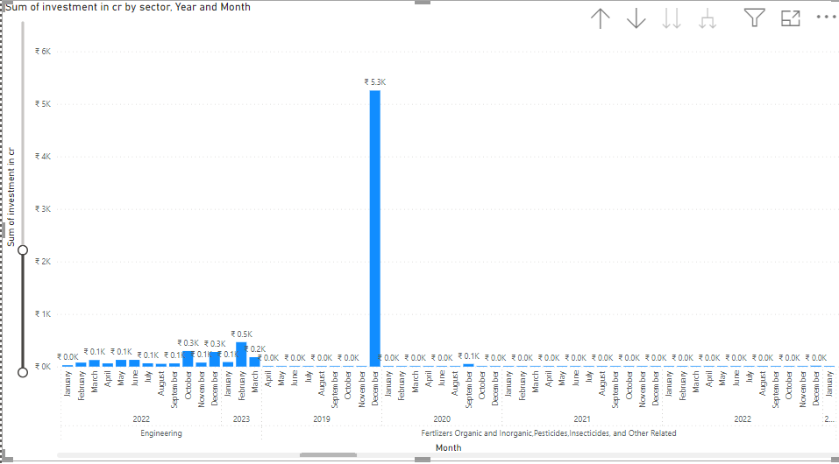
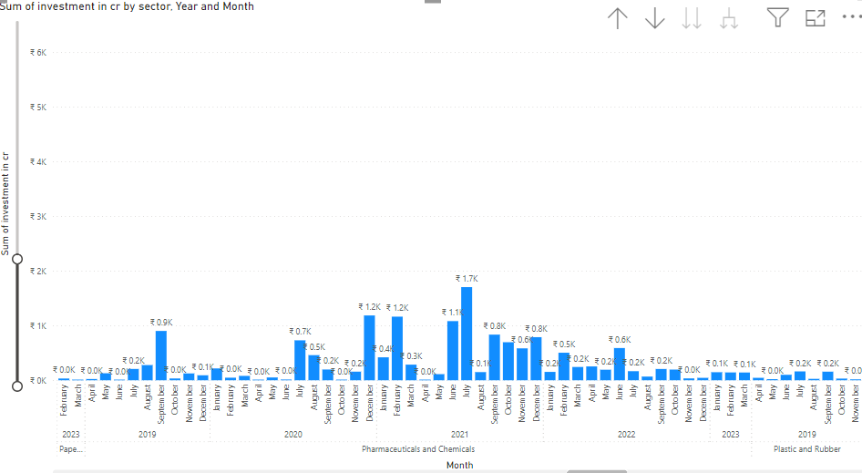
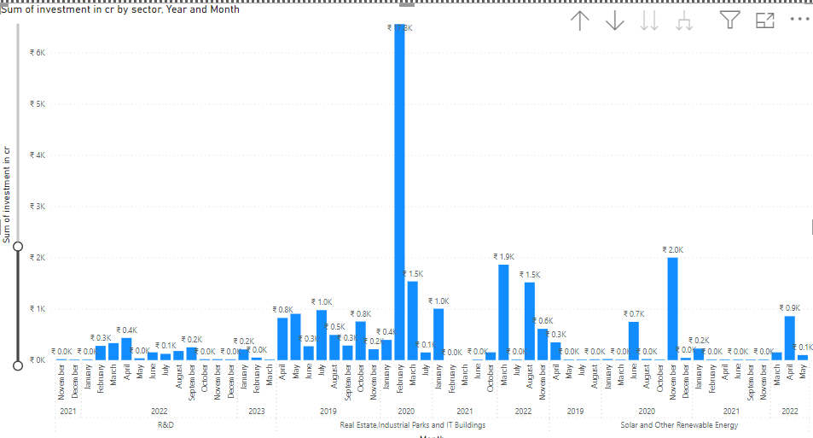
The investment trends for specific sectors
12. Can we identify any seasonal patterns or cyclicality in the investment trends for specific sectors? Do certain sectors experience higher investments during particular months?

Slide 17
1. What are the top 5 districts to buy commercial properties in Telangana? Justify your answer.
1. Hyderabad District
2. Rangareddy
3. Medchal-Malkajgiri District
4. Warangal Urban District
5. Karimnagar District

Slide 18



2. What significant policies or initiatives were put into effect to enhance economic growth, investments, and employment in Telangana by the current government? Can we quantify the impact of these policies using available data?
Since Service sector is the largest contributor to the Telangana's economy, policies to promote the IT sectors aimed to attract IT companies, startups, and technology-focused investments.
Investment in Fertilizers Organic and Inorganic, Pesticides, Insecticides, and Other Related sector stands 5th from other sectors. Since Telangana is an agriculture land, investing in this sectors and introducing modern techniques and Scheme can enhance agricultural productivity.
Program should be launched to support startups and innovation to improve employment.

Slide 19

3. Provide top 5 Insights & 5 recommendations to Telangana government for sustained growth in the next 5 years based on your analysis.
Insights:
Diversification of industries
Skill development and education
Infrastructure development
Encouraging entrepreneurship and innovation
Sustainable development
Recommendation:
Strengthen the ease of doing business
Boost rural development
Improve connectivity
Promote tourism
Foster public-private partnerships

Slide 20

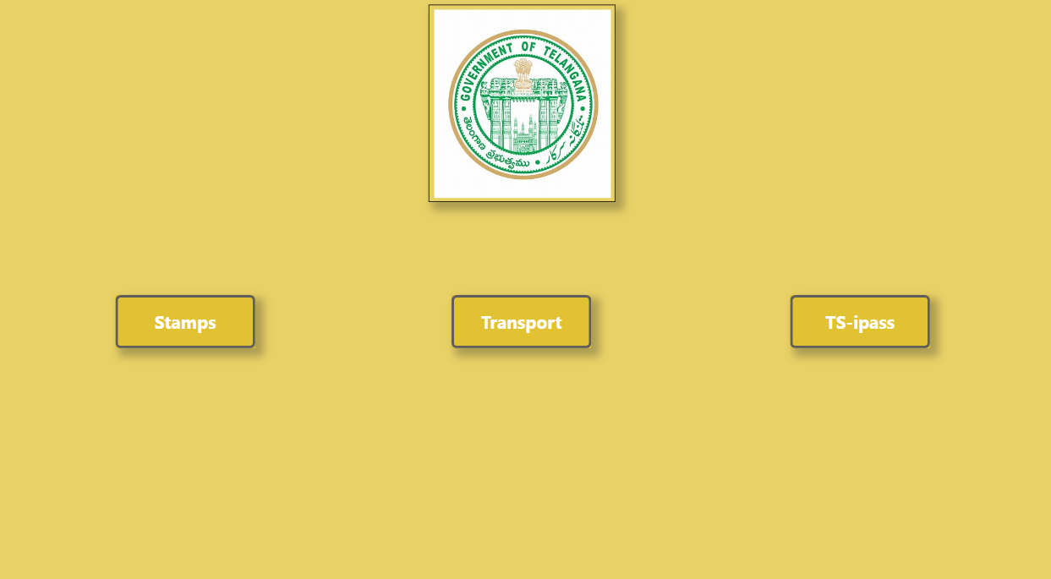
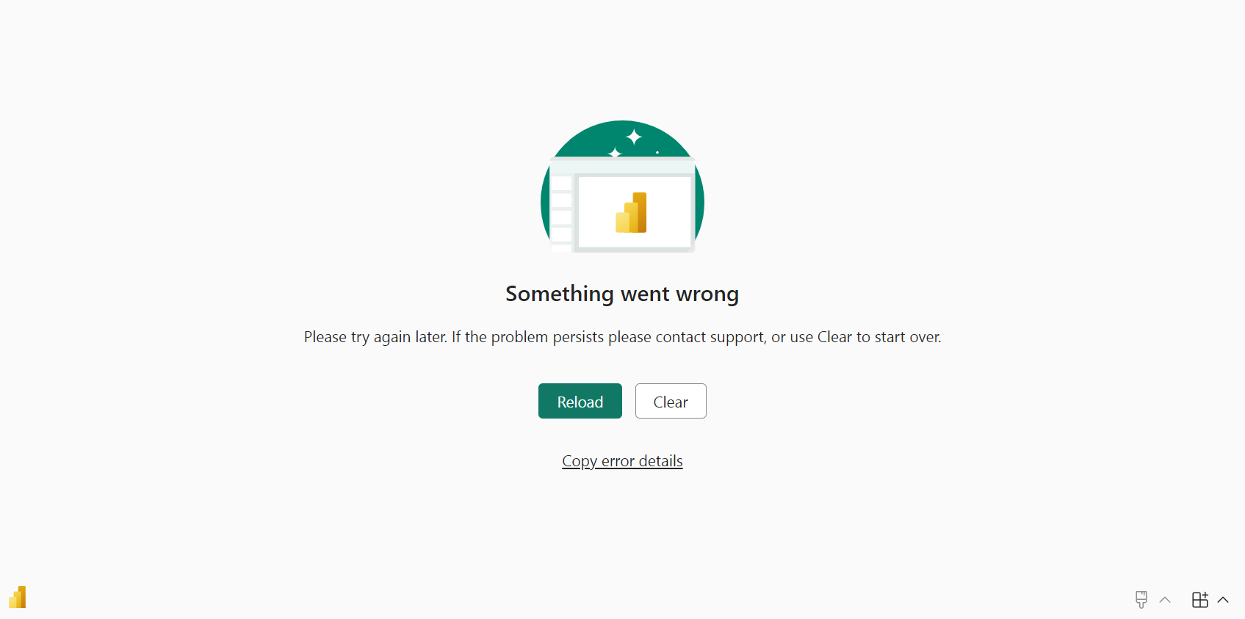

Slide 21
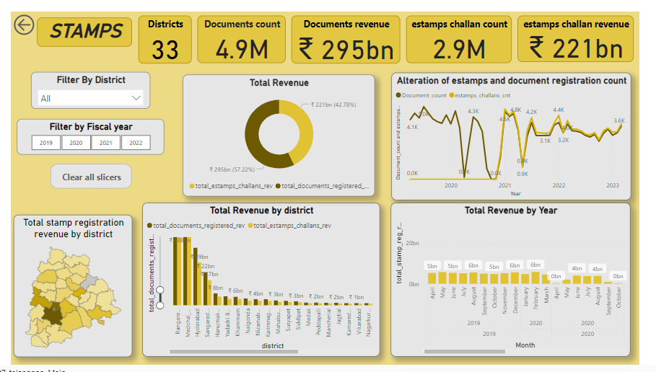

Slide 22
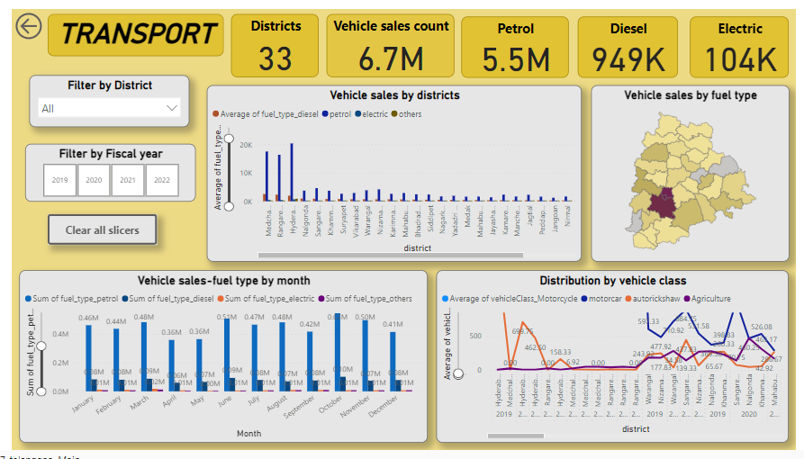

Slide 23
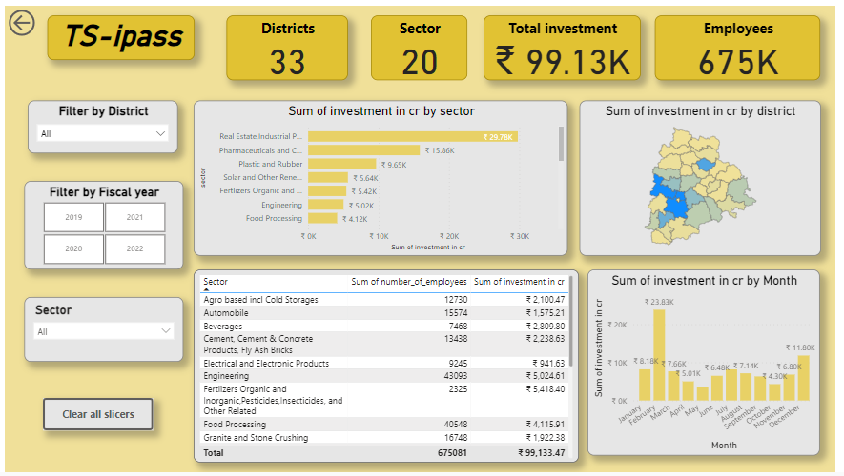

Slide 24
Thank you
Name: Vinodhini Ramakrishnan
Tools used: MySQL and Power BI

