Slide 1
EMPLOYEE ATTRITION ANALYSIS

Slide 2
Agenda
Introduction
Details of Data
Main KPIs
My Design
My interpretation
Tableau public link

Slide 3
Introduction
Employee attrition, or turnover, refers to the rate at which employees leave our company.
This dashboard aims to analyze various factors contributing to attrition, such as demographics, job roles, tenure, and performance metrics.
By understanding the underlying reasons behind attrition, we can proactively address challenges, retain top talent, and foster a positive work environment.
Let's explore the data together to make informed decisions and improve employee retention strategies.

Slide 4
Details of Data
EmployeeID
Age
JobLevel
JobRole
MaritalStatus
MonthlyIncome
NumCompaniesWorked
StandardHours
TotalWorkingYears
TrainingTimesLastYear
YearsAtCompany
YearsSinceLastPromotion

Slide 5
Main KPIs
Attrition --------
Department
EducationField
EmployeeCount
Gender
JobSatisfaction -----
'Yes' indicates that the employee has left the company,
while 'No' indicates that the employee has not left the company.
The degree to which employees feel content and fulfilled with their work and overall experience within the organization.

Slide 6
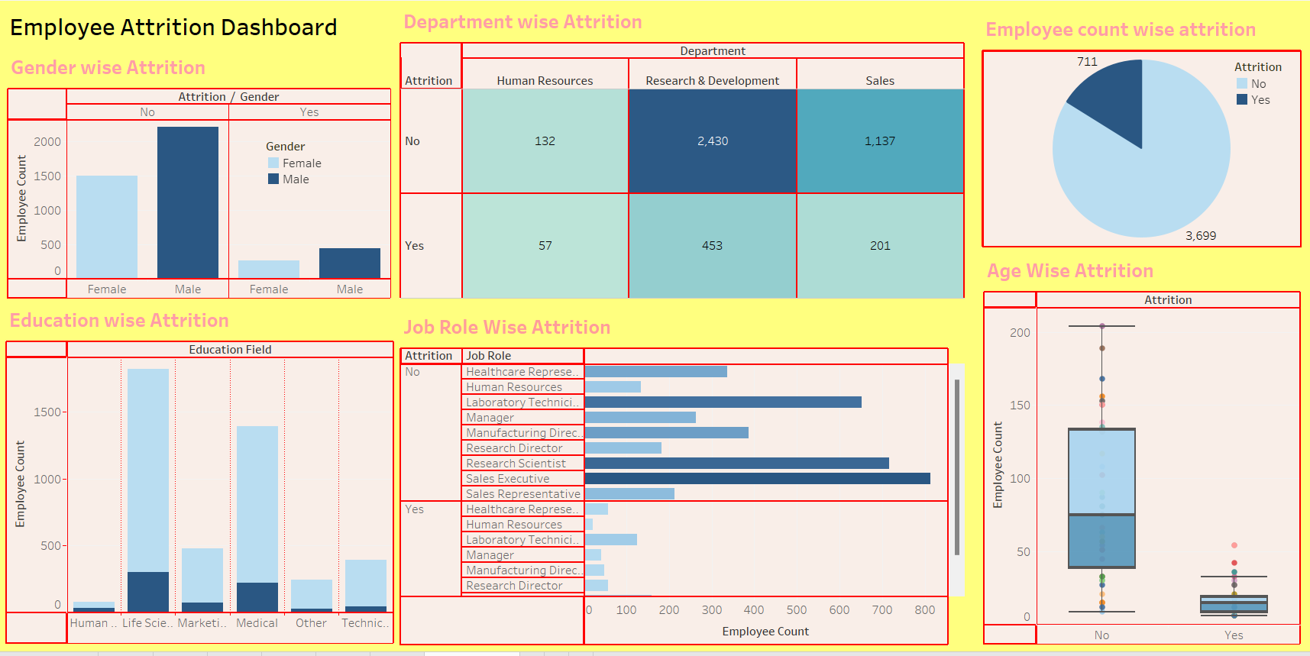
My Design:

Slide 7
My interpretation
Gender-wise Attrition: The higher attrition rate among males suggests a potential need to address specific factors influencing their decision to leave, such as career advancement opportunities, work-life balance, or job satisfaction.
Education Background: The observation that employees with a background in life sciences have the highest attrition rate indicates a need to investigate and address any issues specific to this demographic, potentially related to job roles, career progression, or workplace environment.
Number of Companies Worked: The fact that most employees leaving or staying have only worked in one company may imply a lack of career growth or opportunities for advancement within the organization. Addressing this could involve providing clearer career paths, training opportunities, or recognition programs.
Job Satisfaction Rating: The low satisfaction ratings among sales executives and laboratory technicians, coupled with the prevalence of extreme ratings (1 or 4), suggest potential dissatisfaction with aspects of their roles or working conditions. Identifying and addressing these specific pain points could help improve overall satisfaction and retention.
Department-wise Attrition: The higher attrition rates in departments such as sales executive, research in science, and laboratory technician indicate potential issues specific to these areas, which may require targeted interventions to improve retention.

Slide 8
Tableau public link:
https://public.tableau.com/views/EmployeeAttritionDashboard_17107363616180/Dashboard1?:language=en-US&publish=yes&:sid=&:display_count=n&:origin=viz_share_link

Slide 9
Thank you

