Slide 1
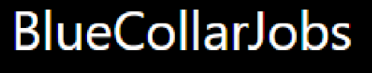

Vinod Kumar Rameshchandra Kuril (STU62f65b8952e581660312457) Department of Computer Engineering Thakur College of Engineering and Technology Mumbai University November 2022

Slide 2
PROJECT TITLE
Job Portal For Informal Job Sector

Slide 3

AGENDA
PROBLEM STATEMENT
PROJECT OVERVIEW
WHO ARE THE END USERS?
OUR SOLUTION AND ITS VALUE PROPOSITION
THE WOW IN OUR SOLUTION
MODELLING
SCREENSHOT OF WEBSITE
RESULTS

Slide 4

PROBLEM STATEMENT
Finding a good domestic worker or a driver is a task. But it’s also a difficult task for that good domestic worker or a driver to find a job. It has always been a problem in the unorganized sector to match the skills of blue-collar workers with available jobs. To bridge this gap, we decided to build a job portal website for an informal sector job.

Slide 5

PROJECT OVERVIEW
Our website (EVERYJOBS) is dedicated to the informal job sector and shall enable the job seekers of this category to become independent, in terms of employment generation and income management. Our goal is to not only bridge the extensive gap between employers and blue or grey collar job workers but to organize the unorganized sector as well.

Slide 6

WHO ARE THE END USERS?
The end user of the website can be classified in two categories:
Job seeker : People who will register on the website to get a job related to their expertise.
Employer : Person who post jobs and get the information of the employees data who have applied for the certain posted job.

Slide 7

OUR SOLUTION AND ITS VALUE PROPOSITION
EVERYJOBS is interactive and accessible to the enriched employers and digitally backward workers. Our current and prospective employers/job seekers will find valuable information about our features on the homepage itself. Having a web-based portal has no agenda to question the less competitive workers who barely understand Internet and its services, it is to make them comfortable with the digitalized hiring solutions. In order to lessen their difficulty, we have built a simple login and register page for potential job seekers and they shall see numerous job opportunities with/without login.

Slide 8

THE WOW IN OUR SOLUTION
For Job Seekers, there are several features:
Forever free. You’d never have to pay to find a great job.
Registration/Sign up : Both employer and job seeker have to register in order to post a job and apply for a job respectively.
Leverage Exclusivity – specially design job portal for informal sector.
Simple yet useful. Our Dashboard service is to keep your applied jobs history safe.
Easy one click applies and many more.
API for Candidate Applications.
Web Scraping feature to get jobs information from the web.

Slide 9
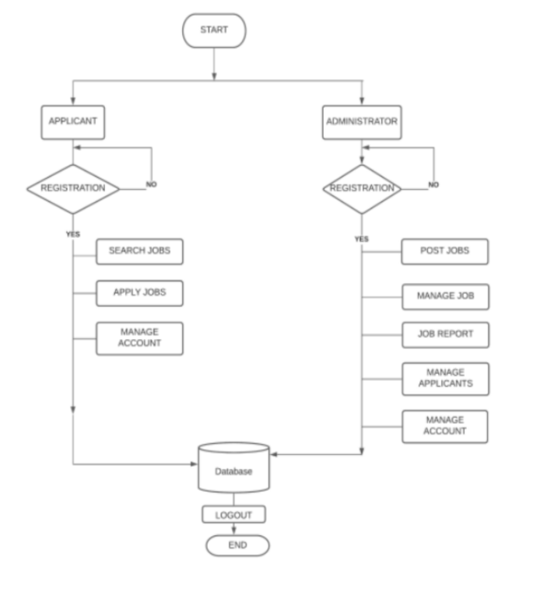
MODELLING
USERFLOW:

Slide 10
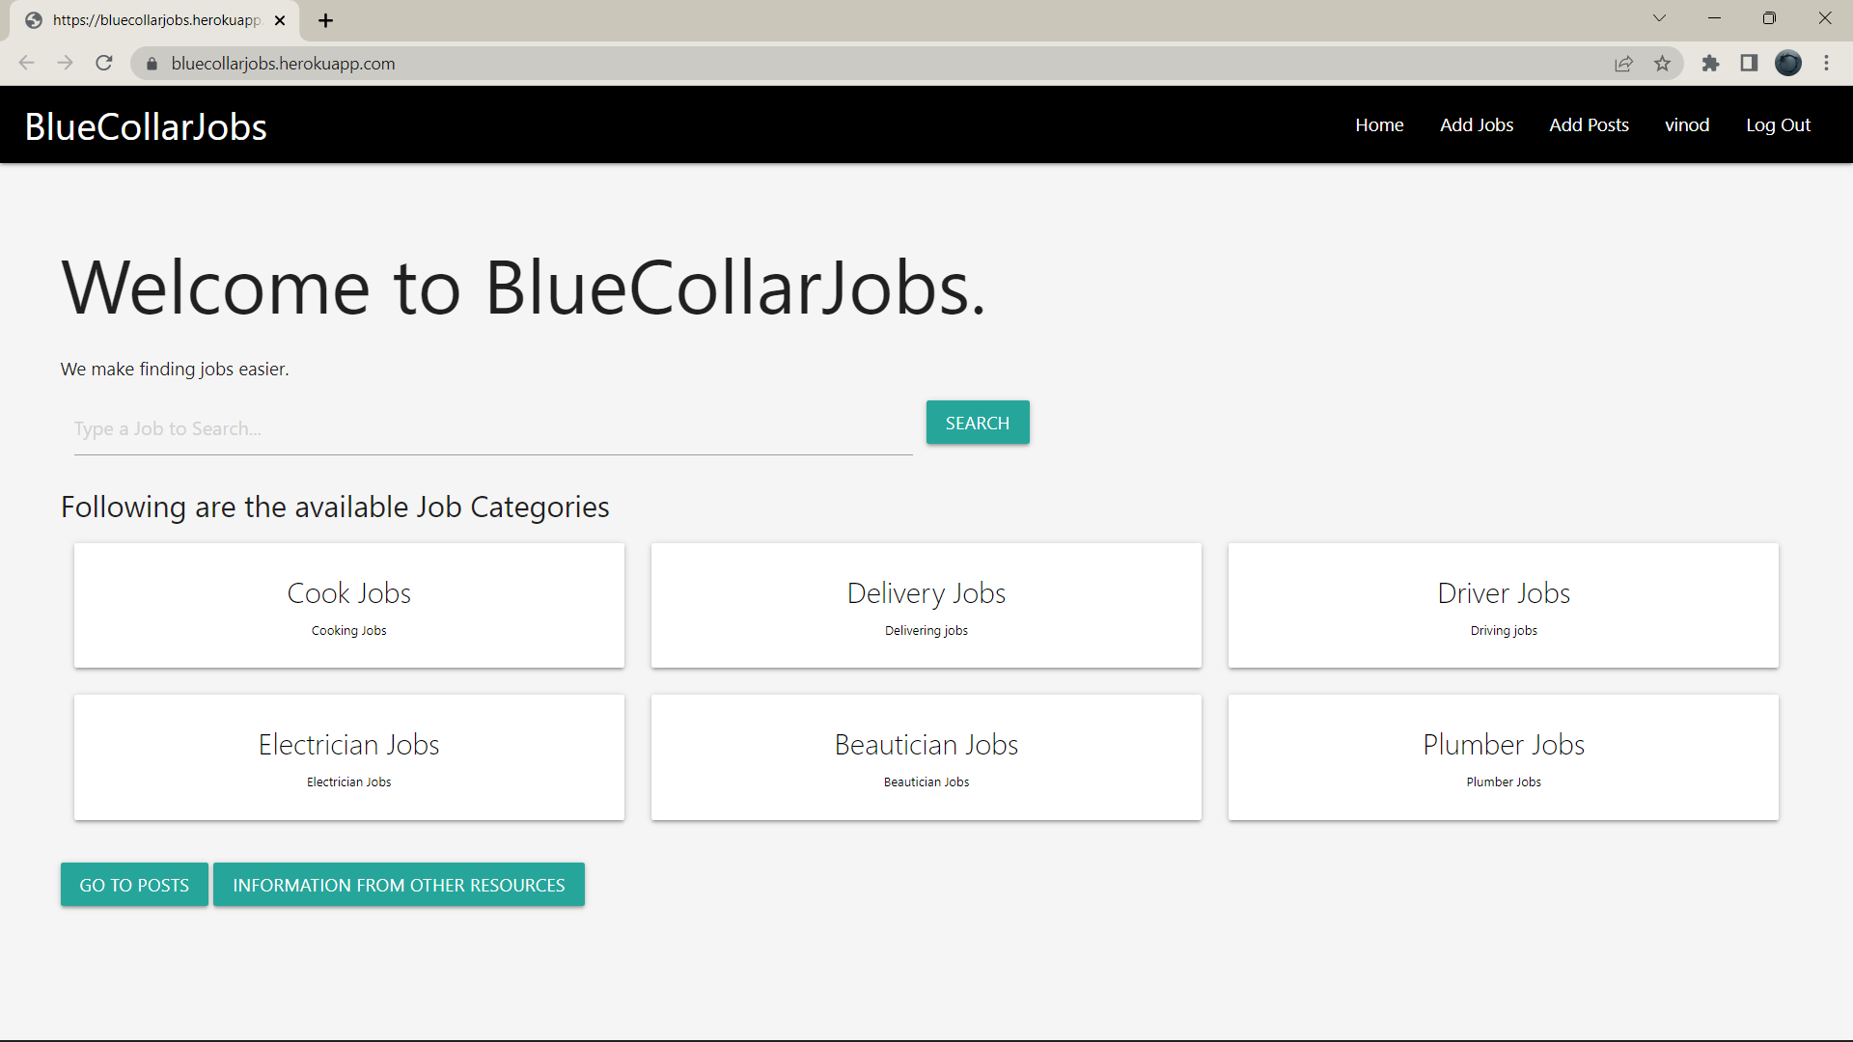
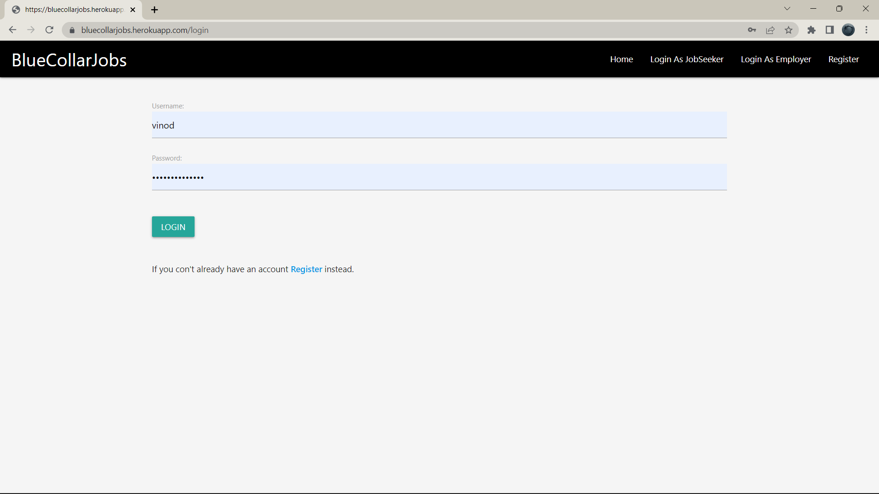
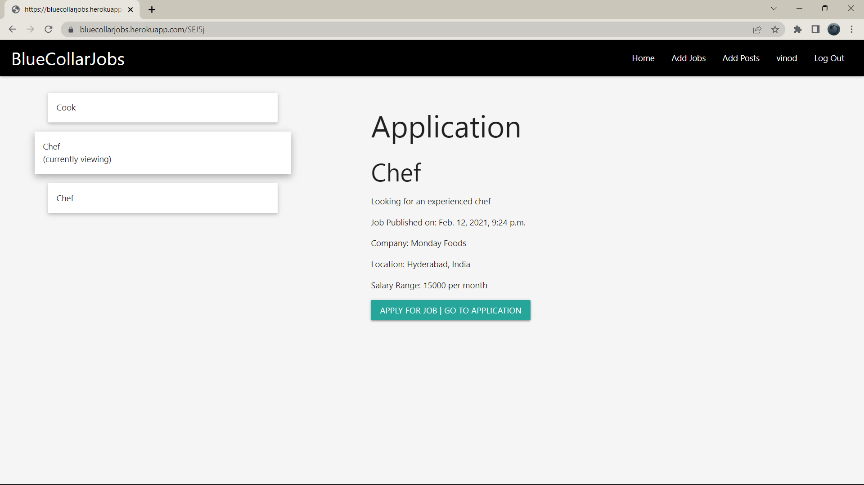
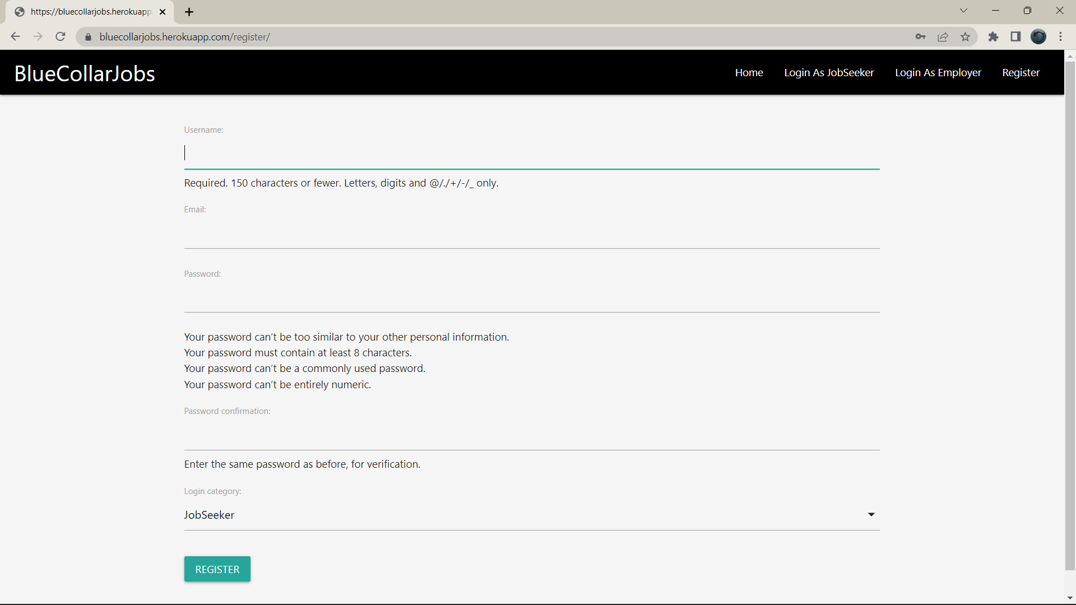
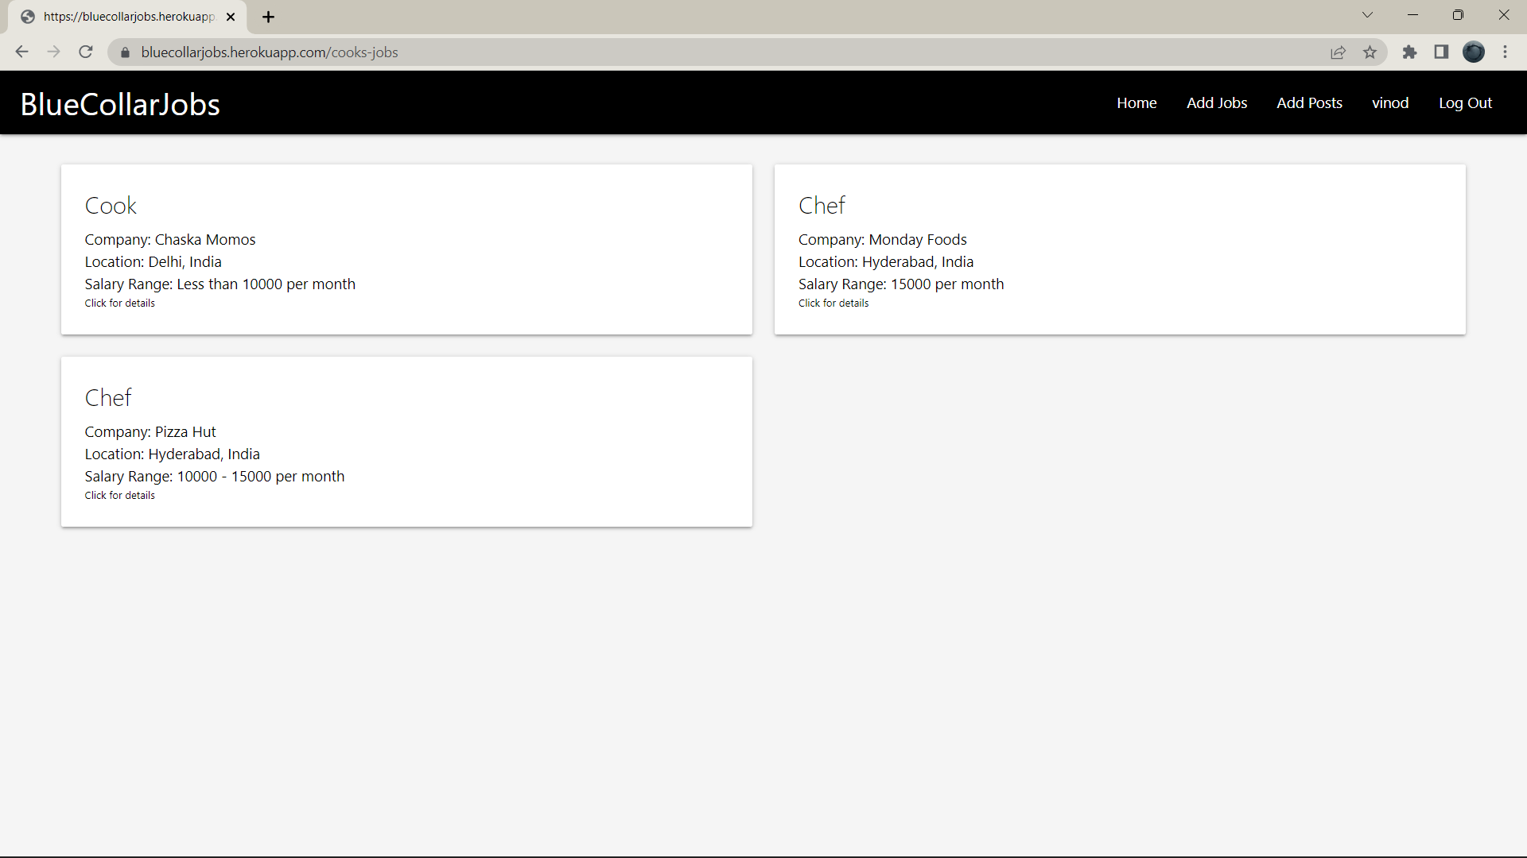
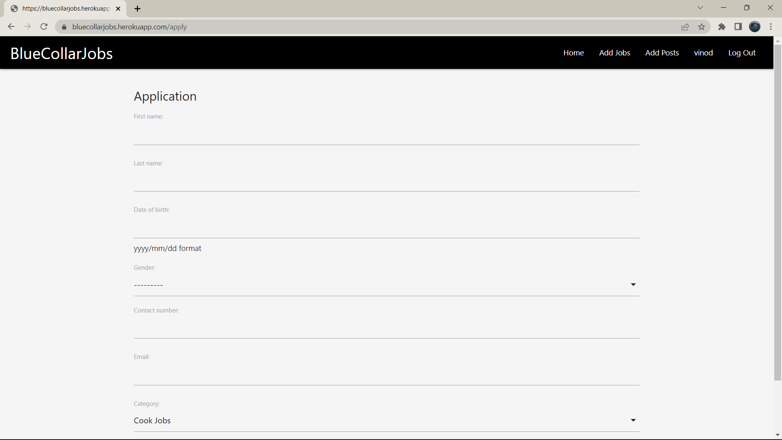
SCREENSHOT OF WEBSITE

Slide 11
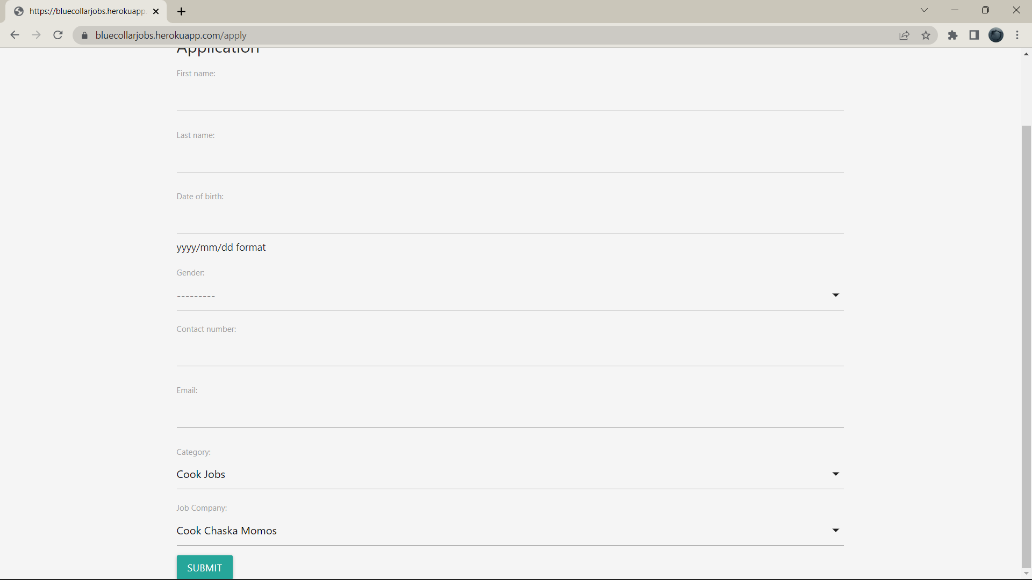
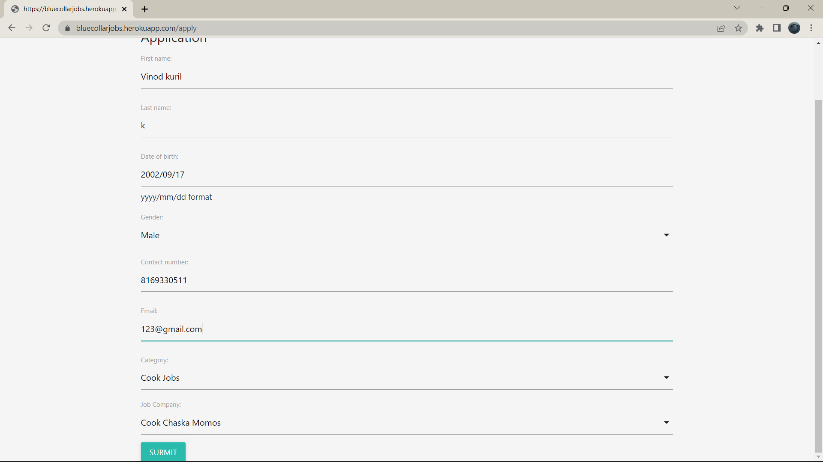
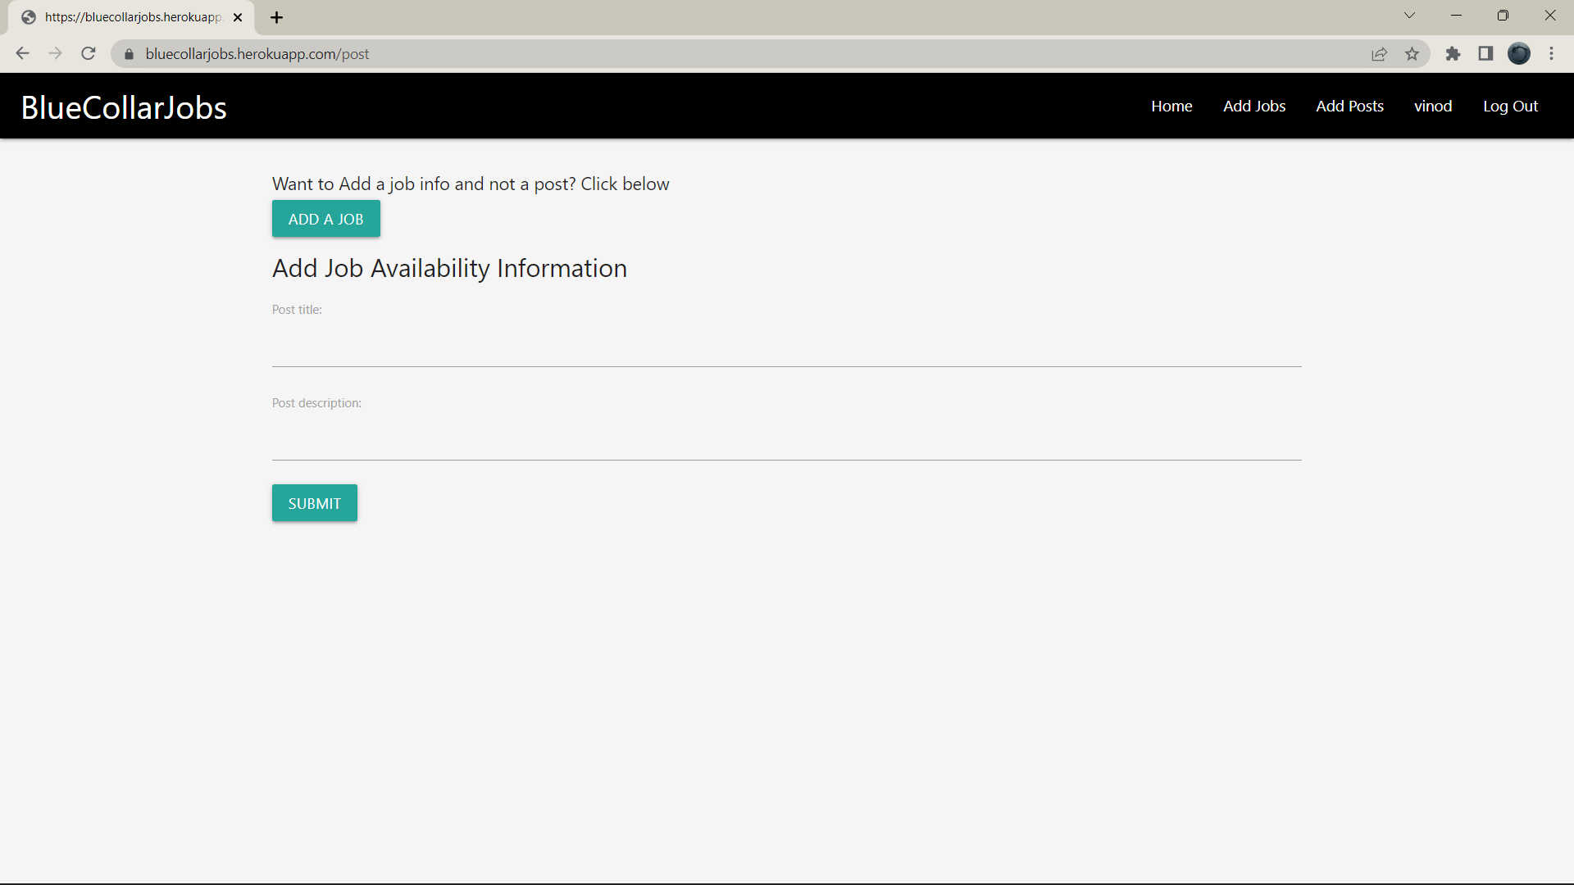
SCREENSHOT OF WEBSITE

Slide 12
RESULTS
This project’s purpose is to create a job portal for unskilled workers. It aims to automate the process of applying for any job, posting new job openings, and so on.
The merits are as follows:
1. Users can enter data into this project using simple and interactive forms. It is very helpful
for the users to enter the required data in such a simple manner.
2. The user is primarily concerned with the accuracy of the information they are entering.
Validations are present at every stage to ensure valid data is entered by the user.
Website link: https://github.com/Vinodk-17/IBM-Full-Stack-Project-JOB-PORTAL-FOR-INFORMAL-JOB-SECTOR

Slide 13
Thank You!!! 😀 😀
.
.

