Slide 1
Retail Sales Analysis: Key Insights for 2011
Prepared for CEO & CMO

Slide 2
Our Approach
Loaded raw dataset into Power BI
Removed duplicates and missing values
Standardized date, customer ID, and country formats
Ensured clean, reliable data for analysis

Slide 3
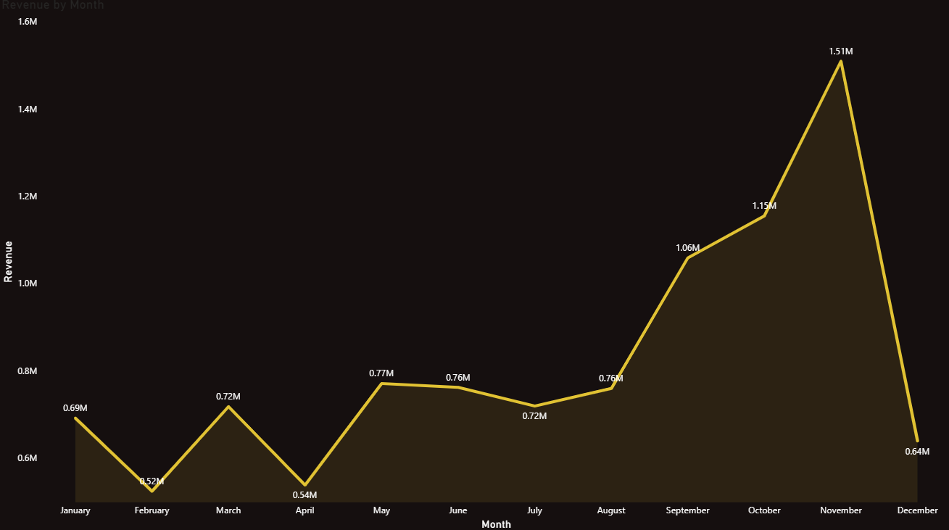
Revenue Trends – 2011 (Monthly)
Line Chart (x-axis = Months, y-axis = Revenue)
Peaks in November–December, dips in summer months
Insight: Seasonal buying behavior – critical for forecasting 2012

Slide 4
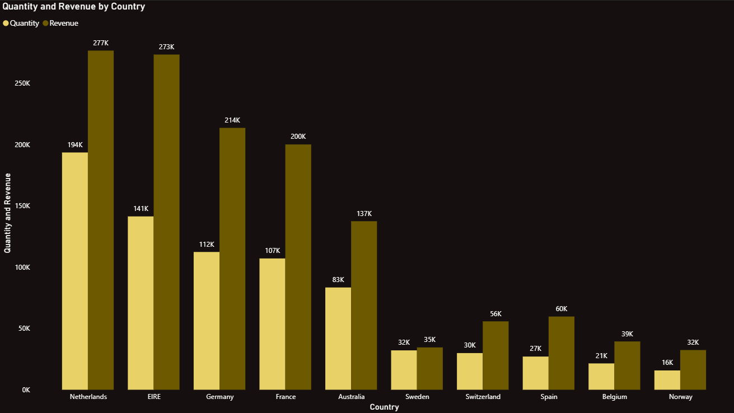
Top 10 Countries by Revenue & Quantity
Stacked Bar Chart (Countries vs. Revenue + Quantity)
Netherlands, Ireland, and Germany leading
Insight: High revenue vs. High volume – pricing vs. demand

Slide 5
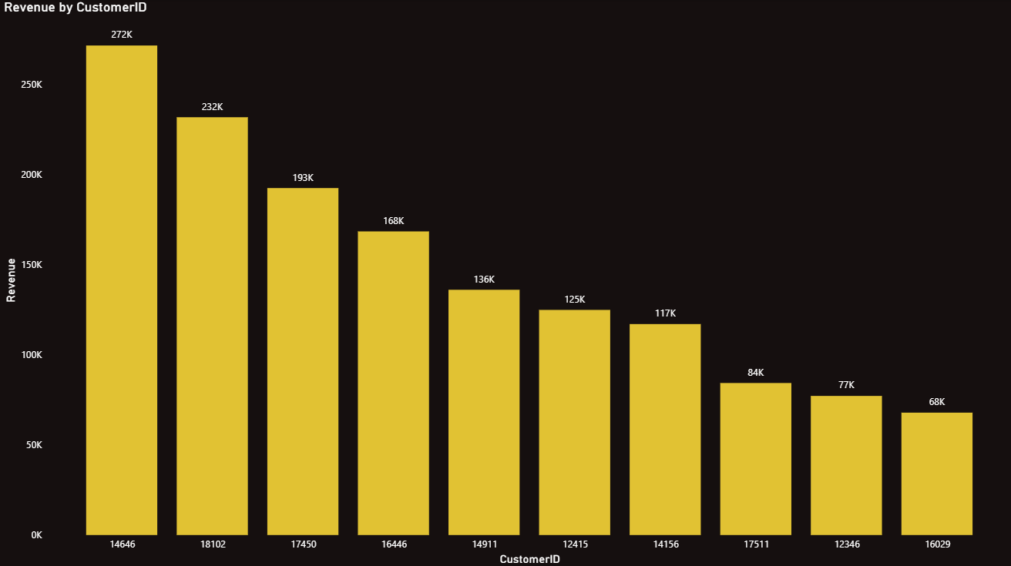
Top 10 Customers by Revenue
Column Chart (Customer ID vs. Revenue descending)
Top 2–3 customers drive majority revenue
Action: Retain & reward high-value customers

Slide 6
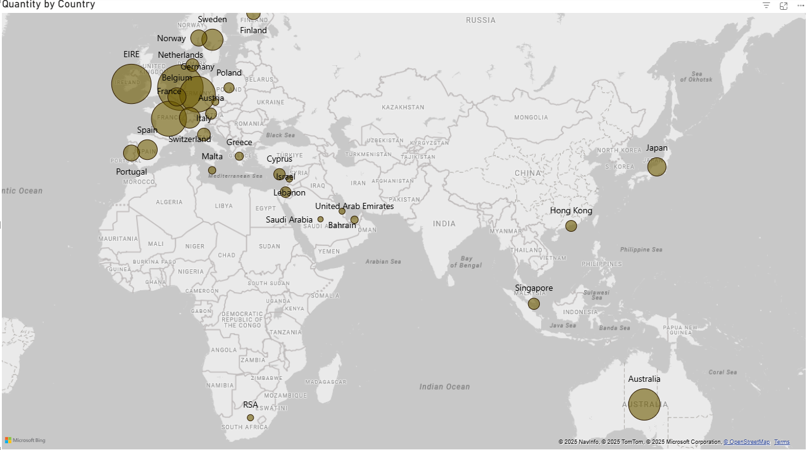
Global Product Demand Distribution
Filled Map (darker shades = higher demand)
Strong demand in Netherlands, Germany, France, and Australia
Opportunity: Expansion into high-demand regions

Slide 7
Key Takeaways
Seasonal revenue peaks → prepare for holidays
Top non-UK countries → tailor marketing strategies
High-value customers → focus on retention
Global demand hotspots → plan expansion strategy
- Focus on boosting inventory and promotions before holiday seasons to maximize sales.
- Strengthen marketing in high-demand countries like Germany, Netherlands, and France.
- Build loyalty programs to retain top customers who generate most revenue. Expand into new global markets with proven strong demand.

Slide 8
Thank You
Questions & Discussion

