Slide 1


CMR TECHNICAL CAMPUS UGC (Autonomous) Kandlakoya, Medchal Road, Hyd-501 401 Department of Computer Science and Engineering
Mini Project Review
Airfare prices prediction using machine learning techniques
BATCH NO-18
Project Guide:
Dr. B. Laxmaiah
Associate Professor, CSE Department
Project Coordinator:
Dr. J Narasimha Rao
Associate Professor, CSE Department
Presented by:
217R1A05R8 : Yashwanth Kumaar Kakani
217R1A0523 : U. Vinod Kumar
217R1A05M7 : G. Manoj Reddy

Slide 2
ABSTRACT
Airfare price prediction using machine learning helps forecast flight prices accurately, supporting decision-making for travellers and businesses.
The process involves analysing historical flight data to identify patterns and predict future price trends.
Commonly used machine learning models include regression, decision trees, support vector machines, and deep learning, which capture various factors like booking time, seasonality, demand, and airline strategies.
These predictive models benefit both consumers and businesses by optimizing travel costs, pricing strategies, inventory management, and revenue.

Slide 3
EXISTING SYSTEM
Airline corporations use complex, dynamic pricing strategies based on financial, marketing, commercial, and social factors, making it difficult for customers to purchase tickets at the lowest price.
Most of these methods use machine learning (ML) models from computational intelligence research for accurate predictions.
Regression and other algorithms, achieving less accuracy in optimizing airline ticket purchases, while ML models like Ripple Down Rule Learner and Logistic Regression for price drop predictions.
Including Linear Regression ,Naïve Bayes ,SoftMax Regression ,and SVM to predict ticket prices with varied success.
Highest prediction Accuracy rate in existing system is for SVM(80.6%)

Slide 4
DISADVANTAGES OF EXISTING SYSTEM
Current airfare prediction systems struggle with accuracy.
Many systems provide generalized recommendations like "buy now" or "wait" without explaining the reasons behind the trends, leaving users confused.
The heavy reliance on historical data makes predictions less effective in real-time.
Most systems do not offer personalized insights based on individual preferences.
Slow and less accurate prices will be predicted.

Slide 5
PROPOSED SYSTEM :
The proposed system for airfare price prediction aims to address the limitations of existing models by incorporating more advanced machine learning techniques and real-time data analysis. This system would leverage advanced ML algorithms, such as random forest and regression tree etc, to better capture complex relationships between various factors like booking time, demand fluctuations, airline competition, and macroeconomic indicators.
By integrating real-time data sources, such as live airline pricing feeds, weather conditions, and global events, the system would provide more accurate and timely predictions.
Additionally, the proposed system would offer personalized recommendations.
Overall, the proposed system would offer a more adaptive, accurate, and user-friendly approach to airfare price prediction, benefiting both consumers and industry stakeholders.

Slide 6
ADVANTAGES OF PROPOSED SYSTEM
Accuracy is improved by using advanced machine learning techniques, regression tree algorithm, SVM algorithm and random forest algorithms, to capture complex variables like demand, booking time, and market conditions.
Integrates Real-Time Data such as airline pricing, global events, and weather conditions, for dynamic and timely predictions.
Personalized Recommendations: Offers tailored forecasts based on individual preferences like preferred airlines, travel dates, and loyalty programs, enhancing relevance for each user.
Adaptability: Adjusts to sudden market changes.
Consumer & Business Benefits: Helps consumers save money and businesses optimize pricing strategies, leading to smarter decision-making for all stakeholders.

Slide 7
HARDWARE REQUIREMENTS
System : i3 Processor or above.
RAM : 4 GB.
Hard Disk : 128 GB.
SOFTWARE REQUIREMENTS
Operating System : Windows 8 or Above.
Coding Language : Python 3.7.0 or Above

Slide 8
Novelty Of Project
The novelty of the proposed airfare price prediction system lies in its integration of advanced machine learning algorithms and real-time data analytics to create a more accurate and dynamic pricing model.
Unlike traditional systems that primarily rely on historical data, the proposed system uses different advanced ML algorithms to identify complex patterns in pricing fluctuations and adapt to changes in real-time. It offers personalized Predictions that is Customizes forecasts based on user preferences (e.g., favorite airlines, travel dates, loyalty programs), offering tailored and relevant predictions for each traveler. Also provides
Dynamic Data Integration which Incorporates live data sources like weather patterns, global events, and social media trends, allowing it to adjust quickly to market changes and deliver timely predictions

Slide 9
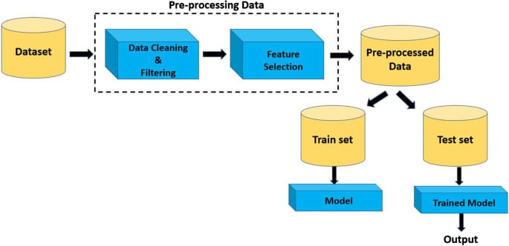
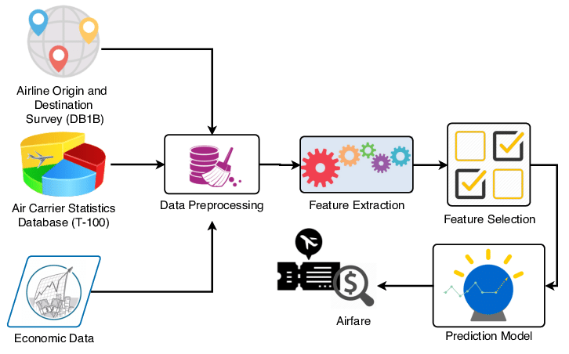
ARCHITECTURE

Slide 10
Modules
User
Upload Dataset
Data Preprocessing
System
Training and testing
Run Algorithms
Accuracy Graph
Predict

Slide 11
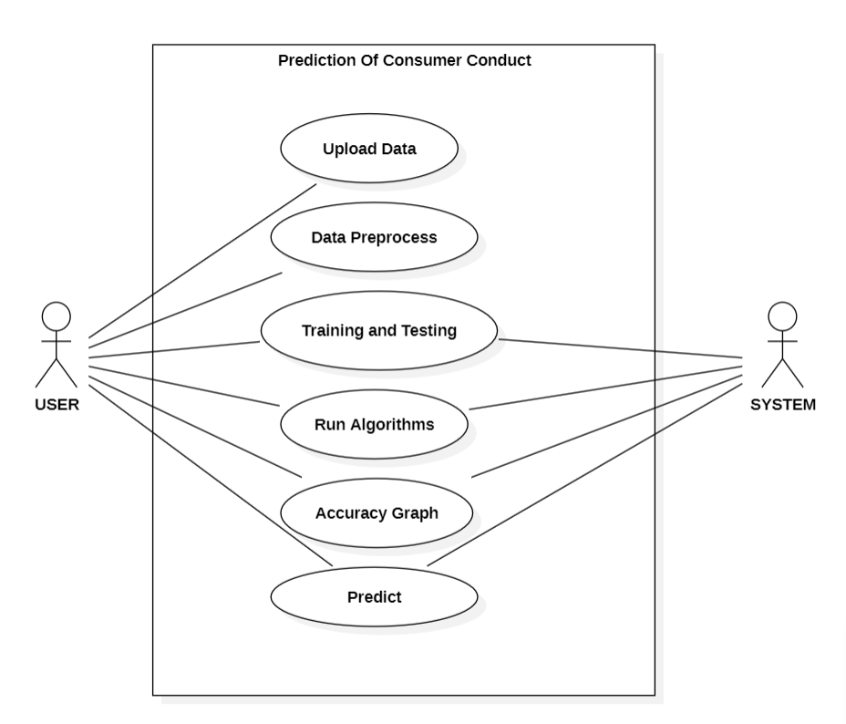
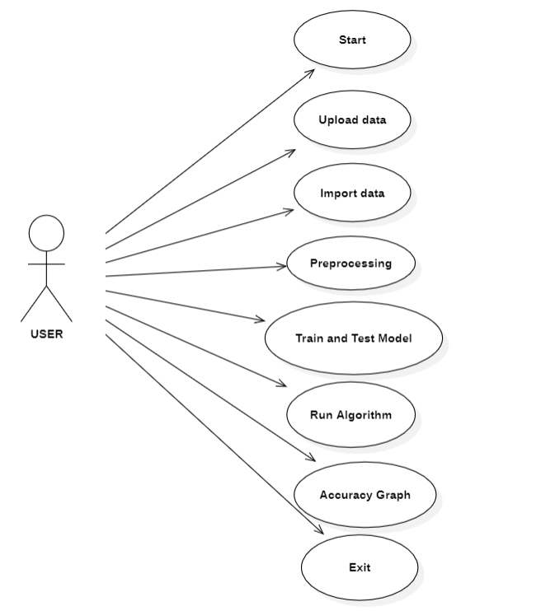
USE CASE DIAGRAM:

Slide 12
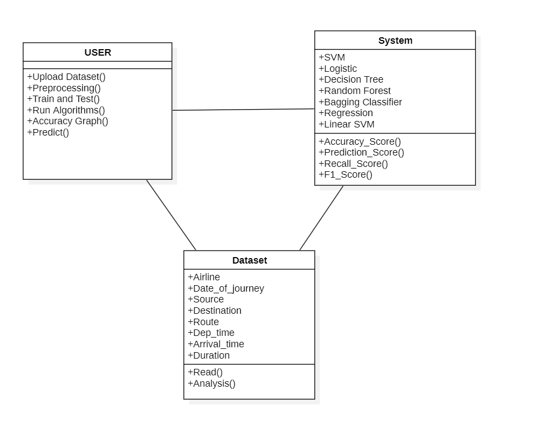
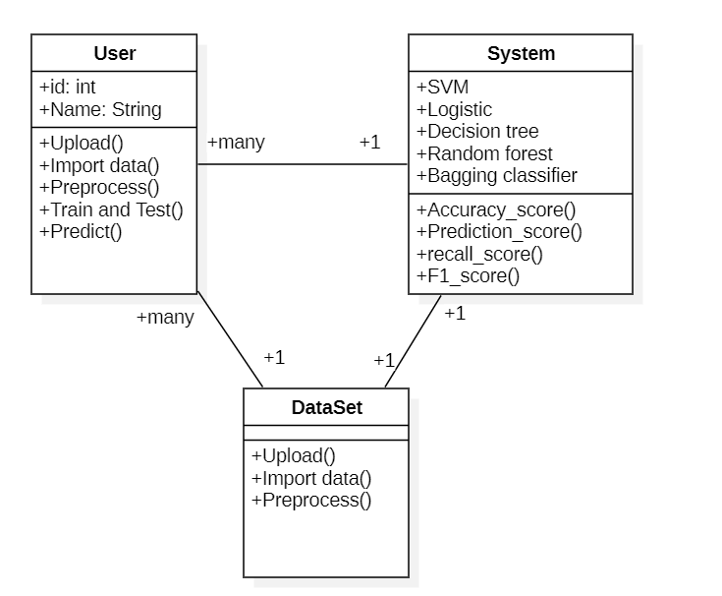
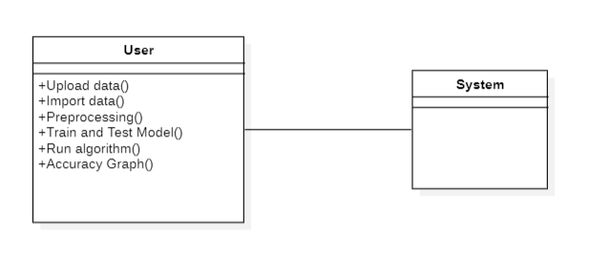
CLASS DIAGRAM:

Slide 13
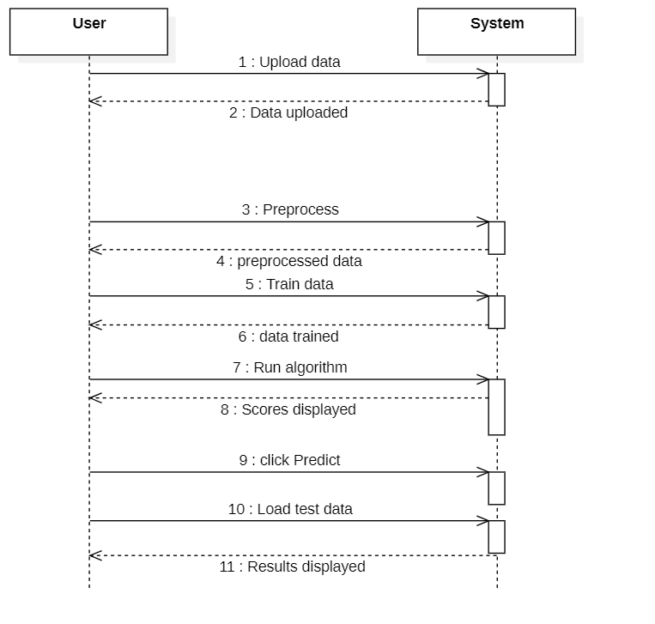
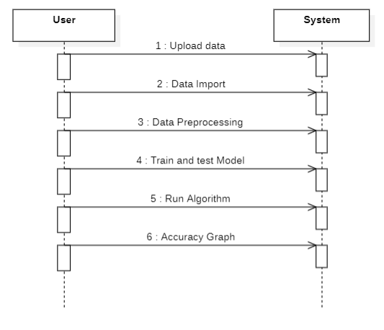
SEQUENCE DIAGRAM:
x
x

Slide 14
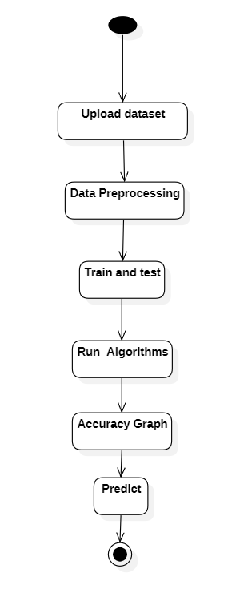
ACTIVITY DIAGRAM:

Slide 15
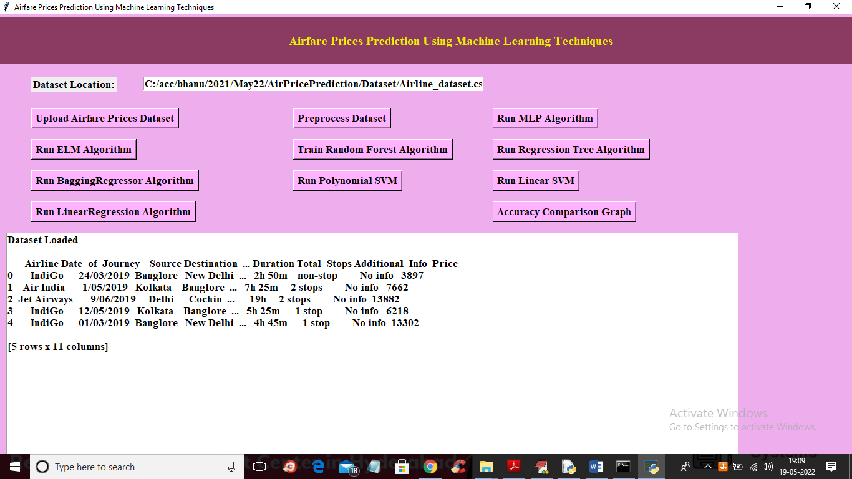
UPLOADING DATASET

Slide 16
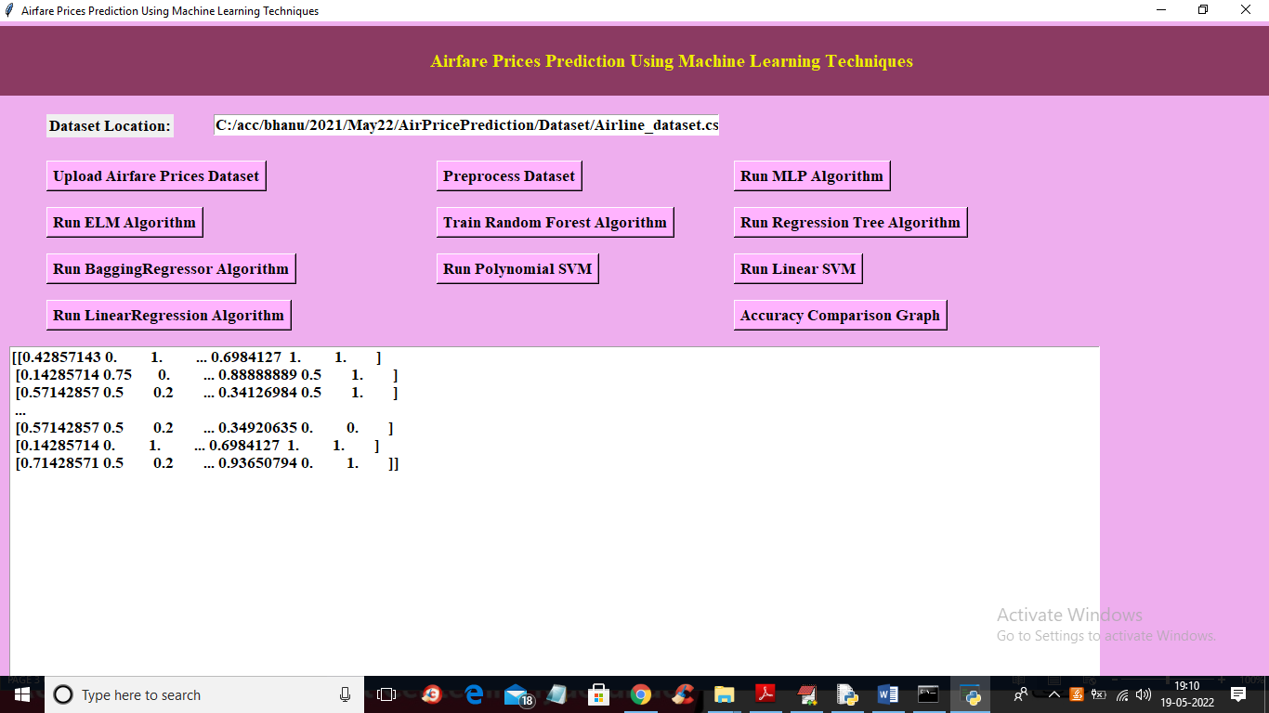
PREPROCESSING

Slide 17
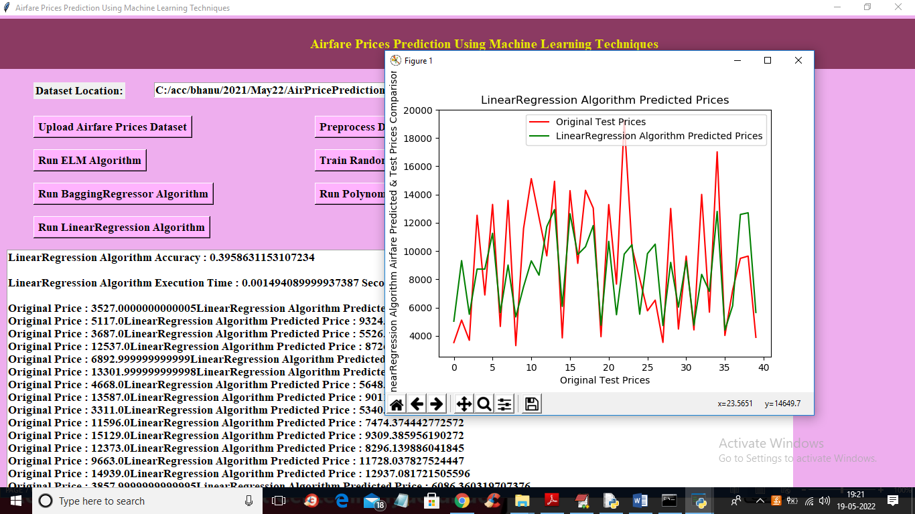
RUN ALGORITHMS

Slide 18
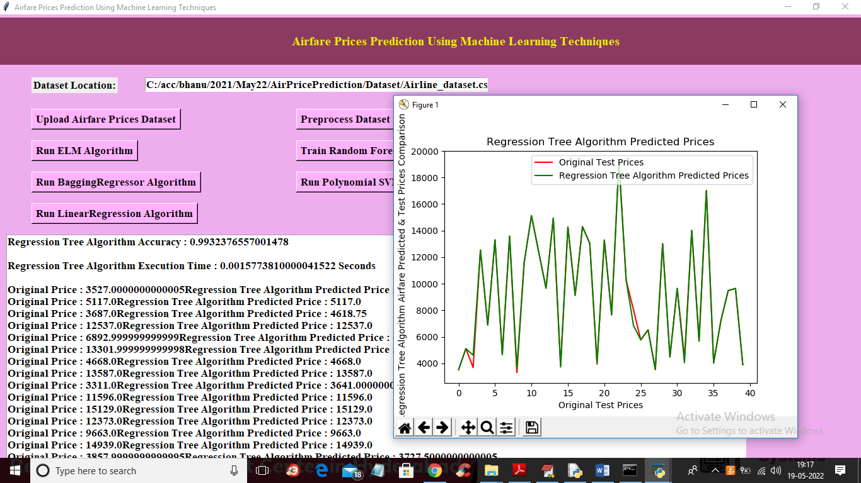

Slide 19
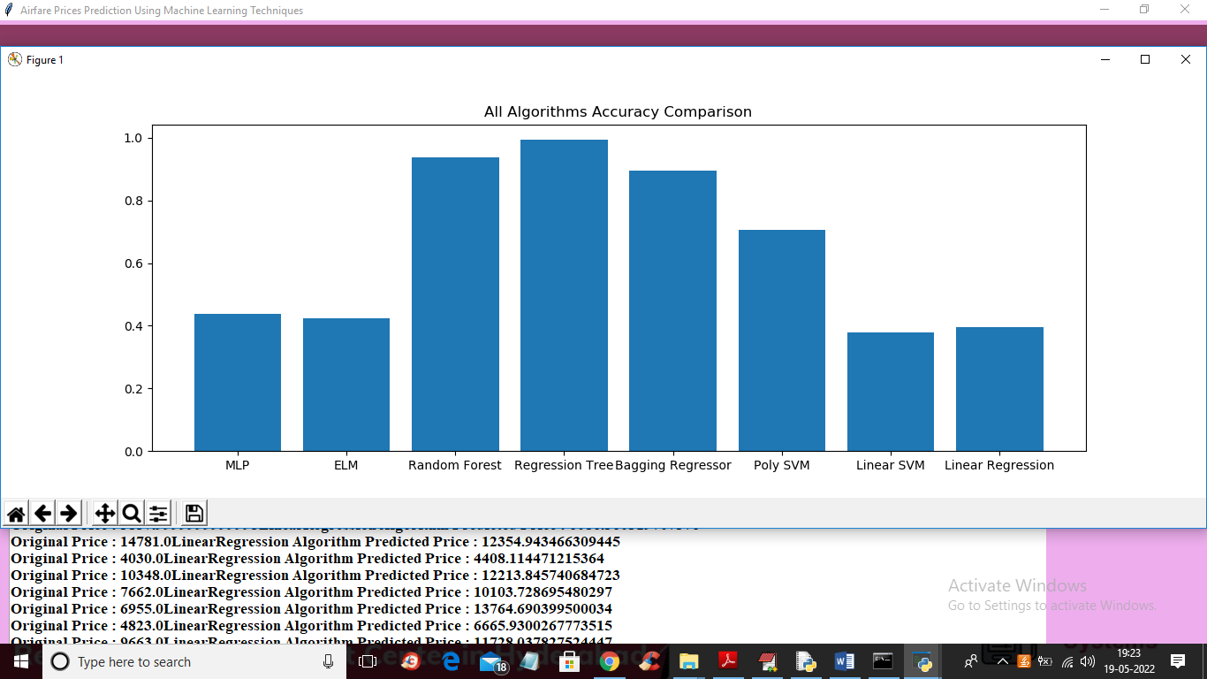
ALL ALGORITHMS ACCURACY GRAPH

Slide 20
SAMPLE CODE
from tkinter import messagebox
from tkinter import *
from tkinter import simpledialog
import tkinter
from tkinter import filedialog
import matplotlib.pyplot as plt
from tkinter.filedialog import askopenfilename
import pandas as pd
import numpy as np
import os
from sklearn.model_selection import train_test_split
from sklearn.preprocessing import MinMaxScaler
from sklearn.svm import SVR #SVR regression
from sklearn.ensemble import RandomForestRegressor #random forest regression class

Slide 21
from sklearn.neural_network import MLPRegressor
from sklearn_extensions.extreme_learning_machines.elm import GenELMRegressor
from sklearn.tree import DecisionTreeRegressor
from sklearn.linear_model import LinearRegression
from sklearn.ensemble import BaggingRegressor
from sklearn.preprocessing import LabelEncoder
import timeit
main = Tk()
main.title("A Holistic Approach on Airfare Price Prediction Using Machine Learning Techniques")
main.geometry("1300x1200")
global filename
global dataset
global X, Y, accuracy, le
sc = MinMaxScaler(feature_range = (0, 1))
global X_train, X_test, y_train, y_test

Slide 22
def runMLP():
global X, Y, accuracy
global X_train, X_test, y_train, y_test
accuracy = []
text.delete('1.0', END)
start = timeit.default_timer()
mlp = MLPRegressor()
mlp.fit(X, Y.ravel())
predict = mlp.predict(X_test)
end = timeit.default_timer()
predictPrice(mlp, predict, y_test, "MLP Algorithm", (end - start))
def runELM():
global X, Y, accuracy
global X_train, X_test, y_train, y_test
accuracy = []
text.delete('1.0', END)
start = timeit.default_timer()
elm_algorithm = GenELMRegressor()
elm_algorithm.fit(X, Y.ravel())
predict = elm_algorithm.predict(X_test)
end = timeit.default_timer()
predictPrice(elm_algorithm, predict, y_test, "ELM Algorithm", (end - start))

Slide 23
def graph():
height = accuracy
bars = ('MLP','ELM','Random Forest','Regression Tree', 'Bagging Regressor', 'Poly SVM', 'Linear SVM', 'Linear Regression')
y_pos = np.arange(len(bars))
plt.bar(y_pos, height)
plt.xticks(y_pos, bars)
plt.title("All Algorithms Accuracy Comparison")
plt.show()
font = ('times', 15, 'bold')
title = Label(main, text='A Holistic Approach on Airfare Price Prediction Using Machine Learning Techniques')
title.config(bg='HotPink4', fg='yellow2')
title.config(font=font)
title.config(height=3, width=120)
title.place(x=0,y=5)
font1 = ('times', 13, 'bold')
ff = ('times', 12, 'bold')
l1 = Label(main, text='Dataset Location:')
l1.config(font=font1)
l1.place(x=50,y=100)

Slide 24
linearsvmButton = Button(main,text="Run Linear SVM", command=runLinearSVM, bg='#ffb3fe')
linearsvmButton.place(x=790,y=250)
linearsvmButton.config(font=font1)
linearButton = Button(main,text="Run LinearRegression Algorithm", command=runLinearRegression, bg='#ffb3fe')
linearButton.place(x=50,y=300)
linearButton.config(font=font1)
graphButton = Button(main,text="Accuracy Comparison Graph", command=graph, bg='#ffb3fe')
graphButton.place(x=790,y=300)
graphButton.config(font=font1)
font1 = ('times', 13, 'bold')
text=Text(main,height=20,width=130)
scroll=Scrollbar(text)
text.configure(yscrollcommand=scroll.set)
text.place(x=10,y=350)
text.config(font=font1)
main.config(bg='plum2')
main.mainloop()

Slide 25
CONCLUSION
This project can result in saving money of inexperienced people by providing them the information related to trends of the flight prices and also give them a predicted value of the price which they use to decide whether to book ticket now or later. On working with different models, it was found out that Random Forest and Regression Tree Algorithm gives the highest accuracy in predicting the output

Slide 26
FUTURE SCOPE
Integration of More Diverse Data
Advanced Machine Learning Models
Dynamic Pricing for Airlines
Multi-Leg and International Flight Support
Mobile and User-Centric Enhancements
Collaboration with Travel Platforms

Slide 27
REFERENCES:
Malighetti, Paleari, and Redondi studied Ryanair's pricing strategies, highlighting how low-cost airlines set prices dynamically (Journal of Air Transport Management, 2009).
The same authors conducted an empirical analysis of Ryanair’s flights from 2006-2007, assessing changes in its pricing strategy (Tourism Management, 2010).
Groves and Gini developed a regression model to predict the optimal time to purchase airline tickets, presented in a technical report from the University of Minnesota (2011).

Slide 28
THANK YOU

