Slide 1
Project Congressional Voting Records
Presentation by
C Vinod kumar
Batch 31
Internship program at INSOFE

Slide 2
Agenda:
Objective
Understanding of Data
Data Exploring & Insights
Data Preprocessing & Challenges
Model building
Conclusion
Internship program at INSOFE

Slide 3
Abstract :
Given data is the official source of information of US Congressional voting on each bill produced in members house.
The votes of members considered as “yes” ,”no” and “not voted” categories.
Objective :
“Learning the Voting Pattern of given data need to classify which party is that member is.”
Internship program at INSOFE

Slide 4
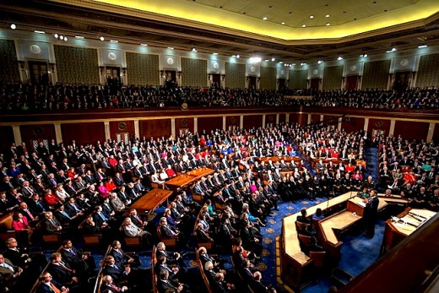
Domain understanding
US has 50 states and 435 congressional districts Each district elects a representative to the House of Representatives for a 2-year term.
Each year the U.S. Senate and House of Representatives take thousands of votes to pass bills, in that some important 16 bills were taken to explain our case study
We can find the each party members voting behavior on each bill’s how they support or not support
“Based on given prior voting patterns we can classify which party is voted for a particular issue”
Internship program at INSOFE

Slide 5
Understanding of Data:
Given dataset contains all categorical variables
435 rows (represents members of the house)
17 columns (independent variables , one dependent variable)
Variable names not given , so for better understanding we labeled all columns with given attribute names in description
Each bill represents voting pattern of each member as “Y” (Voted Yes) , ”N” (Voted No), “?” (Not voted at all)
We replaced “?” with “NA” to understand the how many missing values are there in complete data
Data set having “392” missing values i.e., “5.63%” data is having missing values
Internship program at INSOFE

Slide 6
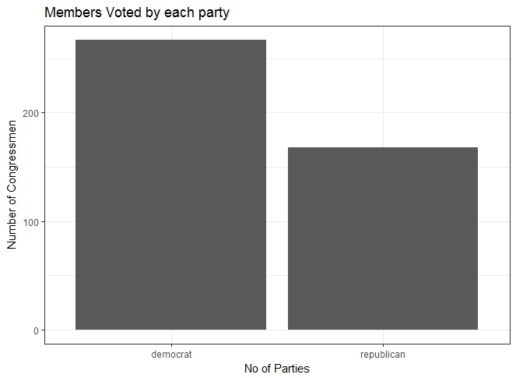
Understanding by visualizing:
In class variable democrat’s more than republic
# R code
> summary(actual_data$classname)
#output
> democrat republican
267 168
> ggplot(actual_data, aes(x=classname),colors()) + theme_bw() + geom_bar() + labs(y="Number of Congressmen",x="No of Parties", title= "Members Voted by each party")
Internship program at INSOFE

Slide 7
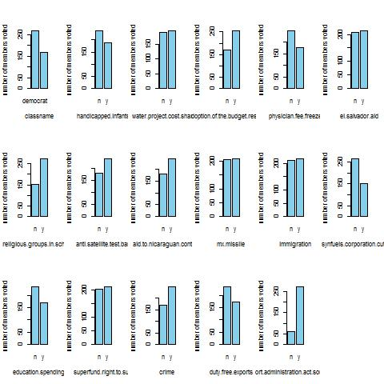
Understanding of Data:
Here we plotted data represents how many are voted for “Y” and “N” for each
bill
There is some variance in each variable some don’t have much variance represents importance of that particular bill
If you see last bill “export_administration_act_south_Africa” having more “Y” votes than “N” votes , because it is very sensitive subject so more importance given
Internship program at INSOFE

Slide 8
Assumptions :
We assume that attribute values are independent of each other given the class
No co-linearity between each variable
Attribute Information:
1. Class Name: 2 (democrat, republican)
2. handicapped-infants: 2 (y,n)
3. water-project-cost-sharing: 2 (y,n)
4. adoption-of-the-budget-resolution: 2 (y,n)
5. physician-fee-freeze: 2 (y,n)
6. el-salvador-aid: 2 (y,n)
7. religious-groups-in-schools: 2 (y,n)
8. anti-satellite-test-ban: 2 (y,n)
9. aid-to-nicaraguan-contras: 2 (y,n)
10. mx-missile: 2 (y,n)
11. immigration: 2 (y,n)
12. synfuels-corporation-cutback: 2 (y,n)
13. education-spending: 2 (y,n)
14. superfund-right-to-sue: 2 (y,n)
15. crime: 2 (y,n)
16. duty-free-exports: 2 (y,n)
17. export-administration-act-south-africa: 2 (y,n)
Internship program at INSOFE

Slide 9
Data Preprocessing
Given data set contains missing values
KNN doesn't work to my data set because here hamming distance doesn't work for categorical, So I used Central Imputation to my data set by using method "mode" ,
Central Imputation by default uses method "median" to replace the missing values
How we imputed
To do imputation I spited data with respective to each class name
All republican's one data frame
All democrats in one data frame
Because Central Imputation replaces missing value with “mode” (whose party votes more)
so while imputing it will impute other party votes to missing values
We imputed missing values on each data frame separately and combined using rbind
> imputed_congress_data <- rbind(republic,democrat)
Internship program at INSOFE

Slide 10
Dividing data set in to train and test
Given Data set is too small so I spited Train data and Test data in 80 and 20 portions
# dividing into data in to training,test 80,20 proportions
set.seed(5000)
proportion_data <- sample(seq(1,2),size = nrow(imputed_congress_data),replace = TRUE, prob = c(.8, .2))
train_congress_data <- imputed_congress_data[proportion_data == 1,]
test_congress_data <- imputed_congress_data[proportion_data == 2,]
Now my data set ready for model building
Internship program at INSOFE

Slide 11
Model building:
It is a classification problem , with categorical variables. Need to classify each member belongs to which party based on voting patterns, So we build classification models on given data set
Naïve Bayes
Logistic Regression
Random Forest
Decision trees
As per business problem we no need to find number of occurrences so I am choosing error metric as “Accuracy” (True positive and True negative
Internship program at INSOFE

Slide 12
Naïve bayes model:
nb_model_congress_data<- naiveBayes(classname~.,data = train_congress_data)
A-priori probabilities:
democrat republican
0.611898 0.388102
Naïve bayes takes and probabilities of Independent events and conditional Probabilities of Independent features
Naïve bayes estimates a joint probability from the training data. Hence this is a Generative model
Naïve bayes classifier predicted accurate results
> summary(pred_test_congress_data) democrat republican
52 30
>summary(pred_train_congress_data) democrat republican
200 153
Metrics Report
 | Accuracy | Recall | Precision
Naïve bayes model | 0.9634 | 0.9803922 | 0.9803922
Internship program at INSOFE

Slide 13
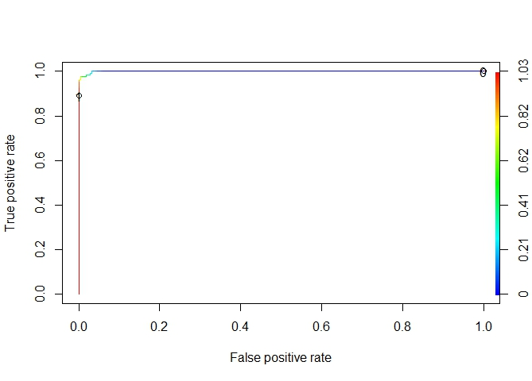
Logistic model:
logistic_model<-glm(classname~.,data = train_congress_data,'binomial')
Logistic model estimates the probability(y/x) directly from the training data by minimizing error
we plot ROC curve which represents True positive rate in y-axis and False positive rate in x-axis
He we can see threshold point at 0.9
Accuracy : 0.9512
Prediction democrat republican
democrat 51 4
republican 0 27
Internship program at INSOFE

Slide 14
Random Forest
Modelforest <- randomForest(classname~.,data = train_congress_data)
Random Forests is an ensemble classifier which uses many decision tree models to predict the result
Confusion matrix train_data
democrat republican
democrat 215 1
republican 0 137
Number of trees: 500
No. of variables tried at each split: 4
OOB estimate of error rate: 3.4%
Confusion matrix: democrat republican class.error
democrat 208 8 0.03703704
republican 4 133 0.02919708
Confusion matrix test data
democrat republican
democrat 51 0
republican 2 29
resultest accuracy_test specificity_test sensitivity_test
resultrain 0.997167 0.9953704 1.0000000
resultest 0.9756098 1.0000000 0.9354839
Internship program at INSOFE

Slide 15
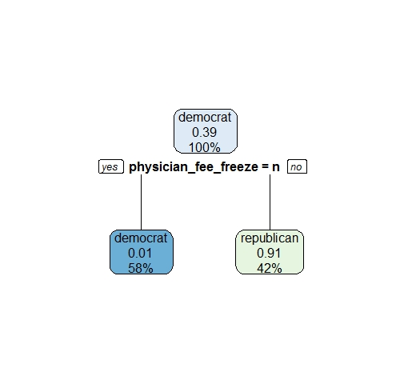
Decision trees
model_rpart <-rpart(classname~.,data=train_congress_data)
I build cart model using rpart
Accuracy 0.9878
Confusion matrix rpart
democrat republican democrat 50 0
republican 1 31
Internship program at INSOFE

Slide 16
Conclusion:
Final summary of the project is I understood the business problem , done preprocessing build model on data set and predicted which party is the member is based on voting pattern
Plan of action is to build model for each variable and see better results, how importance is given to each bill.
Internship program at INSOFE

Slide 17
Thank you
Internship program at INSOFE

