Slide 1

Current
Start
Can Evaluate Policy
Yes
No
Evaluation will fail
End
Biometrics Available
Evaluate Policy
Evaluation will fail
Yes
Yes
No
Passcode Set
No
Evaluation will fail

Slide 2
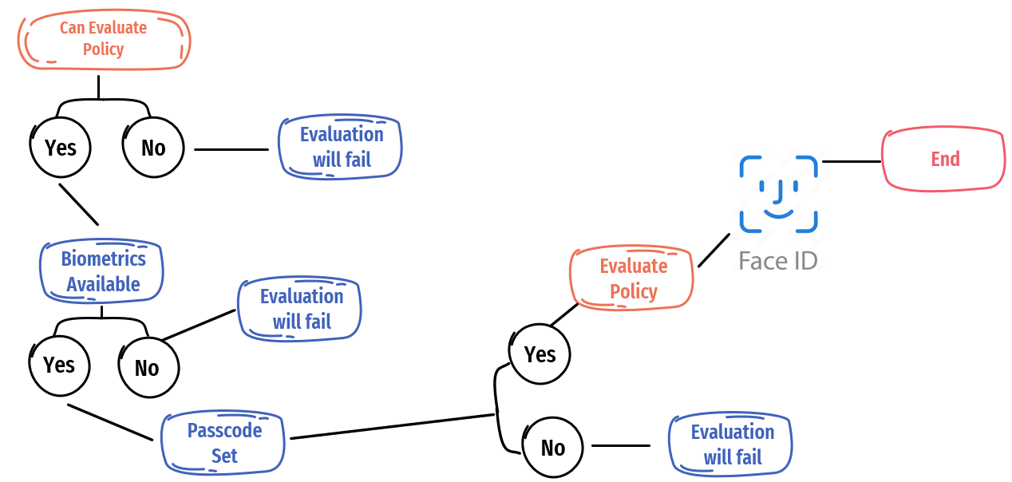
Proposed
Start
Frame Processing
API Detection
Face Analysis
+
+

