Slide 1

Medical Recommendation System with Machine Learning
An AI-powered solution for healthcare accessibility, disease prediction, and personalized health guidance

Slide 2
Healthcare Challenges & Our Solution
Current Problems
Our Solution
Misinformation from online symptom searches
AI-powered Medical Recommendation System that predicts diseases from symptoms and provides personalized guidance on medications, diet, precautions, and workouts
Lack of medical professionals in rural areas
Overcrowded hospitals causing delayed treatment
Preventive healthcare often ignored

Slide 3
Project Objectives
Develop reliable ML model for disease prediction
Create recommendation system for medications, diets, precautions, and workouts
Design user-friendly web application
Promote preventive healthcare through personalized advice
Bridge healthcare gap in rural and underserved communities

Slide 4





System Architecture
User Input
Patient enters symptoms
ML Model
Processes symptoms
Disease Prediction
Identifies possible conditions
Recommendations
Provides personalized guidance

Slide 5
Datasets & Preprocessing
Datasets Used
Preprocessing Steps
Training.csv → Symptoms and diseases
Data cleaning (removing missing/duplicate values)
Symptom-severity.csv → Severity levels
Converting categorical symptoms to numerical form
medications.csv → General medicines
Assigning severity scores for accurate prediction
diets.csv → Dietary recommendations
Splitting data into training and testing sets
precautions_df.csv → Precautions
workout_df.csv → Fitness routines

Slide 6






Machine Learning Models
Random Forest Classifier
Ensemble method combining multiple decision trees
Decision Tree Classifier
Hierarchical decision-making based on symptom patterns
Support Vector Machine
Classification algorithm finding optimal boundaries
Models were evaluated based on accuracy, with the best-performing model selected for the final system

Slide 7




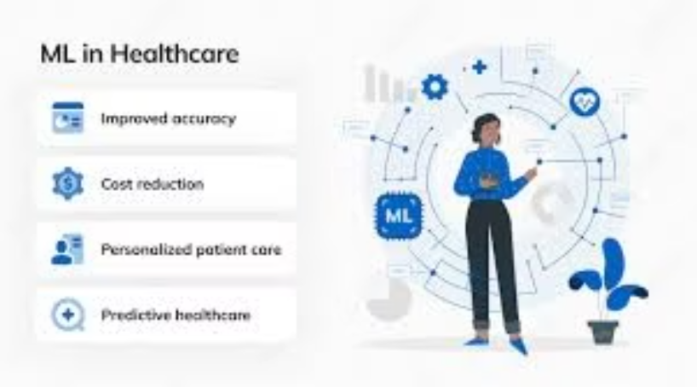
Impact & Benefits
For Patients
For Doctors
Early awareness and guidance, reducing dependency on unreliable online sources
Support system for diagnosis, reducing burden for minor health issues
For Society
For Healthcare System
Increased health awareness through personalized recommendations
Reduced burden on hospitals, improved accessibility in underserved areas

Slide 8

Limitations & Future Enhancements
Current Limitations
Future Enhancements
Recommendations are general, not a substitute for doctor consultation
Integration with Electronic Health Records (EHRs)
Adding real-time chatbots for interaction
Limited dataset size affects accuracy
Multi-language support for rural users
Cannot handle emergency medical situations
Mobile app version for wider accessibility
Integration with wearable devices for real-time health monitoring

Slide 9
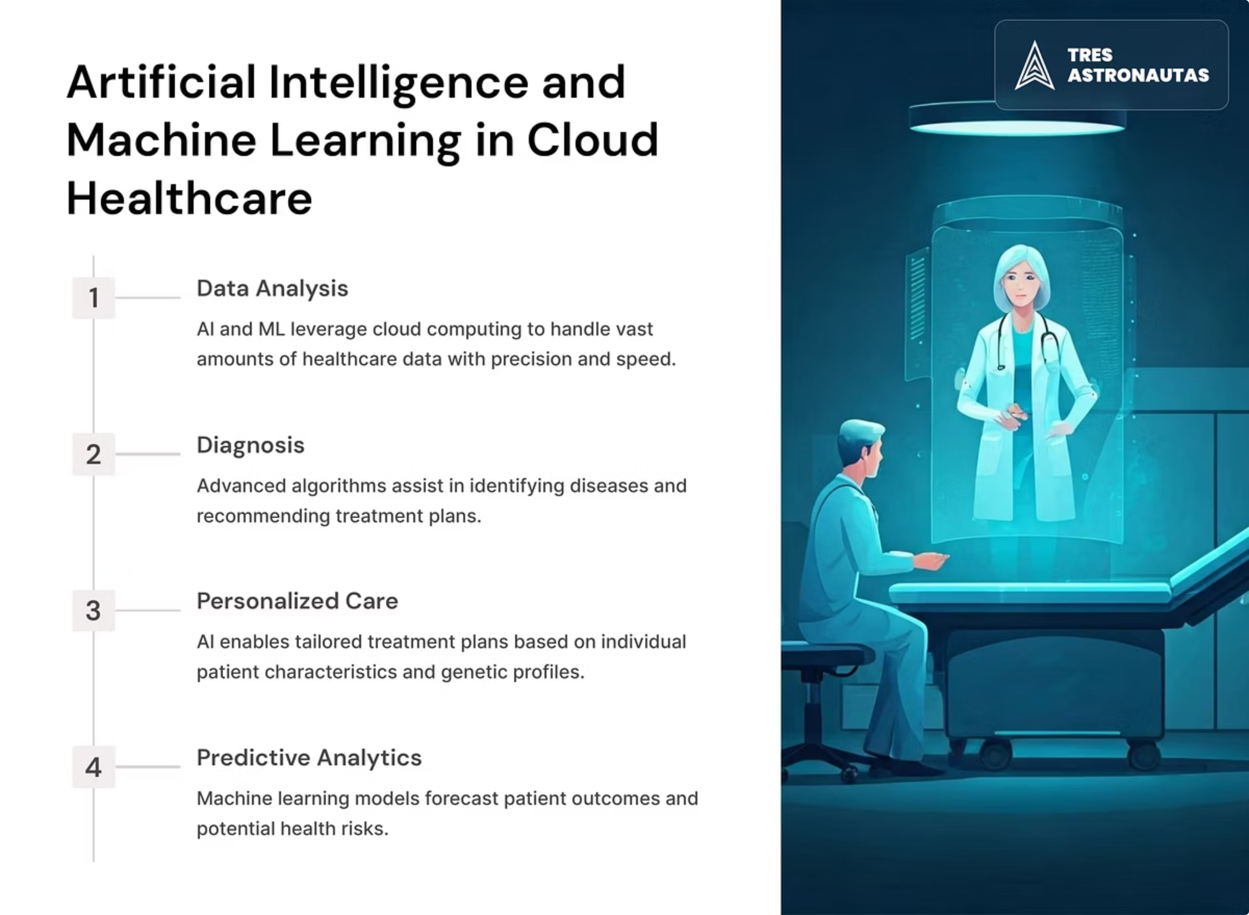
Conclusion
The Medical Recommendation System successfully predicts diseases from symptoms and provides safe, general recommendations on medications, diet, workouts, and precautions.
While it cannot replace certified doctors, it ensures awareness, preventive care, and early intervention, which can significantly improve healthcare accessibility and patient outcomes.
This system bridges the gap in healthcare accessibility, acting as a virtual health assistant that supports patients in making informed health decisions.

