Slide 1

Project Seminar on
Rubber Ducky
Submitted To:
Mr. Govind Singh
H.O.D (C.S.E)
Submitted By:
Awanish Chaurasiya
Niraj Charan
Tanya Singh
Vinay Gurjar
Department of Computer Science & Engineering
Chartered Institute of Technology, Abu Road

Slide 2
Contents
1
Abstract
Introduction
WiFi Profile Grabber
UAC Bypass (user account control)
Dump the SYS SAM FILE
Username and IP exfiltration
Disable Windows Defender
System Architecture
Conclusion
Reference
Department of Computer Science & Engineering
Chartered Institute of Technology, Abu Road

Slide 3
Abstract
2
The Digispark Attiny85 Rubber Ducky Attack is a technique used to exploit computer systems by emulating a USB keyboard.
It involves using a small device to simulate keyboard input and execute pre-programmed scripts to automate actions on the target system.
The technique can be used for malicious purposes, such as gaining remote access or stealing sensitive data, or for ethical purposes, such as testing security systems.
Computer Science and Engineering
Chartered Institute of Technology, Abu Road

Slide 4
Abstract
3
The Digispark Attiny85 Rubber Ducky Attack is easy to carry out and requires minimal technical knowledge or experience.
Organizations can protect against this technique by implementing USB device controls, disabling USB ports, and regularly updating system software.
Computer Science and Engineering
Chartered Institute of Technology, Abu Road

Slide 5
Introduction
4
The Digispark ATTiny85 Rubber Ducky Attack is a technique used to execute pre-programmed keystrokes on a targeted computer by using a Digispark ATTiny85 microcontroller as a USB rubber ducky.
The Digispark ATTiny85 is a small and low-cost microcontroller that can be programmed to act as a USB keyboard, which allows it to simulate human keyboard inputs on a computer.
Computer Science and Engineering
Chartered Institute of Technology, Abu Road

Slide 6
Introduction
5
This technique is often used in security testing or in malicious attacks to gain unauthorized access to a computer system, steal sensitive information, or install malware.
By emulating keyboard inputs, the Digispark ATTiny85 can bypass security measures that are designed to prevent unauthorized access or protect against malicious software.
Computer Science and Engineering
Chartered Institute of Technology, Abu Road

Slide 7

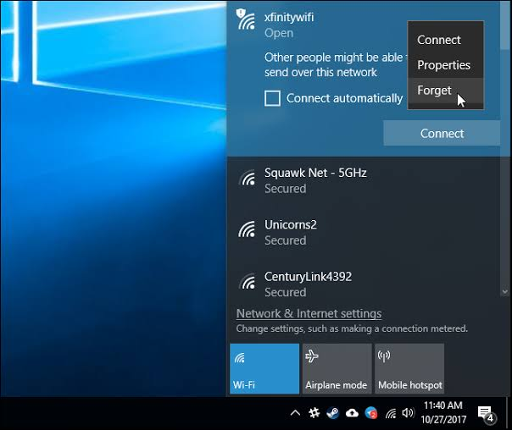
WiFi Profile Grabber
6
Fig: Wifi Profile grabber
Department of Computer Science & Engineering
Chartered Institute of Technology, Abu Road

Slide 8
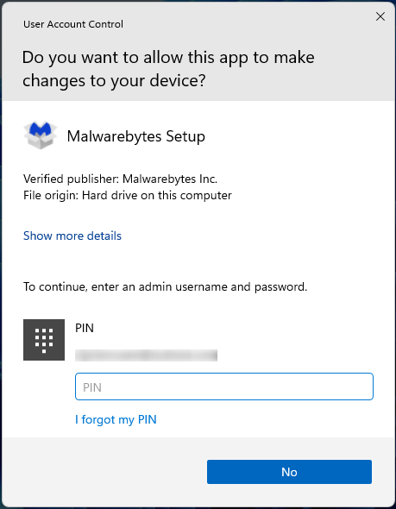
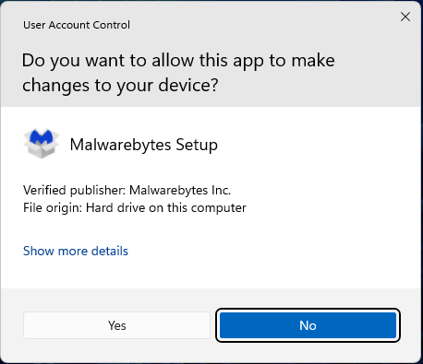
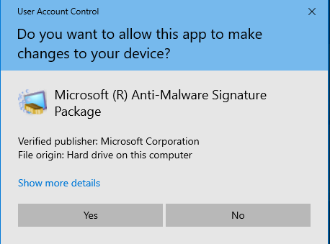
UAC Bypass
7
Fig : UAC Bypass
Department of Computer Science & Engineering
Chartered Institute of Technology, Abu Road

Slide 9
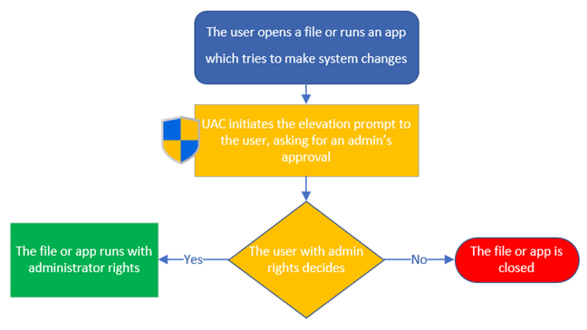
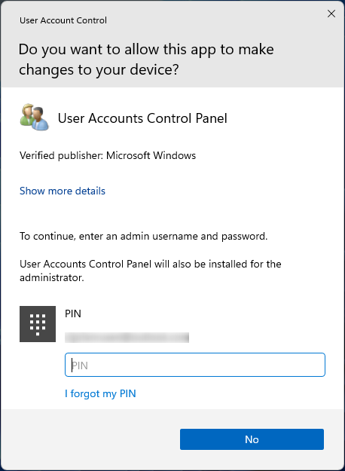
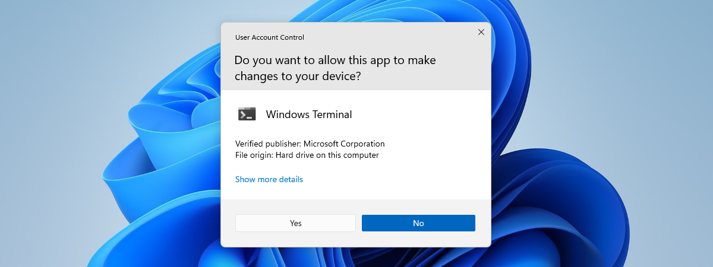
UAC Bypass
8
Fig : UAC Bypass
Department of Computer Science & Engineering
Chartered Institute of Technology, Abu Road

Slide 10


Dump the SYS SAM FILE
9
Fig : SYS SAMP File
Department of Computer Science & Engineering
Chartered Institute of Technology, Abu Road

Slide 11
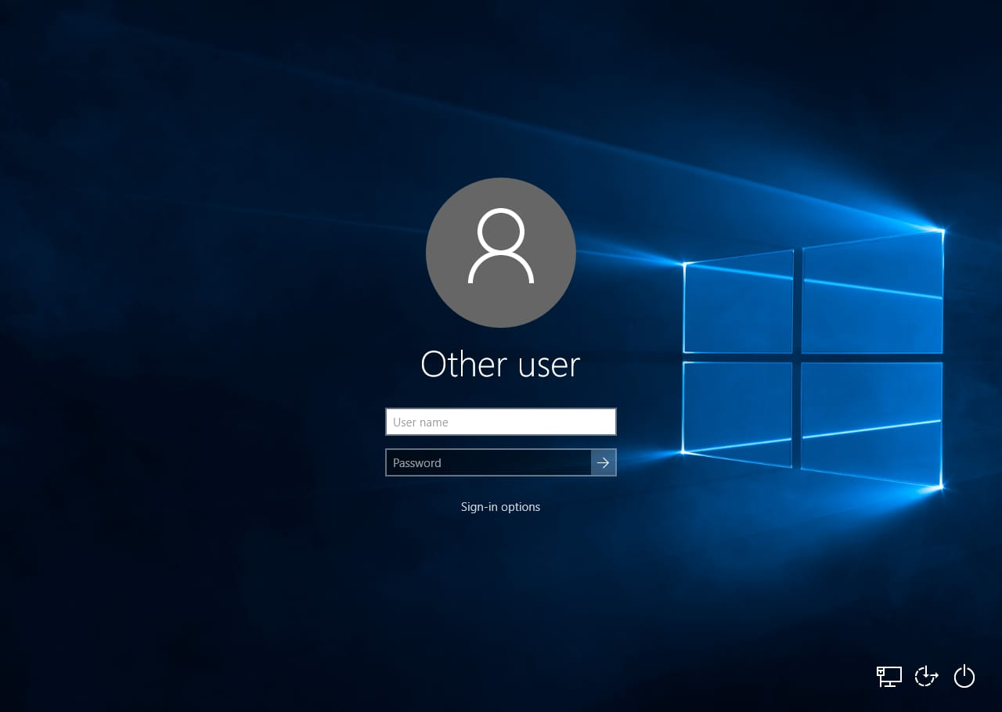
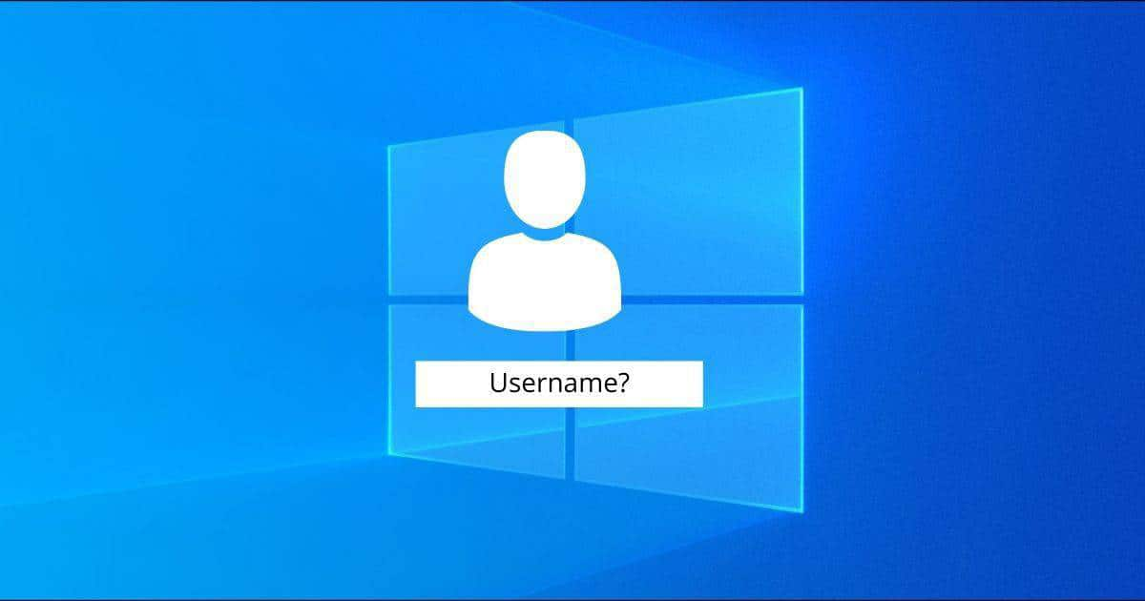
Username and IP Exfiltration
10
Fig: Username Exfiltration
Department of Computer Science & Engineering
Chartered Institute of Technology, Abu Road

Slide 12
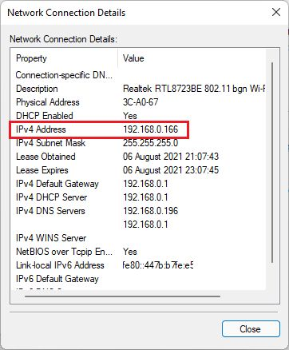


Username and IP Exfiltration
11
Fig: IP Exfiltration
Department of Computer Science & Engineering
Chartered Institute of Technology, Abu Road

Slide 13
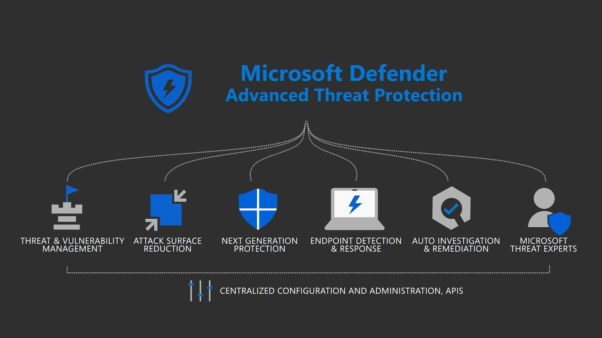
Disable Windows Defender
12
Fig : Windows Defender
Department of Computer Science & Engineering
Chartered Institute of Technology, Abu Road

Slide 14
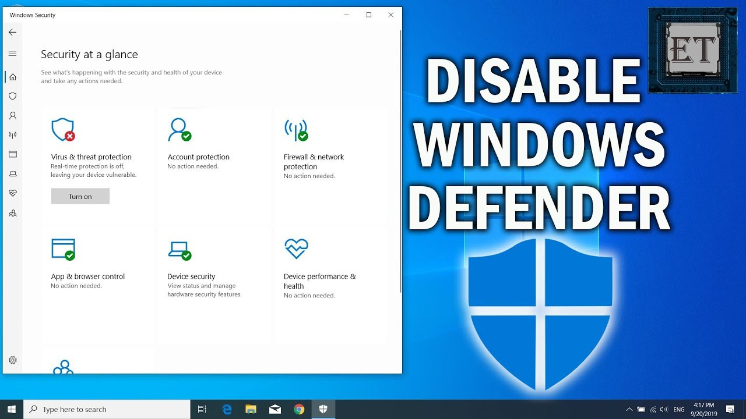

Disable Windows Defender
13
Fig : Disable Windows Defender
Department of Computer Science & Engineering
Chartered Institute of Technology, Abu Road

Slide 15
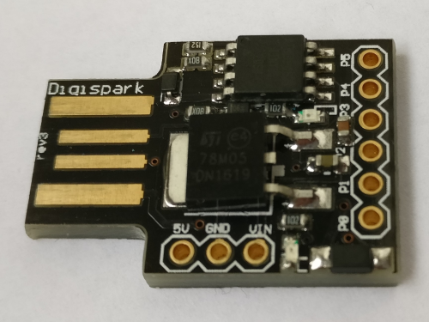
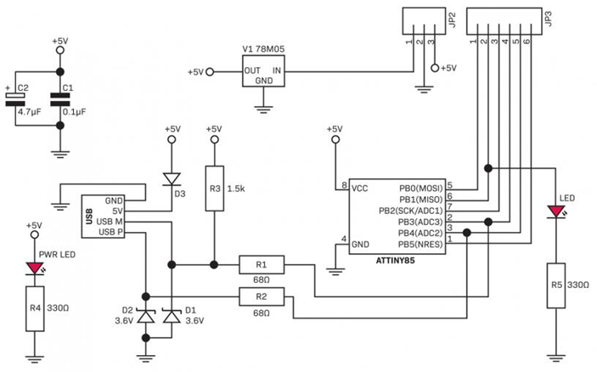
System Architecture
14
The Digispark Attiny85 Rubber Ducky
Fiig : The Digispark Attiny85 Rubber Ducky
Department of Computer Science & Engineering
Chartered Institute of Technology, Abu Road

Slide 16
System Architecture
15
The architecture of this attack involves programming the Digispark ATTiny85 to act as a USB keyboard and then connecting it to the targeted computer via USB. The device appears to the computer as a standard keyboard, allowing it to simulate keystrokes and execute various actions, such as opening applications or executing commands.
To program the Digispark ATTiny85 for this attack, the user must write code using the Arduino IDE, which includes a library for emulating a USB keyboard. The code defines the keystrokes to be executed and the timing between each keystroke. Once the code is uploaded to the Digispark ATTiny85, the device is ready to be used for the Rubber Ducky Attack.
Department of Computer Science & Engineering
Chartered Institute of Technology, Abu Road

Slide 17
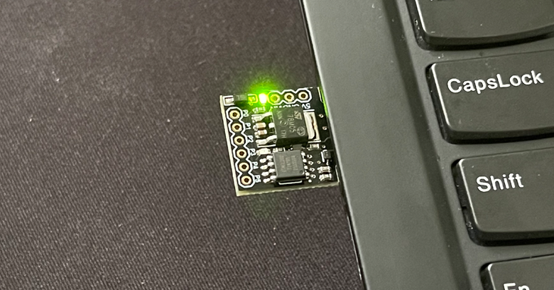
System Architecture
16
The architecture of this attack can be modified and customized depending on the specific goals of the attacker. For example, the code can be programmed to execute more complex actions, such as downloading and installing malware, stealing sensitive data, or establishing a backdoor on the target computer. However, it is important to note that using this attack for illegal or unethical purposes is prohibited and can result in serious consequences.
Fig : Rubber Ducky
Department of Computer Science & Engineering
Chartered Institute of Technology, Abu Road

Slide 18
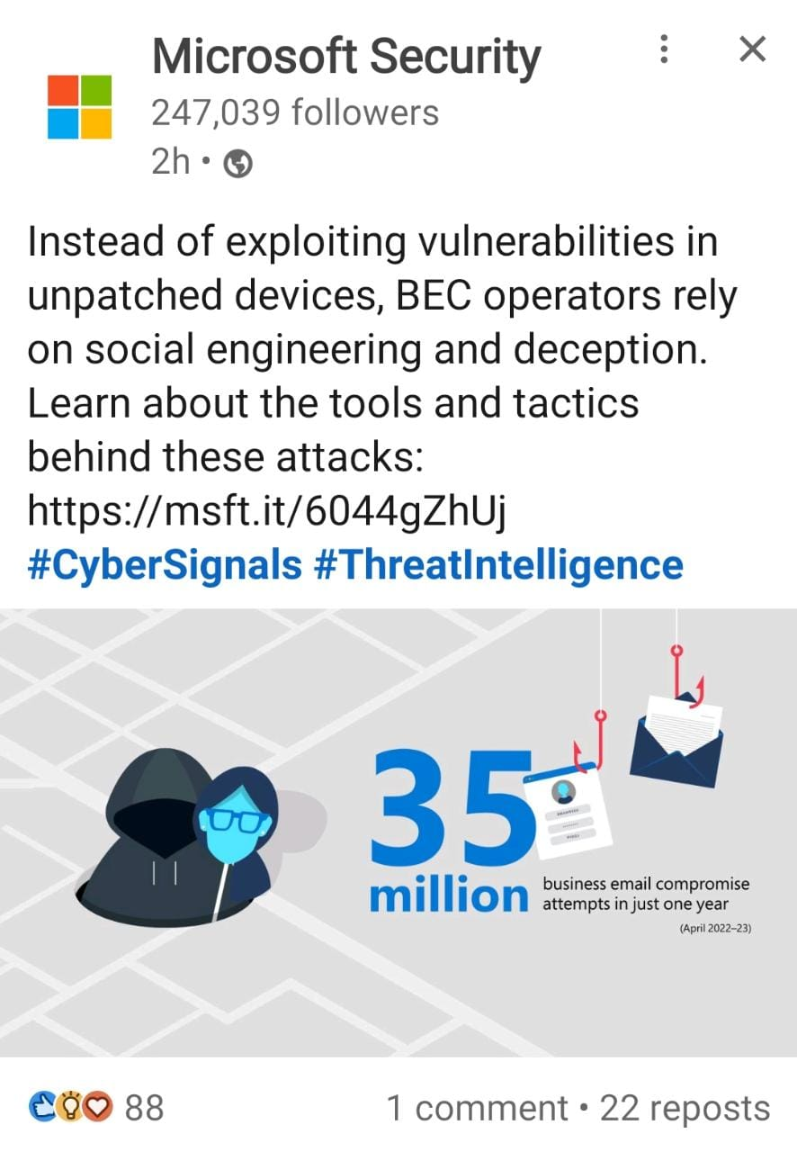
Conclusion
17
This focused on how we can use Ducky Script and burn the program on AT tiny85 chip using Arduino IDE.
In this presentation we demonstrated the process of writing a malware payload which can exploit Windows vulnerability to launch an attack on a victim’s machine. The payload can be executed from the victim’s machine or remotely. Our aim in this project was to launch the attack remotely targeting a Windows machine. To create the malware and launch the attack.
Department of Computer Science & Engineering
Chartered Institute of Technology, Abu Road

Slide 19
References
18
[1] Kumar, S. S., & Venkatesan, S. (2021). Using USB Rubber Ducky to exploit target computers. Journal of Ambient Intelligence and Humanized Computing, 12(4), 3365-3374.
[2] Trivedi, S., & Joshi, R. (2019). Hacking with a $2 microcontroller: The Digispark Attiny85. International Journal of Advanced Research in Computer Science, 10(2), 413-418.
[3] Kumar, V. R., & Shidhaye, S. S. (2020). Using Digispark ATtiny85 as rubber ducky for exploiting windows operating system. International Journal of Engineering Research and Technology, 9(11), 193-197.
[4] Almutairi, A. (2018). The USB rubber ducky and Arduino microcontrollers: Tools for ethical hackers. International Journal of Cyber-Security and Digital Forensics, 7(3), 57-64.
[5] Das, A., & Saha, S. K. (2021). Digispark Attiny85 based USB Rubber Ducky Attack. International Journal of Computer Science and Information Security, 19(5), 36-41.
Department of Computer Science & Engineering
Chartered Institute of Technology, Abu Road

Slide 20
THANK YOU
Any Queries
Department of Computer Science & Engineering
Chartered Institute of Technology, Abu Road

