Slide 1
Energy consumption analysis career fair capstone

Slide 2
Problem statement
Project will analyze energy usage and greenhouse gas (GHG) emissions of Ontario's Broader Public Sector (BPS) organizations, leveraging a comprehensive database of reported data. We aim to identify trends, assess conservation effectiveness, and pinpoint areas for improvement, informing data-driven strategies to achieve climate change mitigation goals within the BPS.

Slide 3

Data understandings
The Dataset spans from 2012 to 2021 and contains information about BPS organizations, including public hospitals and school boards.Key attributes include organization details, operational information, energy consumption data, and GHG emissions.
DATASET LINK : https://data.ontario.ca/dataset/energy-use-and-greenhouse-gas-emissions-for-the-broader-public-sector

Slide 4
Data preprocessing and data cleaning
The data are loaded from the official website of Ontario’s public sector.
After collecting the data sets it will be converted from excel form to data frame format by using Python Library Pandas.
Then consolidate all data frame into one data frame for further operations.
After converting data frame check the columns then drop the unwanted columns that affects the analysis.
Then do the data cleaning like column names mapping, values correction, NULL imputations etc.,

Slide 5
Exploratory data analysis
After completing the Data preprocessing and
Data cleaning then undergo with EDA process for getting some Valuable details, insights about data, getting more information about data.

Slide 6
Tools and technologies used
Python
Pandas, Numpy
Matplotlib, seaborn
Excel
PowerBI
Data preprocessing
Data Cleaning

Slide 7
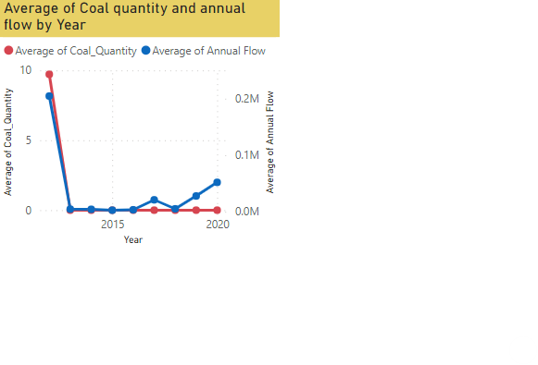
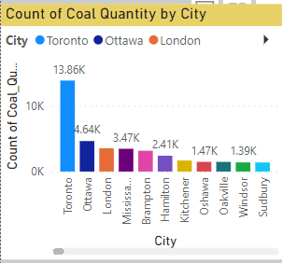
Power bi visualization coal quantity by year and city wise
Average of coal quantity and average of annual flow by Year wise
Count of coal quantity by
City wise

Slide 8
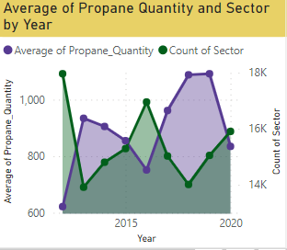
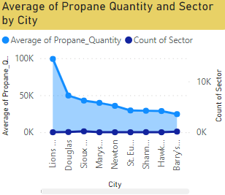
Power bi visualization Propane by year and city wise
Average of propane quantity and count of sector by Year wise
Average of propane and
count of sector by
City wise

Slide 9
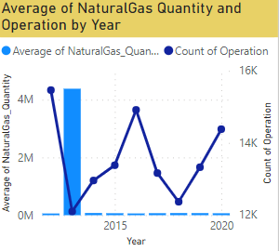
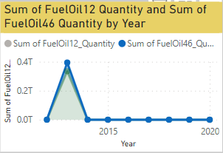
Power bi visualization natural gas quantity by Year wise sum of fuel oil12&fuel oil46 by year wise
The above charts showing the Average natural gas quantity and count of operation by year wise
Sum of Fuel oil12 and sum of Fuel oil46 by Year wise

Slide 10
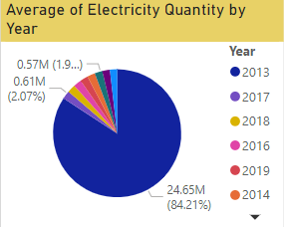
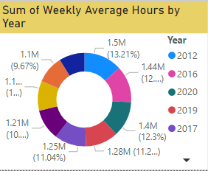
Power bi visualization average of electrical quantity by year wise sum of weekly average hours by year wise
Average of electrical quantity by year wise
sum of weekly average
hours by year wise

Slide 11
conclusion
.
From the above analysis the usage of coal quantity is gradually decreases from the year of 2013.
In the year 2013 the city Toronto is one of the city is highly used the coal.
From 2013 the coal usage decreases but the propane usage is gradually increased and it move to the peak on year 2019.
Fuel oil 12 & 46 usage also peak on 2013 due to dropping the coal, wood usage.
At 89,503,731.73 is the highest GHG emission in the year of 2013.
The reason for the GHG emission is the people move towards the non-renewable sources propane and natural gas instead of coal, wood and fuel oils.
In future the electricity is more important and most needed one so due to this crisis we would avoid to use the both wood, coal, fuels and natural gases, propane also then we will move towards with some renewable sources like Solar, Wind, Tidal, Hydro etc.,

Slide 12
THANK YOU
Submitted by
VINOTH​
DTM-10

