Slide 1
BUSINESS ANALYST ASSIGNMENT
DATA ANALYSIS AND INSIGHTS FOR DIFFERENT PAGE OPTIMIZATION
-BY VINOTH
vinithvishva123@gmail.com

Slide 2
INTRODUCTION
As an intern in the Business Analytics team, the task of a Business Analyst is to analyze the dataset and generate actionable insights to optimize page performance for a fictional company called “XYZ”.
The dataset contains user data from various regions, customer
demographics, product information, and marketing campaign details.
The objective of the assignment is to identify critical factors influencing Data Analysis and Insights for different Page Optimization and how to get more user installation and engagement from the App and Website User and propose recommendations for improving performance.

Slide 3
USER ACQUISITION

Slide 4
USER ACQUISITION
User acquisition is a fundamental aspect of business growth, emphasizing the strategic methods employed to increase the user base.
Successful user acquisition involves understanding the target audience, creating compelling value propositions, and utilizing various marketing channels such as content marketing, social media, paid advertising, and email campaigns.
The goal is not only to acquire users but also to convert them into active and engaged customers. Analytics and tracking play a crucial role in measuring the effectiveness of different acquisition channels, enabling businesses to make data-driven decisions over time.

Slide 5


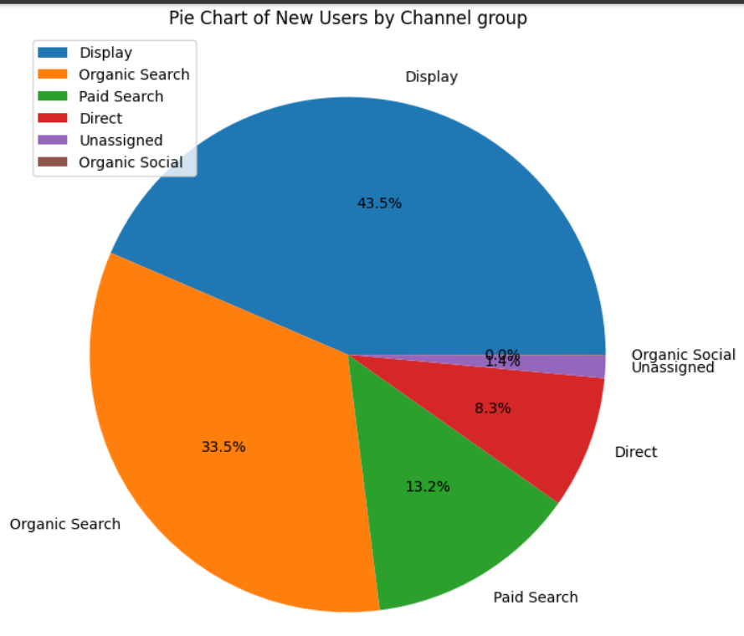
NEW USERS BY CHANNEL GROUP
Channels are predefined categories that help you track and analyze where your website's traffic comes from. -
They provide a clear way to monitor the performance of different sources sending visitors to your site, such as search engines, social media, or referral links.
THE FINDINGS:
Most amount of Users reached our website by the Display Channel Mode.
Organic Search Mode generated 33.5% of User Acquisition.
Paid Search stood third in terms of most contributions towards user acquistion with 13.2% of Acquisition.
Only 8.3% of the Users reached our website in the Direct Channel Mode.
The Unassigned channel mode contributed the second least with just 1.4% of Users.
Organic Social contributed the least amount of Users to the website.

Slide 6
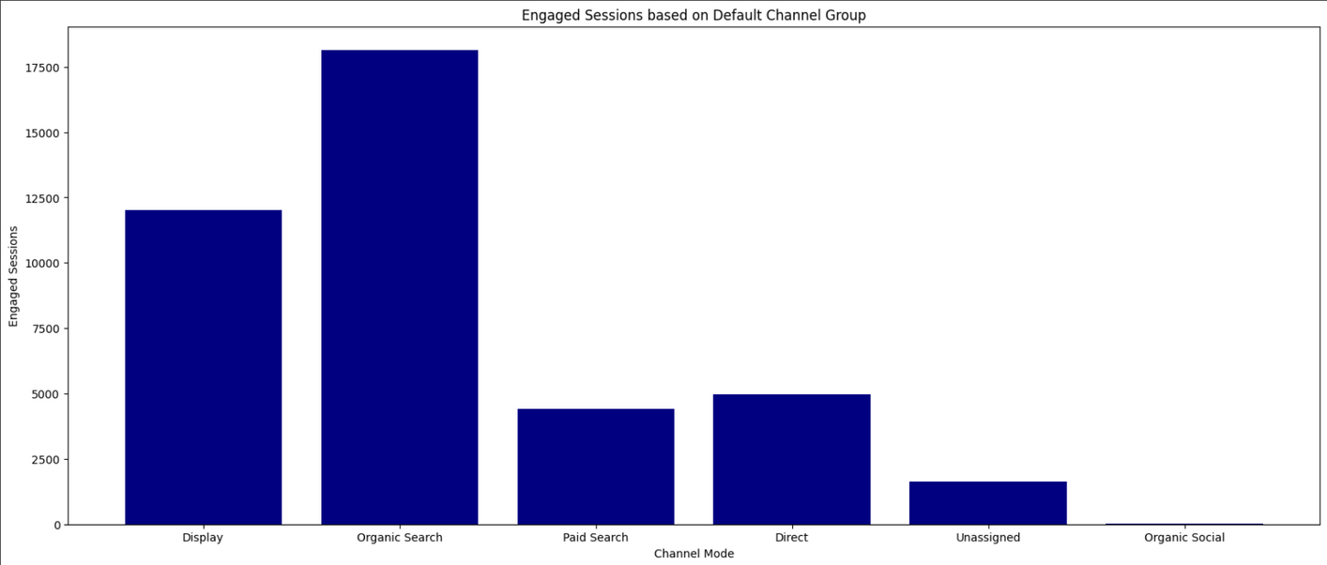
ENGAGED SESSIONS BASED ON CHANNEL GROUP
Engagement session is a metrics that enables you to measure and analyze user engagement with your website or app.
THE FINDINGS:
The users that found us using Organic Search had the most amount of Engaged Session.
The Display Channel generated the second most Engaged Session for the User.
The users who Directly searched for our website stood third in terms of Engaged Session.
The Paid Search mode accounted to be the fourth most Session Engagement to the Users.
The Unassigned and Organic Social generated the least amount of User Engagement

Slide 7
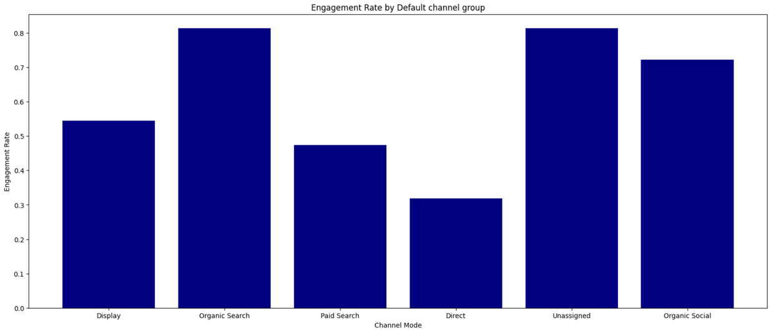
ENGAGEMENT RATE BASED ON CHANNEL GROUP
The engagement rate is the percentage of engaged sessions on your website or mobile app
THE FINDINGS:
The Organic Search Users accounted the most amount of Engagement Rate.
The Unassigned Channel stood second.
Users with Organic Social accounted to be the third most Engagement rate for the Users.
The Display mode generated the fourth most amount of Engagement Rate.
The Paid Search and Direct channel mode generated the least engagement rate compared to the other channels.

Slide 8
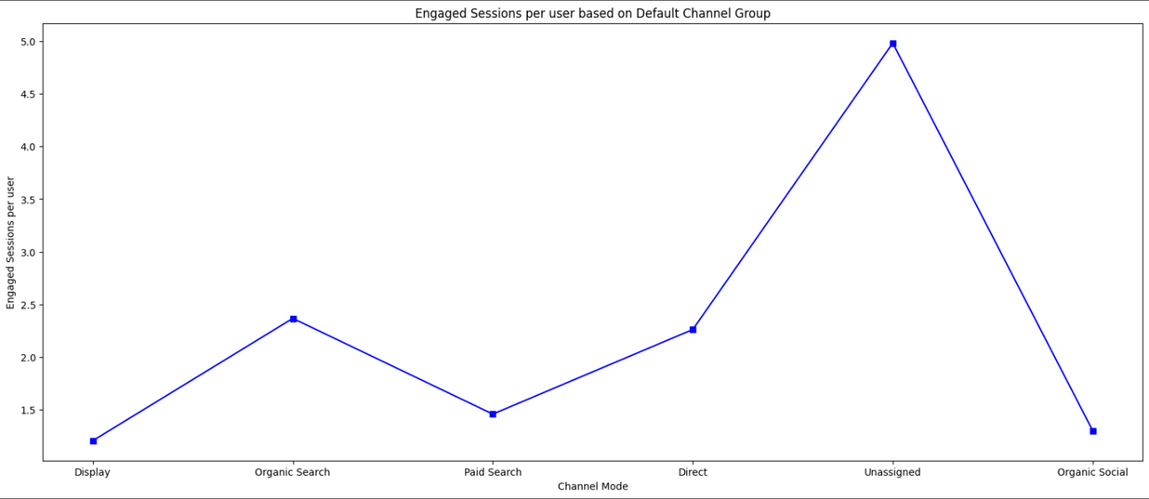
ENGAGED SESSIONS PER USER BASED ON CHANNEL GROUP
An engaged session is a period during which a user is engaged with your website or app.
An engaged session is a session that lasts longer than 10 seconds, has a conversion event, or has at least 2 pageviews or screenviews.
THE FINDINGS:
The Unassigned Search mode accounted the most amount of Engagement per User amount.
Users finding us through Organic Search stood second.
The Direct Search mode generated the third most amount of engagement per user.
Paid Search and Display channel mode generated the least amount of Engagement per user.

Slide 9
ENGAGED SESSIONS PER USER BASED ON CHANNEL GROUP
An engaged session is a period during which a user is engaged with your website or app.
An engaged session is a session that lasts longer than 10 seconds, has a conversion event, or has at least 2 pageviews or screenviews.
THE FINDINGS:
The Unassigned Search mode accounted the most amount of Engagement per User amount.
Users finding us through Organic Search stood second.
The Direct Search mode generated the third most amount of engagement per user.
Paid Search and Display channel mode generated the least amount of Engagement per user.

Slide 10
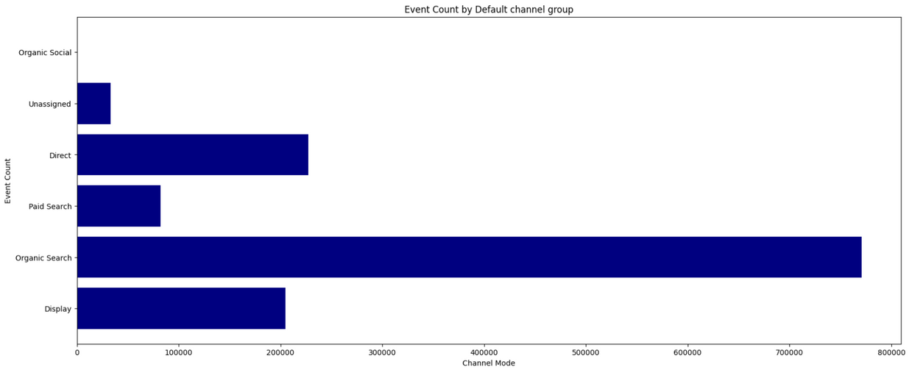
EVENT COUNT BY CHANNEL MODE
Event count measures how often users interact with specific elements on a website within a given time span. The higher the number, the more likely users are to find something worth clicking, watching, or purchasing on the site.
THE FINDINGS:
Users that found the website using Organic Search accounted to generate the most Event Counts.
The Display mode generated the second most Event Counts.
The Direct mode generated the third most Event Counts.
Users that found using the Paid Search mode generated the fourth most Event Counts.
Unassigned and Organic Social generated the least amount of Event Counts

Slide 11
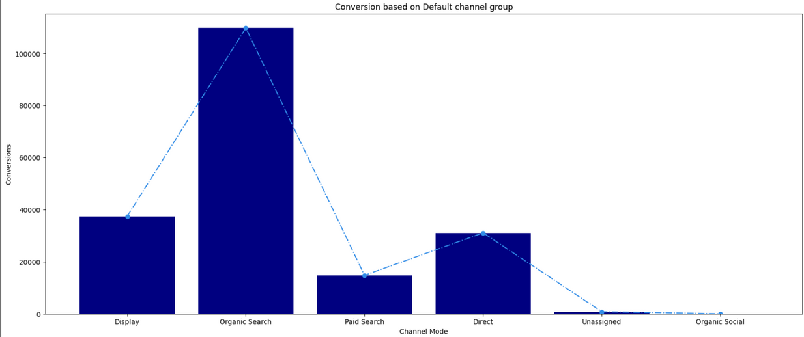
CONVERSION BASED ON CHANNEL GROUP
A conversion is any user action that's valuable to your business; for example, a user purchasing from your store or subscribing to your newsletter are examples of common conversions.
THE FINDINGS:
The Organic search mode generated the most amount of Conversions.
The Display search mode generated the second most amount of Conversions.
Users with Direct Channel mode generated the third most Conversions.
Paid Search accounted to generate the Fourth most amount of conversions.
Unassigned and Organic Social generated the least amount of conversions.

Slide 12
TRAFFIC ACQUISITION

Slide 13

TRAFFIC ACQUISITION
Traffic acquisition is the strategic process of attracting and directing visitors to a website or online platform.
The ultimate goal of traffic acquisition is not just to bring in any visitors but to target and engage the right audience—those who are likely to convert into customers, subscribers, or active users.
Analyzing the effectiveness of different acquisition channels, optimizing strategies, and adapting to changing trends are essential aspects of a successful traffic acquisition strategy, contributing significantly to the overall growth and success of an online presence.

Slide 14
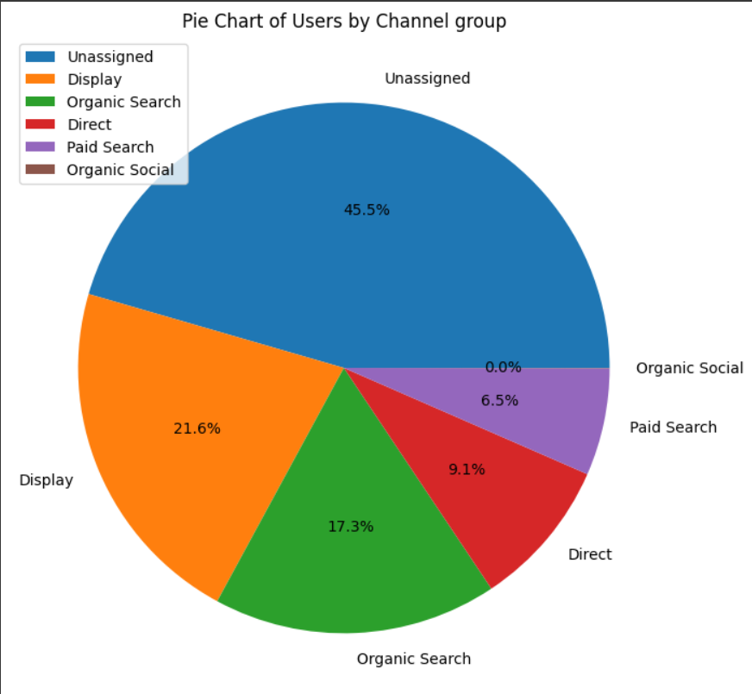
USERS BY CHANNEL GROUP
Users by Channel Group refers to a metric that provides insights into the number of users visiting a website based on different predefined channel groupings. Channels represent the various sources through which users find and access a website.
THE FINDINGS:
The Unassigned Channel Group attracted the most amount of Users.
The Display Channel group stood seconf in terms of Traffic Acquisition.
The Organic Search Channel generated the third most amount of Users.
Users through Direct Search generated the fourth most amount of Users.
The least amount of Traffic was generated by the Paid Search and Organic Social Channel mode.

Slide 15
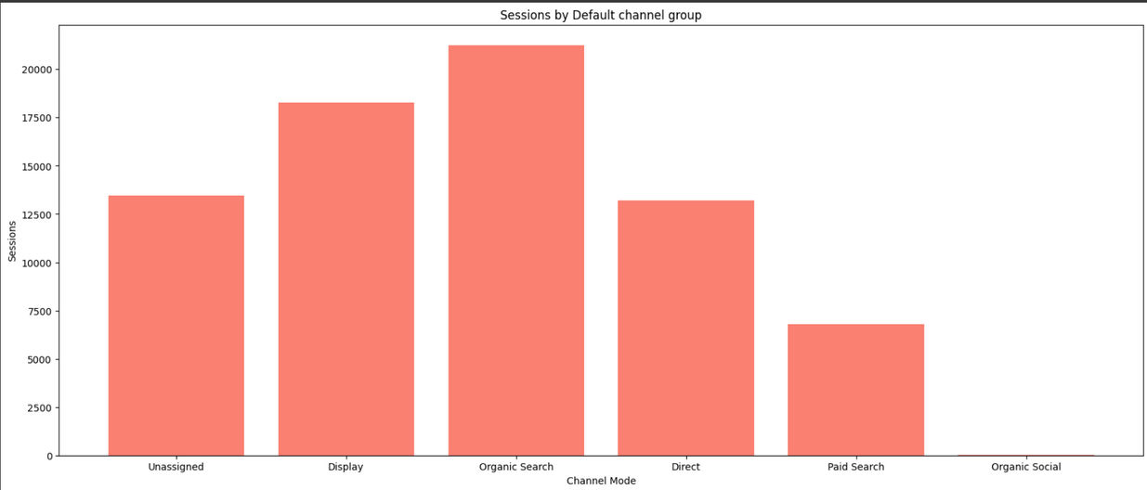
SESSIONS BY CHANNEL MODE
Engagement session is a metrics that enables you to measure and analyze user engagement with your website or app.
THE FINDINGS:
The Organic Search Channel Group generated the most amount of Sessions.
The Display Channel group stood second in terms of Sessions.
The Unassigned Channel generated the third most amount of Sessions.
Users through Direct Search generated the fourth most amount of Users.
The least amount of Session was generated by the Paid Search and Organic Social Channel mode.

Slide 16
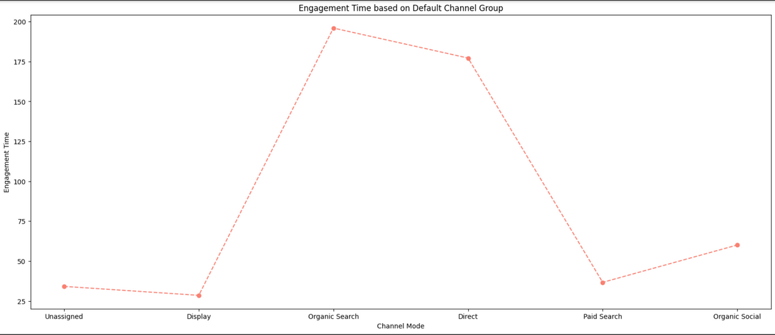
ENGAGEMENT TIME BASED ON CHANNEL GROUP
Engagement time refers to the amount of time users spend actively interacting with or consuming content on a website, application, or digital platform.
It is a metric used to gauge the level of user involvement and interest in the provided content.
THE FINDINGS:
The Organic Search Channel observed the most amount of Time Engagement.
The Direct Search Channel observed the second most amount of Time Engagement.
The Organic Social stood third.
Users through Paid Search Channel observed the fourth most amount of Time Engagement.
The Display and Unassigned Channel observed the least amount of Time Engagement.

Slide 17
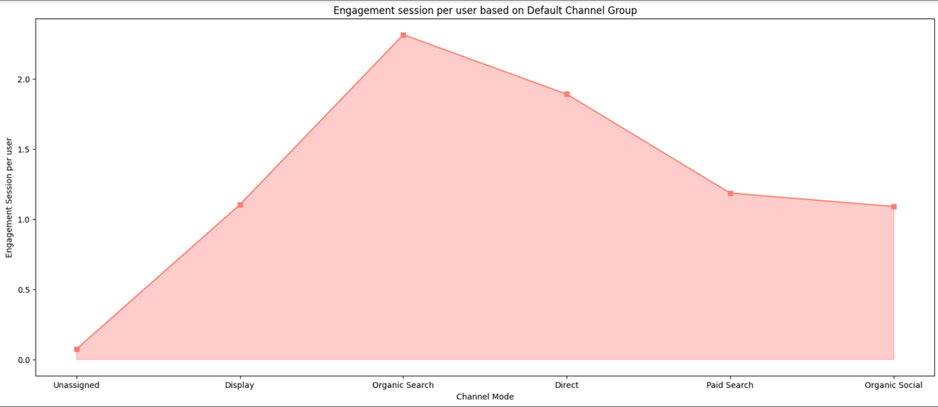
ENGAGEMENT SESSION PER USER
Engagement session per user is a crucial metric that provides insights into the level of interaction and interest a user has with a website or application during a single visit.
This metric measures the average time a user spends actively engaging with content or features, indicating the depth of their involvement
THE FINDINGS:
The Organic Search Channel observed the most amount of Engagement Session per user.
The Direct Search Channel observed the second most amount of Engagement session per user.
Users through Paid Search Channel observed the third most amount of Engagement Session per user.
The Organic Social stood fourth in terms of most amount of Engagement session per user.
The Display and Unassigned Channel observed the least amount of Engagement session per user.

Slide 18
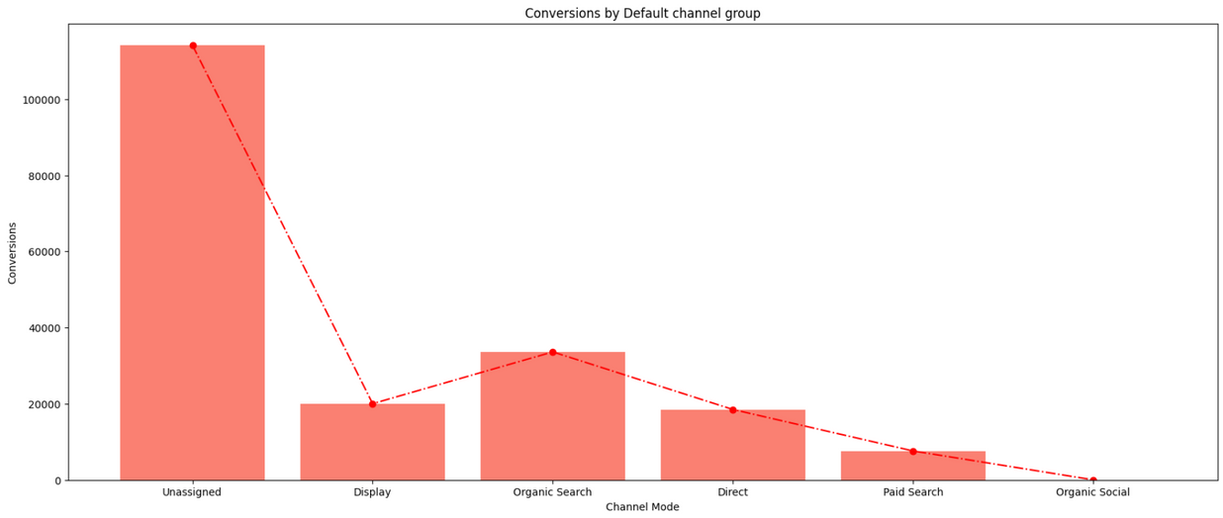
CONVERSIONS BY CHANNEL GROUP
THE FINDINGS:
The Unassigned Channel generated the most amount of Conversions.
Organic Search generated the second most amount of Conversions.
The Direct Search Channels generated the third most amount of Conversions.
Display Search Channels generated the fourth most amount of conversions.
The Paid Search and Organic Social generated the least amount of Conversions

Slide 19
CONVERSION
REPORT

Slide 20
CONVERSION REPORT
A conversion report is a comprehensive analysis that provides valuable insights into the success of a website, campaign, or marketing strategy in terms of achieving predefined goals.
The conversion report typically outlines the number of conversions, conversion rates, and the effectiveness of different channels in driving successful outcomes.
This report is a critical tool for businesses to evaluate the performance of their digital initiatives, helping them identify high-performing channels and areas that may require improvement.
A well-analyzed conversion report not only provides a snapshot of past performance but also serves as a valuable guide for making data-driven decisions to improve future campaigns and achieve business objectives.

Slide 21
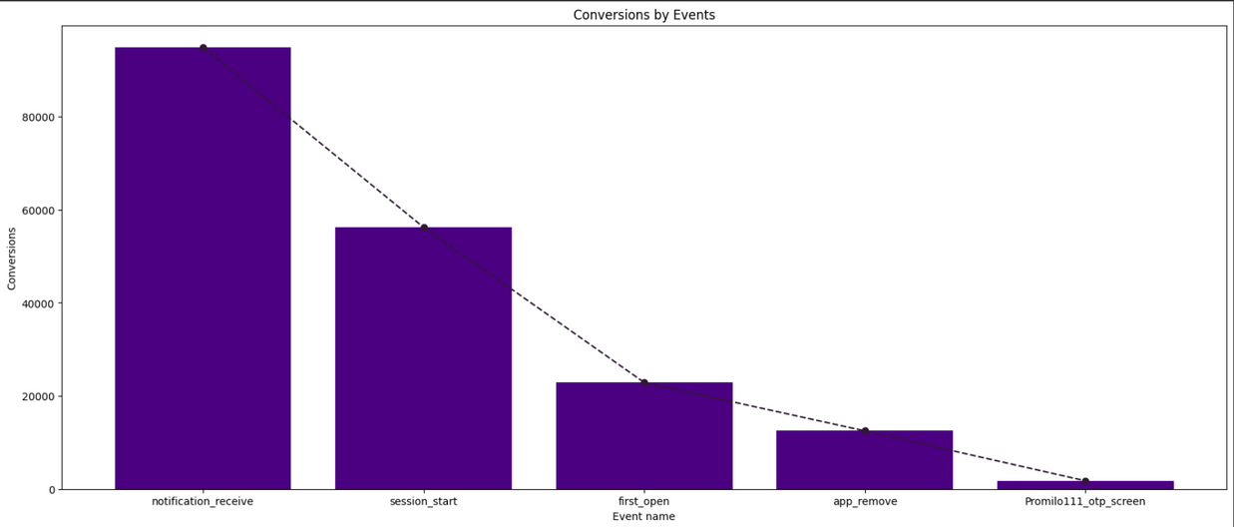
CONVERSIONS BASED ON TOP 5 EVENTS
Conversions, or successful outcomes on a website, become clearer when we focus on the top five events that matter most, shedding light on the key actions users take to achieve specific goals.
THE FINDINGS:
The top-most Event was named notification_receive, which gives us an insight that the specific event generated the most amount of Conversions.
session_start event generated the second-most amount of Conversions.
The third most Conversion was generated by first_open event.
app_remove event Converted to be the fourth-most Event.
Promilo_111_otp_screen stood fifth in terms of most Conversions

Slide 22
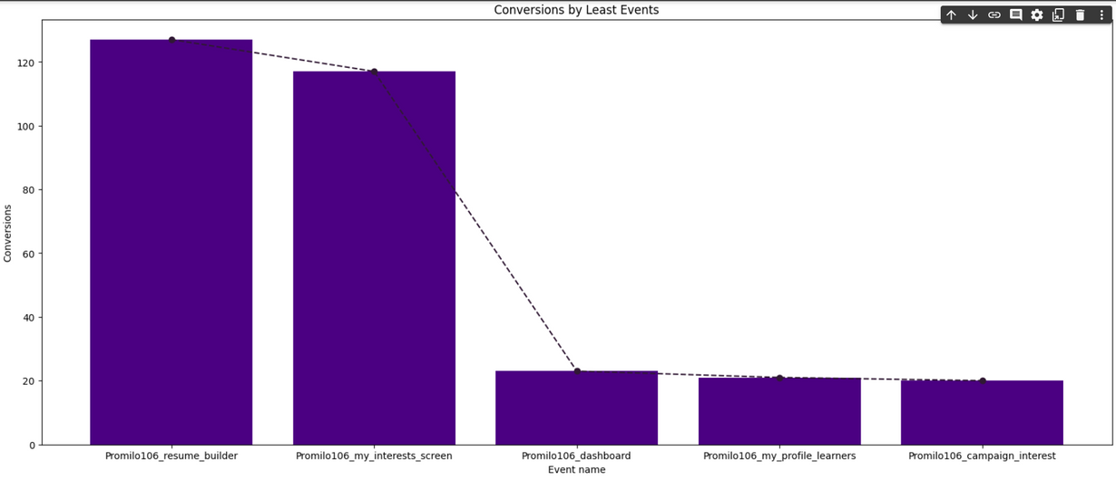
CONVERSIONS BASED ON BOTTOM 5 EVENTS
Understanding the bottom five events provides insights into the less impactful actions users take, helping identify areas for improvement in achieving desired conversions on a website or digital platform.
THE FINDINGS:
The 5th most Event was named Promilo 106_Resume Builder, which gives us an insight that the specific event generated the fifth least amount of Conversions.
Promilo 106_my_interests_screen generated the fourth-least amount of Conversions.
Promilo 106_Dashboards, Promilo 106_my_profile_learners, Promilo 106_campaign_events accounted to be the least generating Events in terms of Conversions

Slide 23
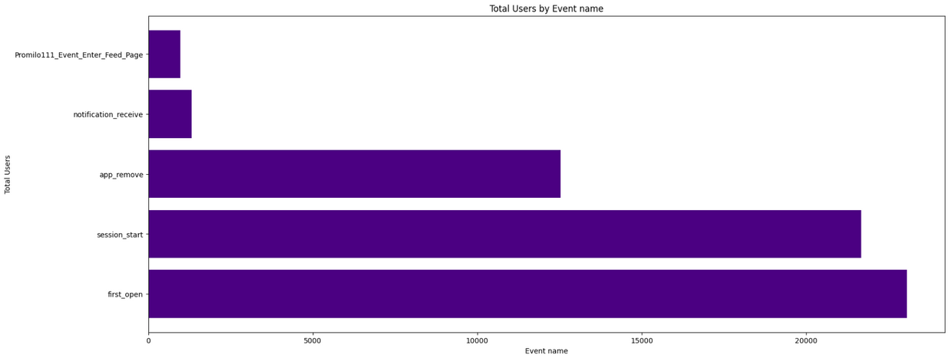
TOTAL USERS BY EVENT NAME
The total number of users categorized by event name gives a detailed breakdown of user interactions, providing a comprehensive view of specific actions and their respective impacts on a website or application.
THE FINDINGS:
first_open events generated the most amount of Users.
session_start event generated the second most amount of Users in terms of Conversions.
app_remove event generated the third most amount of Users.
notification_receive generated the fourth most amount of Users.
Promilo11_Event_Enter_Feed_Page generated the fifth mostamount of Users based on Conversion.

