Slide 1
NTTPC-OEM-VoIP Phase 2
Development Approach/Understanding Slide
Date (18 April 2018)

Slide 2
Introduction
The current scenario of the NTTPC OEM VoIP Billing Calculation tool
In the existing NTTPC VoIP Billing Calculation Tool the billing details for each OEM are calculated using the communication details obtained from NTT Com. After calculating, the billing details were sent to the OEMs in CD-R or over Web API. The Web APIs were developed as part of STEP 1 of this project.
The existing system has drawbacks like un-avoidable consumption of time in getting the communication details from NTT Com; lack of retention capability to backup the input data after completing the billing calculation; time consuming task of sending the billing details to some OEMs in CD-R format and finally to adhere to the company’s security policy while sending mails outside, it is required to send multiple mails to the same OEMs who receive the billing details through mail in the other services.
In order to resolve the above issues as new billing calculation tool in Web GUI mode is to be developed.

Slide 3
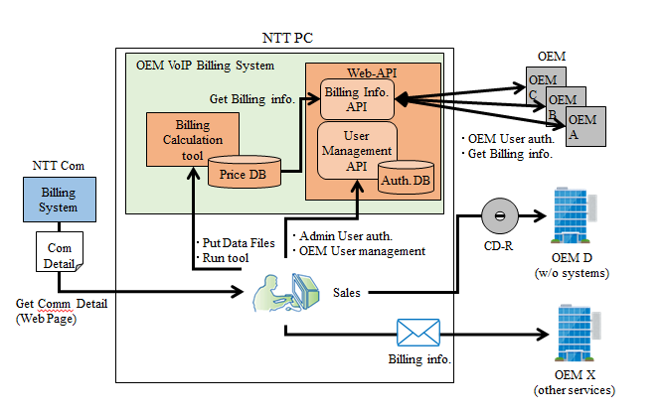
Scope of the Project
The process of getting communication files from NTT Com, longer retention period for billing information , a Web GUI and file storage feature for uploading and downloading files by admin and OEM user respectively are the new features that are needed to be added as per the project scope.

Slide 4
Requirement Specifications
Automate the process of getting communication details file from NTT Com and running the calculation tool to reduce the overhead and operation mistakes.
Improve the data retention period in the billing calculation tool. There should be a provision to save the billing information from NTT Com in Price DB for a certain period.
Two files must be generated by Sales Admin user, one is the billing details for OEM user and other new files for the accounting system
The process of user management has to be enhanced. Web GUI based user authentication system has to be developed with different features for Admin user and OEM user respectively.
For user authentication, the system should use email address as login ID and password to login.
A stipulated time after running the billing calculation tool, an e-mail has to be sent to the OEM user keeping the Admin user in charge in ‘Cc address’. This function is necessary only if the billing details are sent to the OEM user through mail. Hence, a provision for enabling and disabling the “send e-mail” option has to be present.

Slide 5
Approach plan
The approach plan towards the project requirements is further elaborated in the following sections

Slide 6
1. Automation process
NTT Com Website
Fetching
PHP and Selenium Code
Pre-defined location
Communication File
Decrypted
VoIP Billing Calculation Tool
At a pre-defined date, the PHP and Selenium code will execute every month. The code will authenticate and access the NTT Com Website, check for the Communication file and fetch it into the designated location. From that location the file will be fetched into the tool.

Slide 7
2. Improving the data retention in Price DB
Communication File
VoIP Billing Calculation Tool
Calculations
Price DB
Backup
To improve the data retention in Price DB, it is required to take backup of the data. As the data is getting deleted after calculations, the data backup has been planned before the calculations. But the data storage mode is yet to decide

Slide 8

3. Generating report files
NTT Com Communication file
VoIP Billing Calculation Tool
Web GUI
Manual download
New files to accounting system
Sales
The calculated billing details are sent to each OEM respectively. One output will generate all the billing details of different charges. Another new files which are manually downloaded from NTT Com website are used for manual calculation and uploaded to the GUI

Slide 9
4. User Management & Authentication
Admin User
Admin user should manage the OEM user accounts through create, read, update and delete operations.
OEM User
Only OEM user can update its own account
The admin user must be allowed to upload some files to OEM user
The admin user must be allowed to see OEM related Information like who accessed the application and how many times the report downloaded.
OEM user can be able to download billing information file from the Web GUI
The user authentication is done using e-mail ID and password.

Slide 10
5. E-mail feature
VoIP Billing Calculation Tool
Upload to GUI
Mail Notification
Configuration
YES
?
NO
Notification sent to the OEM user with Admin in charge in cc
Option in GUI to toggle Mail Notification

Slide 11
Questions?
Two kinds of report files have to be generated from the tool. One is the calculated billing files to be sent to each OEM respectively and the other new files to use as an input to the accounting system to be used by the sales team. What is the format of the second file type?
What is the file format of the communication file that NTTPC sales team is downloading every month?
How feasible is to get Data using FTP/SCP/CIFS/API from NTT Communication?

Slide 12


Emerio Technologies Pvt. Ltd.
8th Floor, SKCL Central Square II,
Unit B20, Thiru Vi Ka Industrial Estate,
Guindy, Chennai 600 032, India.
Tel: +91 (44) 42929999
Fax: +91 (44) 42929901

