Slide 1
Source Code Management
By,
Vinothkumar P

Slide 2

What is SCM?
Tracking & Managing changes to code
History of code development
Notes:
https://git-scm.com/book/en/v2/Getting-Started-About-Version-Control

Slide 3
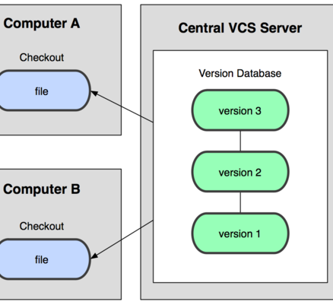
Types
Centralized Version Control System (CVCS)
Example: SVN
uses centralized server to store all the files.
All the version files are stored in Central VCS server
In case central server crashes, entire data of the project will be lost

Slide 4
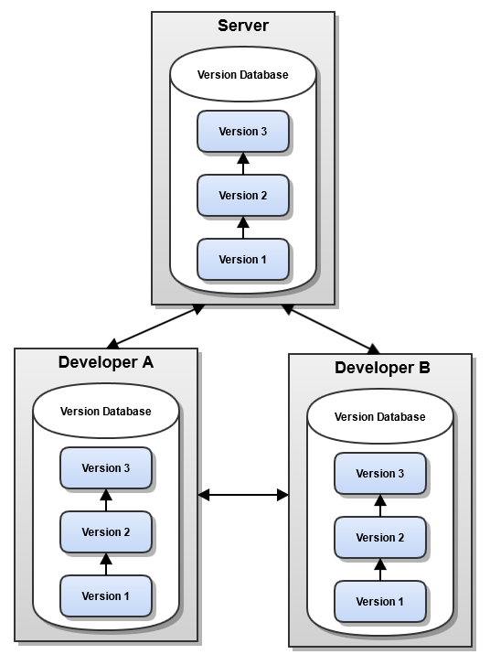
Types…
Distributed/Decentralized Version Control System (DVCS)
GIT
does not have a centralized server
“clones” a copy of a repository
pushing & pulling – no internet
Notes:
every developer “clones” a copy of a repository and has the full history of the project on their own hard drive
pushing and pulling can be done without an internet connection

Slide 5
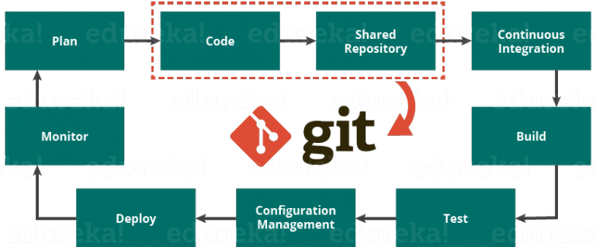
GIT
Open source DVCS – for tracking changes
Can create local repository & link to remote server
GIT Role in DevOps
Notes:
Source: https://www.edureka.co/blog/what-is-git/

Slide 6
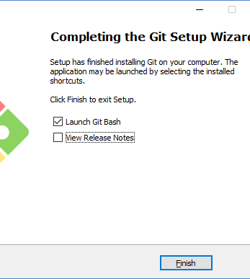
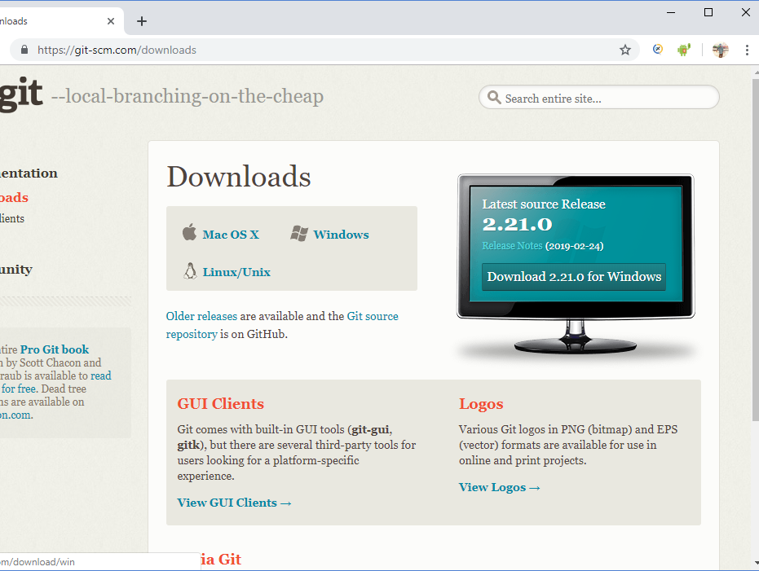
Download & Install
Open source with Public & Private Flavor
Download Link: https://git-scm.com/downloads
Install 32 (or) 64 Bit
Notes:
While installing, its advised not to make any changes. Just go with recommended options which selected by default

Slide 7
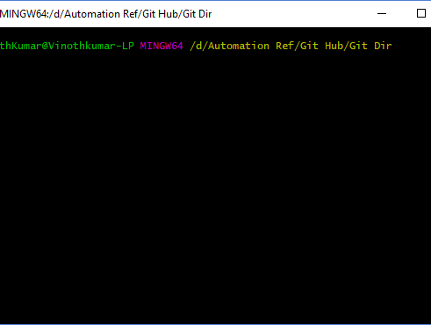
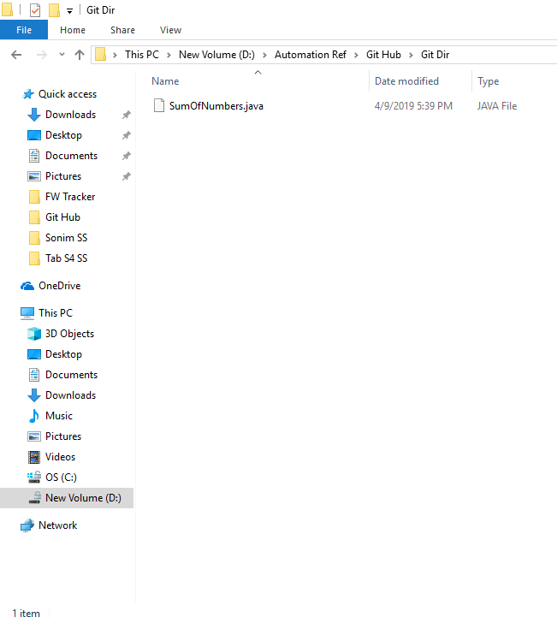
GIT Basic commands
Checking version: git --version
Make a Local Git repository & navigate to it (Linux commands)
Initialize the directory: git init
Checking Status: git status
Have file into Git directory & Status
Add file into repository: git add “filename” (or) git add .
Commit: git commit -m “Message you wish to show”
Notes:
Git status: Basically, when we created repository it was an empty. Now Git noticed that new file available and the name will be shown in red.
Add File: If we want Git to track the file, then we should add the file into repository
Once we commit we can see an warning/message to link Git Remote server

Slide 8
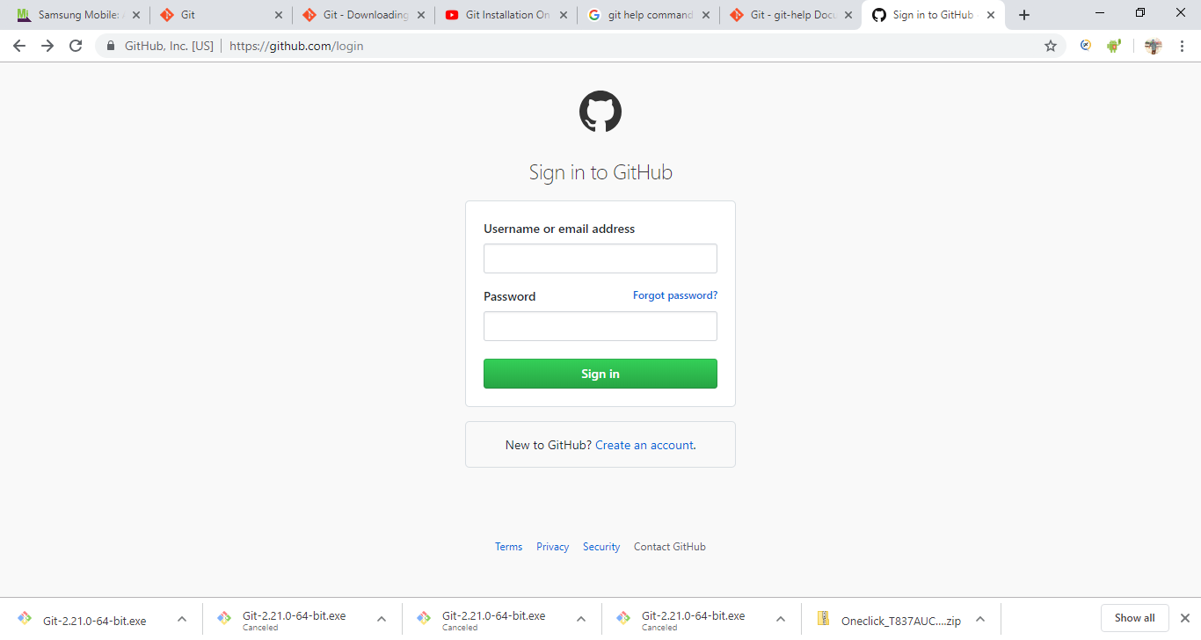
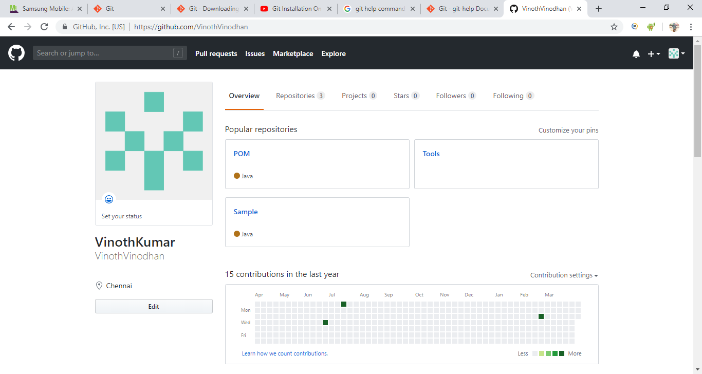
Git Hub account & Linking
Create Git Hub Account: https://github.com/login
Linking Local to Remote:
git config --global user.email you@example.com
git config --global user.name "Your Name"
Make some changes – status, add & commit

Slide 9
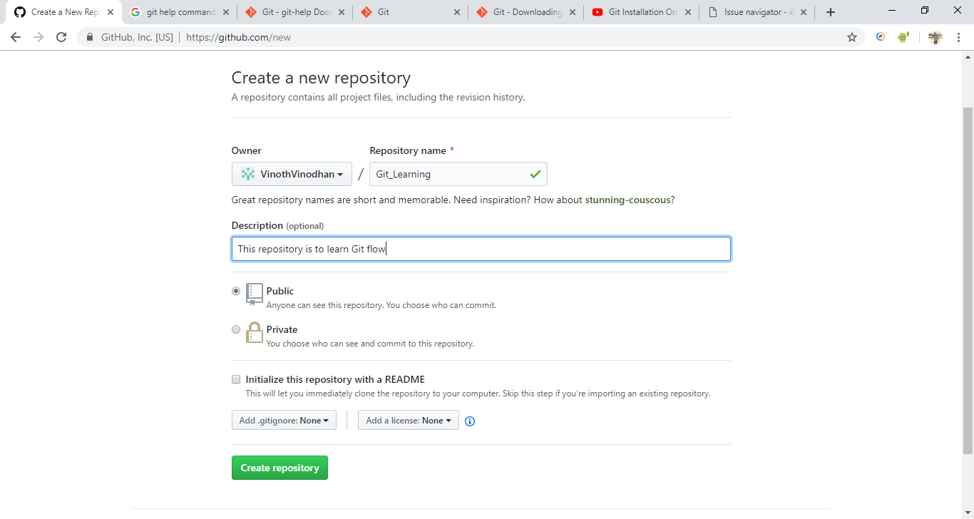
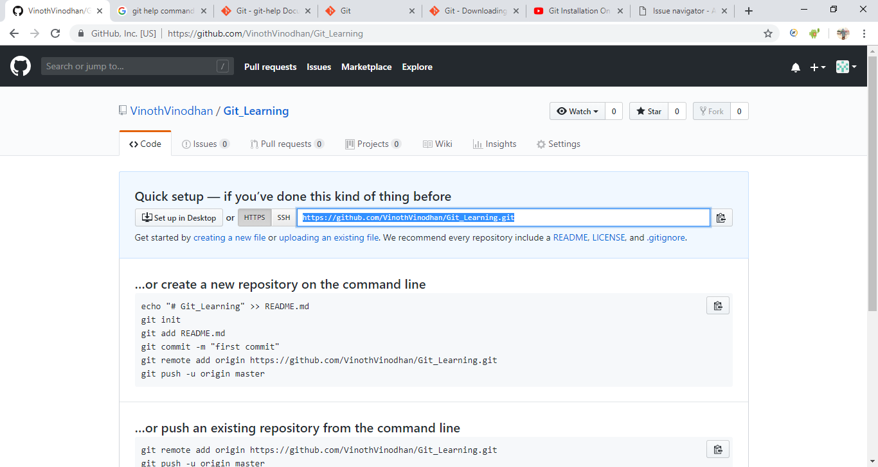
Remote Git Repository
Created Remote Repository
Link Remote to Local:
git remote add origin “URL copied from Git Hub”
Push File: git push –u origin master
GitHub Login – Login
Logs: git log
Commit logs: git log --pretty=oneline
Validate commit: git remote –v
Clear screen: clear

Slide 10
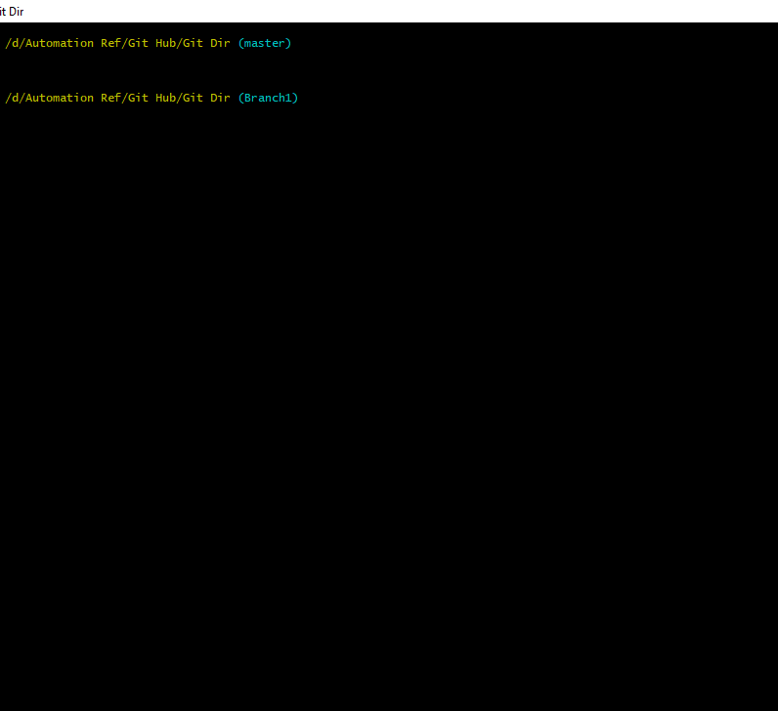
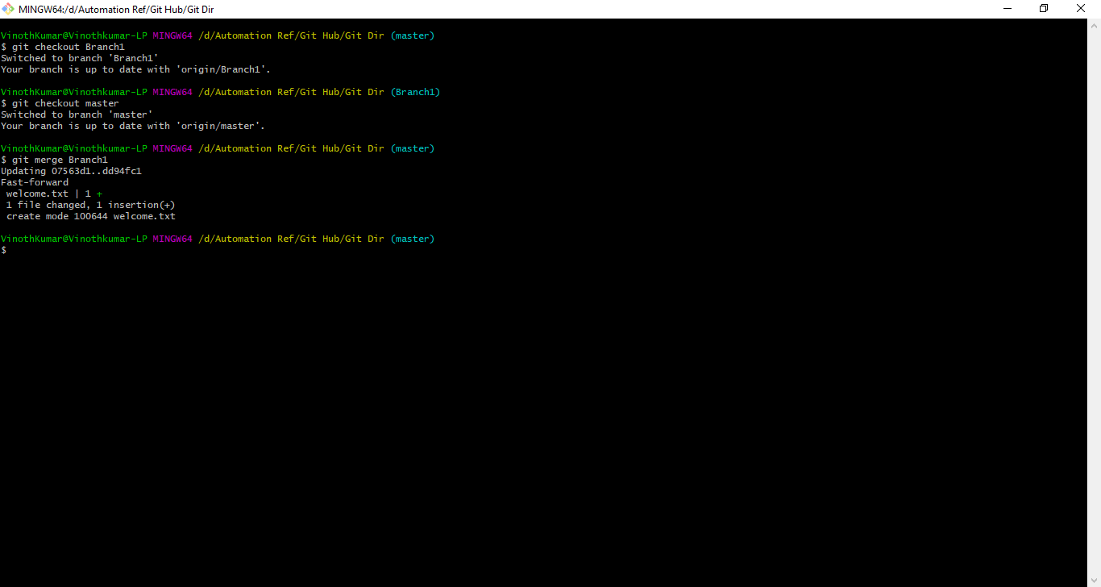
GIT Branching
Can make any No of Branches
Delete Branches once task is completed
Make sure you are out of sub branches before delete
Create a new branch: git branch “branch name”
Ex: git branch Branch1
Check available branches: git branch –v
Switch to Branch: git checkout “Branch name”
Ex: git checkout Branch1
Switch back to master: git checkout master
Branch files wont be available in branches
Push branch to server: git push –u origin “Branch name”
Ex: git push –u origin Branch1
Check the branch progress in remote server before & after push
Merge: git merge “Branch name”
Ex: git merge Branch1
Check the log: git log - - pretty=oneline

