Slide 1


Algebra and Combinatorics
TEAM MEMBERS: Priyanga S S, Raahul Kanna K,
Raghavendra R, Ragul S, Ragunath, Thanishkasri, Karthi S

Slide 2

CONTENTS
1. Eulerian Circuits in Power Grid and Utility Mapping
2. Homomorphisms in Software and Data Structures
3. Lattices in Cryptography and Security

Slide 3


01
Eulerian Circuits in Power Grid and Utility Mapping

Slide 4


Understanding Eulerian Circuits
What is an Eulerian Circuit?
An Eulerian circuit is a special kind of path in a graph. Imagine a map with roads and cities. An Eulerian circuit is a route that starts at a city, travels along every road exactly once, and then returns to the starting city.
Key Idea: It's about visiting every "edge" (road) just one time.
Conditions for an Eulerian Circuit:
For a graph to have an Eulerian circuit, two main things must be true:
Connected
Even Degree
All parts of the graph must be connected, meaning you can get from any city to any other city.
Every city (vertex) in the graph must have an "even degree." The degree of a city is the number of roads connected to it. If a city has 3 roads, its degree is 3 (odd). If it has 4 roads, its degree is 4 (even).
Why "Even Degree"?
Think about entering and leaving a city. If you enter via one road, you must leave via another if you don't want to use the same road twice. This means for every "entrance" to a city, there's an "exit," making the total number of roads connected to it even.

Slide 5





Basic Concepts and Example
Graph Terminology:
1
2
3
Vertex (Node)
Edge (Link)
Degree of a Vertex
A point or intersection (e.g., a city, a power station).
A connection between two vertices (e.g., a road, a power line).
The number of edges connected to that vertex.
Eulerian Circuit Formula/Rule:
A connected graph has an Eulerian circuit if and only if every vertex has an even degree.
Simple Example:
Consider a square. It has 4 vertices (corners) and 4 edges (sides). Each corner is connected to 2 sides. The degree of each vertex is 2 (even). Therefore, you can draw a square without lifting your pen, tracing each side once, and ending where you started. This is an Eulerian circuit.
Non-Example:
Imagine a triangle with an extra line from one corner to the middle of an opposite side. Some corners might have an odd number of lines, making an Eulerian circuit impossible.

Slide 6


Eulerian Circuits in Power Grids
Application: Power Grid Inspection
Power grids are vast networks of power stations (vertices) and transmission lines (edges).
Problem: How can an inspection drone or team check every power line without repeating paths or missing any?
Solution: If the power grid (or a section of it) can be modeled as a graph with an Eulerian circuit, then a single, continuous path can be planned to inspect every line efficiently.
Benefits for Power Grids:
Efficiency
Completeness
Optimized Routing
Reduces fuel consumption and time for inspection.
Ensures every part of the network is checked.
Provides a clear, single path for maintenance crews.
Challenge: Real-world grids are complex. They might not always perfectly fit the "even degree" rule. Solutions involve adding temporary "dummy" edges or breaking down the problem into smaller Eulerian paths.

Slide 7
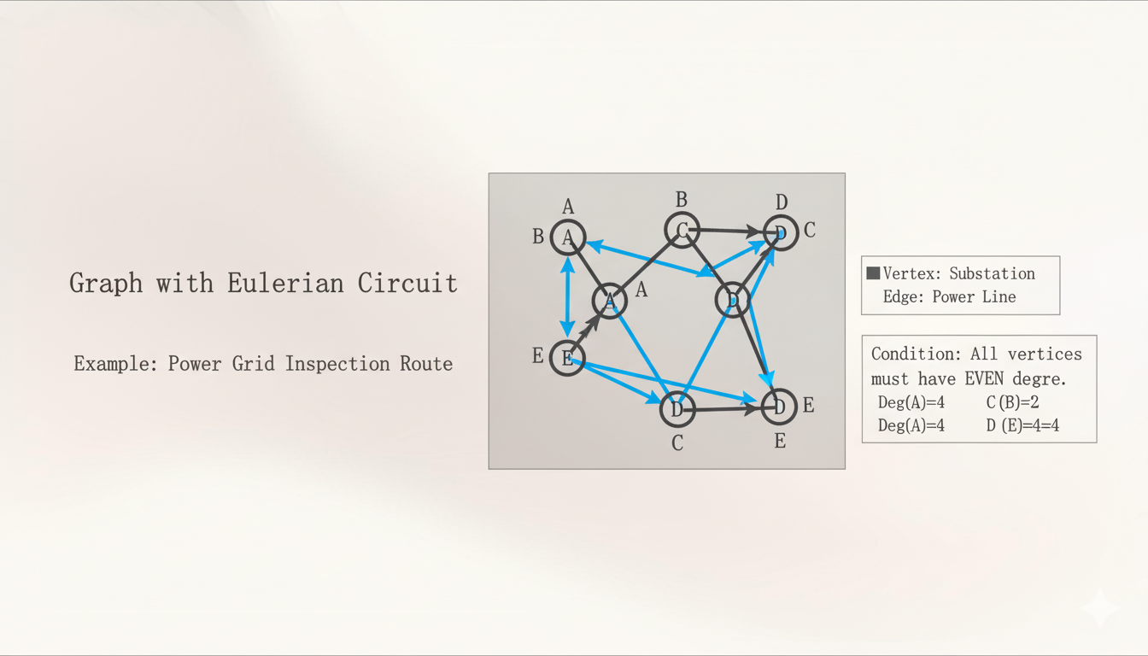
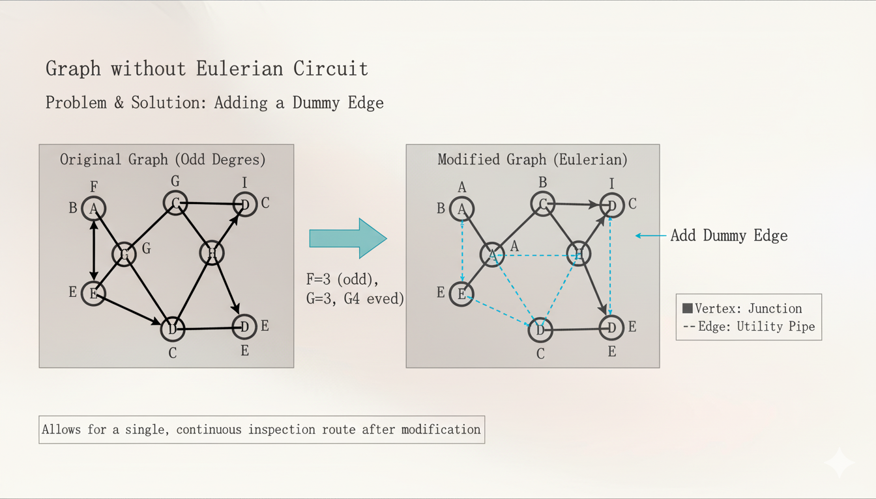

Slide 8


Advanced Considerations and Practical Adjustments
Real-World Deviations:
Most real-world networks (power grids, utility maps) are not perfect Eulerian circuits. They often have vertices with odd degrees.
Eulerian Path: If a graph has exactly two vertices with odd degrees, an Eulerian path exists (starts at one odd-degree vertex and ends at the other, traversing every edge once).
Strategies for Non-Eulerian Graphs:
Edge Duplication
Path Decomposition
Approximation Algorithms
Add "dummy" edges to connect odd-degree vertices or transform them into even-degree vertices. This creates an Eulerian circuit but means some physical paths are traversed twice.
Break down the complex network into smaller sub-graphs that are Eulerian, or use multiple vehicles/teams to cover different paths.
For very large and dynamic networks, use algorithms that find "near-Eulerian" paths to achieve high efficiency, even if not perfectly optimal.
Keywords: Graph Theory, Network Optimization, Pathfinding, Routing, Efficiency.

Slide 9

02
Homomorphisms in Software and Data Structures

Slide 10
What are Homomorphisms?
Definition:
In mathematics, a homomorphism is a special kind of map or function between two algebraic structures (like groups, rings, or graphs) that preserves their structure.
Simple Analogy:
Imagine you have two Lego sets. A homomorphism is like having instructions to build something with the first set, and then translating those instructions to build a similar structure with the second set, even if the pieces are different colors or sizes. The "relationships" between the pieces stay the same.
Key Idea: It's about maintaining essential properties and relationships during a transformation from one structure to another.
Formal Idea:
If you have two structures, A and B, and a function f from A to B, f is a homomorphism if it respects the operations of those structures. For example, if * is an operation: f(x * y) = f(x) * f(y).

Slide 11




Homomorphisms in Data Structures
Data Abstraction and Simplification:
Homomorphisms are powerful for creating abstractions of complex data structures.
Problem: Real-world data can be incredibly detailed and hard to manage directly.
Solution: A homomorphism can map a complex data structure to a simpler one, keeping only the essential relationships
and properties.
Example: A Social Network Graph
Complex Graph: A social network where vertices are people and edges are friendships, with additional data like age, location, interests on each person and friendship.
Homomorphic Map: We could create a homomorphism that maps this complex graph to a simpler one that only shows who is mutually friends with whom, ignoring all other data. This simpler graph still preserves the core "friendship" relationship structure.
Benefits:
1
2
3
Reduces computational load when only core relationships are needed.
Simplifies analysis.
Easier to visualize.

Slide 12
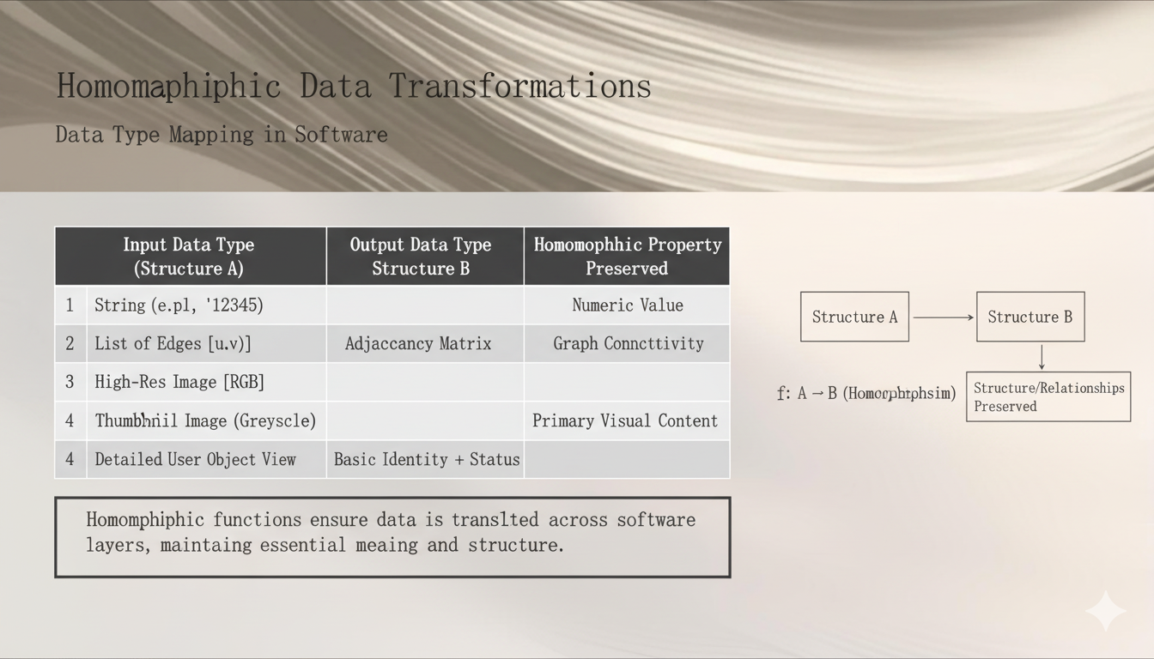

Slide 13
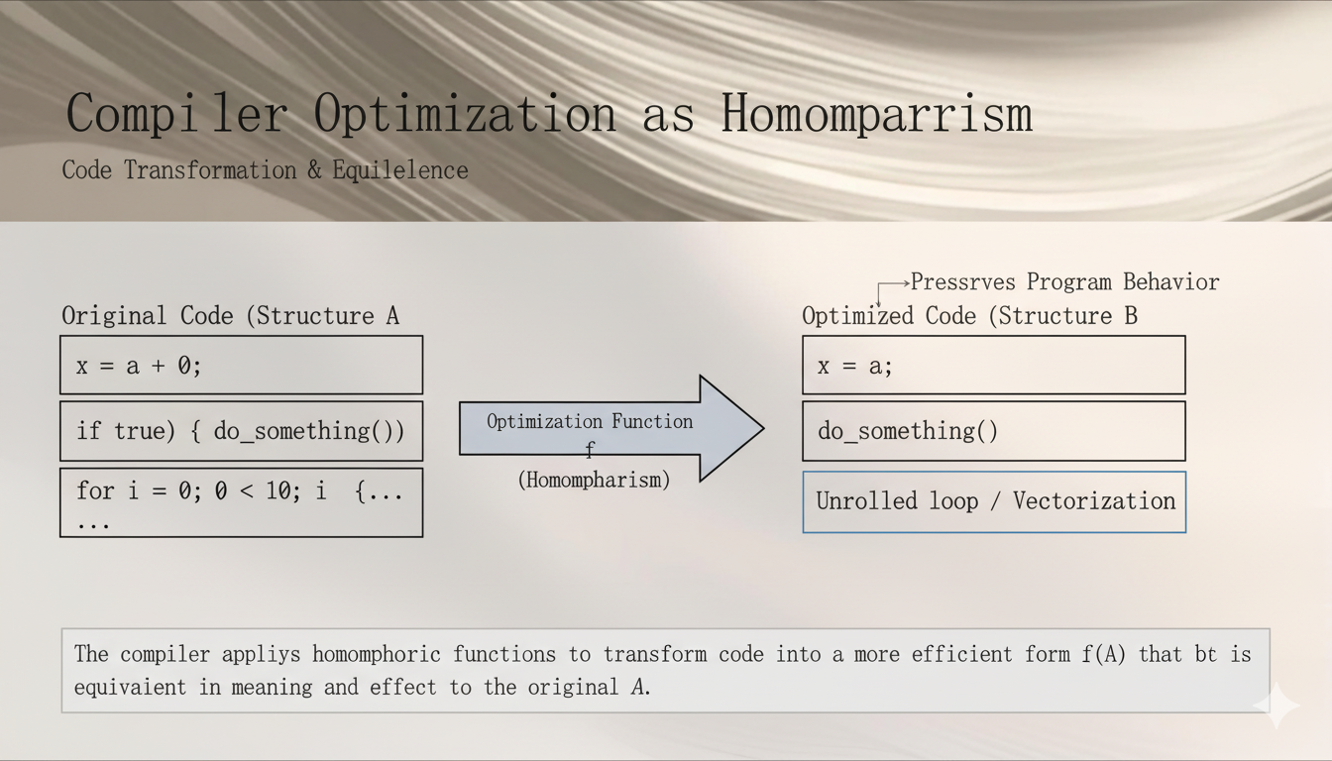

Slide 14



Importance and Impact
Why are Homomorphisms Important in Computing?
Data Integrity
Abstraction Power
Guarantees that data transformations don't corrupt essential information.
Enables developers to work with simpler models of complex systems.
Correctness Proofs
Foundation for Algorithms
Provides a mathematical basis for proving that system components interact correctly.
Many algorithms rely on identifying and exploiting homomorphic mappings to simplify problems.
Keywords: Data Transformation, System Design, Abstraction, Compiler Design, Program Correctness.

Slide 15
03
Lattices in Cryptography and Security

Slide 16
Introduction to Lattices
What are Lattices?
In mathematics, a lattice (specifically a mathematical lattice or point lattice) is a regular, repeating arrangement of points in an N-dimensional space.
Imagine a grid of points that extends infinitely in all directions. These points are generated by integer linear combinations of a set of basis vectors.
Simple Analogy:
Think of a perfectly tiled floor. Each intersection of grout lines is a "lattice point." If you take a step, you land on another lattice point. You can't land just anywhere; you're restricted to this grid.
Key Idea: Structured arrangement of points with inherent mathematical properties, particularly useful for "hard problems" in cryptography.
Visualizing a 2D Lattice:
Imagine two non-parallel vectors, v1 and v2. A lattice generated by v1 and v2 consists of all points av1 + bv2 where a and b are any integers (..., -2, -1, 0, 1, 2, ...).

Slide 17
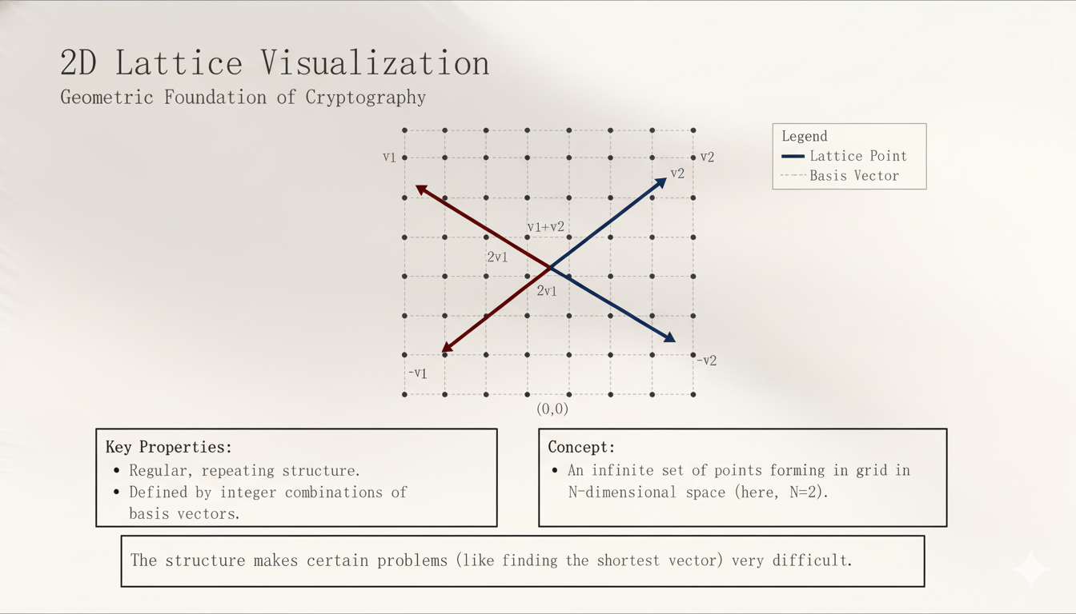

Slide 18


The Hard Problems of Lattices
Foundation of Lattice Cryptography:
Lattice-based cryptography relies on certain problems related to lattices that are very easy to state but extremely difficult to solve, even for powerful computers. These are known as "hard problems"
1
2
Shortest Vector Problem (SVP)
Closest Vector Problem (CVP)
Problem: Given a lattice, find the shortest non-zero vector (the point closest to the origin, besides the origin itself).
Problem: Given a lattice and a random point not in the lattice, find the lattice point closest to that random point.\
Difficulty: NP-hard. This means as the dimension (N) of the lattice grows, the time to find the shortest vector grows exponentially. No efficient algorithm is known.
Difficulty: Also NP-hard. Even harder than SVP in the
general case.
Why are these problems "hard"?
In high-dimensional spaces (many dimensions, N=100s or 1000s), there are too many possible vectors to check. The "closeness" or "shortestness" becomes incredibly hard to pinpoint.

Slide 19
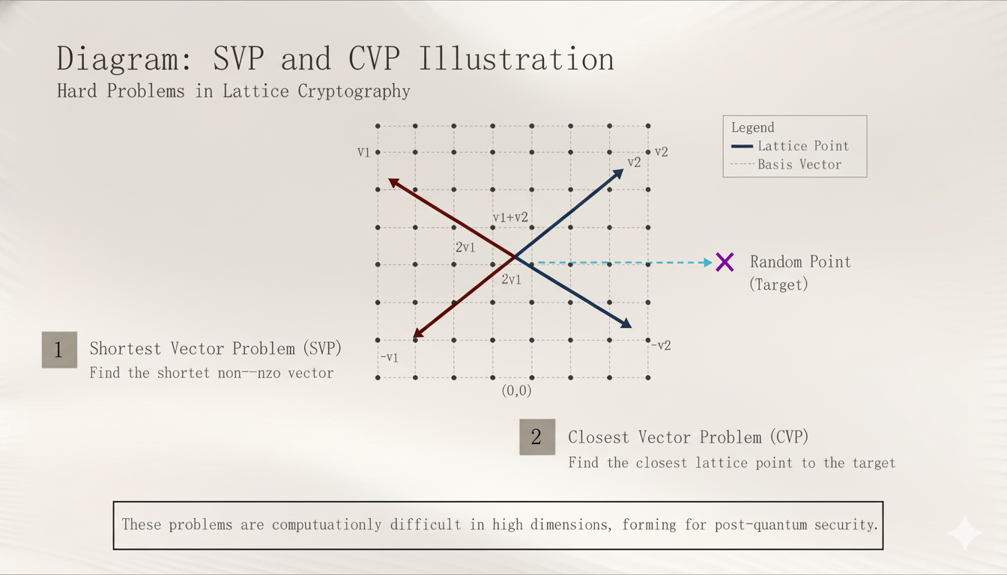

Slide 20
Learning With Errors (LWE)
LWE Problem:
The Learning With Errors (LWE) problem is a fundamental assumption in many lattice-based cryptosystems.
Concept: Imagine a simple linear equation Ax = b. LWE adds "noise" (errors) to this equation: Ax + e = b, where e is a small random error vector.
Problem: Given many such noisy equations (A and b), the goal is to find the original secret x.
Hardness: This problem is believed to be very hard to solve. Its difficulty is reducible to the difficulty of SVP and CVP in certain lattices. This means if you could solve LWE efficiently, you could solve SVP and CVP efficiently.
Why LWE is Important:
It's a versatile problem that can be used to build various cryptographic primitives.
Its security relies on the hardness of lattice problems, which are conjectured to be resistant to quantum computer attacks.

Slide 21
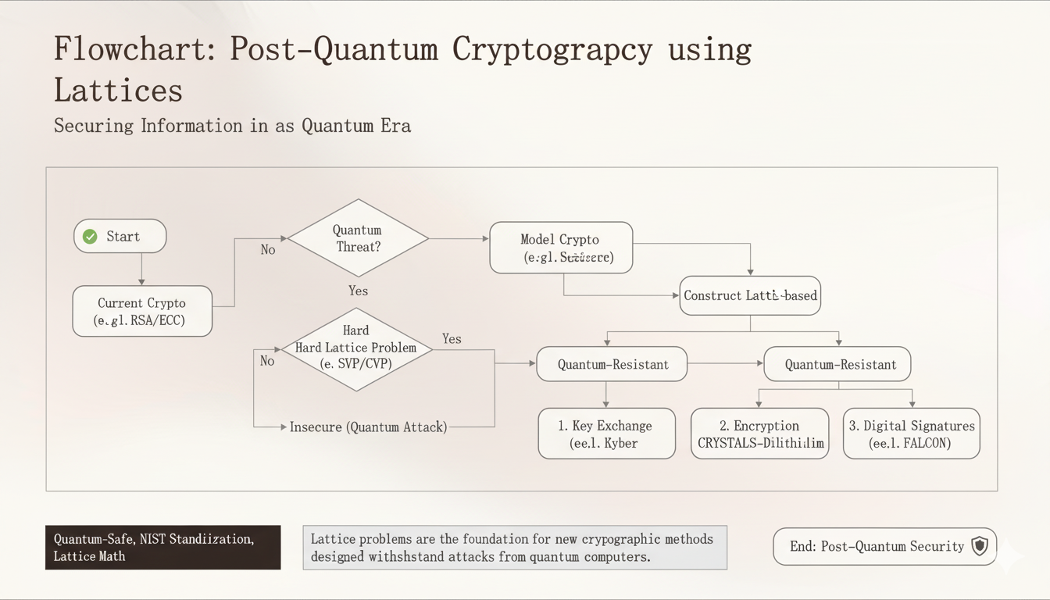

Slide 22
Applications: Key Exchange and Encryption
Key Exchange:
Problem: Two parties need to establish a shared secret key over an insecure channel.
Lattice Solution: Protocols like Kyber (currently being standardized by NIST) use lattice problems to enable secure key agreement. Parties exchange public lattice-related data, and the hardness of LWE makes it impossible for an eavesdropper to derive the shared secret.
Encryption:
Problem: Sending confidential messages.
Lattice Solution: Lattice-based public-key encryption schemes allow anyone to encrypt a message using a public key, but only the holder of the private key (derived from lattice problems) can decrypt it.
Digital Signatures:
Problem: Verifying the authenticity and integrity of messages.
Lattice Solution: Schemes like Dilithium (also undergoing NIST standardization) use lattice problems to create robust digital signatures that are secure against quantum adversaries.
Impact on Security:
Lattice-based cryptography is crucial for the future of cybersecurity, providing the tools needed to secure communications and data in a post-quantum world.
Keywords: Quantum Computing, Post-Quantum Cryptography, Public-Key Encryption, Digital Signatures, NIST.

Slide 23
Thank You

