Slide 1













Employee Data Analysis using Excel
STUDENT NAME: V.VINOTHA PRABA.
REGISTER NO:312216820, EC156DF8478BDCE88EE4E7EE51151D5D.
DEPARTMENT: lll B.COM (ACCONTING AND FINANCE).
COLLEGE: SHRI KRISHNASWAMY COLLEGE FOR WOMEN.
1
Notes:
1.7.2013
1
‹#›

Slide 2




PROJECT TITLE
Employee PERFORMANCE Analysis using Excel
2

Slide 3





AGENDA
Problem Statement
Project Overview
End Users
Our Solution and Proposition
Dataset Description
Modelling Approach
Results and Discussion
Conclusion
3/21/2024 Annual Review
3

Slide 4

PROBLEM STATEMENT
Organizations often struggle to gain meaningful insights from employee data, which is critical for making informed decisions about workforce management, productivity improvement, and employee satisfaction. The lack of a structured approach to analyze employee data can lead to the following challenges:
4

Slide 5

PROJECT OVERVIEW
Employee performance is a critical aspect of organizational success. It refers to how well employees carry out their job responsibilities and contribute to the organization's goals. Evaluating and managing employee performance helps organizations ensure that their workforce is productive, efficient, and aligned with strategic objectives
5

Slide 6

WHO ARE THE END USERS?
Human Resources (HR) Managers:
Department Managers and Team Leads:
project manager
Senior Management and Executives:
employees
6

Slide 7

OUR SOLUTION AND ITS VALUE PROPOSITION
conditional Formatting- missing values
filtering -Remove blank cells
Formula -performance for( very high, High, medium ).
Pivot table -Summarizing data set
Graph - data visualization
7

Slide 8
Dataset Description
employee data set source - KAGGLE
TOTAL 9 FEATURES
6 FEATURES USED
Numbers of years worked
EMPLOYEE NAME IN TAXT
GENDER
DEPARTMENT
employee job rate- number
employee job rate- textr

Slide 9

THE "WOW" IN OUR SOLUTION
Conditional Formatting - in that i deleting the blank and empty cells
formula for analysising the employee performance using the formula
=IFS(L2>=5,"veryhigh",L2>=4,"high",L2>=3,"medium",TRUE,"low")
3/21/2024 Annual Review
9

Slide 10
MODELLING
DATA COLLECTION
I collected the data from kaggle website
load the collected to excel
FEATURE COLLECTION
collected the feature about the employee data set such
employee id , employee name, Gender, Department, FTE, employee
type, salary, location, starting date
DATA CLEANING
Missing Values: Data may have missing entries due to various reasons like errors in data collection or merging datasets from different sources
Detection: Identify missing values using functions
Handling Missing Values: There are several strategies
Removal: Remove rows or columns with missing values if they are not critical.
SUMMARY
here i given the summary about the employee in FTE and i visualizing the data using the pivot table and create the graph
VALIDATION
validation is a process of Data analysis using the excel include the pivot table
10

Slide 11
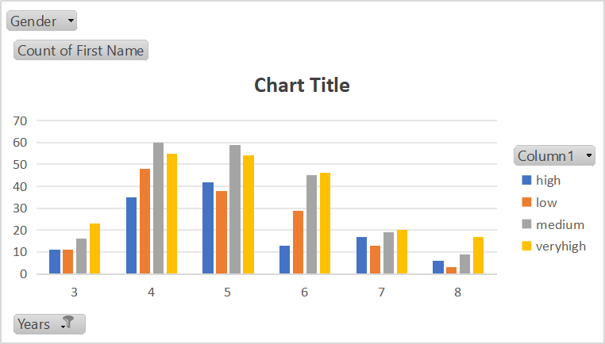
RESULTS
(BOTH GENDER)
11

Slide 12
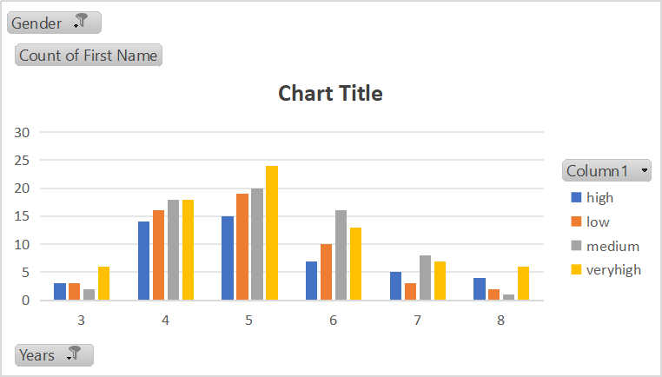
RESULTS
(FEMALE EMPLOYEE)
11

Slide 13
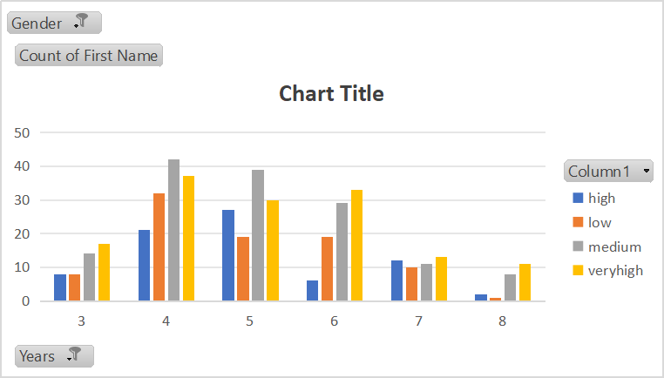
RESULTS
(MALE EMPLOYEE)
11

Slide 14
conclusion
Employee performance is a cornerstone of organizational success. By effectively managing and evaluating performance, organizations can ensure that their workforce is productive, engaged, and aligned with the company’s strategic goals. Regular performance assessments provide valuable insights into employee strengths and areas for improvement, enabling targeted development, better resource allocation, and more informed decision-making.

