Slide 1
Employee performance analysis using excel
Name : s . Vinotha
Register no : 312214284
Department : financial accounting
College : st. Thomas college art & science

Slide 2
PROJECT TITLE
Employee performance analysis using excel

Slide 3
DATASET DESCRIPTION
Dataset is a set or collection of data. This set is normally presented in a tabular pattern. Every column describes a particular variable. And each row corresponds to a given member of the data set, as per the given question. This is a part of data management.

Slide 4
AGENDA
Standard Meeting Agenda: The Backbone of Team Meets. ...
Kickoff Meet Agenda: Starting Off on the Right Foot. ...
Brainstorming Agenda: Unleashing Creative Potential. ...
Board Meet Agenda: Formal and Focused. ...
Action Review Meeting Agenda: Tracking Progress.

Slide 5
PROBLEM STATEMENT
decent Problem Statement should have 5 essential elements: Importance Problem–Solution Gap Quantification Neutrality Scope Forming a Problem Statement raises the probability of taking advantage of the potencies of Conscious Processing and may also develop the environment for causing and then assessing an 'Aha' moment ...

Slide 6
PROJECT OVERVIEW
project overview is a detailed description of a project's goals and objectives, the steps to achieve these goals, and the expected outcomes. In addition, a project overview enables you to outline the project schedule, budget, necessary resources, and status.

Slide 7
WHO ARE THE END USER
the process that mornitors the performance and effectiveness of IT operations from the end user's perspective. EUEM provides data and insight that IT and DevOps teams need to improve services and quickly solve user issues.

Slide 8
DATA COLLECTION
Data collection is the process of collecting and analyzing information on relevant variables in a predetermined, methodical way so that one can respond to specific research questions, test hypotheses, and assess results. Data collection can be either qualitative or quantitative.

Slide 9
FEATURES COLLECTION
feature collection is a data structure containing one or more features that share the same geometry type and set of attributes .

Slide 10
INCENTIVE PERFORMANCE CALCULERIN
Base Formula = Business Outcome + Sum of Individual Goal Outcomes.
overall performance outcome of 1 (Unsatisfactory) will result in no incentive payment for the employee.
Incentive Amount = (Actual Performance - Threshold) × Incentive Rate.
Where,
Actual performance: This is the performance achieved by the individual or team during the defined period.

Slide 11
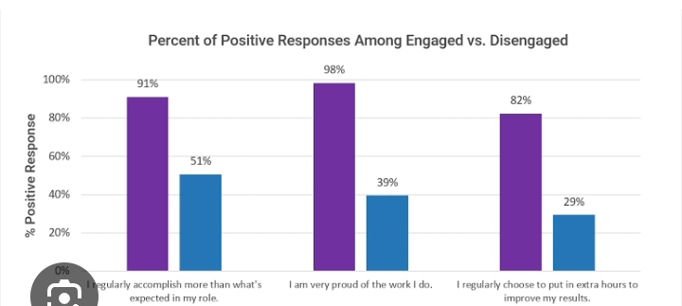
RESULT

Slide 12
CONCLUSION
conclusion, performance appraisal is an important process that provides numerous benefits to both employees and organizations. It helps employees identify areas for improvement, set goals, receive feedback, and receive recognition for their achievements.

