Slide 1
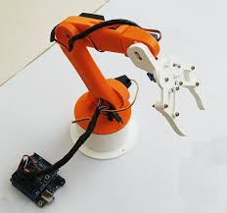
21ARE304
01
Mini Project
Teleoperated Robotic Arm
This project aims to develop a teleoperated robotic arm system controlled via a graphical user interface (GUI). The use of a GUI for control simplifies the user experience, making the system accessible to users with varying levels of technical expertise.
K Vinoth Kumar
CH.EN.U4ARE22011

Slide 2
21ARE304
02
Introduction
In the ever-evolving field of robotics, teleoperation plays a crucial role in extending human capabilities by allowing precise and remote control of robotic systems. This project focuses on the development of a teleoperated robotic arm, controlled through a graphical user interface (GUI).
The core of this project involves integrating an Arduino microcontroller with a Raspberry Pi, which serves as the central processing unit. The Raspberry Picommunicates with the Arduino, which controls the robotic arm's actuators. The user interacts with the system through a GUI developed using Tkinter.
This interface provides an accessible platform for users to input commands, monitor the arm's status, and receive real-time feedback.

Slide 3
21ARE304
02
One of the key features of this project is the inclusion of predefined commands and positions, allowing the robotic arm to perform specific tasks efficiently and consistently.
These predefined settings simplify the operation, making it suitable for various applications, including industrial automation, research, and education.
Additionally, the system incorporates safety mechanisms such as emergency stops and movement limits to ensure safe and reliable operation.

Slide 4
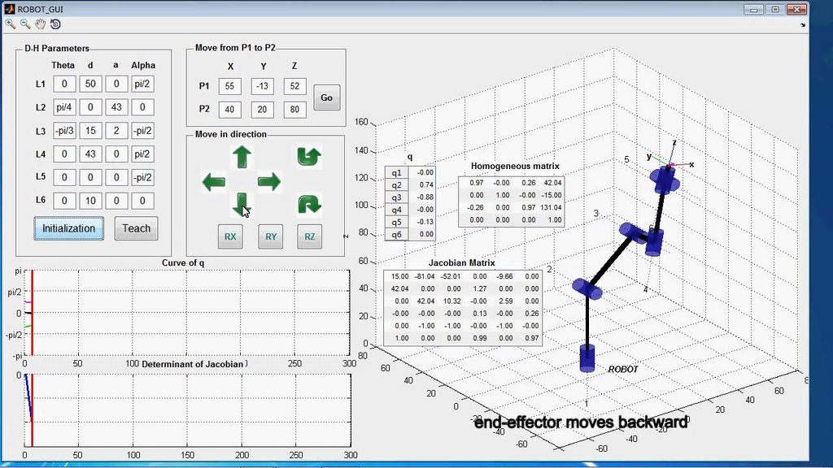
21ARE304
03
The Idea
the idea is to create a versatile and user-friendly teleoperated robotic arm system that can be easily operated and adapted for a wide range of tasks, making advanced robotics accessible to a broader audience.
Purposes
Enhance Human Capabilities
Educational and Research Tool
Industrial and Practical Applications

Slide 5
21ARE304
03
Objectives
Develop an Intuitive GUI
Implement Predefined Movements
Ensure System Safety and Reliability
Novelty
User-Centric Design
Versatile Application

Slide 6
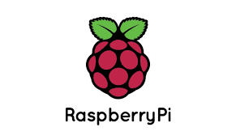


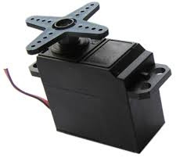
21ARE304
09
Components Required
Raspberry Pi
Arduino
PCA9685
Servo Motor
3D printed Arm

Slide 7

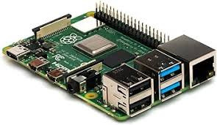
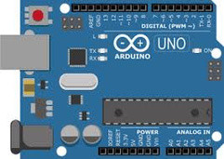
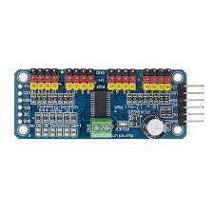
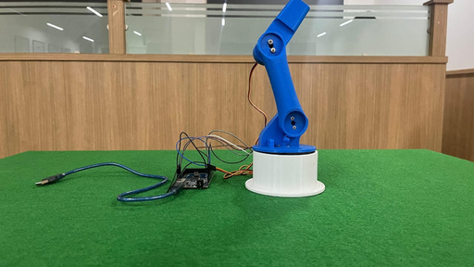
21ARE304
04
Project Plans
GUI
Commands
Serial Comm
RPi
Arduino
PCA9685
Servo in Printed Arm

Slide 8
21ARE304
04
Initialisation
Project Action Plans
Analyze similar projects, available technologies, and components to determine feasibility and potential challenges.
Identify and allocate necessary resources, including hardware, software and personnel.
Design
Define the system's overall architecture, including the integration of Arduino, Raspberry Pi, and the GUI.
Outline the communication protocols and data flow between components.
GUI
Design the graphical user interface using Tkinter, focusing on ease of use, real-time feedback, and accessibility.
Plan features like control panels, slider scales, status displays, and error notifications.

Slide 9
21ARE304
04
Hardware Setup & Integration
Enhancements
3D print and Assemble the robotic arm with all necessary sensors and actuators.
Integrate the Arduino and Raspberry Pi, ensuring smooth communication and control.
Based on feedback and performance evaluation, identify potential enhancements and new features.
Establish a maintenance plan to ensure the system remains functional and up-to-date.
Testing
Test individual components and modules, including hardware, control algorithms, and GUI functions.
Verify the accuracy and responsiveness of the robotic arm's movements and the GUI's real-time feedback.
Deployment
Deploy the system in the intended environment, ensuring all components are set up and functioning correctly.
Evaluate the system's performance, reliability, and user satisfaction.

