Slide 1
Capstone project Keylogger & Security
Presented by : N. Vinothini
College Name : Anjalai Ammal Mahalingam Engineerig College
Department : B . Tech Information Technology

Slide 2
Outline
Problem statement
Proposed system / solutions
System Development Approach
Algorithm & Deployment
Result
Conclusion
Future scope
References

Slide 3
Problem statement
Develop a keylogger program capable of recording keystrokes typed by a user on a computer keyboard without their knowledge or consent. The keylogger should run covertly in the background, capturing all keyboard input, including special keys such as function keys, modifier keys (e.g., Shift, Ctrl, Alt), and alphanumeric characters. Additionally, the keylogger should have the ability to store the recorded keystrokes securely and efficiently, ensuring that the data remains confidential and cannot be easily accessed or tampered with by unauthorized users. A keylogger, sometimes called a keystroke logger. The latter type is also known as system monitoring software or keyboard capture software.

Slide 4
Proposed systems & solutions
The solution to the above existing problem is that we can create software keyloggers instead of hardware keyloggers.
The proposed model provides a solution that reduces trouble installing the keylogger to the target System. Because keylogger software can be installed remotely and does not need any physical access of the target system.
The designed software is powerful enough to be installed targeted system itself when a user clicks, for example malicious link sent to him through mail or any social network media and finally captures all the user's keystrokes when logged into the system, it saves the logs to a folder or sends the log directly to a third party's email address.

Slide 5
System approach
Requirement analysis : Analyze the requirements to determine whether the keylogger system is necessary, taking into account the anticipated use cases as well as security needs such access control and data encryption.
Design : Create a blueprint for the keylogger program's architecture, including components for safe storage, user authentication, keystroke collection, and encryption techniques.
Development: Write the keylogger's code with an emphasis on working covertly and being compatible with the intended operating systems. To protect collected data, use encryption algorithms and secure storage mechanisms.

Slide 6
Continued..
Testing: To make sure the keylogger performs as intended, put it through a rigorous testing process that includes security evaluations, functionality tests, and compliance with ethical and legal requirements.
Deployment: Install and configure the keylogger system correctly before rolling it out in the intended setting.
Monitoring & Maintenance: Implement monitoring tools to detect any security breaches or anomalies in keylogger operation. Regularly update the system to address emerging security threats and maintain compliance with regulations.
Ethical Considerations: Create policies that emphasize user permission, privacy protection, and compliance with laws pertaining to data gathering and surveillance. These policies should be used to ensure that the keylogger system is used responsibly. Review and update policies frequently to ensure compliance with changing ethical norms.

Slide 7
Algorithm
Keylogging: Always keep an eye on keyboard input, record keystrokes, encrypt them with AES, and store the encrypted data safely. Encryption: To preserve confidentiality, encrypt recorded keystrokes using AES with a secure key and IV. Security Measures: To protect data and avoid detection, use access controls, authentication methods, and anti-detection strategies. Monitoring: Update and patch the keylogger program on a regular basis, keep an eye out for threats, and act quickly to reduce hazards.

Slide 8
Deployment
Local Deployment:
Install covertly on the target system to run silently in the background.
Configure to start automatically upon system boot for continuous operation.
Store captured keystrokes securely on the local system.
Remote Deployment:
Use social engineering or phishing to trick users into installing remotely.
Transmit captured keystrokes securely to a remote server controlled by the attacker.
Security Considerations:
Prioritize stealth to avoid detection by antivirus software or system monitoring tools.
Encrypt transmitted data and regularly update to evade detection and address vulnerabilities.
Ethical and Legal:
Deploy responsibly, ensuring compliance with laws and obtaining consent where necessary.
Respect user privacy and handle captured data securely.

Slide 9
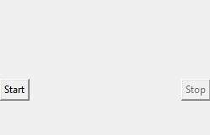

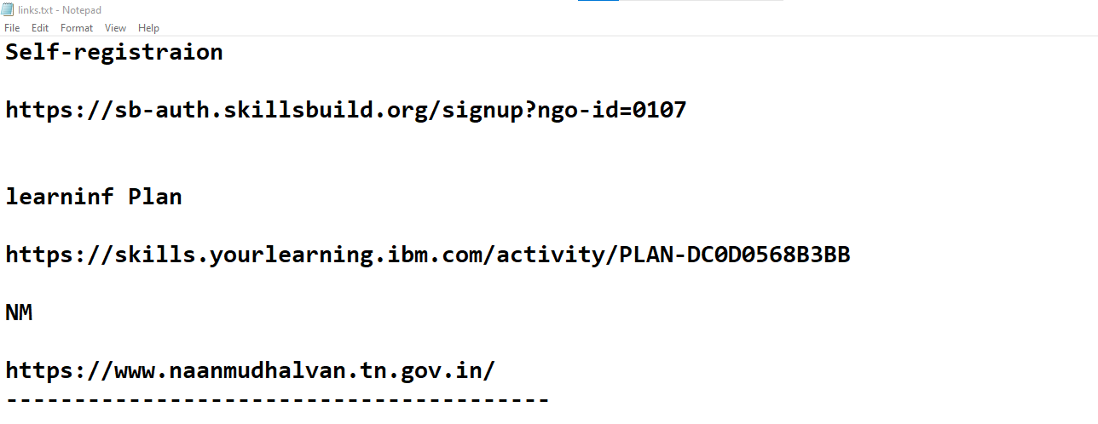
Result

Slide 10
Conclusion
In summary, keyloggers provide useful features for keeping track of and recording keyboard action, but the use of these tools should be constrained by moral standards, adherence to the law, and consideration for user privacy. Keyloggers can be useful tools for security, forensic investigation, and parental control when used and maintained properly. However, in order to avoid abuse and safeguard people's rights to confidentiality and privacy, it is imperative that openness, permission, and data protection procedures be followed. Therefore, before using keyloggers in any situation, it is crucial to carefully assess the ethical, legal, and security ramifications.

Slide 11
Future scope
Future Scope of Keylogger:
Enhanced Security: Improved encryption and anti-detection measures.
Behavioral Analysis: Machine learning for anomaly detection.
Cross-Platform Compatibility: Support for mobile and IoT devices.
Cloud-Based Monitoring: Scalable, remote monitoring and storage.
Real-Time Detection: Immediate response to security threats.
Privacy Features: Anonymization and selective logging.
Compliance Solutions: GDPR, CCPA compliance features.
Forensic Capabilities: Aid in investigations and evidence collection.
User Education: Promoting responsible usage and privacy awareness.
Integration with Security Ecosystems: Collaboration with SIEM platforms for centralized monitoring.

Slide 12
References
Szor, P. (2005). The Art of Computer Virus Research and Defense. Addison-Wesley.
Research papers on keylogger detection and cybersecurity from academic databases such as IEEE Xplore, ACM Digital Library, and Google Scholar.

