Slide 1

Software Supply Chain Risk Analyzer
An automated SBOM analysis platform that detects vulnerabilities, license conflicts, and outdated dependencies — delivering an actionable risk score for modern enterprise applications.
HACKATHON SUBMISSION
TRACK: THIRD-PARTY & SOFTWARE RISK

Slide 2

The Problem: Hidden Risk in Your Supply Chain
Modern enterprise applications depend on hundreds of third-party open-source libraries. When a critical vulnerability is disclosed, organizations face a dangerous gap in visibility.
Slow Identification
Teams cannot quickly identify which applications are affected by a newly disclosed CVE.
Hidden Dependencies
Transitive dependencies remain invisible, leaving critical attack surfaces unmonitored.
Manual & Error-Prone
Manual dependency tracking is slow, inconsistent, and prone to human error.
License & Compliance Risk
Incompatible licenses create legal exposure that goes undetected until it's too late.

Slide 3




Project Objectives
Our solution automates the full SBOM analysis pipeline — from ingestion to risk scoring — giving security teams the visibility they need to act fast.
Automate SBOM Ingestion
Detect Vulnerabilities
Parse and process SBOM files automatically, eliminating manual data entry.
Match dependencies against known CVE databases to flag risky libraries.
Check License Compliance
Visualize Risk
Identify incompatible or restrictive licenses across the dependency tree.
Generate interactive dashboards with charts and an overall risk score.

Slide 4
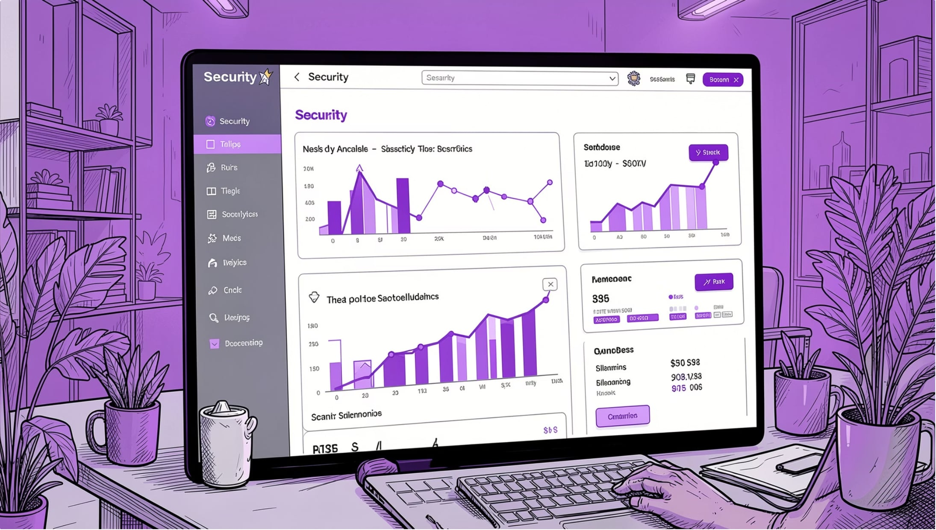

Our Solution
The Software Supply Chain Risk Analyzer is a web-based platform that automates dependency analysis from SBOM upload to risk report — in seconds.
SBOM Upload & Parsing
Multi-Layer Risk Detection
Interactive Risk Dashboard
Accepts CSV-formatted SBOM files for instant analysis.
Simultaneously checks for vulnerabilities, outdated libraries, and license conflicts.
Visual charts, risk scores, and prioritized security recommendations.

Slide 5

System Architecture
User Upload
Risk Engine
Upload SBOM CSV file
Compare deps and compute scores
Flask Ingest
Dashboard
Parse CSV and load JSON DBs
Interactive charts and report
The Flask backend orchestrates the full pipeline — ingesting SBOM CSVs, cross-referencing JSON metadata databases, running the risk engine, and rendering results through an interactive dashboard.

Slide 6
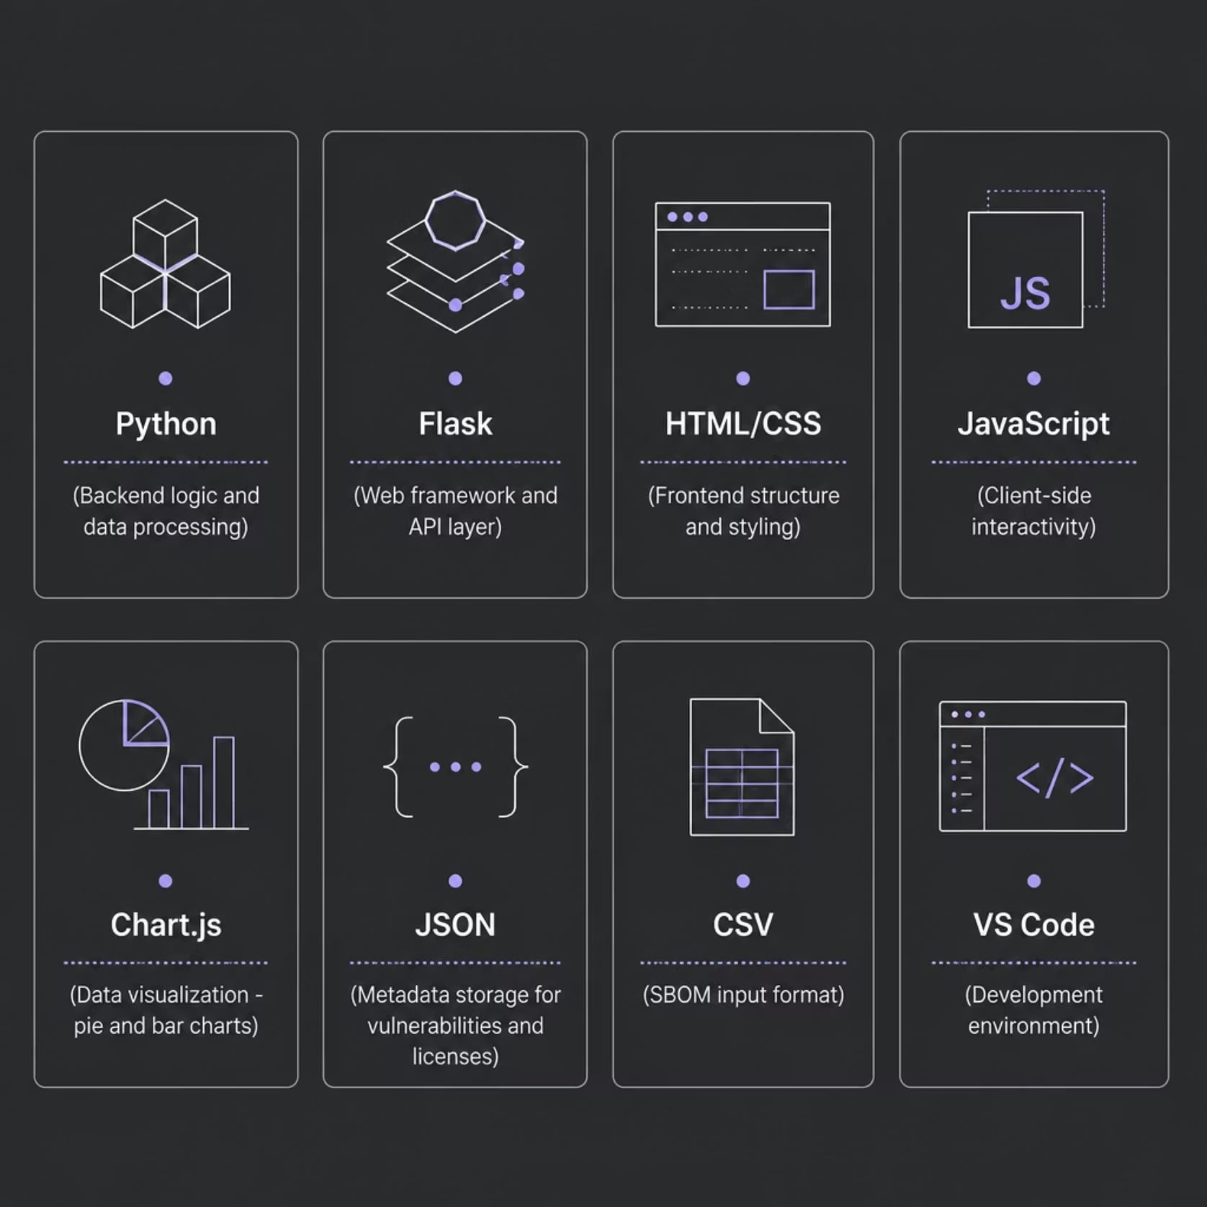
Technology Stack
Why These Tools?
Each technology was chosen for simplicity, speed, and hackathon readiness.
Python + Flask — Rapid backend development with minimal boilerplate
Chart.js — Lightweight, responsive charts for risk visualization
JSON / CSV — Standard formats for SBOM data and metadata
Vanilla JS — No heavy framework overhead for the frontend

Slide 7
System Workflow
Upload SBOM
1
User uploads a CSV-formatted SBOM file through the web interface.
Parse & Load Data
2
Flask parses the CSV and loads JSON vulnerability and license databases.
Analyze Dependencies
3
The risk engine cross-references each library against known CVEs, versions, and licenses.
Detect Risks
4
Flags vulnerable, outdated, and license-conflicting libraries automatically.
Score & Report
5
Calculates an overall risk score and renders the interactive dashboard.

Slide 8
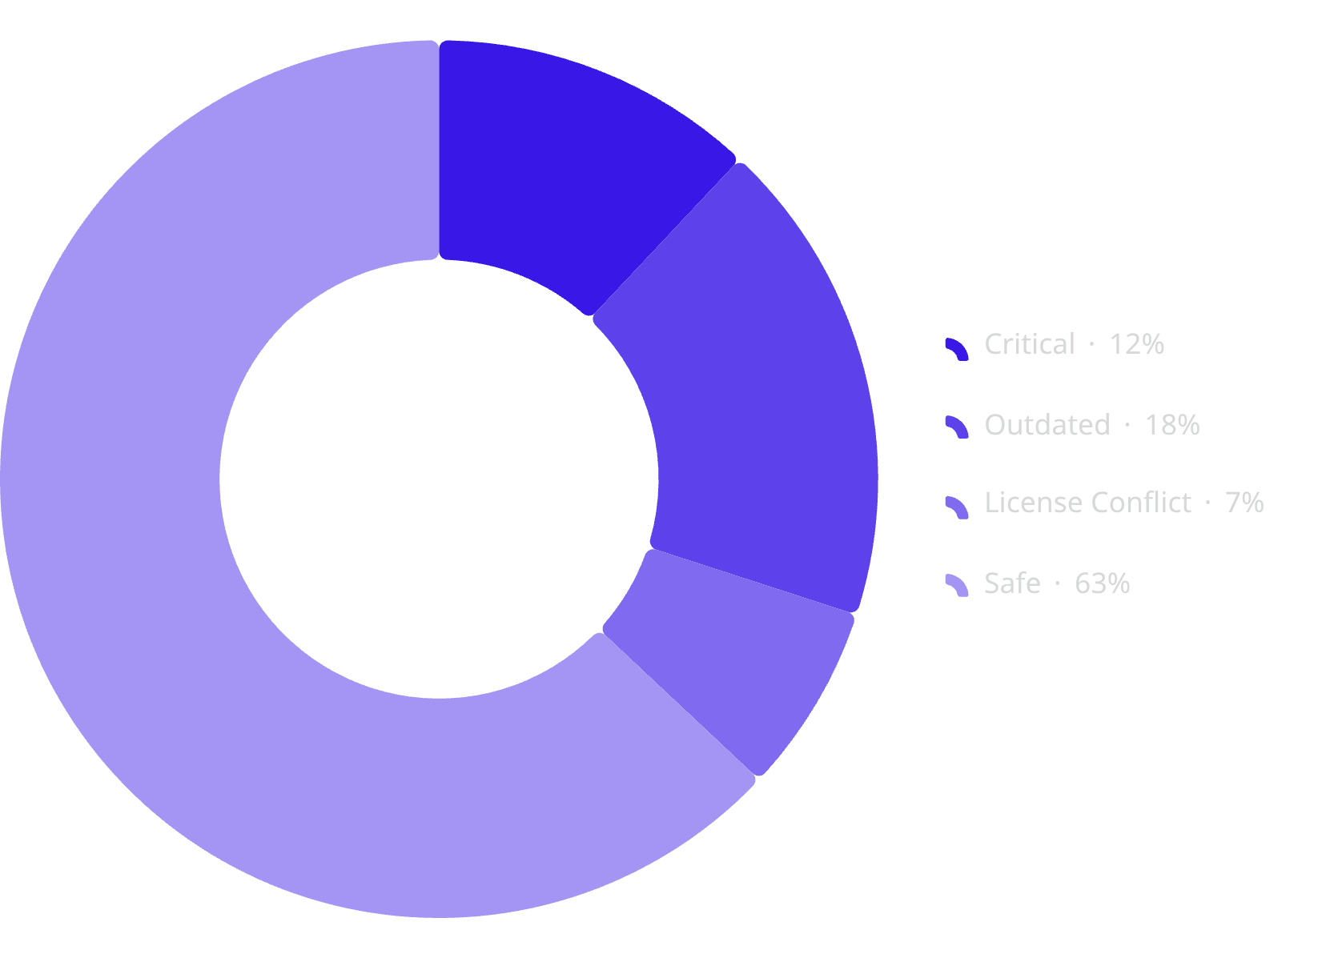
Dashboard & Risk Visualization
The dashboard gives security teams an at-a-glance view of application risk, with charts that make prioritization intuitive.
Sample Risk Distribution
Dashboard Metrics
Total Libraries — Full inventory of all dependencies
Critical Libraries — CVE-flagged components requiring immediate action
Outdated Libraries — Versions behind the latest secure release
License Conflicts — Incompatible or restrictive license terms
Overall Risk Score — Composite score for executive reporting
Sample data for illustration. Actual values depend on the uploaded SBOM.

Slide 9
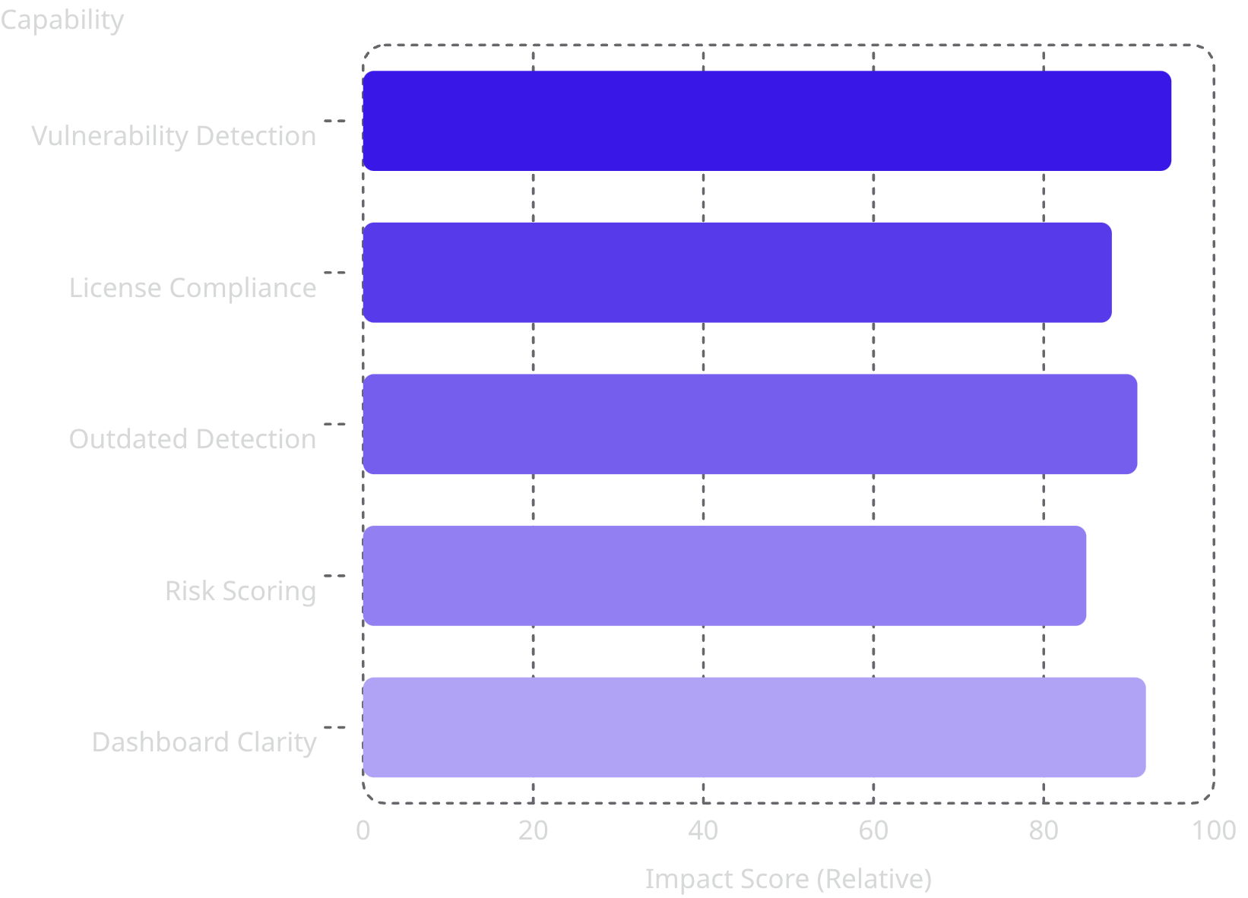

Results & Benefits
What We Delivered
Detects vulnerable libraries against known CVE databases
Flags outdated dependencies before they become exploits
Identifies incompatible licenses to reduce legal exposure
Generates a composite risk score for prioritization
Provides interactive charts and actionable recommendations
Key Win: Faster vulnerability identification with dramatically reduced manual effort — improving software supply chain security end-to-end.
Relative impact scores for illustration — not benchmarked data.

Slide 10






Future Scope & Conclusion
Real-Time NVD API
Live CVE feeds for up-to-the-minute vulnerability detection.
AI Remediation
ML-based suggestions to prioritize and fix the highest-risk dependencies.
GitHub Integration
Automated SBOM scanning on every pull request and release.
Cloud Deployment
Scalable SaaS model with email alerts and PDF report generation.
The Software Supply Chain Risk Analyzer automates dependency risk identification — delivering vulnerability detection, license compliance, and an interactive risk dashboard in a single workflow.
Thank you — Questions & Discussion welcome.

